Slide 1

Deploying DNSSEC in Windows Server 2012
David Cates
Platform Services Group
Microsoft Corporation

Slide 2
Agenda
Overview
Deployment
Operations
New in DNS

Slide 3
The Basic Idea
Overview
Deployment
Operations
New in DNS
DNSSEC introduces 5 new record types:
  Resource Record Signature (RRSIG)
  DNS Public Key (DNSKEY)
  Delegation Signer (DS)
  Next Secure (NSEC)
  Next Secure 3 (NSEC3)
Using the new records resolvers build a chain of trust for any signed zone
DNS Responses include signatures and can be validated

Slide 4
DNSSEC in Windows 2008 R2
Overview
Deployment
Operations
New in DNS
Microsoft introduced support for DNSSEC in Windows 2008 R2…
  Ability to sign zones offline and host signed zones
  Validation of signed responses
  Support for NSEC

Slide 5


DNSSEC in Windows Server 2012 R2
Overview
Deployment
Operations
New in DNS
Enabling enterprise DNSSEC rollout
Interoperability
Latest RFCs
  NSEC3 Support
  RSA/SHA-2, ECDSA Signing
  Automated Trust Anchor rollover
Support for 3rd Party Key Mgmt
Dynamic
Manageability
Automation

Slide 6
DNSSEC in Windows Server 2012 R2
Overview
Deployment
Operations
New in DNS
Enabling enterprise DNSSEC rollout
Interoperability
Active Directory Integrated
  Support for dynamic updates
  Preserving the multi-master DNS model
  Leverage AD for secure key distribution and Trust Anchor distribution
Improve DNS/DNSSEC server performance
Dynamic
Manageability
Automation

Slide 7
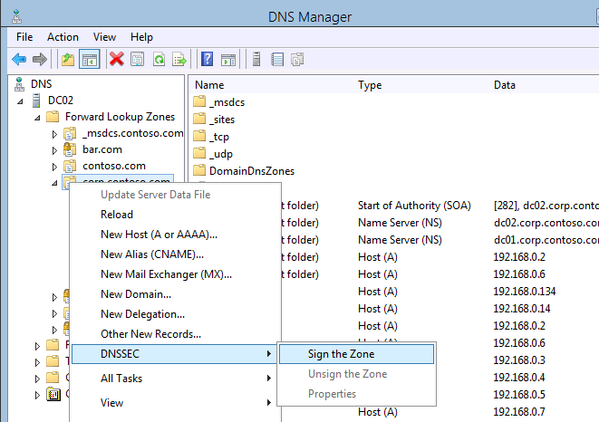
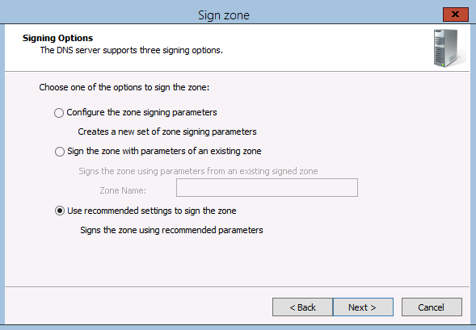
DNSSEC in Windows Server 2012 R2
Overview
Deployment
Operations
New in DNS
Enabling enterprise DNSSEC rollout
Interoperability
Dynamic
Manageability
Automation

Slide 8
DNSSEC in Windows Server 2012 R2
Overview
Deployment
Operations
New in DNS
Enabling enterprise DNSSEC rollout
Interoperability
Automated re-signing on static and dynamic updates
Automated key rollovers
Automated signature refresh
Automated updating of secure delegations
Automated distribution and updating of Trust Anchors
Dynamic
Manageability
Automation

Slide 9

Introduce Windows Server 2012
Overview
Deployment
Operations
New in DNS
Active Directory integrated zone
Classic multi-master deployment
  Hosted on five DNS servers that are also domain controllers

Slide 10

Signing a zone
Overview
Deployment
Operations
New in DNS
AD integrated zone
DNS Manager wizard walks admin through signing process
Generates Keys for signing zone on the first DC.
Signs it’s own copy of the zone

Slide 11
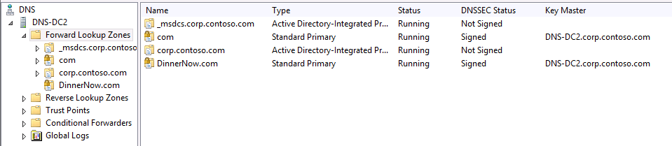
Key Master Role
Overview
Deployment
Operations
New in DNS
Single location for all key generation and management
  Responsible for automated key rollover
Administrator designates one server to be the key master
  First DNSSEC server becomes KM

Slide 12
Signing entire zone
Overview
Deployment
Operations
New in DNS
Private zone signing keys replicate automatically to all DCs hosting the zone through AD replication
Each zone owner signs its own copy of the zone when it receives the key
  Only Server 2012 DCs will sign their copy of the zone

Slide 13

Updating zone data
Overview
Deployment
Operations
New in DNS
Client sends dynamic update to any authoritative DNS server
That DNS server updates its own copy of the zone and generates signatures
The unsigned update is replicated to all other authoritative servers
Each DNS server adds the update to its copy of the zone and generates signatures

Slide 14
Demo
Signing a zone

Slide 15
Trust Anchor Distribution & Mgmt.
Overview
Deployment
Operations
New in DNS
Trust Anchor Distribution
  Trust Anchors replicate to all DNS servers that are DCs in the forest via AD
  Distribution of TAs to servers not a domain controller in the forest is manual via PowerShell or DNS Manager
Trust Anchor maintenance
  Trust Anchor updates are automatically replicated via AD to all servers in the forest
  Automated Trust Anchor rollover is used to keep TAs up to date

Slide 16


Key Rollover Process
Overview
Deployment
Operations
New in DNS
KSK
Initial
Insert new Key
Replicate
Resign w/ new Key
Remove old Key
ZSK1
contoso.com
ZSK2

Slide 17
Key Rollover Process
Overview
Deployment
Operations
New in DNS
KSK
Initial
Insert new Key
Replicate
Resign w/ new Key
Remove old Key
ZSK1
contoso.com
ZSK2

Slide 18
Key Management has low TCO
Overview
Deployment
Operations
New in DNS
Automated key rollovers
  Key rollover frequency is configured per zone
  Key master automatically generates new keys and replicates via AD
  Zone owners rollover keys and re-signs the zone
  Secure delegations from the parent are also automatically updated (within the same forest)
Signatures stay up-to-date
  New records are signed automatically when zone data changes
    Static and dynamic updates
    NSEC records are kept up to date

Slide 19
DNSSEC signing performance
Overview
Deployment
Operations
New in DNS

Slide 20
Windows Server 2012 R2
DNS performance
Overview
Deployment
Operations
New in DNS

Slide 21
New in DNS for Windows Server 2012
Overview
Deployment
Operations
New in DNS
IPAM
PowerShell cmdlets
  Near parity with dnscmd.exe
Dynamic re-ordering of forwarders
  Server now picks the forwarder that is responsive over the ones that are not responsive
  Basically, unresponsive forwarders are dropped to the bottom of the list for successive queries
WINS Support for DNSSEC

Slide 22
Summary
Overview
Deployment
Operations
New in DNS
Easy to deploy
Smart defaults
Automated management for day to day operations
Standards compliant
High Performance

Slide 23
© 2012 Microsoft Corporation. All rights reserved. Microsoft, Windows, Windows Vista and other product names are or may be registered trademarks and/or trademarks in the U.S. and/or other countries.
The information herein is for informational purposes only and represents the current view of Microsoft Corporation as of the date of this presentation. Because Microsoft must respond to changing market conditions, it should not be interpreted to be a commitment on the
part of Microsoft, and Microsoft cannot guarantee the accuracy of any information provided after the date of this presentation. MICROSOFT MAKES NO WARRANTIES, EXPRESS, IMPLIED OR STATUTORY, AS TO THE INFORMATION IN THIS PRESENTATION.

