Slide 1
Open Resolvers in COM/NET Resolution
Duane Wessels, Aziz Mohaisen
DNS-OARC 2014 Spring Workshop
Warsaw, Poland

Slide 2
Outine
Why do we care about Open Resolvers?
Surveys at Verisign
Characterizing Open Resolvers
Intersection with COM/NET query sources
Geographic distribution
Discussion

Slide 3
Why do we care?
Exploited in DDoS attacks
Makes cache poisoning attacks much easier
Cache snooping
Analogous to open mail relays
Note: we’re talking about unintentionally open resolvers here…

Slide 4
Two Surveys of IPv4
Open Resolvers

Slide 5
Models
Target forwards query directly to Authority
Prober
Q1
R2
Target
R1
Auth
NS
Q2

Slide 6
Models
Target forwards to a “forwarder”
Prober
Q1
Target
R2
Auth
NS
R1
Forwarder
Q2

Slide 7
October 2013 Survey
From Amazon Web Services
Took 173 Hours
  2013-10-28 14:00 – 2013-11-04 18:00
Sent 3,676,739,504 Q1 probes
  All IPv4 space, except class D/E, RFC1918 and do-not-probe list
Received 43,538,209 Q2’s
  For 28,897,054 distinct probes
  From 277,049 distinct IP addresses
Received 34,604,998 R2’s
  For 32,040,586 distinct probes
  From 31,424,854 distinct IP addresses

Slide 8
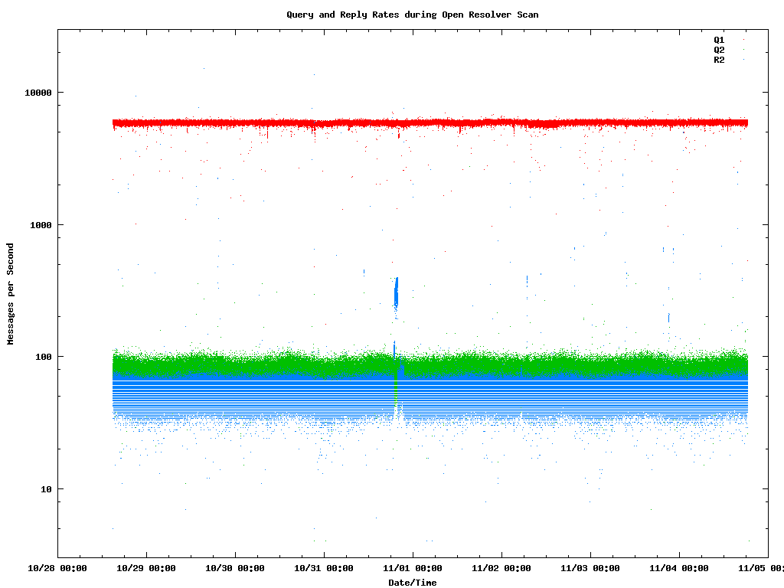

Slide 9
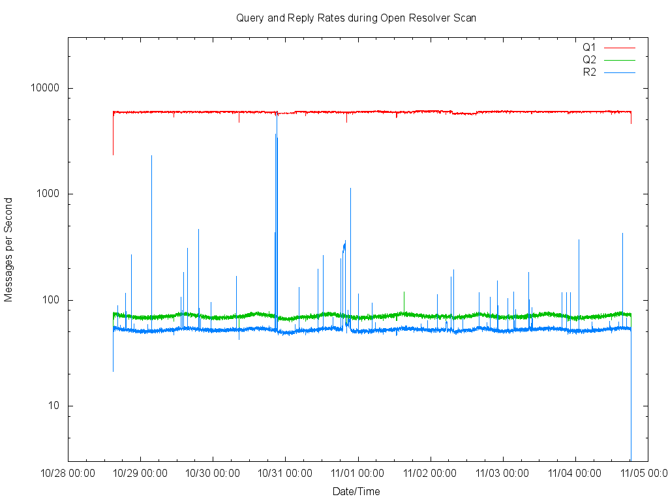
6000
70
55

Slide 10
May 2014 Survey
From Verisign
Took 17 hours
  2014-05-01 18:20 – 2014-05-02 11:30
Sent 3,676,724,690 Q1 probes
  All IPv4 space, except class D/E, RFC1918, and do-not-probe list
Received 38,079,578 Q2’s
  For 24,553,785 distinct probes
  From 230,417 distinct IP addresses
Received 28,426,251 R2’s
  For 27,905,762 distinct probes
  From 27,281,623 distinct IP addresses

Slide 11
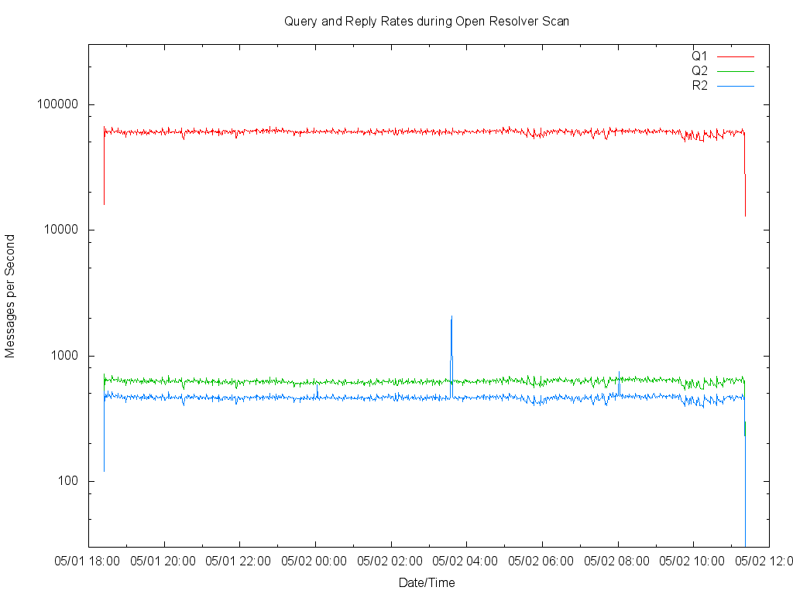
60200
620
460

Slide 12
Data Analysis
Data is collected with pcap while scan runs
Pcap files are then parsed into whitespace delimited text
  Separate files for Q1, Q2, R1, R2
The text files are loaded onto Hadoop
Analyzed with Hive (SQL statements)
  Lots of large, multi-table joins

Slide 13
Closed Targets
When the probe results in neither a Q1 nor an R2.
Prober
Target
Auth
NS
Forwarder
 | Oct 2013 | May 2014
Closed % | 99.1 | 99.2

Slide 14
Open Targets
When the probe results in either a Q1 or an R2.
Prober
Target
Auth
NS
Forwarder
 | Oct 2013 | May 2014
Open Count | 33,660,906 | 29,292,597
 | Oct 2013 | May 2014
openresolverproject | 32,673,337 | 27,454,609

Slide 15
Simple Open Resolver
Q2 source address equals Target address
i.e., Target does not forward elsewhere
Prober
Target
Auth
NS
 | Oct 2013 | May 2014
Simple | 0.6 % | 0.6 %

Slide 16
Forwarder
Q2 source address differs from Target address
How many to Google?
Prober
Target
Auth
NS
Forwarder
 | Oct 2013 | May 2014
Simple | 0.6 % | 0.6 %
Forwarder | 79.8 % | 78.0 %
 | Oct 2013 | May 2014
Google Fwds | 8.3 % | 8.9 %

Slide 17
No Q2, R2 Error
Didn’t get a Q2 query and got an Error response
Usually REFUSED, which is good!
Prober
Target
Auth
NS
Forwarder
 | Oct 2013 | May 2014
Simple | 0.6 % | 0.6 %
Forwarder | 79.8 % | 78.0 %
Err No Forward | 10.8 % | 12.6 %
RCODE | Oct 2013 | May 2014
1 FORMERR | 0 .0 % | 0.0 %
2 SERVFAIL | 10.0 % | 9.1 %
3 NXDOMAIN | 3.0 % | 3.6 %
4 NOTIMPL | 0.0 % | 0.0 %
5 REFUSED | 86.9 % | 87.3 %
7 | 0.0 % | 0.0 %
9 | 0.0 % | 0.0 %
10 | 0.0 %

Slide 18
Got Q2, but R2 error code
Received the Q2 query, but then got an error response.
Usually SERVFAIL
Prober
Target
Auth
NS
Forwarder
 | Oct 2013 | May 2014
Simple | 0.6 % | 0.6 %
Forwarder | 79.8 % | 78.0 %
Err No Forward | 10.8 % | 12.6 %
Err w/ Forward | 0.7 % | 0.5 %
RCODE | Oct 2013 | May 2014
1 FORMERR | 0 .1 % | 0.4 %
2 SERVFAIL | 77.5 % | 75.9 %
3 NXDOMAIN | 0.4 % | 0.1 %
4 NOTIMPL | 0.0 %
5 REFUSED | 22.0 % | 23.6 %
13 | 0.0 %

Slide 19
R2 Blocked
Received Q2
But no R2
Prober
Target
?
Auth
NS
Forwarder
 | Oct 2013 | May 2014
Simple | 0.6 % | 0.6 %
Forwarder | 79.8 % | 78.0 %
Err No Forward | 10.8 % | 12.6 %
Err w/ Forward | 0.7 % | 0.5 %
R2 Blocked | 4.8 % | 4.7 %

Slide 20
Synthesized Answers
No Q2
R2 had an Answer section with an A record, but wrong value.
Many answer with their own IP
Prober
Target
Auth
NS
Forwarder
 | Oct 2013 | May 2014
Simple | 0.6 % | 0.6 %
Forwarder | 79.8 % | 78.0 %
Err No Forward | 10.8 % | 12.6 %
Err w/ Forward | 0.7 % | 0.5 %
R2 Blocked | 4.8 % | 4.7 %
Synthesized | 3.4 % | 3.6 %

Slide 21
Q2 Missing
No Q2, but R2 had an Answer section with correct A record!
How?
  Data collection problem
  Lucky guess
Prober
Target
Auth
NS
Forwarder
 | Oct 2013 | May 2014
Simple | 0.6 % | 0.6 %
Forwarder | 79.8 % | 78.0 %
Err No Forward | 10.8 % | 12.6 %
Err w/ Forward | 0.7 % | 0.5 %
R2 Blocked | 4.8 % | 4.7 %
Synthesized | 3.4 % | 3.6 %
Q2 Missing | 0.0 % | 0.0 %
Totals | 100 % | 100 %
120 times in Oct 2013 survey
1109 times in May 2014 survey

Slide 22
Weirdness: R2 not from Target
Sent query to x.x.x.x
Got response from y.y.y.y
Prober
Target
?
Auth
NS
Forwarder
 | Oct 2013 | May 2014
IP Changed | 2.1 % | 2.4 %

Slide 23
Weirdness: Local Port Changed
Query sent from port X
Response sent to port Y
1560 cases
Prober
X
Target
Y
Auth
NS
Forwarder
 | Oct 2013 | May 2014
Local Port | 1560 | 4936

Slide 24
Weirdness: Remote Port Changed
Query to port 53
Response from port != 53
Prober
53
Target
12345
Auth
NS
Forwarder
 | Oct 2013 | May 2014
Remote Port | 46.2 % | 46.7 %

Slide 25
Weirdness: Q2 with RD=1
Usually queries to Authoritative name servers have RD=0
Prober
Target
Auth
NS
RD=1
Forwarder
 | Oct 2013 | May 2014
Q2 RD=1 | 6079 | 5186

Slide 26
Weirdness: R2 with AA=1
Usually responses from recursive name servers have AA=0
Prober
Target
AA=1
Auth
NS
Forwarder
 | Oct 2013 | May 2014
R2 AA=1 | 0.7 % | 0.8 %

Slide 27
Intersection with
COM/NET Queriers

Slide 28
COM/NET Query Data
Four Verisign “big” sites
Only 4 of 13 gtld-servers.net letters
Site | Server
Amsterdam | h.gtld-servers.net
Wash DC | l.gtld-servers.net
New York | c.gtld-servers.net
San Francisco | g.gtld-servers.net

Slide 29
Intersection of open resolvers and COM/NET
(Oct 2013)
What percent of open resolver exit Ips appear in the COM/NET query data?
Example: At Amsterdam, we see 64.3% of the open resolvers IPs in one day. This is 5.2% of all COM/NET IPs seen there. Those IPs are responsible for 51.7% of COM/NET queries at the site.
Site | %OR IPs | %COM/NET IPs | %COM/NET Queries
Amsterdam | 64.3 | 5.2 | 51.7
Wash DC | 66.4 | 5.5 | 48.4
New York | 66.2 | 5.2 | 46.2
San Francisco | 64.6 | 5.4 | 45.2

Slide 33
Intersection of open resolvers and COM/NET
(May 2014)
Site | %OR IPs | %COM/NET IPs | %COM/NET Queries
Amsterdam (H) | 59.4 | 4.8 | 57.2
Wash DC (L) | 61.3 | 4.8 | 50.6
New York (C) | down for maintenance
San Francisco (G) | 59.2 | 4.9 | 47.4

Slide 34
Geographic Distribution

Slide 35
Open Resolvers Geographical Distribution
Open resolvers are massively distributed
  232 countries (including special territories)
  10,240 different cities
  13,887 different organizations (including ISPs)
  83,407 different networks (domains)
All distributions are heavy tailed (city, org, net, country)
Open resolvers/forwarder associations are distributed
  Includes across country associations
  Not only limited to well-understood applications, but includes service providers association without territory resolvers

Slide 36
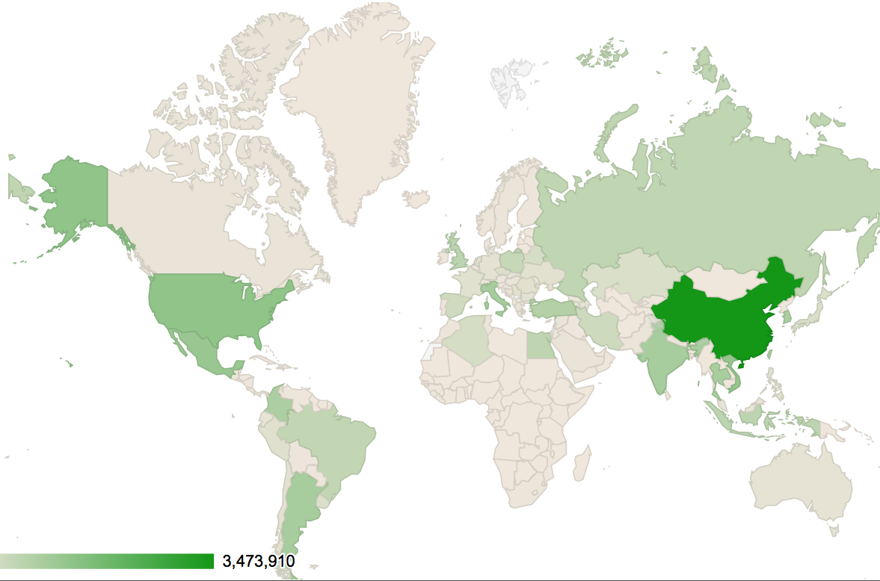
Open Resolvers Geographical Distribution
Notes:
258258 nld
286710 cze
311086 ury
320091 kaz
322081 jpn
392734 blr
408319 dza
505926 esp
524828 irn
624899 pol
704310 bra
738321 rus
744241 egy
780029 idn
787018 gbr
935324 tur
1025733 col
1036693 kor
1069513 tha
1072459 twn
1115820 ind
1116045 ita
1123195 arg
1327370 mex
1389890 vnm
1473466 usa
3473910 chn

Slide 37
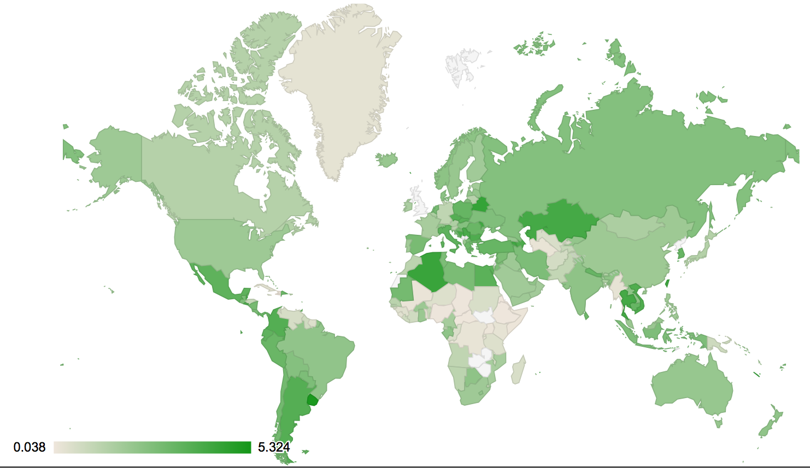
Open Resolvers vs. Internet Usage
Per-user distribution is consistent with overall per-country, except in a few cases (small, hop countries)

Slide 38
Organization Level Distribution – Resolvers
Notes:
Certain organizations (e.g., uninet.net.mx) have more than their country share of open resolvers, indicating that open resolvers/proxies association is across-country

Slide 39
Organization Level Distribution – Open Resolvers Per Forwarder
Notes:
Certain organizations (e.g., uninet.net.mx) have more than their country share of open resolvers, indicating that open resolvers/proxies association is across-country

Slide 40
Organization Level Distribution - log₁₀(Forwarders)
Notes:
Certain organizations (e.g., uninet.net.mx) have more than their country share of open resolvers, indicating that open resolvers/proxies association is across-country

Slide 41
Final Thoughts

Slide 42
Key Points
Still many millions of Open Resolvers on the Internet
  The trend is decreasing
Most Open Resolvers forward to another recursive
About half respond from the wrong port!
Open Resolver forwarder IPs are strongly linked to COM/NET queries.
  Responsible for 50% of the query traffic

Slide 43
Questions?

