Slide 2
Zeroing in On Zero Days
DNS OARC
Spring 2014
Ralf Weber
Ralf.weber@Nominum.com

Slide 3
Nominum Data Sources
Worldwide ISP DNS data
  ~Terabyte of data per day
  Rough estimate 5% of ISPs resolver traffic
  Activity from around the world, including China
  Limited response data
  Lots of other data sources – various threat feeds etc

Slide 4
Have You Been Seeing This?
krsfwzohwdghqx.liebiao.800fy.com.
wxctkzubkb.liebiao.800fy.com.
avytafkjad.liebiao.800fy.com.
gfqhuxenun.liebiao.800fy.com.
uv.liebiao.800fy.com.
ivatsnkb.liebiao.800fy.com.
wfmlgzyrufaxid.liebiao.800fy.com.
qzgziliv.liebiao.800fy.com.
qxgtqfyv.liebiao.800fy.com.

Slide 5
Interesting Recent Trend
Pseudo Random Subdomain Attacks
First observed Jan 2014
~950 names attacked
  1 – 2 day spikes
  Queries observed at resolvers worldwide
  Queries start and stop about the same time worldwide
Usually one more label than a resolvable domain
  First label random, but often follows a pattern
  Millions – tens of millions of randomized subdomains
  Auth servers often fail, if they stay up they usually give back NXDOMAIN
  Recently we also see NODATA, NOERROR returned
Mostly very low normal daily query volumes, from within China
  Predominantly Chinese gaming & adult sites, some exceptions
IPs sending attack-related queries strongly correlated with
Open DNS Proxies or Resolvers

Slide 6
Uptick in Unique Names
600M
500M
400M
300M
200M
100M

Slide 7
Characteristics of Target Names
Some names w/high Alexa rank
Chinese gaming sites
  evidence suggests some reside on hacked legit sites
Adult content
UK gaming site

Slide 8
Alexa Data for Attacked Names
Name under attack “Core” name Alexa rank
baidu.com. baidu.com 5
blog.sina.com.cn. sina.com.cn 13
xlscq.blog.163.com. 163.com 30
www.bet365.com. bet365.com 179
www.appledaily.com.tw. appledaily.com.tw 915
hk.apple.nextmedia.com. nextmedia.com 2017
nextmedia.com. nextmedia.com 2017
tw.nextmedia.com. nextmedia.com 2017
1.92xin.sinaapp.com. sinaapp.com 4786
applevideo.edgesuite.net. edgesuite.net 5579
7% of names attacked in Alexa 1M
Some very high ranking
92% of names have never been in Alexa 1M
Data was normalized to reflect different ranks over time

Slide 9
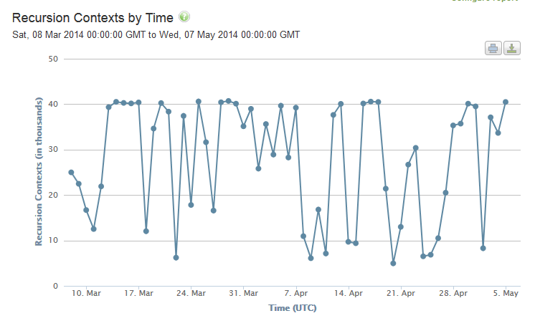
Resolver Impact

Slide 10
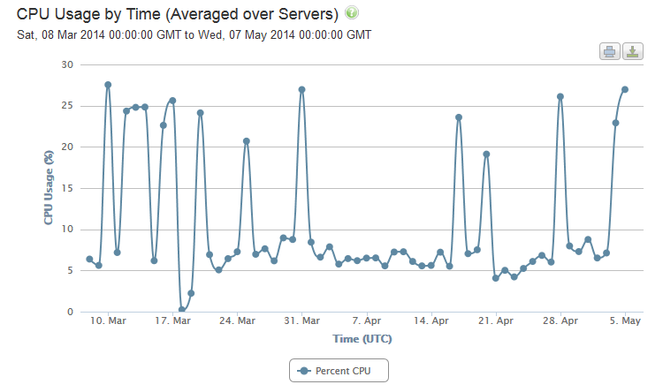
Resolver Impact

Slide 11
Attack Distribution # Days
Mar 10 – May 6 2014
% domains
attacked
Cumulative
%
Total domains
attacked
Days domain
attacked
71.9% 71.9% 373 1
18.7% 90.6% 97 2
3.5% 94.0% 18 3
2.5% 96.5% 13 4
1.5% 98.1% 8 5
0.6% 98.7% 3 6
0.4% 99.0% 2 7
0.4% 99.4% 2 8
0.4% 99.8% 2 9
0.2% 100.0% 1 17

Slide 12
Top Ten Names Used
Ranked by days used
2.1% 2.1% 17 www.500sf.com.
1.1% 3.3% 9 www.yuerengu.com.cn.
1.1% 4.4% 9 liebiao.800fy.com.
1.0% 5.4% 8 www.23us.com.
1.0% 6.4% 8 www.uc711.com.
0.9% 7.3% 7 wuyangairsoft.com.
0.9% 8.2% 7 web.pay1.cn.
0.8% 8.9% 6 www.zhaobjl.com.
0.8% 9.7% 6 978sf1111.ewc668.com.
0.8% 10.4% 6 vip.mia0pay.net.

Slide 13
One Month Worldwide Activity For A Name liebiao800fy.com Mar 28-Apr 28 2014
+-------+------+-----------+----------+
| month | day | queries | names |
+-------+------+-----------+----------+
| 3 | 29 | 74945476 | 45045747 |
| 3 | 30 | 113542882 | 67604377 |
| 3 | 31 | 68961558 | 42379537 |
| 4 | 1 | 31279835 | 18210170 |
| 4 | 2 | 51596367 | 30243023 |
| 4 | 3 | 3532539 | 2316163 |
| 4 | 5 | 2 | 1 |
| 4 | 6 | 1 | 1 |
| 4 | 7 | 1 | 1 |
| 4 | 9 | 1 | 1 |
| 4 | 10 | 4 | 2 |
| 4 | 11 | 1 | 1 |
| 4 | 15 | 1 | 1 |
| 4 | 16 | 1 | 1 |
| 4 | 17 | 1 | 1 |
| 4 | 18 | 1 | 1 |
| 4 | 19 | 2 | 2 |
| 4 | 20 | 1 | 1 |
| 4 | 21 | 1 | 1 |
| 4 | 22 | 1 | 1 |
| 4 | 23 | 1 | 1 |
| 4 | 24 | 1 | 1 |
| 4 | 26 | 1 | 1 |
| 4 | 27 | 1 | 1 |
| 4 | 28 | 1 | 1 |
+-------+------+-----------+----------+
Very low
activity
Several days
with no activity

Slide 14
Daily Query Pattern
QPS for *.800fy.com
March 29 00:00 GMT through Apr 3 00:00 GMT

Slide 15
Matches with openresolverproject scans liebiao800fy.com 0326 and 0402
March 29 00:00 GMT through Apr 3 00:00 GMT

Slide 16
Zeroing In On Zero Days
Some success figuring out randomization algorithms
  Detect spikes
  Analyze subdomains
  Known pattern?
    Move to a monitor and block list
  New pattern?
    Monitor
Enables very fast detection
  New domains with familiar patterns - ~20 mins
  New patterns – working on algorithms to automate
We can add affected domains to block or monitor lists quickly
  They get distributed instantly
It will get harder – attackers will adapt

Slide 17

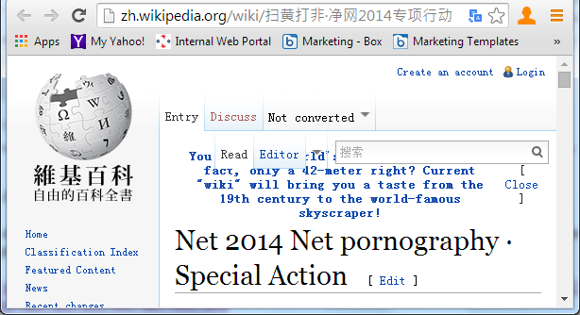
Abrupt End to Major Attack Activity
Is Chinese gov crackdown on certain kinds of web content responsible?

Slide 18
What’s The Motive?
Skirmishing among small game/adult site owners?
Testing and perfecting techniques
for a bigger event?

Slide 19
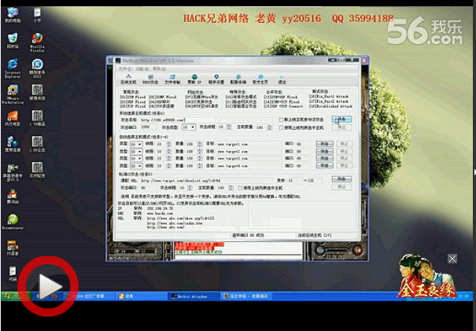
Your Friendly Neighborhood DDoS Service
A real Chinese menu ☺

Slide 20
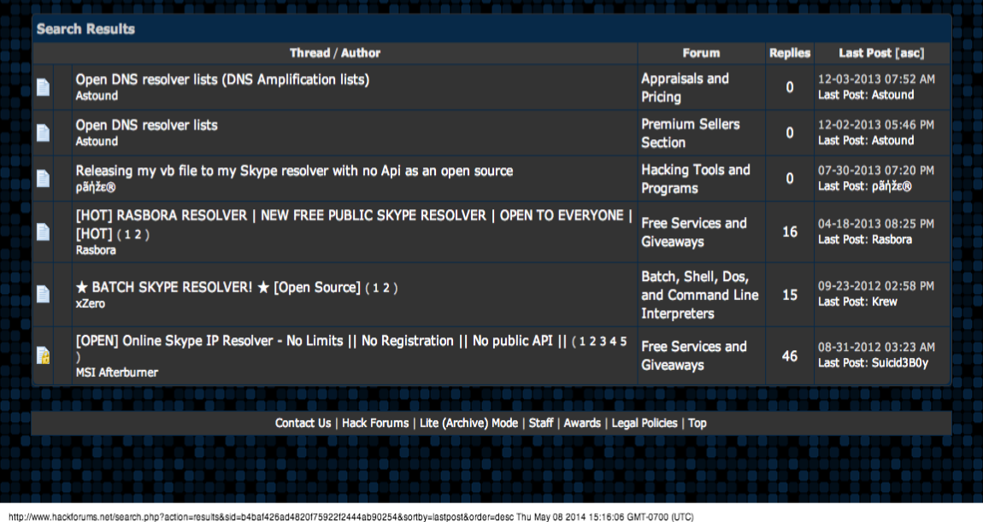
Your Friendly Neighborhood DDoS Service

Slide 21



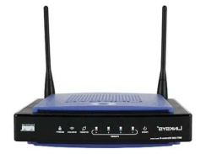
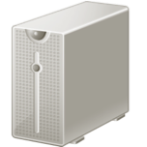
Open DNS Proxies
1
Attacker spoofs
IP address of target.
Sends queries to
open home gateways.
4
Proxy forwards
answer to target,
floods it with
DNS traffic.
Small
query
Internet
Large
answer
ISP border
3
ISP resolver
replies to proxy
with amplified
answer
2
Open DNS proxy
forwards queries
to ISP resolver
ISP Network

Slide 22
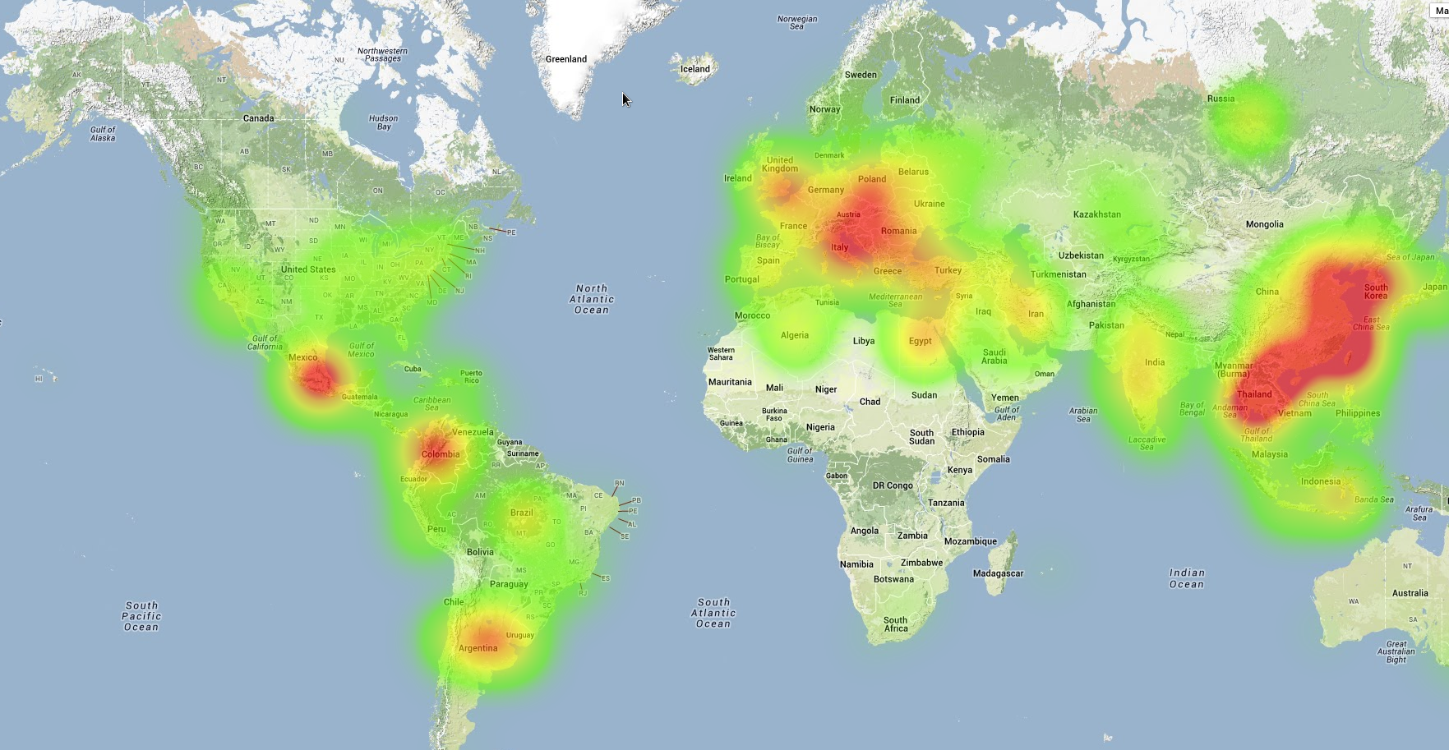
Open DNS Proxies Globally

Slide 23
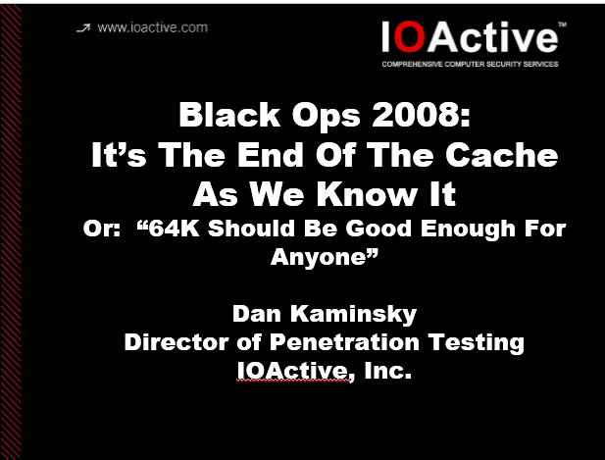
Other Uses for Random Subdomains

Slide 24

Interesting Tension
DNS
Cache
Poisoning
DDoS
DNSSEC

Slide 25

A Perfect Storm?
Open DNS proxies and resolvers
Infra for sending fake queries
Lots of testing
Infra for sending fake answers
Minimally there’s DDoS exposure
Potential cache poisoning exposure

Slide 26
Way Forward
Data! Logging is a “Good Thing”
  We are starting to get response data
Fast, automated detection
Dynamic lists derived from fast detect
Robust policy framework
DNSSEC

