Slide 1
Kindred Domains: Detecting and Clustering Botnet Domains Using DNS Traffic
Matt Thomas
Data Architect, Verisign Labs

Slide 2


About the Author
Matthew Thomas
Data Architect
Verisign Labs
Aziz Mohaisen
Sr. Research Scientist
Verisign Labs

Slide 3
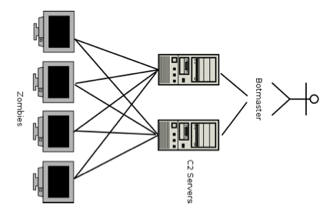
An Overview of Command & Control Botnets
Malware commonly uses Domain Fast-Fluxing or Domain Generation Algorithms (DGA)
Typically seeded by system clock
Domains span many TLDs
DNS traffic lookup patterns will emerge as all infected hosts resolve the same set of domains
  Most result in NXDomain

Slide 4

Conficker: The Quintessential DGA
A malware family that popularized the concept of DGA
Thousands of infected machines still exist
Many variants – each generates different set of domains
DGA Algorithm was reverse engineered
  Provides set of domains generated for each variant for a given day
  Useful “ground truth” for detection
How does Conficker traffic differ from typical NXD traffic?

Slide 5
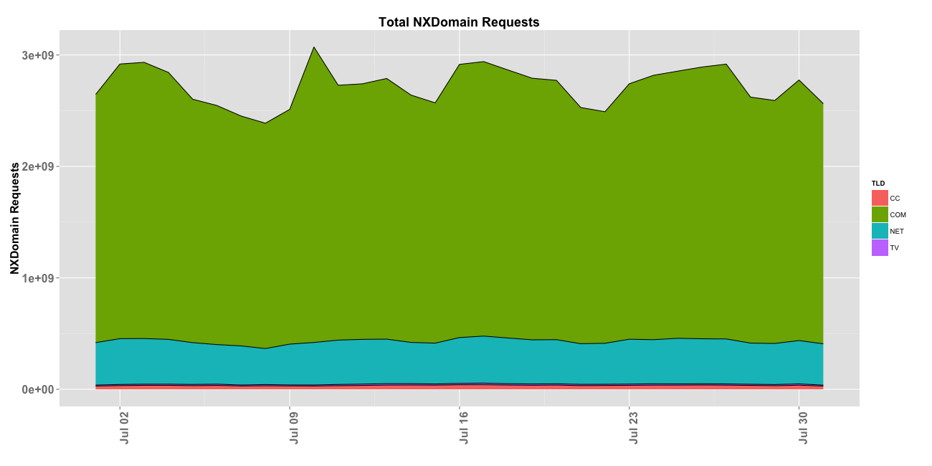
NXDomain Traffic Data
Daily volume of NXD traffic for CC/TV/NET/COM
NXD traffic is associated with domains not registered, mistyped, etc

Slide 6
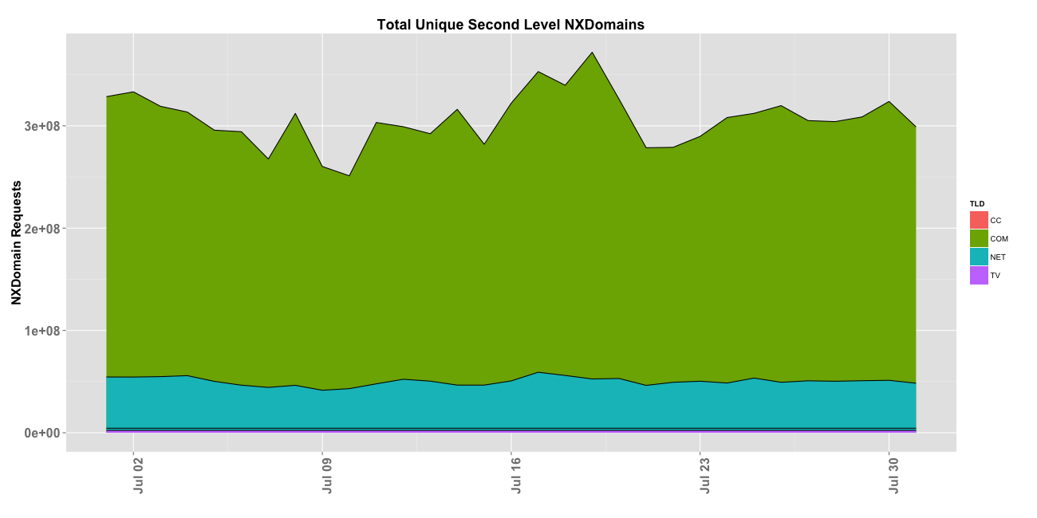
NXDomain Traffic Data
Daily number of unique Second Level Domains (SLDs)
The traffic is NXD (not registered domains, mistyped, etc)

Slide 7
NXDomain Traffic Data
COM typically sees ~2.5 billion NXD requests per day and spans over 350 million unique SLDs
NET receives 500 million NXD requests over 60M SLDs (SLDs that are not registered, or mistyped)
ccTLDs receive significantly less traffic, and less NXD
What’s the distribution of requests per SLD?

Slide 8
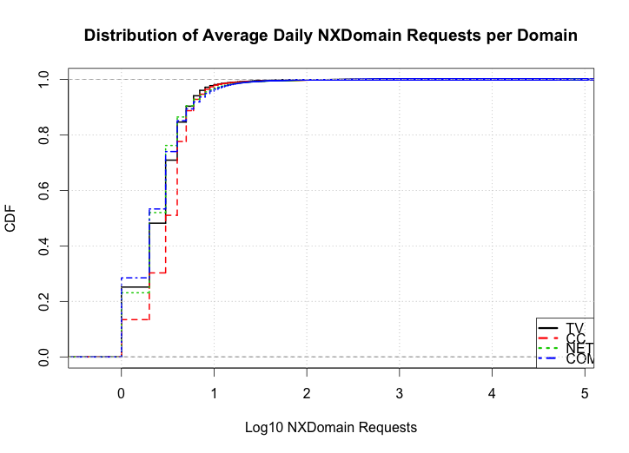
NXDomain Traffic Data
CDF of average number of NXD requests per SLD

Slide 9
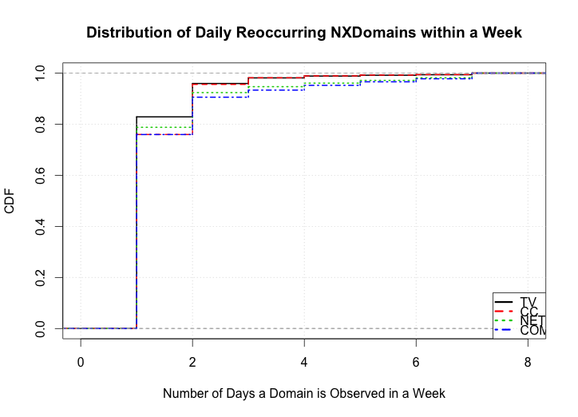
NXDomain Traffic Data
CDF of number of days an SLD appears in a week

Slide 10
NXDomain Traffic Data
Average SLD receives minimal amount of NXD traffic
  95% of SLD’s NXD receive less than 10 requests within 24 hours
High “churn” rate within the SLD set during a week
How does Conficker’s NXD traffic compare?

Slide 11
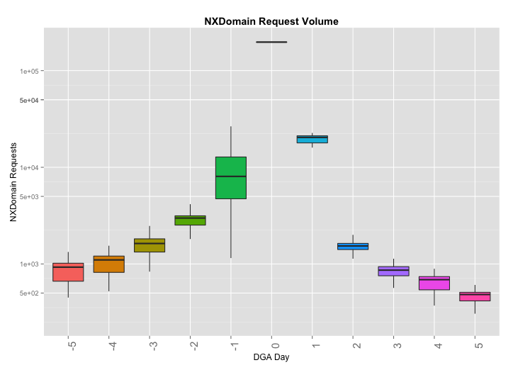
Conficker’s NXDomain Traffic Data
NXD traffic volume for DGA domains prior, during and after their expected generation date

Slide 12
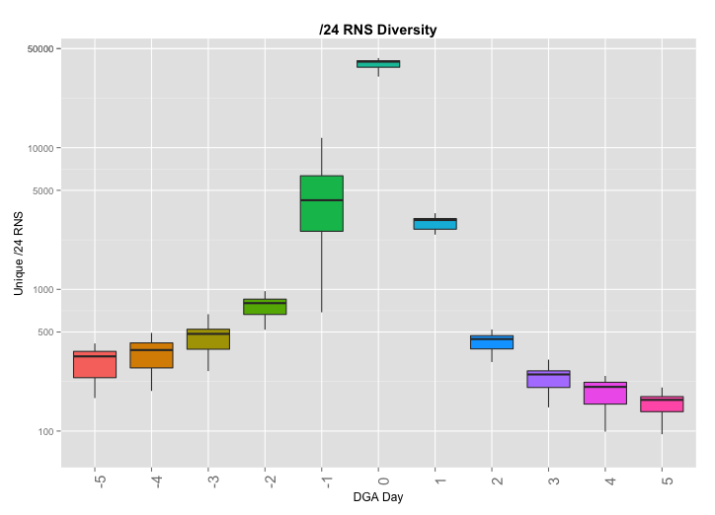
Conficker’s NXDomain Traffic Data
NXD traffic diversity (/24 of the RNS) for DGA domains prior, during and after their expected generation date

Slide 13
Conficker’s NXDomain Traffic Data
Despite specific generation date, DGA domains receive traffic pre and post its specific generation date
  Possible global clock skew; also possible misconfiguration
Large amount of traffic from diverse set of RNS for SLDs
  Statistical abnormal compare to whole NXD population
How can we detect and associate malware domains?

Slide 14
Detection and Clustering

Slide 15

Computing Traffic Similarity
We try to address the following questions:
  How similar are traffic streams to each other?
  Can the similarity be used to group different traffic streams?
The similarity function is a real-valued function that quantifies the similarity between two entities
Jaccard Index is a statistic for comparing the similarity and diversity of sample sets (one among many)

Slide 16
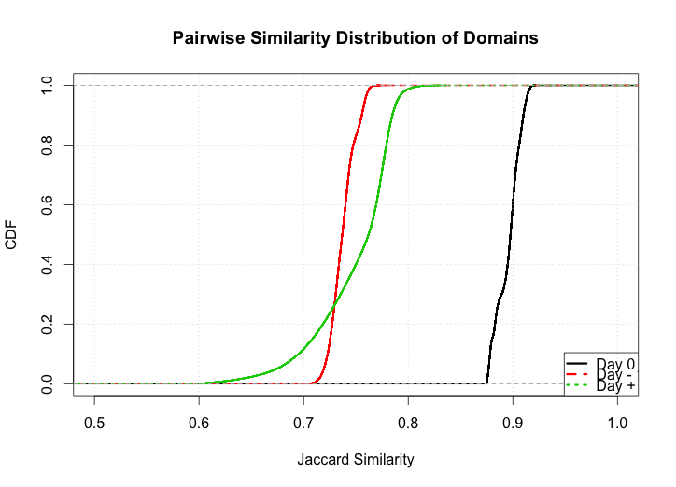
Conficker’s Traffic Similarity
CDF of pairwise domain similarities for a set of DGA domains based on on their /24 RNS set for a given day

Slide 17
Conficker’s Traffic Similarity
Subset of domains from Conficker A & B clustered based on similarity using single-linkage algorithm

Slide 18
Conficker’s NXDomain Traffic Data
Domains on a specific DGA date have very high similarity measures, most measuring higher than 0.9
Techniques such as hierarchical clustering could potentially group domains from a specific DGA into distinct clusters based on DNS traffic similarity
How do various similarity thresholds affect the cluster?

Slide 19
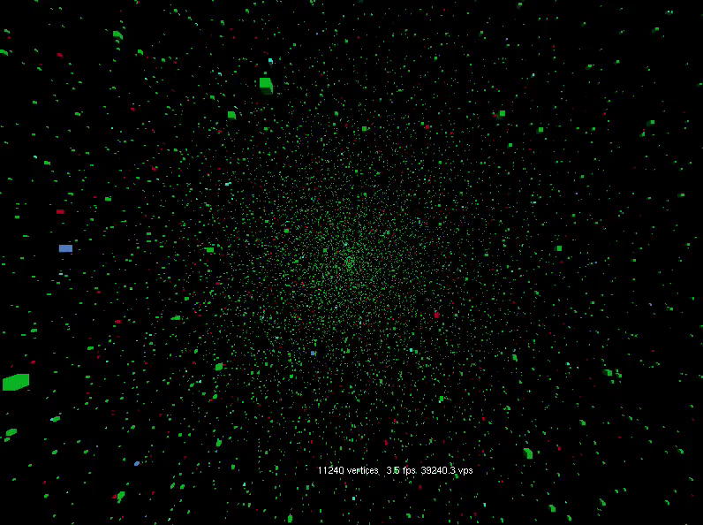

Slide 20
Clustering – Similarity Thresholds

Slide 21
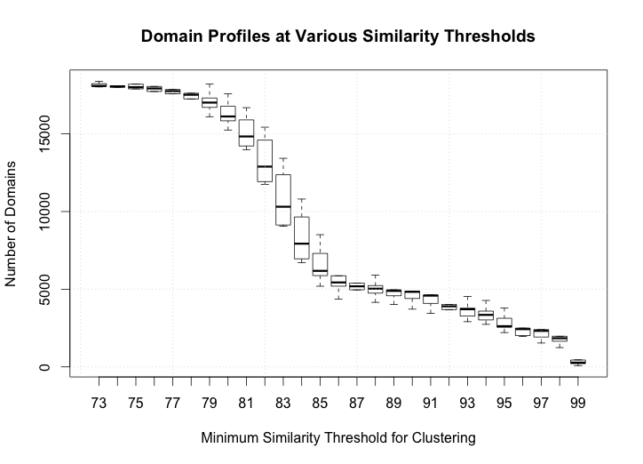
Clustering – Similarity Thresholds
The number of SLDs contained in a cluster at various similarity threshold levels

Slide 22
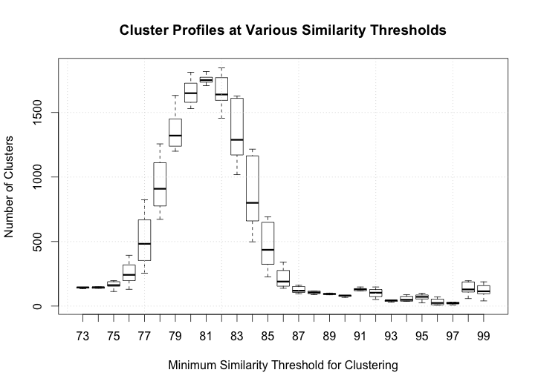
Clustering – Similarity Thresholds
The number of distinct clusters formed at various similarity threshold levels

Slide 23
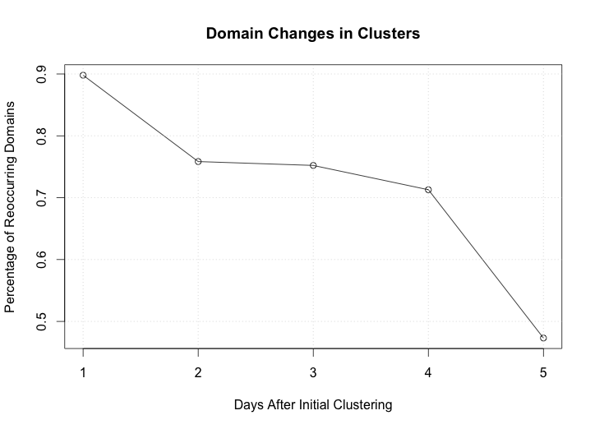
Clustering – Similarity Thresholds
Temporal evolution of clusters based on SLDs present

Slide 24
Global Malware Detection

Slide 25
Global Malware Detection
Similarity thresholds influence the number of clusters and the number of domains within each cluster
What resulting clusters appear when such a technique is applied to all NXD traffic?

Slide 26
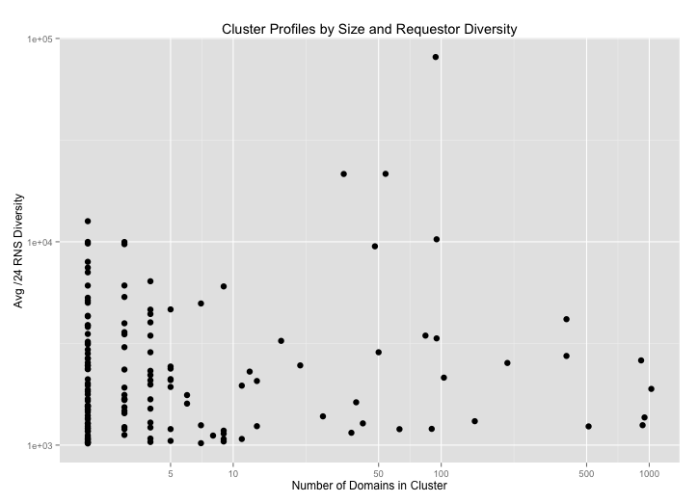
Global Malware Detection
Clusters identified with a similarity threshold set to > 0.9
Each point is a cluster – measures # domains and # RNS

Slide 27
Global Malware Detection
Many detected clusters of malware/variants use a small amount of domains observable in our dataset
A few clusters generated several hundred domains
  May influence evasiveness and resilience of a botnet
Several clusters have thousands of distinct /24s
  Infection rate or prevalence of a malware

Slide 28
Concluding Remarks and Future Work
We look at using the authoritative NXD traffic for identifying DGA’s used as the C&C channel of malware
  We use the largest dataset from com/net resolution
  Domain names used for C&C are identifiable by their request pattern
  Different generations of the Conficker malware family are identified
  Clustering of traffic yields interesting structures identifying evasion
Future works: We will look into extending the work
  To other malware families using DNS for C&C
  Highlight operation impact and evolution of evasion techniques
  Explore spread of infections via remote sensing at the DNS level

