Slide 1
Measuring DANE TLSA Deployment
Liang Zhu¹, Duane Wessels²,
Allison Mankin², John Heidemann¹
1. USC ISI 2. Verisign Labs

Slide 2
DANE is Important
DANE defines trust for “named entities”
Use DNSSEC to prove integrity
Named Entities: web sites, email addresses
Concern about CA trust after multiple compromises
DANE TLSA complements CAs, allowing owner to describe what they trust
Built on DNSSEC's root of trust
owners control which CAs, certs, or algorithms to reduce vulnerability

Slide 3
DANE Deployment Status is Unknown
No systematic study of DANE TLSA deployment
Few prior work ^{[1]} tracks TLSA records
Understand how DANE TLSA has been used
Are people using it correctly?
What is the common usage?
Can we see DANE take off?
[1] https://www.tlsa.info/statistics/best_results

Slide 4
Contribution: First Systematic Measurements of DANE TLSA
Observe TLSA deployment in .com and .net
Current DANE TLSA use is early but grows
We look for correctness
7-12% of records seem wrong
We look at response sizes (with DNSSEC)
31% of require IP fragmentation with UDP

Slide 5
How we track TLSA names
for ALL DS records in com&net zones
extract $DOMAIN //DNSSEC signed
check _443._tcp.$DOMAIN
check _443._tcp.www.$DOMAIN
for SMTP port 25, 465, 587
if MX record
check _$PORT._tcp.$MX
if no MX record
check _$PORT._tcp.$DOMAIN
Actively probe (.com&.net)
DNSSEC signed zones
HTTPS: port 443
SMTP: port 587, 465, 25
Alternative sources:
watching resolvers or web crawls
But com and net are easy (in bulk) and provide better coverage
Notes:
No need to mention TLSA names (ports and protocol)

Slide 6
Findings and Observations
Understand the current TLSA use:
How many TLSA names are there?
Does DANE TLSA grow well?
Is DANE TLSA used correctly?
What are the most common TLSA parameters?
Are TLSA replies problematically large?
Notes:
we use this measurement
to start to answer these questions.

Slide 7
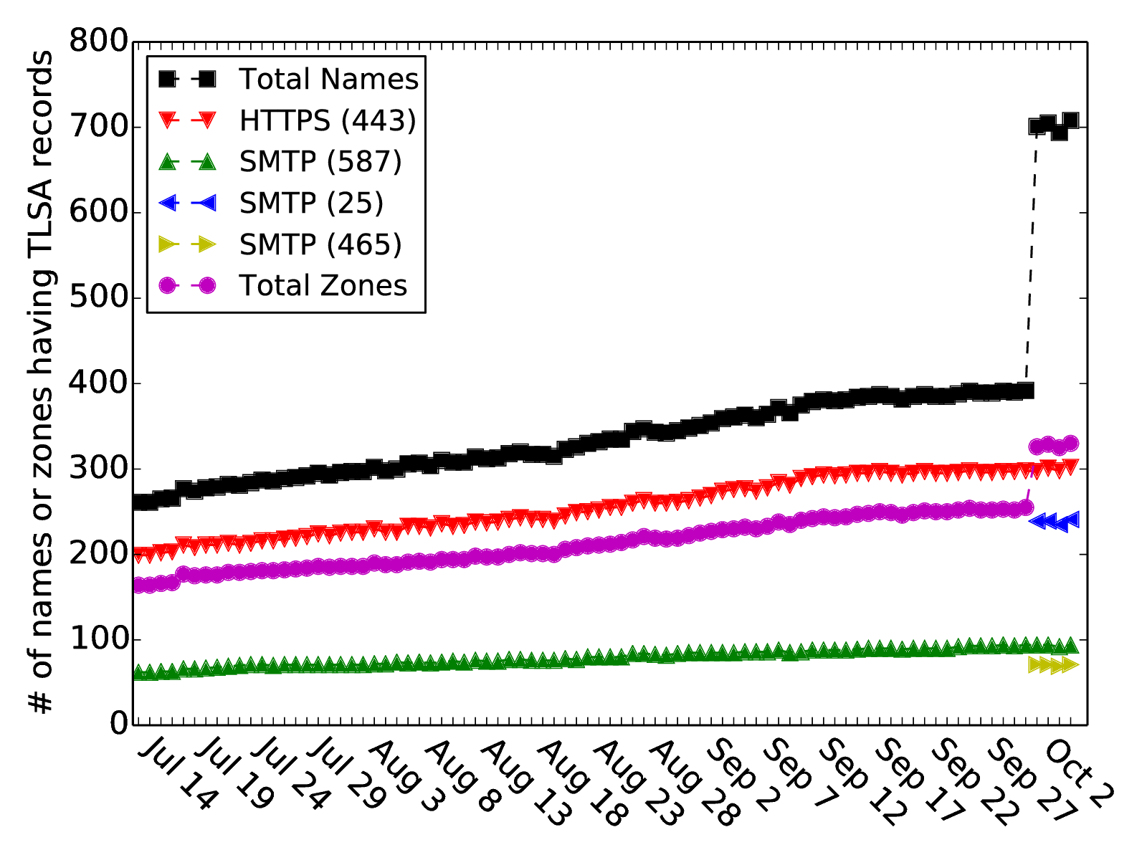
The number of TLSA names
big jump from new SMTP ports (25, 465)
Trend: slow but steady increase
DANE TLSA use is early
of the 461k signed zones, only about 708 TLSA names are found in the latest
Notes:
DANE TLSA use is early but growing

Slide 8
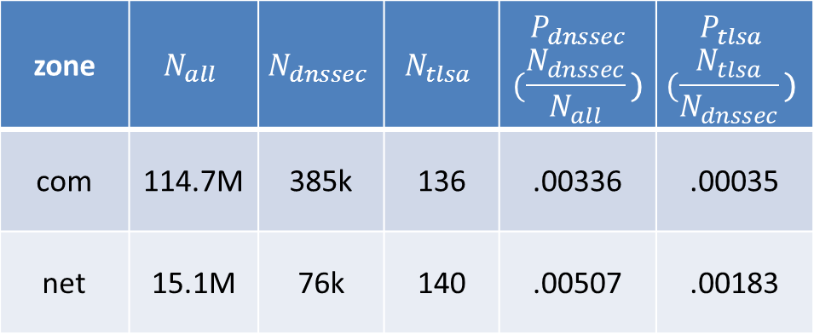
DANE TLSA Penetration Rates
Penetration (P): each technology into its base of possible users
TLSA active zone: A zone contains at least one TLSA record
As of 2014-10-06:
zone | $$N_{all}$$ | $$N_{dnssec}$$ | $$N_{tlsa}$$ | $$P_{dnssec}$$ $$(\frac{N_{dnssec}}{N_{all}}\text{)}$$ | $$P_{tlsa}$$ $$(\frac{N_{tlsa}}{N_{dnssec}}\text{)}$$
com | 114.7M | 385k | 136 | .00336 | .00035
net | 15.1M | 76k | 140 | .00507 | .00183
DANE TLSA: small but maybe off to a start, but still immature (2 years
after standardization)
DNSSEC: deployment is still modest, 9 years after standardization ( ~3.5 years after signing .com and signing .net)
Notes:
DANE is growing well compared to current DNSSEC
Domains Secured with DNSSEC
com 385,582
net 76,473
edu 67
Updated 2014-10-06 16:51:48
ACTIVE ZONE
.COM
114,666,581
as of 10/07/2014 08:48:16 AM UTC
.NET
15,077,288
as of 10/07/2014 08:48:16 AM UTC
DNSSEC Deployment Milestone Update https://www.nanog.org/meetings/nanog53/presentations/Tuesday/Larson_DNS.pdf
Zones that Verisign had a hand in signing:
Root zone Signed on July 15, 2010
.edu zone Signed on July 28, 2010
.net zone Signed on December 9, 2010
.com zone Signed on March 31, 2011

Slide 9
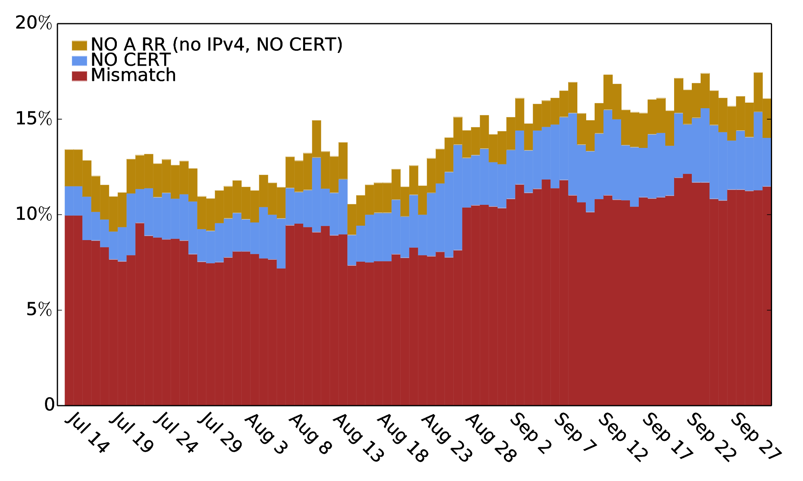
Is DANE TLSA used correctly
Validate TLSA records assuming DNSSEC integrity for simplicity
No cert/No A record: DANE TLSA does not work even deployed
Mismatch: the use of DANE TLSA will fail
Consistently, 7%-12% TLSA records are mismatched
(ports 443 and 587 only)

Slide 10
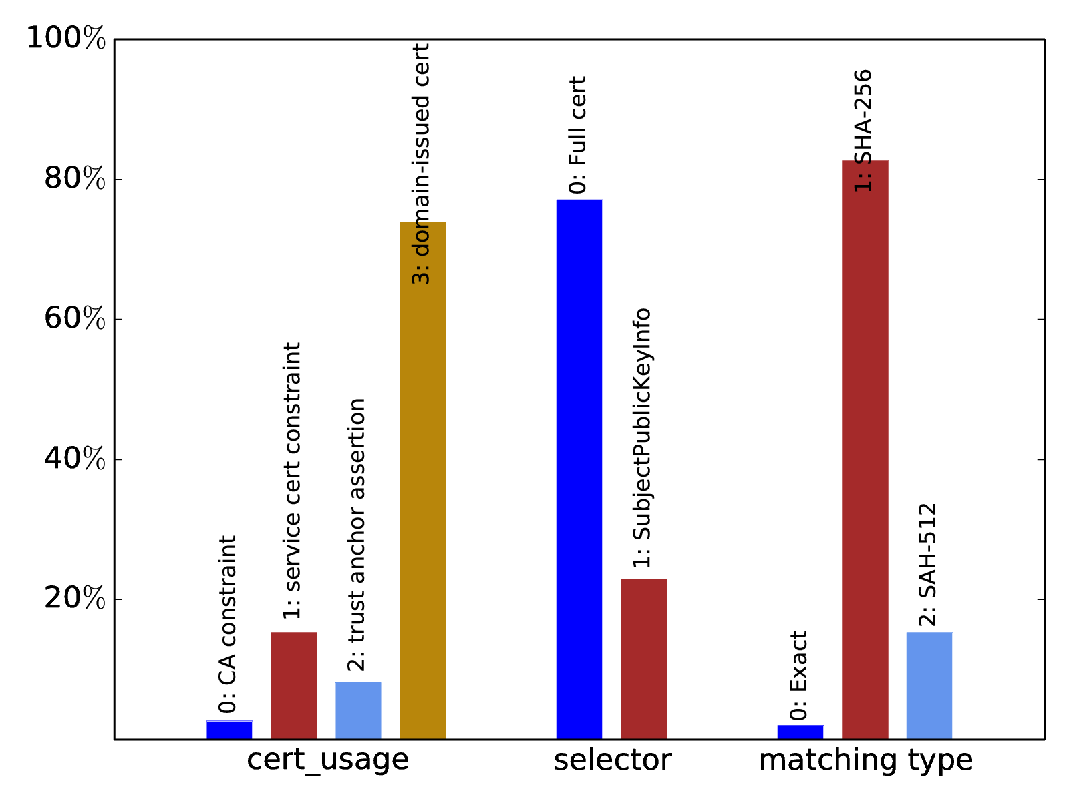
Observed TLSA Parameters
Domain-issued cert:
most DANE TLSA cases are independent from CA without serving its trust source
SHA-256:
It is currently strong enough and not necessary to use stronger algorithm bringing more bits in DNS response
total 780 TLSA records in 701 TLSA responses captured on Oct. 2, 2014

Slide 11
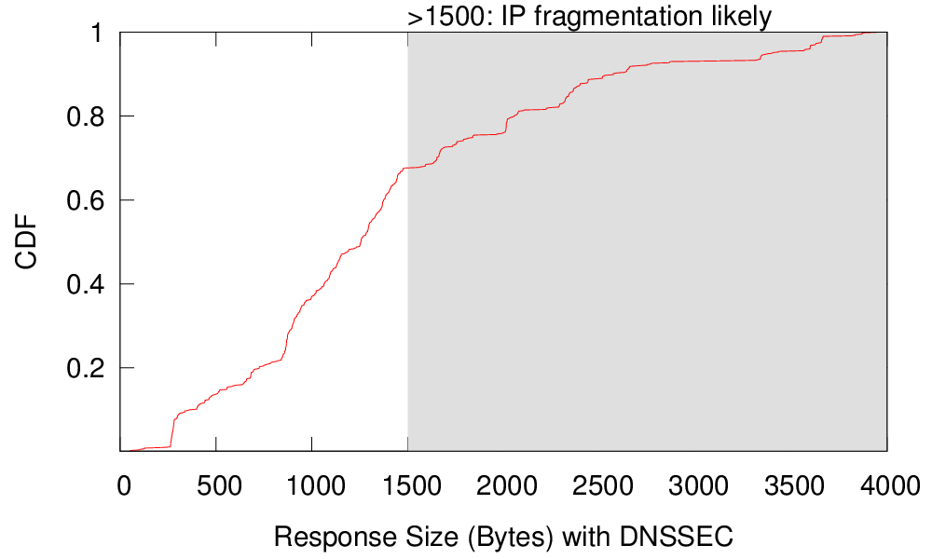
Problematically Large Responses
Large DNS packets with UDP: more than 1500 Bytes => IP fragmentation
Problems:
Risk of fragmentation attack ^{[2]}
Add extra latency of resending due to lost fragments
31% TLSA responses with DNSSEC are larger than 1500 B
Query TLSA record with DNSSEC to authoritative servers of the 701 TLSA names on Oct. 2, 2014
Most are caused by multiple RRs and DNSSEC signature in authority and additional sections. It provides more authoritative server options but may cause fragmentation problems
31% TLSA responses are Problematically Large
[2] A. Herzberg and H. Shulmanz. Fragmentation considered poisonous. IEEE Conference on Communications and Network Security, Oct. 2013.
Notes:
For example, a name has 5 different authoritative servers and each of them has its own IPv4 and IPv6 addresses

Slide 12
Conclusion
We are tracking DANE growth
We are working on improvements
IPv6 certificate validation
Check other RR types: OPENPGPKEY
Data and code
working to get stats on the web and hope to release the code
Early results:
DANE TLSA use is early, but growing
7-12% of TLSA records are invalid
31% replies force fragments
We would like feedback from you
© 2014 VeriSign, Inc. All rights reserved. VERISIGN and other trademarks, service marks, and designs are registered or unregistered trademarks of VeriSign, Inc. and its subsidiaries in the United States and in foreign countries. All other trademarks are property of their respective owners.

