Slide 1
Measuring the Leakage of Onion at the Root
A measurement of Tor’s .onion pseudo-top-level domain in the global domain name system
Aziz Mohaisen
Verisign Labs
(Joint work with Matt Thomas)

Slide 2
Agenda
The global DNS and private namespace usage
.Onion measurements from the A and J root servers
  A Longitudinal Study of .Onion Traffic
  Root Sampling Completeness (Representative?)
  Volume and Diversity of Hidden Service Requests
  Most Requested Hidden Services
  ASN + Geo Diversity of Hidden Service Requests
  Tor and the World: Event Correlation
Trends from Day in the Life (DITL) of Internet
Concluding Remarks and Future Work
Q&A

Slide 3
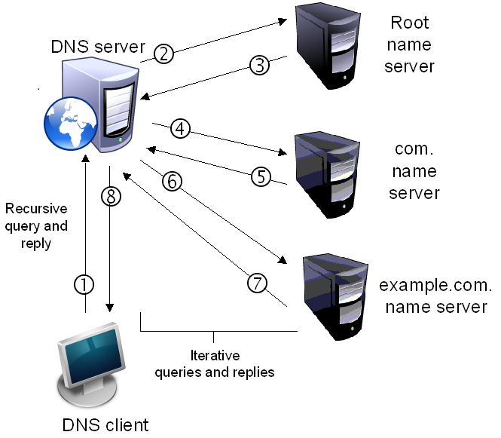
The Global DNS and Private Namespace Usage
The global DNS is a hierarchical system
Currently there are 13 groups [A-M] of root servers
Authoritative for TLDs such as “.com”, “net”, etc.
Many installed systems utilize non-delegated TLDs for internal namespaces
  E.g. “.corp” “.home”
Queries to the roots for such TLDs result in NXDomains
Notes:
You maybe want to talk in item 1 about the kinds of resolvers/servers:
Stub
Recursive
Root
Authoritative

Slide 4

The Global DNS and Private Namespace Usage
Delegation of new gTLDs spurred more critical studies of NXD requests at the roots.
  Potential “Name Collision” Risks (see namecollisions.net).
  Unintended leaked DNS queries may expose potentially sensitive private information and present additional threat vectors.
Tor is a system that exploits the absence of a non-delegated TLD - .onion – for its Hidden Services
  Tor is designed not to route .onion requests into the public DNS
  It relies on the hidden service protocol for “torizing” requests.

Slide 5
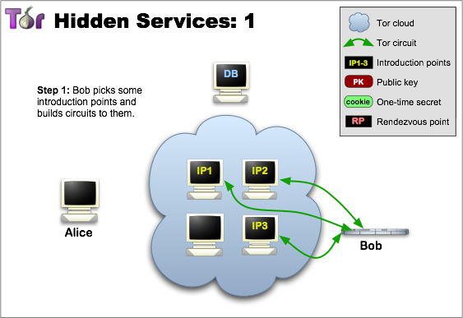
A primer on Tor’s Hidden Services
Source: torproject.org

Slide 6
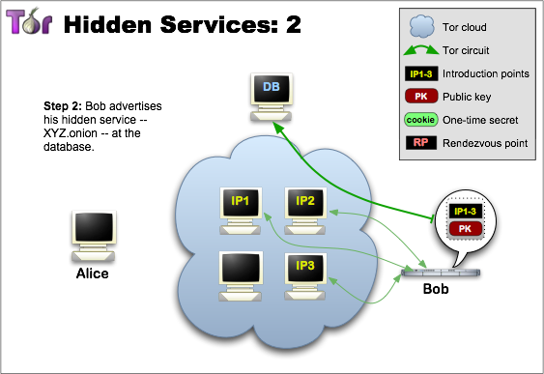
A primer on Tor’s Hidden Services, cont.
Source: torproject.org

Slide 7
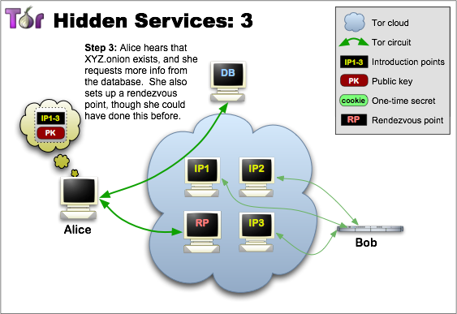
A primer on Tor’s Hidden Services, cont.
Source: torproject.org

Slide 8
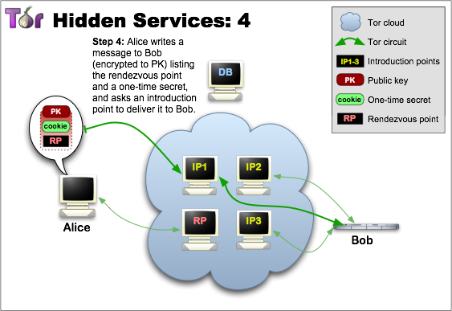
A primer on Tor’s Hidden Services, cont.
Source: torproject.org

Slide 9
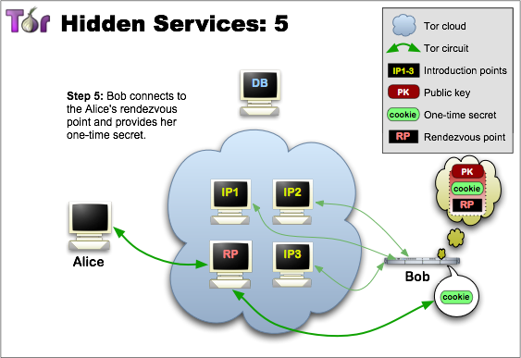
A primer on Tor’s Hidden Services, cont.
Source: torproject.org

Slide 10
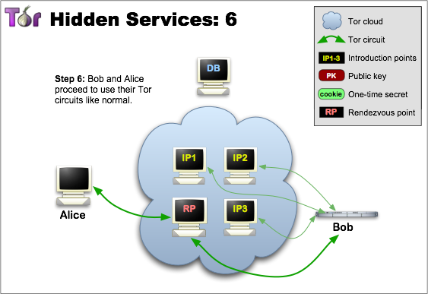
A primer on Tor’s Hidden Services, cont.
Source: torproject.org

Slide 11
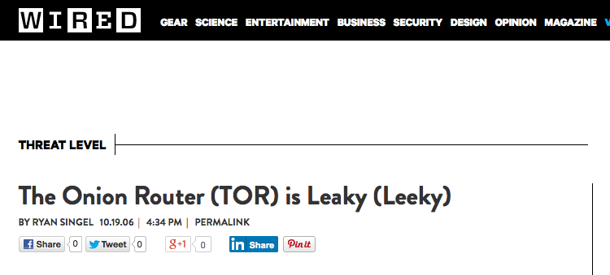
Tor Leaks DNS Queries…
Source: wired.com

Slide 12
.Onion Measurements From A and J Root
General Overview

Slide 13
A Longitudinal Study of .Onion Traffic
Six month capture from A & J Roots
  27.6M requests
  81K SLDs
  172K IPs
  105K /24s
  21K ASNs
Onion ranked 461

Slide 14
Root Sampling Completeness (Representative?)
A+J observe ~3300 SLDs/day
Separately ~2500
  75% combined
Prior SLD-root affinity reports suggests A&J observe 20% of total root traffic; confirmed by our study

Slide 15
Volume and Diversity of Hidden Service Requests
Various measures of traffic to SLD distribution
  90% <= 10 requests
  95% <= 10 ASNs
Very few SLDs with large and diverse traffic pattern
Notes:
We will talk about those SLDs next.

Slide 16
.Onion Measurements From A and J Root
Popular Services and Requesters

Slide 17
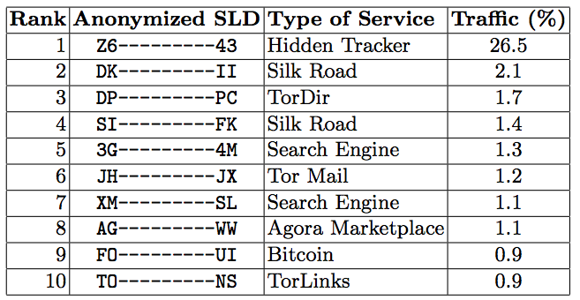
Most Requested Hidden Services
Total of 81k SLDs!
  Trackers
    P2P systems
    Tor Directory
    Search Engines
    Tor-related, etc
  Deep web:
    Silk road
    Agora marketplace
    (bitcoin)
26.5% of all .Onion traffic to one Hidden Service
Long tail distribution over remaining Hidden Services
Top 10 SLDs account for 38% of all .Onion traffic
Notes:
Can you plot the second item of the long tail? Maybe an excuse why you didn’t?

Slide 18
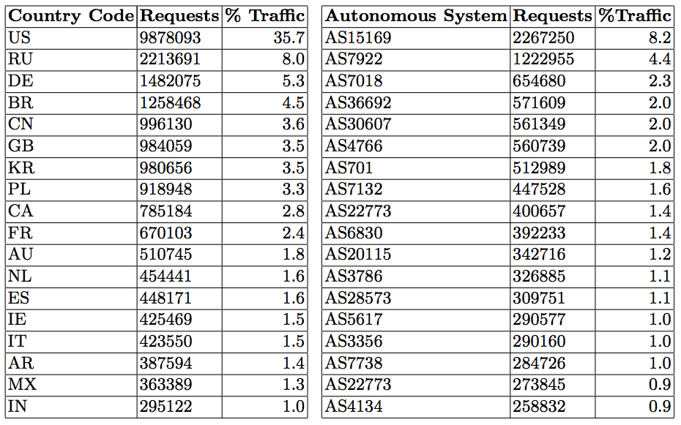
ASN + Geo Diversity of Hidden Service Requests
Geo distribution of requests differs from that reported by Tor
  USA (⬆13.4). Germany (⬇8.8), France (⬇6.2) and Spain (⬇4.4).
Large percentage of traffic issued from public DNS services
  Google (AS15169), OpenDNS (AS36692)
Notes:
Potential reasons for the geo distribution? Maybe the source of leakage is not to do with a real “hidden service” or a tor client running at the host; which is the part reported by the Tor project.
Maybe you want to comment on how expected/anticipated is it to see public DNS services here.
AS7922: COMCAST
AS7018: ATT
Other reasons for observed distribution could be Tor client affinities hard-coded to avoid certain elements, or skewed observations from our perspective because of US biases and affinities within our own observation space.

Slide 19
.Onion Measurements From A and J Root
Event Correlation

Slide 20
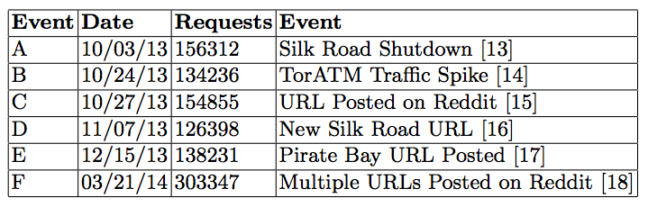
Tor and the World: Event Correlation
Several spikes in Onion Traffic can be correlated to specific hidden services and reported events.
Many spikes coincide with postings of Onion URLs on popular websites

Slide 21
Tor and the World: Event Correlation, cont.
Reported events within Turkey during elections
Measure onion requests from Turkish IP addresses

Slide 22
.Onion Measurements From DITL
An Overview

Slide 23
DITL Dataset
DITL provides archival data
  Simultaneous measurement effort from roots and name servers; two days a year; data managed by DNS-OARC.
  Covers 7 years, from 2008 to 2014 (1-2 days per year)
  From all root servers (‘A’ through ‘M’); 6,850,728 .onion queries
  Originated from 5,324,412 IP address, over 336,273 /24 addresses
  Queried 18,330 .onion SLDs the total of 7 years
Year | # roots | Root servers | Total queries
2008 | 7 | (A,C,F,H,K,L,M) | 3,710
2009 | 8 | (A,C,E,F,H,K,L,M) | 13,343
2010 | 13 | ALL | 2,371,869
2011 | 11 | All except B and G | 691,385
2012 | 10 | All except B, D, and G | 693,524
2013 | 11 | All except B and G | 137,1650
2014 | 9 | All except B, D, G, and L | 1,705,247

Slide 24
DITL Dataset, cont.
Root | Organization | # queries | # years | Traffic (%)
A-root | Verisign | 515,107 | 7 | 7.52
B-root | USC-ISI | 97,119 | 1 | 1.42
C-root | Cogent | 723,152 | 7 | 10.56
D-root | UMD | 205,403 | 3 | 3.0
E-root | NASA | 151,014 | 6 | 2.2
F-root | Internet Sys | 763,663 | 7 | 11.15
G-root | Defense Info Sys | 72,232 | 1 | 1.05
H-root | US Army | 360,490 | 7 | 5.26
I-root | Netnod | 975,579 | 5 | 14.24
J-root | Verisign | 842,361 | 5 | 12.3
K-root | RIPE | 733,951 | 7 | 10.71
L-root | ICANN | 649,648 | 6 | 9.48
M-root | WIDE | 761,009 | 7 | 11.11

Slide 25
DITL Dataset, cont.
z6gw6skubmo2pj43.onion

Slide 26
DITL Dataset, cont.

Slide 27
Potential Causes of Leakage and Remedies
“Ignorance of the crowd”
  Hypothetical scenarios support that from analogous contexts.
Search list processing
Browser prefetching
  A problem with other collision-related incidents.
Malware: Chewbacca, 64-bit variants of Zeus, etc
  As suggested in many reports.
Bundle misconfiguration
Potential remedies :
  Enabling blocking at the stub and recursive resolvers.
  Automated configuration.
  User notification for further actions.

Slide 28
Potential Implications
The potential implications depend on who is querying
  Individual user IP: most severe; clear identification and potential privacy threat to the individual users.
  Recursive DNS resolvers: outbound queries are aggregated, and less threat to privacy. Incentives may prevent recursive from sharing such information.
    ISP resolver: outbound queries are aggregated. Incentives may guard user privacy, even when ISP sees individual user IP.
    Open resolvers: outbound queries are aggregated, but some threat to privacy. Open resolver’s incentives are unclear.
    DPRIVE (DNS PRIVate Exchange) and privacy enhanced resolution are two potential ways to address an observer and remedy risk

Slide 29
Concluding Remarks and Future Work
We measured a sample of .Onion DNS requests to A+J
  Examined unique characteristics of these requests longitudinally
    Network and Geographical
  Increased traffic spikes correlated with specific events
    URL postings, Censorship
Certain causes of leaked DNS queries remains unknown
  Misconfiguration, search lists, typos, poor user understanding, etc.
We plan to continue the examination of the leaked queries
  Other non-delegated privacy TLDs (i2p, exit, etc).
  Malware (by name/family)

