Slide 1
Popularity ranking for domain names
Sebastian Castro – NZRS
DNS-OARC Workshop – Amsterdam 2015

Slide 2
Introduction
Td-idf: term frequency – inverse document frequency
Method to determine how important is a word within a document in a collection or corpus (ref from Wikipedia)
Tf: number of times a word occurs in a document
Idf: inverse function of the number of documents a word occurs

Slide 3
What if?
Using authoritative DNS data, replace words by domains (query name) and documents by the set of queries coming from a given IP address?
d = query name from DNS
a = source address
A = all unique source addresses

Slide 4
Methodology
For every day, calculate

Slide 5
Methodology

Slide 6
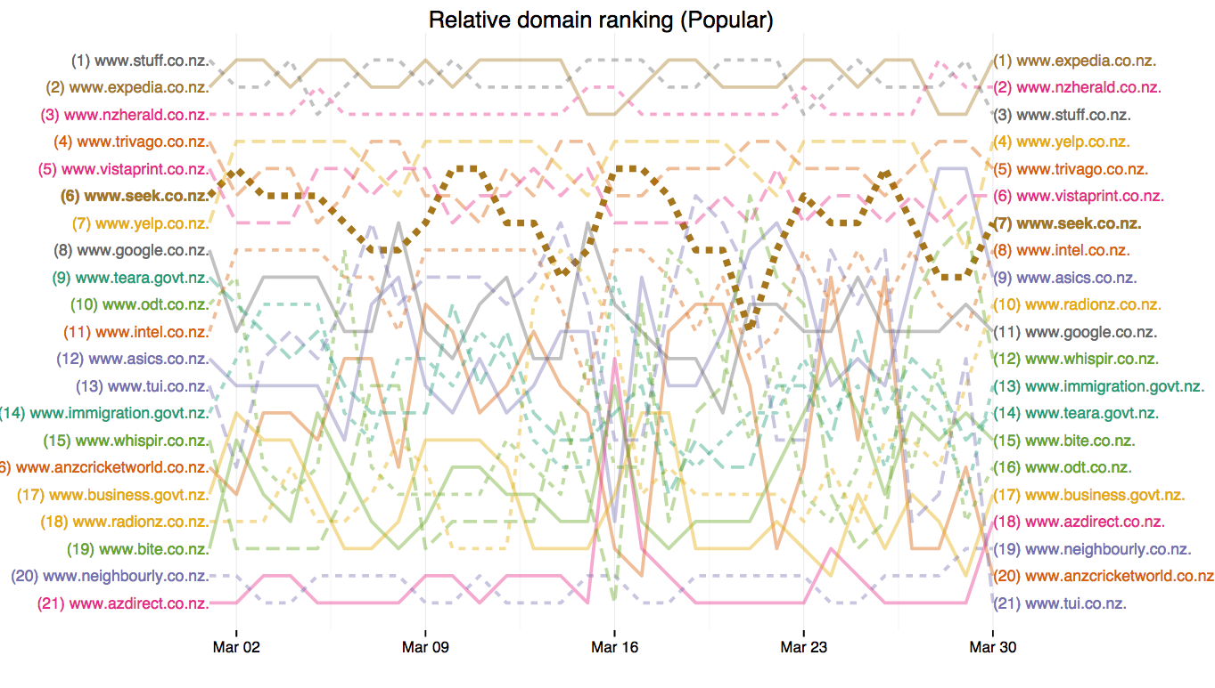
Pretty pictures

Slide 7
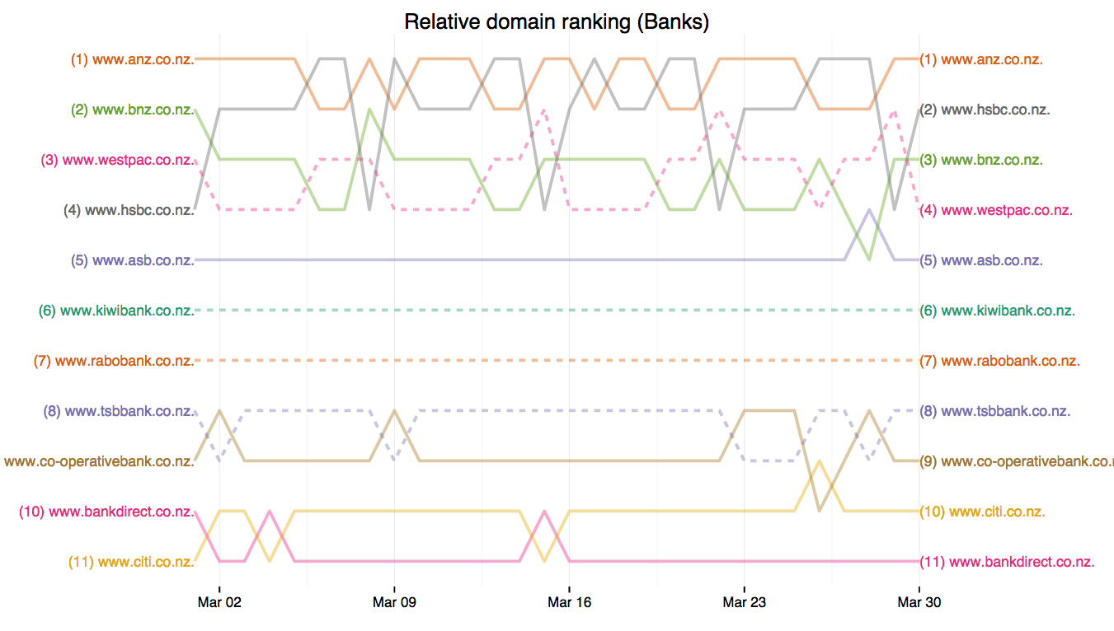
More pretty pictures

Slide 8
Interactive visualization demo
Bump chart, evolution of ranking across time
Inspired from http://datatodisplay.com/demonstrations/co2/
Bank ranking http://domain-rank.nzrs.net.nz/bank.html
Popular ranking http://domain-rank.nzrs.net.nz/popular.html

Slide 9
ToDo List
Evaluate how TTL affects the results
Explore other query name and type combinations
Compare this to some “ground truth”
Possibly identify addresses by “role” and give different weight to well known sources
For example, using Verisign’s idea about source address clustering
Make code available for analysis and visualization

Slide 10
Thanks for your attention
sebastian@nzrs.net.nz

