Slide 2
Drilling down into DNS DDoS Data Amsterdam, May 2015
Ralf Weber

Slide 3
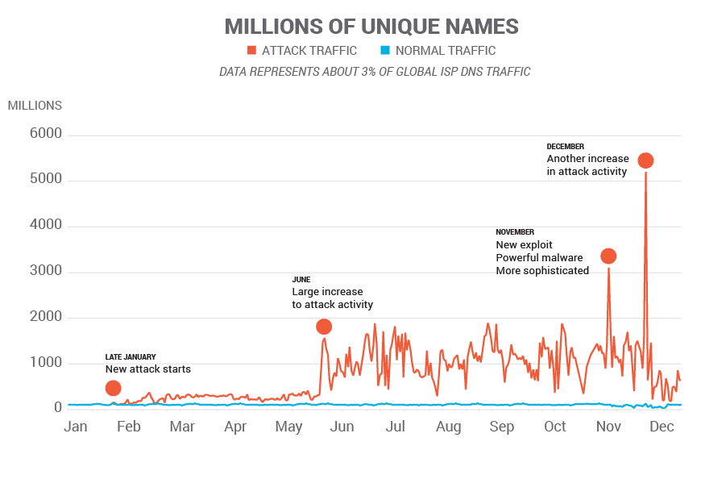
2014 Random Subdomain Attacks
2014 Data

Slide 4
2015 – Quieter in Some Ways
2015 Data
All quiet???
JAN
FEB
MAR
APR

Slide 5
Observations
4 major categories of attacks distinguished by:
Randomization algorithms
Use of open DNS proxies or bots
Traffic patterns – intensity, duration, ToD
Domains attacked
LOTS of other attack activity out in the long tail

Slide 6
Observations
Use of open resolvers/proxies still predominates
Installed base around 17M
Trend toward more stealthy attacks
Only send enough traffic to bring down authorities
Highly distributed attacks – 1000s of open resolvers
Often low intensity per IP
Interesting recent example: www.appledaily.com

Slide 7
Observations
Bot based attacks
Tend to be few IPs - tens to hundreds
High to very high intensity per IP - Up to 1000s of QPS/IP - Long tail with lower QPS
Recent interesting example: rutgers.edu

Slide 8
Remediation is Needed
Considerable stress on DNS infrastructure:
Resolvers Queries require recursion Working around failed or slow authorities Stress concentrates as authorities fail
Authorities Unexpopected spikes exceed provisioned limits
New rate limiting approaches
Limit traffic to authorities
Ingress filtering
Drop incoming queries based on policy

Slide 9
Testing Efficiency of Rate Limiting
Authoritative
Server
Internet
Attack Traffic
ISP Resolver
User traffic

Slide 10
Testing Efficiency of Rate Limiting
Authoritative
Server
Internet
Authoritative Outbund rate limiting
Attack Traffic
ISP Resolver
Inggess policy based filtering
User traffic

Slide 11
Setup for Testing Rate Limiting
Test impact of outbound rate limiting different software
BIND
Power DNS
Unbound
Vantio CacheServe
Auth Server only answers at a certain rate
Two domains (one at 100qps, one at 1 qps)
Domains only have one authoritative server
Normal User traffic gets 100% replies
Insert Attack Traffic
This will overflow the auth server rate

Slide 12
Test Method: HW, Resolvers, Traffic Sources
Server HW
Intel E5-2690V2, 20 cores/40 threads,
128 GB, 4TB disks
10 Gig Ethernet, 4G Internet connection
dnsperf - simulate “normal” customer traffic
10kqps: normal traffic, sampled from Euro ISP
100 qps: traffic for 2 domains (99 + 1) being attacked
tcpreplay – simulate attack traffic
2 * 5,000 qps for two domains, result is Nxdomain

Slide 13
Test Method: Execution
Run all traffic for 15 minutes
Do a couple of runs to
Preload cache
Rule out problems at one point in time
This is running over the Internet
Packet Loss is expected
Test server to auth has a ~150ms round trip
Count packets
At machine running dnsperf
At authoritative server

Slide 14
Test Diagram
Redwood City, CA
Regensberg, Germany
good traffic
10kqps background
100qps for test domains
2 domains
being attacked
dnsperf
Authoritative
Servers
Resolver
tcpreplay
other
resolutions
100qps
1qps
attack traffic
2 * 5000 qps for
two domains
Rate limits should not be hit for normal traffic
Resolver and authoritative servers record traffic

Slide 15
Run good traffic: User results

Slide 16
Run good traffic: Test domains results

Slide 17
Run good traffic: Authoritiative Server Results

Slide 18
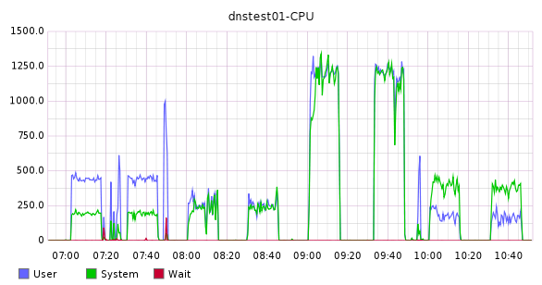
System Stats
Bind
Vantio
Power DNS
Unbound

Slide 19
Run attack traffic – Compare with normal
Notes:
Around 16% Servfail that will be noted by users

Slide 20
Run protected attack traffic: User results

Slide 21
Run good traffic: User results

Slide 22
Run protected attack traffic: Test domains results

Slide 23
Run good traffic: Test domains results

Slide 24
Run protected attack traffic: Authoritiative Server Results
Notes:
Bind unprotected issued only 2 million queries

Slide 25
Run good traffic: Authoritiative Server Results

Slide 26
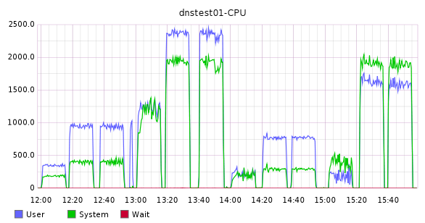
System Stats
Bind
Unbound
Vantio
Power DNS

Slide 27
Results: Resolver Traffic 9,000,000 queries
Resolver | Test run | Type | No Error | NXDomain | Lost | Servfail
Vantio | 3 | Good | 8987622 | 12248 | 74 | 56
 | 5 | Attack | 8988291 | 11576 | 100 | 33
ingress filter | 7 | Attack | 8978049 | 20668 | 1142 | 141
PDNS | 3 | Good | 8989007 | 9477 | 94 | 1422
 | 5 | Attack | 8986967 | 8767 | 2868 | 1398
Bind | 3 | Good | 8986205 | 11537 | 231 | 2027
 | 5 | Attack | 8985913 | 11571 | 371 | 2145
unprotect | 7 | Attack | 7497150 | 19291 | 5436 | 1478123
Unbound | 8 | Good | 8982254 | 17309 | 287 | 150
 | 9 | Attack | 8975942 | 17114 | 901 | 6043

Slide 28
Results: Attack domains
Software | Test Run | Type | No Error | Lost | Servfail | Auth Noerror | Auth NXDomain | Auth Dropped
CS7 | 3 | Good | 89970 | 0 | 30 | 8997 | 0 | 0
 | 5 | Attack | 1450 | 0 | 88550 | 145 | 93684 | 80790
ingress filter | 7 | Attack | 899950 | 0 | 50 | 8998 | 0 | 0
PDNS | 3 | Good | 89929 | 0 | 71 | 8995 | 0 | 0
 | 5 | Attack | 807 | 1395 | 87798 | 99 | 16317 | 62131
Bind | 3 | Good | 90000 | 0 | 0 | 9000 | 0 | 0
 | 5 | Attack | 560 | 2 | 89438 | 56 | 7683 | 6670
unprotect | 7 | Attack | 3310 | 160 | 86530 | 332 | 94315 | 2538256
Unbound | 8 | Good | 90000 | 0 | 0 | 16401 | 0 | 0
 | 9 | Attack | 4311 | 6 | 85584 | 910 | 48110 | 417843

Slide 29
Take aways
Random subdomain attacks can affect normal user traffic
Outbound rate limiting protections works great for non affected traffic
Outbound rate limiting does not protect the attacked domain
Ingress list based filtering does

Slide 30
Recent Attacks: www.appledaily.com.tw
April 30 2015
Alexa Rank – 574
Attack lasted ~10 hours
Used open home gateways
Also widely publicized attacks Summer 2014

Slide 31
Flying Under the Radar
{random}.www.appledaily.com.tw sample 40 mins of traffic
Total queries 735M
Total clients 10.6M
Attack queries 37.9M (5.15%of total)
Attack clients 79.7 thousand (0.75% of total)
Average QPS per attacking client = .2

Slide 32
Recent Attacks: rutgers.edu
April 28, 2015
Alexa Rank 3,805
Many earlier attacks
{random}.rutgers.edu Sample 60 mins traffic
Total queries 1.01 Billion
Attack queries 19.1 Million
Total clients 11.1 Million
Attack clients 238
Average QPS per client = 22

Slide 33
Challenge: Protecting Good Traffic
Whitelist to protect legitimate queries
Blocklist to eliminate malicious traffic
www.appledaily.com.tw.
liebiao.800fy.com.
www.23us.com.
wuyangairsoft.com.
*. www.appledaily.com.tw.
*. liebiao.800fy.com.
*. www.23us.com.
*. wuyangairsoft.com.

Slide 34
Examples
Query: www.appledaily.com.tw.
Answered, protected by whitelist
Query: avytafkjad.www.appledaily.com.tw.
Blocked by blocklist
Query: www2.appledaily.com.tw.
Answered through normal resolution

Slide 35
Summary
Constant DNS Based DDoS evolution
Open Home Gateways remain a problem
Malware-based exploits create broad exposure
Not clear where attacks are headed
Evidence attackers refining techniques
Remediation needs to be undertaken with care
Clients want answers!!
Critical to protect good traffic

