Slide 1
Root Zone KSK: The Road Ahead
Edward Lewis | DNS-OARC & RIPE DNSWG | May 2015
edward.lewis@icann.org

Slide 2
Agenda
Setting the scene
Change of Hardware Security Modules (HSMs)
Roll (change) the Key Signing Key (KSK)
The big finish
Notes:
This is a simpler agenda slide, the outline for your presentation.

Slide 3
Background
Root Zone KSK
The trust anchor in the DNSSEC hierarchy
Has been in operation since June 2010
With no roll of key itself
And with no change of HSM (until April 2015)
"After 5 years of operation"
Concerns over HSM (hardware) battery life
Requirement to roll the KSK

Slide 4
The Players
Root Zone Management Partners
Internet Corporation for Assigned Names and Numbers (ICANN)
U.S. Department of Commerce, National Telecommunications and Information Administration (NTIA)
Verisign
External Design Team for KSK roll
ICANN
Performs DNSSEC and KSK functions (plus others) in accordance with the IANA functions contract

Slide 5
What is a...
KSK
Key-Signing Key signs DNSKEY RR set
Root Zone KSK
Public key in DNS Validator Trust Anchor sets
Copied everywhere - "configuration data"
Private key used only inside HSM
HSM
Hardware Security Module
Specialized hardware
Operates KSK
Prevents exposure of private key

Slide 6
Public Impact
HSM change
Not much impact to the public
So long as they work, they are unseen
Concerns that existing set is growing old
Specifically the internal battery
KSK roll
Large impact (on those validating)
Anybody operating a validator has it now
All copies need to be updated
Trusting the new KSK is work to be done

Slide 7
Goal for today
This presentation is intended to
Inform
Stir reaction and feedback
Call attention to a coming ICANN Public Comment Period on KSK roll
Two means for feedback
Informal via mic and mail list, comments picked up by KSK roll Design Team
Formal via an upcoming ICANN Public Comment period (to be announced)

Slide 8
HSM Change (or "Tech Refresh")
Straightforward Replacement
Same brand, newer model
Culpeper, Virginia, USA Facility
Ceremony XXI on April 9, 2015 (went flawlessly)
El Segundo, California, USA Facility
Ceremony XXII planned for August 13, 2015
Documented Plan
https://www.icann.org/news/announcement-3-2015-03-23-en

Slide 9
KSK Roll
Compared to HSM change
Greater public impact
Various options to consider
Approach
ICANN Public Consultation (2012)
Previous engineering effort (2013)
Current external design team (2015)

Slide 10
Milestones
Current Design Team Plan
Study, discussion until June
Present report for ICANN Public Comment
One month, covering ICANN 53
One month to prepare final report
Root Zone Management Partners then develop a plan and execute

Slide 11
Design Team Roster
Joe Abley
John Dickinson
Ondrej Sury
Yoshiro Yoneya
Jaap Akkerhuis
Geoff Huston
Paul Wouters
Plus participation of the aforementioned Root Zone Management Partners

Slide 12
In theory
On paper...
The industry collective wisdom is fairly mature
There have been many KSK rolls before
What works, breaks has been experienced
But the Root Zone KSK is different
Other KSK rolls inform the parent (or DLV)
A new root KSK has to be updated everywhere
Mitigated by RFC5011's trust anchor management

Slide 13
In practice
...but...
Any plan will face external challenges
Will validators have trouble receiving responses during the roll? (Fragmentation issues)
Are automated trust anchor updates implemented correctly?
Will operators know how to prepare, how to react?
Will all DNSSEC code paths perform correctly?

Slide 14
A Discussion with the Design Team
This presentation is to inform and invite participation
Concerns of the design team
MTU, IPv4 and IPv6 fragment handling
Alternate algorithm to RSA-SHA256
RFC 5011 and Trust Anchor maintenance
So, now, with members of the design team
What concerns do you have?
What comments do you want to add?

Slide 15
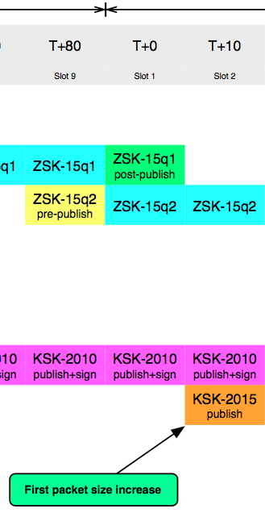
Potential Step 1 – Pre-publish new KSK (2015)

Slide 16
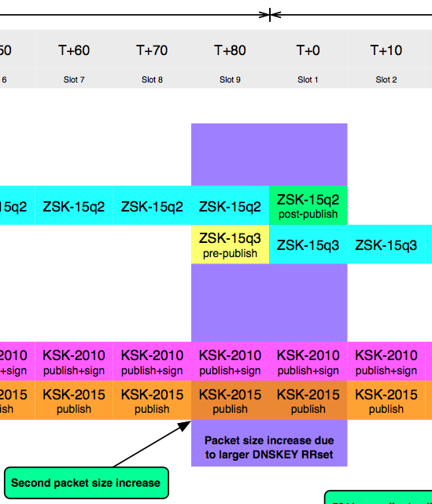
Potential Step 2 – Regular ZSK Roll

Slide 17
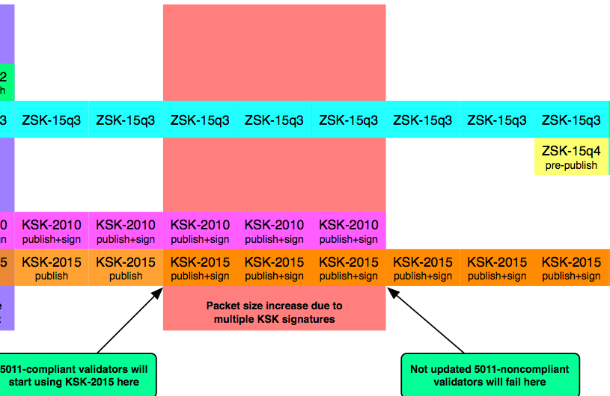
Potential Step 3 – Removal of old KSK (2010)

Slide 18
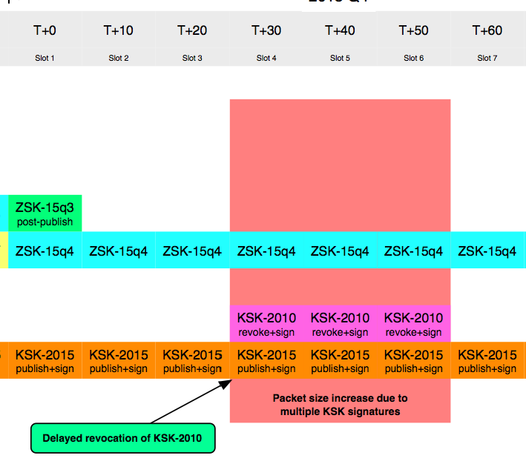
Potential Step 4 – Revoke 2010 after ZSK roll

Slide 19
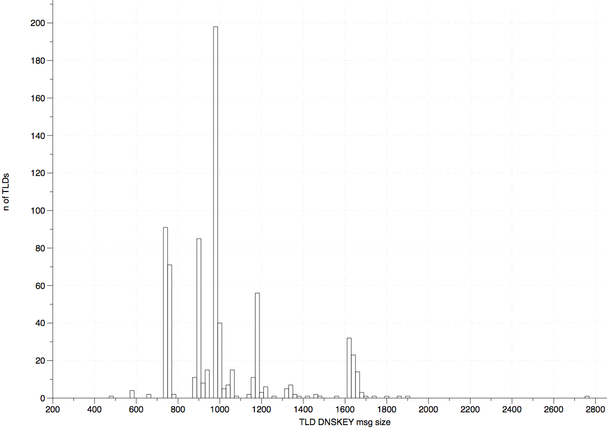
Recently Measured DNSKEY Response Sizes (TLD)
One 2048b KSK, One 1280b ZSK, two signatures
512Bytes
1500 Bytes
One outlier

Slide 20
DNSSEC Links
http://www.iana.org/dnssec
http://www.root-dnssec.org
http://www.verisigninc.com/assets/dps-zsk-operator-1527.pdf

