Slide 1
A study of caching behavior with respect to root server TTLs
Matthew Thomas, Duane Wessels
October 3rd, 2015

Slide 2
RSSAC003 – RSSAC Advisory on Root zone TTLs
Consider the extent to which:
  (1) the current root zone TTLs are appropriate for today’s environment
  (2) lowering the NS RRset TTL makes sense
  (3) the impacts that TTL changes would have on the wider DNS
Work party volunteers:
  Duane Wessels, Warren Kumari, Jaap Akkerhuis, Shumon Huque, Brian Dickson, John Bond, Joe Abley, and Matthew Thomas
Full report published September 16th, 2015
  https://www.icann.org/en/system/files/files/rssac-003-root-zone-ttls-21aug15-en.pdf

Slide 3
RSSAC003 – RSSAC Advisory on Root zone TTLs
1. Document the history of TTLs in the root zone
2. Obtain a measure for TLD managers’ technical preferences for NS and DS TTLs by surveying what those managers have published in TLD zones.
3. Survey "max-cache-ttl" parameters of various recursive implementations
4. Analyze DITL data for the extent that recursive resolvers honor TTLs
5. Study interactions between the SOA refresh timer and serving stale data

Slide 4


Waiting for a TTL to expire in theory
http://dnsreactions.tumblr.com/post/127469871134/waiting-for-a-2-day-ttl-to-expire

Slide 5
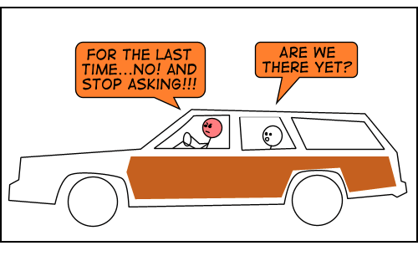
Waiting for a TTL to expire in the real world…
. 518400 IN NS a.root-servers.net.
. 518400 IN NS b.root-servers.net.
. 518400 IN NS c.root-servers.net.
….
dig @a.root-servers.net . ns

Slide 6
DITL Data
Year | A | B | C | D | E | F | G | H | I | J | K | L | M
2014 | X |  | X |  | X | X |  | X | X* | X | X |  | X
2015 | X | X* | X |  |  | X |  | X | X* | X | X | X | X
Data Caveats
I-Root & B-Root data removed due to anonymization.
Obvious spoofed IP ranges removed.
Data stored in PCAP files partitioned by root operator.
In order to obtain measurements, we need to massage the raw DITL data into a more optimal format…

Slide 7
Grouping, Sorting, and Measuring DITL
T₁
T₂
IP₁
TLD₁
TLD₂
T₃
IP₂
TLD₁
Time
Group by IP address and TLD
Sort by Time
Measure elapsed time between queries for group
  Use median of distribution of inter-query time deltas

Slide 8
Some basic inter-query DITL measurement stats
 | 2014 | 2015
Roots Analyzed | 8 | 8
Delegated TLDs at DITL Collection | 534* | 905*
IP-TLD Observations | 106MM | 165MM
Inter-query Time Measurements | 8.75B | 18.27B
Observed IPs | 9.78MM | 11.03MM
* Includes “.” and “root-servers.net.”
As one might expect, the data follows exhibits a long tail distribution…

Slide 9
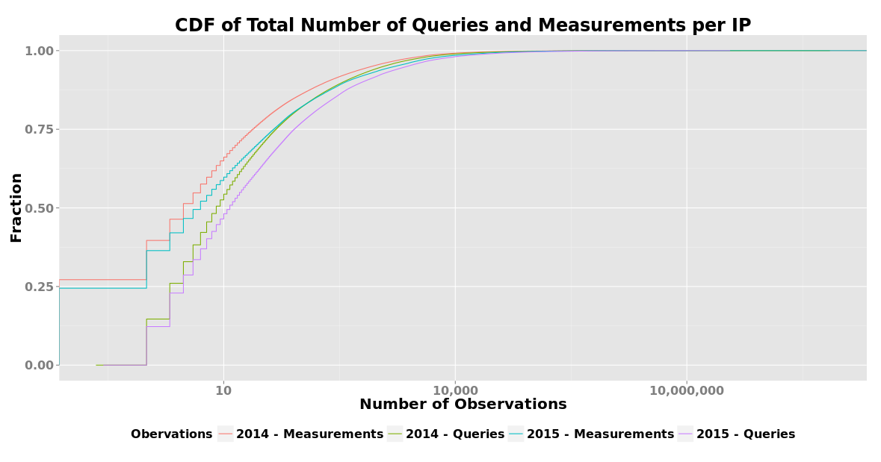



Queries and Measurements by IPs
~65% of IPs have 10 or fewer Measurements

Slide 10
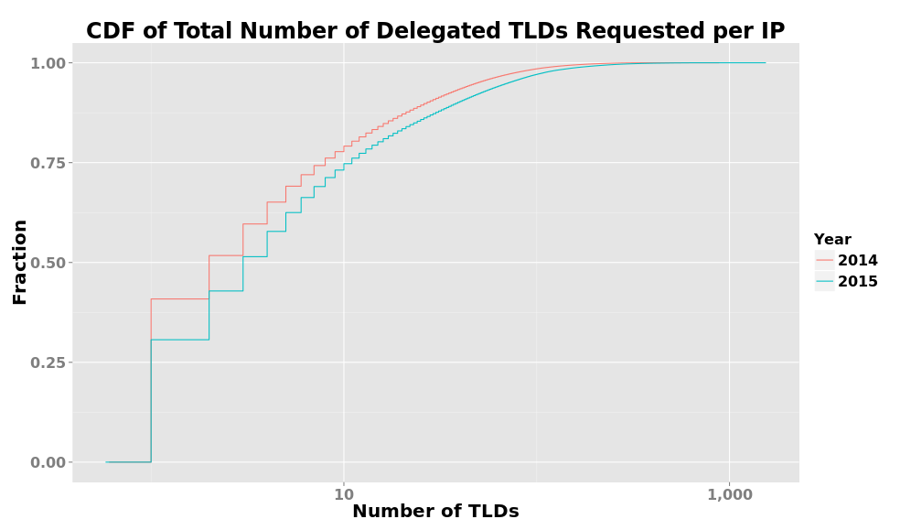
Delegated TLDs Requested by IP

Slide 11
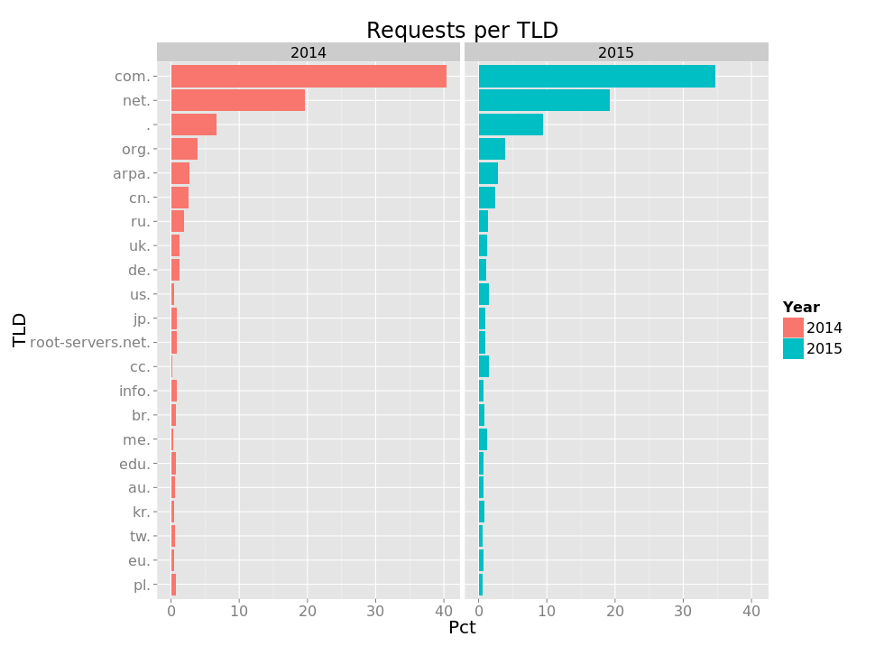
Total Requests by TLD

Slide 12
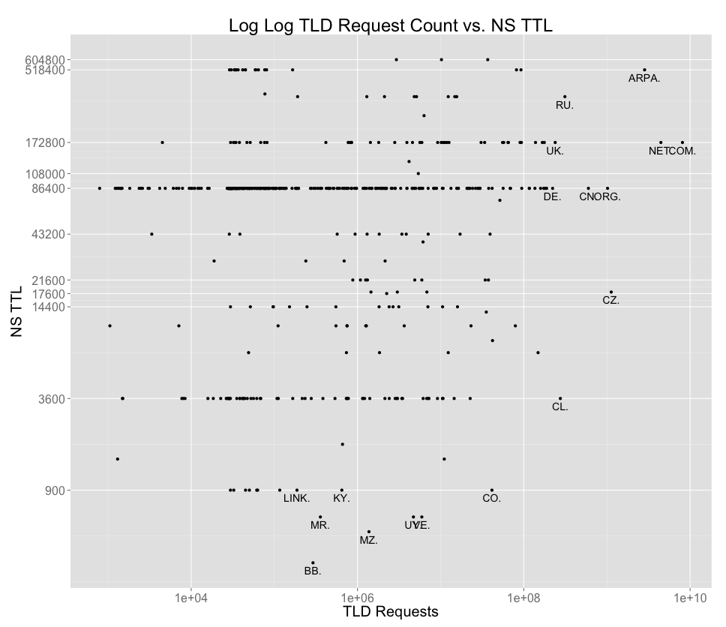
Total Requests by TLD vs. NS TTL (2014 DITL)

Slide 13
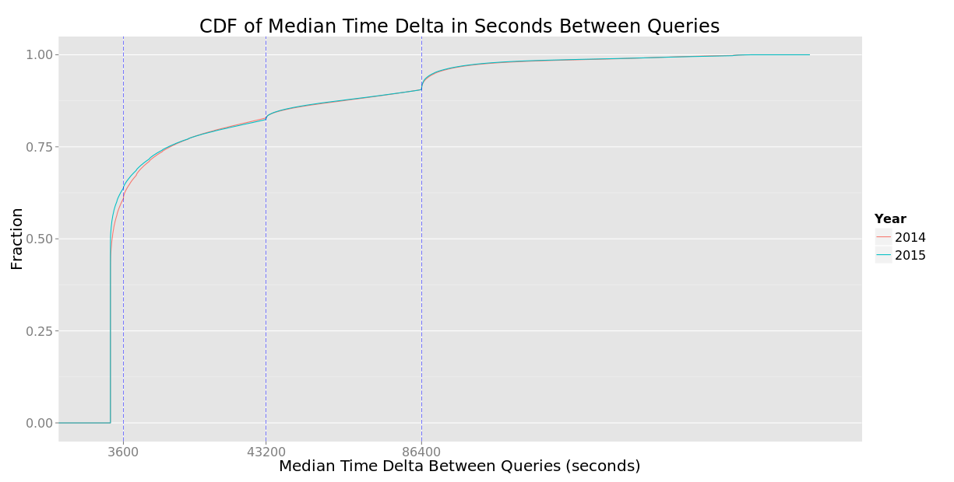
General Inter-Query Delay at the Roots

Slide 14
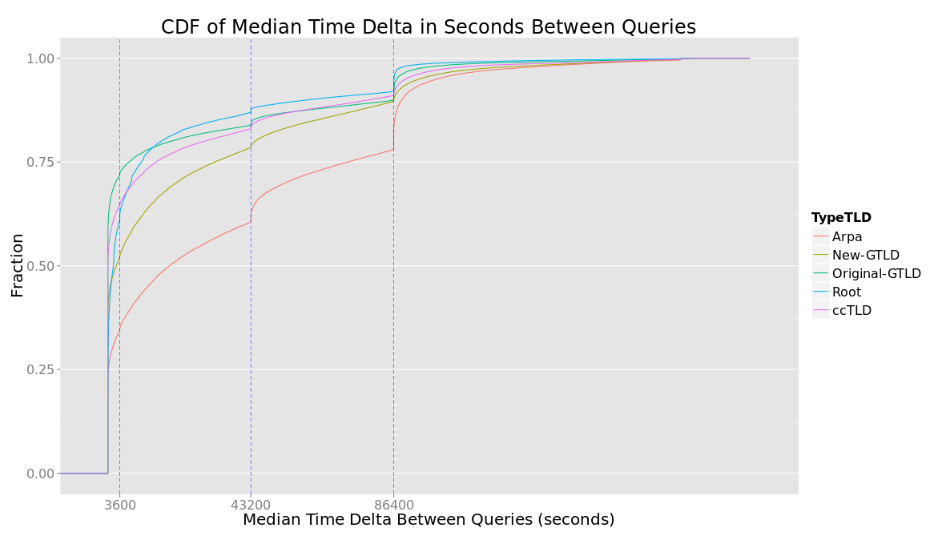
Inter-Query Delay at the Roots by TLD Type (2015)

Slide 15
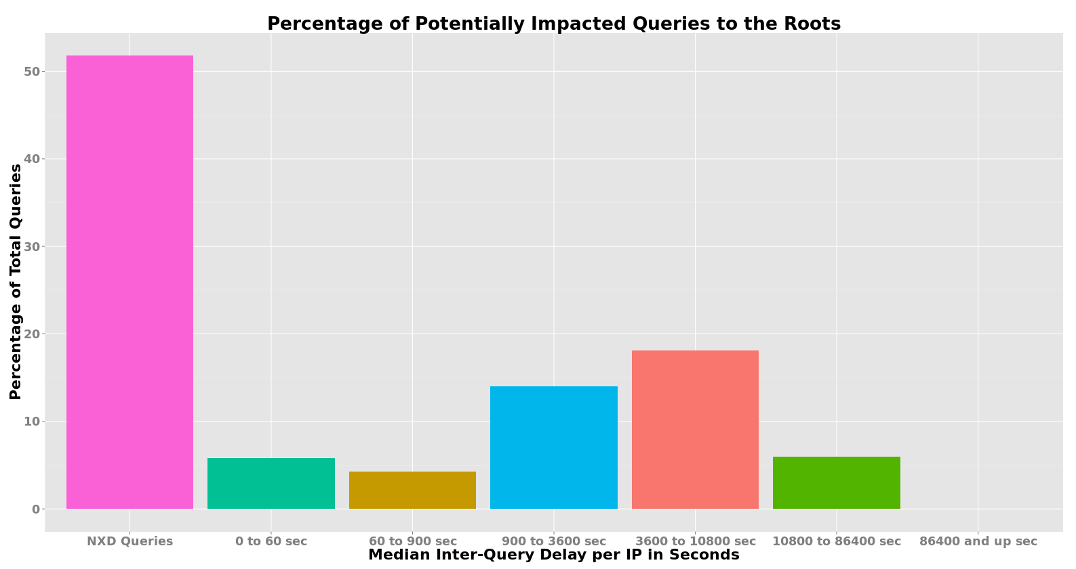
Potential Impacts by Altering Root TTLs

Slide 16
Surveying “max-cache-ttl” behavior of large Open Recursive Name Servers

Slide 17
max-cache-ttl
Popular caching name servers have a “Max TTL” setting
Not specific to Root or any other zone.
Learning what we can about popular recursive services might inform authoritative TTL choices.

Slide 18
Survey Technique
Write custom name server (thanks ldns!)
Send TXT queries under zone ‘epoch.verisignlabs.com’ to open recursives
Return TXT response with time-of-query in rdata and a 10-day TTL:
[dwessels@nfarnsworth ~]$ dig a4x90f8.epoch.verisignlabs.com TXT
;; ANSWER SECTION:
a4x90f8.epoch.verisignlabs.com. 604800 IN TXT "At the tone, the time will be 1442263295. Beep!"
Repeat same query later
Measure time-in-cache for a particular response
Plot time-of-measurement vs returned-TTL

Slide 19
UltraDNS
8 Unique cached records

Slide 20
Dyn
13 Unique cached records

Slide 21
OpenDNS
104 Unique cached records

Slide 22
Google
250 Unique cached records

Slide 23
Google - Hourly

Slide 24
An Extreme Case
; <<>> DiG 9.9.5-3ubuntu0.2-Ubuntu <<>> @8.8.8.8 rssac.epoch.verisignlabs.com txt
; (1 server found)
;; global options: +cmd
;; Got answer:
;; ->>HEADER<<- opcode: QUERY, status: NOERROR, id: 61987
;; flags: qr rd ra; QUERY: 1, ANSWER: 1, AUTHORITY: 0, ADDITIONAL: 1
;; OPT PSEUDOSECTION:
; EDNS: version: 0, flags:; udp: 512
;; QUESTION SECTION:
;rssac.epoch.verisignlabs.com. IN TXT
;; ANSWER SECTION:
rssac.epoch.verisignlabs.com. 20691 IN TXT "At the tone, the time will be 1432182858. Beep!"
;; Query time: 8 msec
;; SERVER: 8.8.8.8#53(8.8.8.8)
;; WHEN: Thu May 21 05:56:32 EDT 2015
;; MSG SIZE rcvd: 118
Thu May 21 05:56:32 EDT 2015 = 1432202192
1432202192 - 1432182858 = 19334
TTL should be 21600 - 19334 = 2266
TTL is 5+ hours larger than expected

Slide 25
Conclusions
Difficult measurement due to data size, tools available and duration of DITL collection window.
Root zone TTLs appear to not matter to most clients.
  Largest variations in TTL adherence observed at TLD level
Traffic to root name servers would change very little if TTLs were reduced to 1 day.
Popular open recursive name servers cache for 1 day or less.

