Slide 1
Real World Impacts of EDNS Client Subnet
Brian Hartvigsen
Manager, Site Reliability Engineering

Slide 2
I see you’re in SEA, we have a DC there…
youtube.com
youtube.com
Google SEA
Google SEA
Google
SJC
ISP
SEA
Me
BOI
youtube.com
Google
SJC
Google
SEA

Slide 3
I see you’re in DFW, we have a DC in SJC…
youtube.com
youtube.com
OpenDNS
DFW
Google SJC
Google SJC
Google
SJC
ISP
SEA
Me
BOI
youtube.com
Google
SJC
Google
SEA

Slide 4
A Short History
Draft for EDNS Client IP sent to DNSOP
Many CDNs & DNS server software add support
Akamai announces support when using OpenDNS or Google
Renamed EDNS Client Subnet
2010
2011
…
2015
Google/OpenDNS both using option code 0x50FA
Announcement of Global Internet Speedup Initiative
Option code 0x08 assigned
Notes:
Global Internet Speedup Initiative announced
Google, OpenDNS
Bit Gravity, CDNetworks, Cloudflare, Comodo, Edgecast
PowerDNS (), gdnsd (1.5.3 / 2011-06-03), Knot DNS (1.5.0 / 2014-06-06)
Unbound (contrib patch)
BIND (unofficial patches)
dnspython (dnspython-clientsubnetoption / 2012-09-19)
2014-06-03 OpenDNS & Akamai are talking EDNS client subnet

Slide 5
I see you’re asking for BOI, SEA is good!
youtube.com
(for BOI)
youtube.com
OpenDNS
DFW
Google SEA
Google SEA
Google
SJC
ISP
SEA
Me
BOI
youtube.com
Google
SJC
Google
SEA

Slide 6
A Couple Notes on OpenDNS’ implementation
Whitelist Only
Not accepted from client side
Fixed scope, manageable via configuration

Slide 7
The Setup
Mirror production traffic to 2 resolvers
Identical traffic
~2 weeks of data
Enable ECS on only 1
Monitor

Slide 8
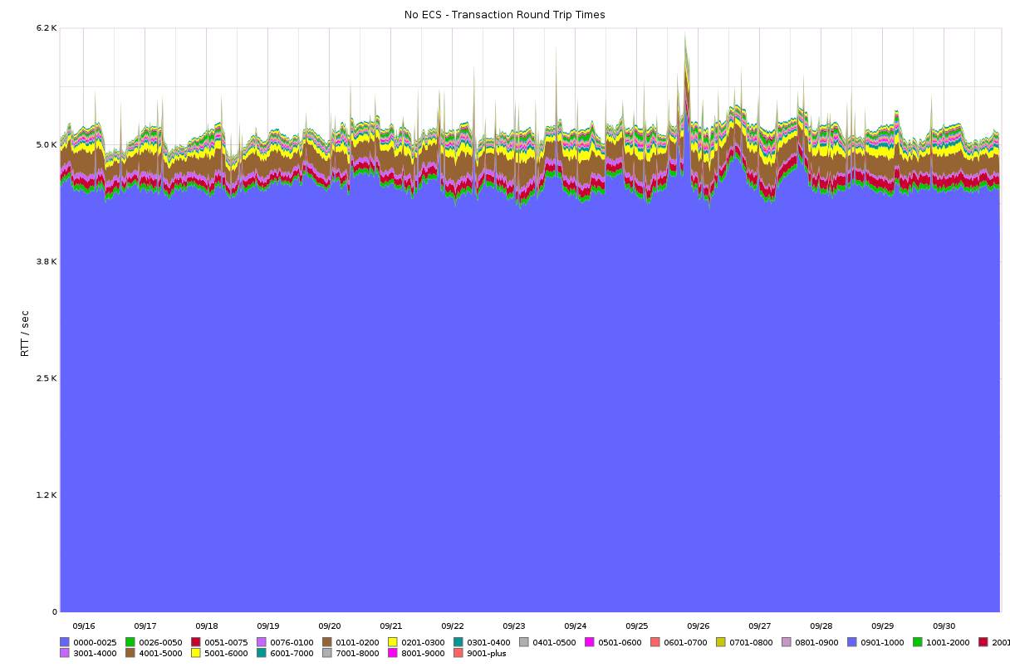
Start from the user’s perspective
Biggest measure is RTT
~5000 qps
~85% <25ms
~95% <300ms

Slide 9
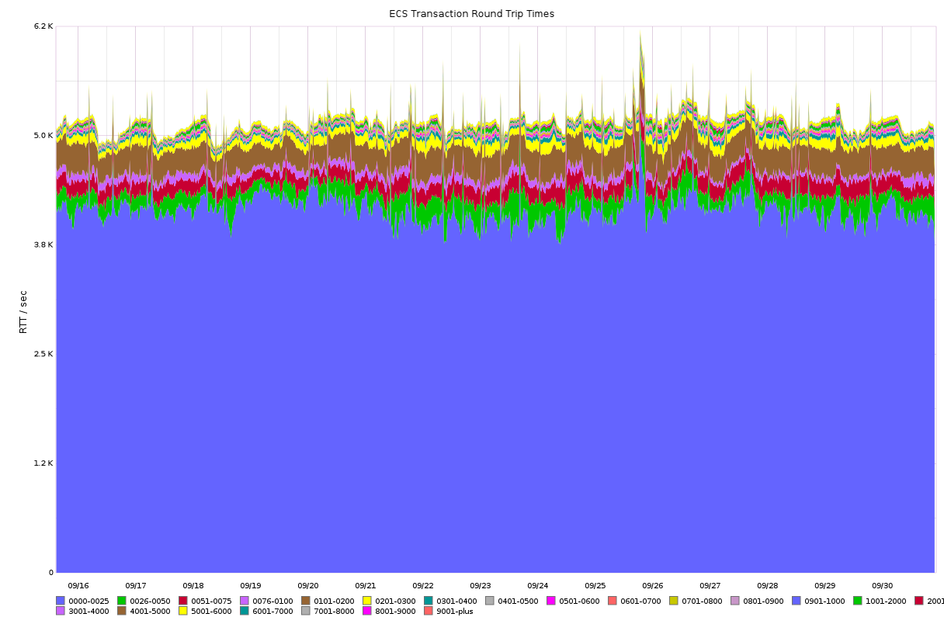
Still ~95% <300ms
But only ~80% <25ms
More jitter in RTT

Slide 10
Cache Hits vs Cache Misses
Cache Miss is no data or record with non-matching ECS info
Every failed lookup = 2 + n number of misses
n = number of possible ECS enabled records that won’t match (max 16,777,215)
Store ECS ability as a special record in the cache
Every successful lookup == 2 cache hits (special record + actual record)

Slide 11
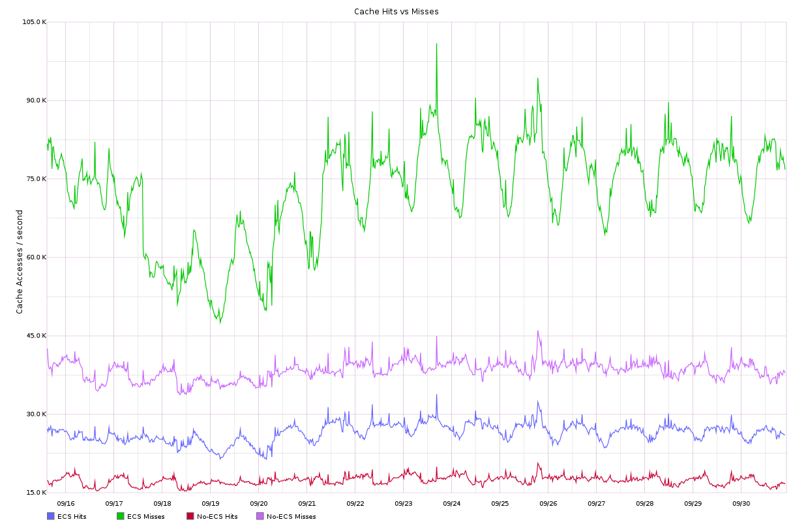

Slide 12
Cache Churn
Fixed cache size per resolver
Allocate all available memory
Bi-directional linked list
Measure cache “cycle”
How often we run out of room in the cache to store something

Slide 13
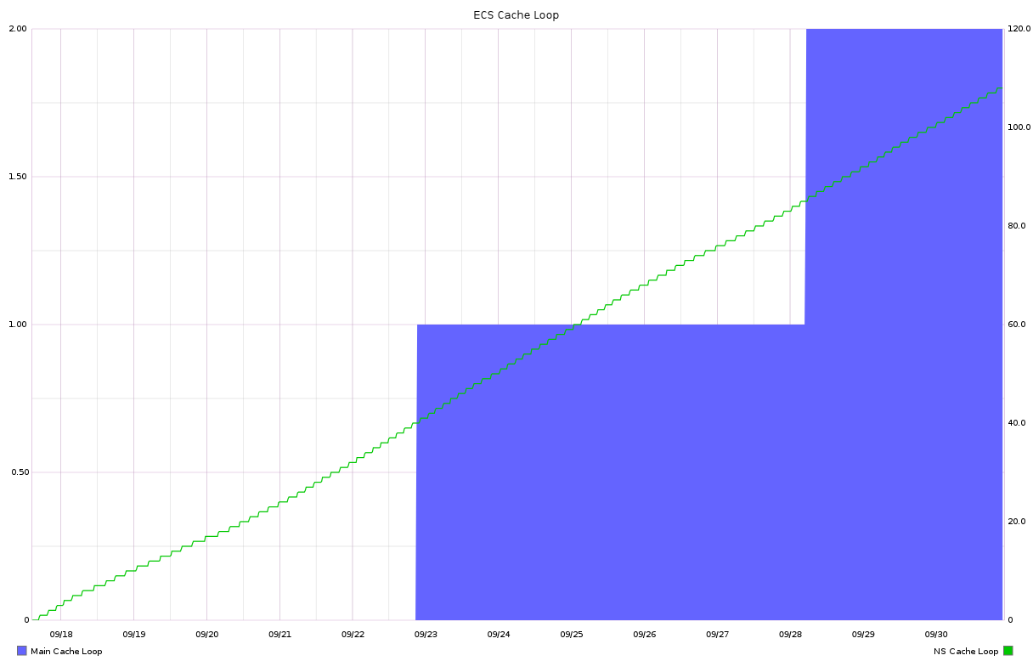
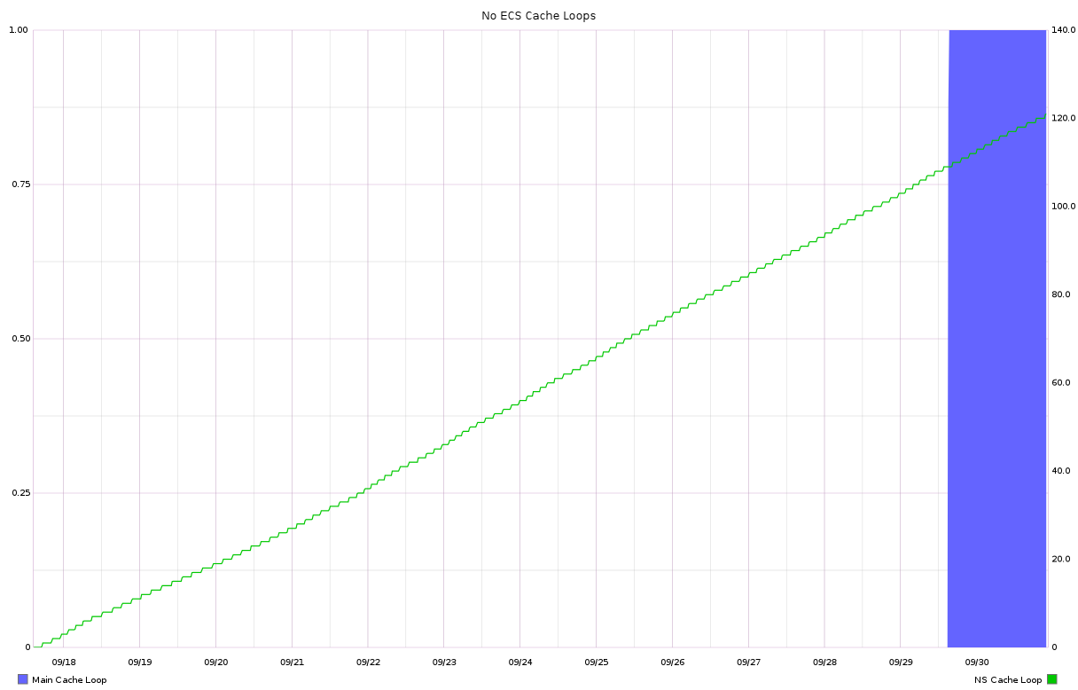

Slide 14
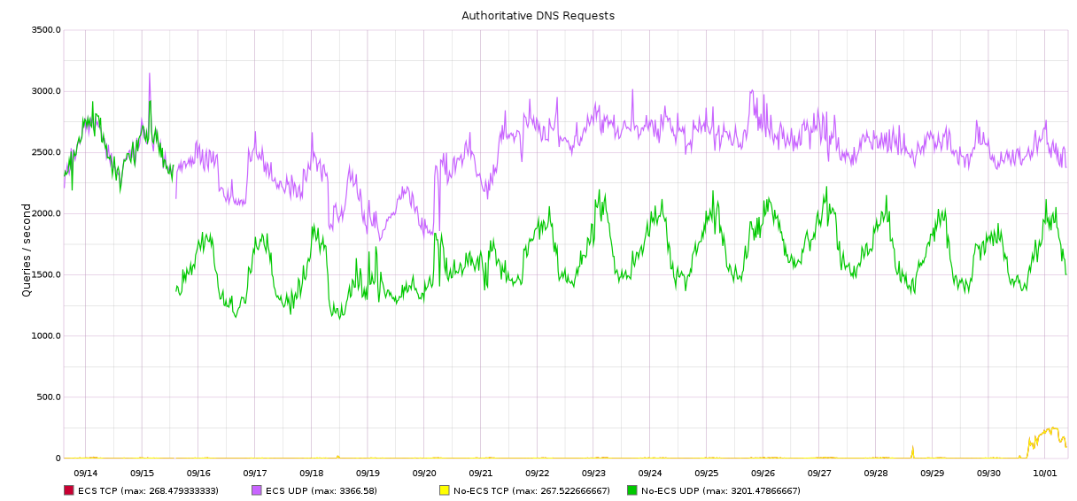
Moving upstream

Slide 15
Bumps in the Road
Malformed responses
Common one was getting back additional 0 bits in address
Remember to chop it to NETMASK

Slide 16
Bumps in the Road
Different A records for nameservers w/ ECS
example.com NS ns1.example.com
ns1.example.com A 192.0.2.53 (for 1.2.3.0/24)
ns1.example.com A 192.0.2.153 (for 1.2.4.0/24)
ns1.example.com A 192.0.2.253 (no ECS)
Which records should you use when resolving www.example.com for 1.2.3.0/24?
Discussion and clarification around this is welcome

