Slide 1



Klik om de stijl te bewerken
Klik om de modelstijlen te bewerken
  Tweede niveau
    Derde niveau
      Vierde niveau
        Vijfde niveau
DNS Big Data Analytics
DNS-OARC Fall 2015 Workshop
October 4th 2015
Maarten Wullink, SIDN
Wie zijn wij? | Mijlpalen | Organisatie | Het huidige internet | Missie - Visie | Diensten | Referenties | Samenvatting
1

Slide 2
SIDN
Domain name registry for .nl ccTLD
> 5,6 million domain names
2,45 million domain names secured with DNSSEC
SIDN Labs is the R&D team of SIDN
Notes:
- Sidn is the domain name Registry for the .nl cctld and is responsible for the registration and delegation of .nl domain names.
- With 5,5 million names the 7th largest TLD
- 2,4 million .nl domain names are secured with DNSSEC. This makes the .nl zone the largest DNSSEC secured zone in the world.
I am also a part of sidn labs, which is the r&d team of sidn

Slide 3
DNS Data @SIDN
> 3.1 million distinct resolvers
> 1.3 billion query's daily
> 300 GB of PCAP data daily
Notes:
- We are receiving queries from well over 3 million unique resolvers each month
- Together these resolvers send over 1,3 B query’s daily
- If we save all these queries with traditional pcap format then the compressed daily data volume would be about 300 GB
- Currently we are capturing about 10% of this data, some 130 M queries each day.
This data is stored in our big data platform.

Slide 4
ENTRADA
ENhanced Top-Level Domain Resilience through Advanced Data Analysis
Goal: data-driven improved security & stability of .nl
Problem: Existing solutions for analyzing network data do not work well with large datasets and have limited analytical capabilities.
Main requirement: high-performance, near real-time data warehouse
Approach: avoid expensive pcap analysis:
    Convert pcap data to a performance-optimized format (key)
    Perform analysis with tools/engines that leverage that
Notes:
For the purpose of capturing and analyzing DNS query data we have developed the ENTRADA platform.

Slide 5
Requirements
SQL support
Scalability
High performance
Capacity for >1 year of DNS data
Extensibility
Stability
Don’t spend too much money!
Notes:
After talking to potential users and budget holder we came up with a short list of requirements:
SQL support: for us is very important, for 2 reasons:
1- SQL knowledge is very widespread at SIDN and offers a quick adoption of a new platform.
2- Having a platform without SQL requires more support or dedicated developers to analyze the data
Scalability:
We want to start small with a research cluster and be able to grow to a lager production cluster.
Adding more compute and storage capacity to the system must be possible and cost efficient.
Performance: fast enough to support interactive querying of the data, not having to wait hours or days.
Capacity, mulit year storage and also analytics capacity.
Extensibility, be able to use multiple analytical engines
stability: failure of a harddrive or a server may not result in loss of data but temporary performance degradation is acceptable .
And finaly, we don’t want to spend too much money until this data has proven it’s value.

Slide 6
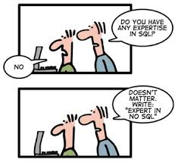
Query Engine Options
Engines galore!
Evaluated SQL and NoSQL solutions
Relational SQL (PostgreSQL)
MongoDB
Cassandra
Elasticsearch
Hadoop (HBASE + Apache Phoenix or Hive)
SQL on Hadoop (HDFS + Impala + Parquet)
Notes:
There are a lot of options available!
We need a solution optimised for writing once and reading many times.
Evaluated serveral types of databases:
- relational sql,
- nosql documentbased,
- hadoop Hbase
- hadoop Impala

Slide 7

SQL on Hadoop
Best fit for our requirements
Hadoop
Node N
Hadoop
Node N+1
Hadoop
Node N+2
IMPALA
IMPALA
IMPALA
PARQUET
PARQUET
PARQUET
HDFS
Notes:
we found SQL on Hadoop with Impala to be the best for our situation.
parquet is an efficient columnar storage format and contributes to perfomance requirement
Hadoop HDFS is a distributed filesystem. And contributes to the fault tolerance, redundancy and scalability requirement
Impala is a massively parallel processing query engine and contributes to performance and sql compatibility
When a query is executed it is distributed to all the nodes and each impala instance will process only the data local to the node.
Avoiding expensive network io

Slide 8
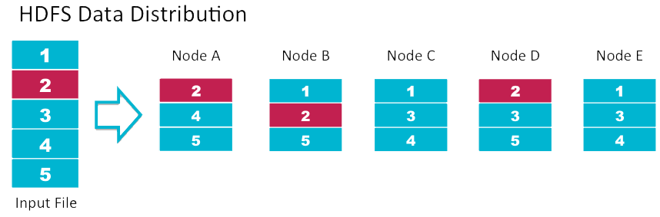
HDFS
Distributed file system for storing large volumes of data
High availability through replication of data blocks
Scalable to hundreds of PB’s and thousands of servers
Notes:
So how does HDSF work?
A files is split into blocks
Each block is stored on multiple nodes, default replication factor is 3x
failure of a disk or node does not cause data corruption or data loss.
data is replicated to another node.

Slide 9

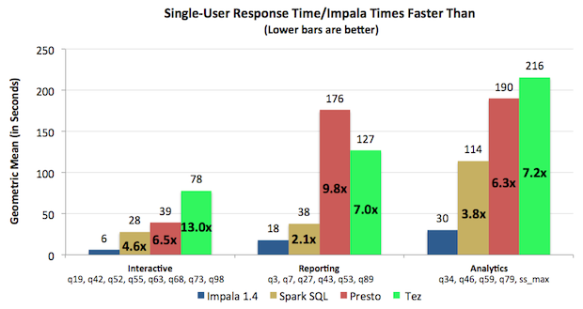
Impala query engine
MPP (massively parallel processing)
Inspired by Google Dremel paper
Provides low latency and high concurrency for BI/analytic queries on Hadoop
Excellent performance when compared to other Hadoop based query engines.
Notes:
Impala is a massively parallel query engine
Impala deamon is co-located on every hadoop node, so it can use data locality when processing a query
this means only data local to the node is crunched. No need to transfer big chunks of data across the network
Impala uses runtime code generation with LLVM to compile sql to native code for faster execution.

Slide 10
Impala (2)
Data formats
Text
Hadoop formats
Apache Avro
Apache Parquet
Interfaces
Web-based GUI
Command line (impala-shell)
Python (Impyla)
JDBC
Notes:
Multiple formats are supported, from textbased to binary and parquet columnar format
Impala has multiple interfaces to submit queries, from a webbased gui to programming api’s for python and java

Slide 11

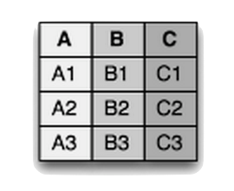


Apache Parquet
Why not just use the PCAP files?
  Reading (compressed) PCAP data is just too slow
  Analytical engines cannot read PCAP files
Columnar storage format
data
row oriented
column oriented
Notes:
So, why not just use pcap files?
1) Decompressing an reading pcap files is slow! Lots of CPU and IO required
2) Analytical engines cannot read PCAP files natively:
There is a RIPE library which can be used to query pcap files with Hive, but it is slow. It has to read the entire file
What is a columnar format anyway?
If we look at a normal data table with rows and columns
Normal row oriented database would:
Store the column values for each row sequentually
With a Columnar format
The column values are stored sequentually for each column.
Why is this a good thing?
1) This means the data is more homogeneous which helps with efficient encoding en compression of the data
2) When reading the data only those columns we are interested in have to be read, skipping all the others. This saves a lot of IO.

Slide 12
Apache Parquet (2)
Columnar storage allows for efficient encoding/compression
    multiple encoding schemes
    support for Snappy compression
Partition data (e.g. by year, month, day and server)
    Partition pruning allows Impala to skip data we are not interested in
Other analytical engines such as Apache Spark can use the same Parquet data.
Notes:
encoding
Parquet supports multiple types of encding such as dictionary and run-length encoding to write data more efficient.
Compression
Compression and especially decompression must be fast to avoid a perfomance hit
Google Snappy aims for high speeds and reasonable compression ratio.
It’s faster than gzip, but gzip compression ratio is better.
partition
Partition pruning allows impala to only read the data the user is interested in.

Slide 13
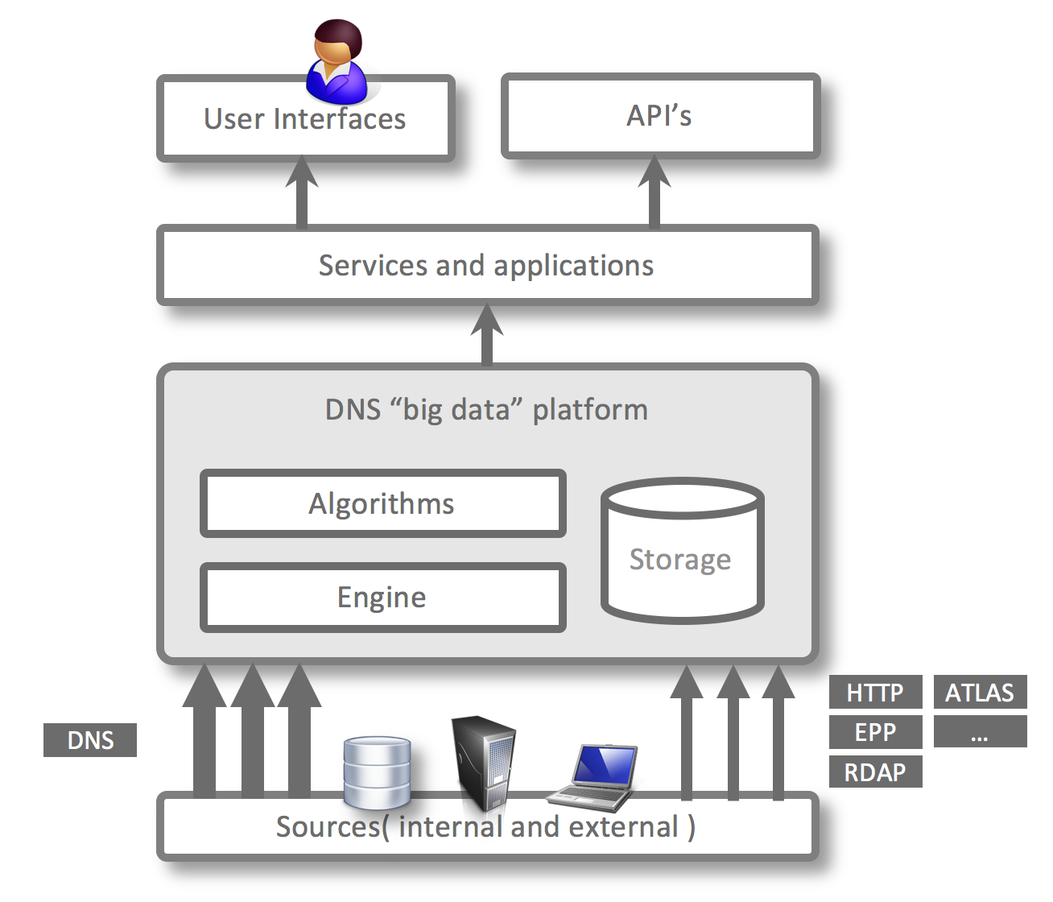
ENTRADA Architecture
  ‘DNS big data’ system
  Goal: develop applications and services that further enhance the security and stability of .nl, the DNS, and the Internet at large
  ENTRADA main components
    Applications and services
    Platform
    Data sources
    Privacy framework
Notes:
This is the Entrada highlevel architecture overview
Right now the only supported data source are DNS query data and ICMP data.
Other sources are also possible such as
- registration transactions of the domain name registration system.
- data from our sinkholes
The platform is composed out of:
A distributed storage layer
A distributed query engine
- Algorithms to perform data analysis
On top of this layer we are developing new applications and services.
The top layer contains externally available interfaces of the system:
- gui for interactive use
API for machine access

Slide 14

ENTRADA Privacy Framework
Download paper:
http://goo.gl/GvsfzQ
Policy elements:
• Purpose
• Data that is used
• Filters on the data
• Retention period
• Access to the data
• Type of application
(Research vs. Production)
Notes:
To Comply with the Dutch Data Protection Act we developed a privacy framework for dns big data. which Integrates legal, technical and organisational aspects of privacy management.
This is required because the resolver IP address of a dns query is considered to be a personal identifier.
Every new application development project must first create a privacy policy (describe policy elements)
The policy has to be aproved by the privacy board of sidn.
The ENTRADA components have a policy enforcement point where the specific policies are implemented
We described the privacy framework in our privacy position paper which can be downloaded from our website sidnlabs.nl
Thec current policy for research is to anonymize after 18 months by removing src ip address

Slide 15
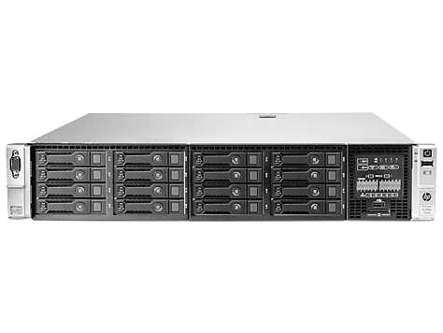
Cluster Design
nano sized
location I
location II
location III
management node
data nodes
data nodes
2Gb/s network
Notes:
As you can see we currently use a very small cluster, only 5 nodes distributed over 3 locations
1 mgmt node and 4 data nodes.
Management node is responsible for:
- cluster management
Data staging
Data nodes are responsible for storing and analyzing data:

Slide 16
Hardware
Management node
HP ProLiant DL380
Xeon 1.9 GHz 12 core CPU
64GB RAM
3 TB storage
Data node
Scaling
HP ProLiant DL380
Vertical by adding more resources
Horizontal by adding more data nodes
Xeon 1.9 GHz 12 core CPU
64GB RAM
6 TB storage
Notes:
Total capacity data nodes
24TB of storage
48 CPU cores
256 GB RAM

Slide 17
Workflow
name server
PCAP
staging
PCAP
decode
Join
Hadoop
Filter
Impala
Analyst
Enrich
Parquet
Monitoring
Metrics
Import
Query data available for analysis within 10 minutes
Notes:
Workflow:
PCAP files with query data is sent from name servers to the staging server
The pcap staging area functions as short term storage of raw data
Steps are:
decoding pcap data from wire format to memory object model:
- Join DNS query with the response from the NS
- Filter response sections, remove some parts of the data we are not interested in
Enrich (resolver IP)
- Add the geo location
Add the AS number
-collect metrics and send to monitoring tool
Write to parquet and upload to hdfs
- From there it can be analyzed by a researcher using the Impala query engine for interactive and automatic analytics

Slide 18
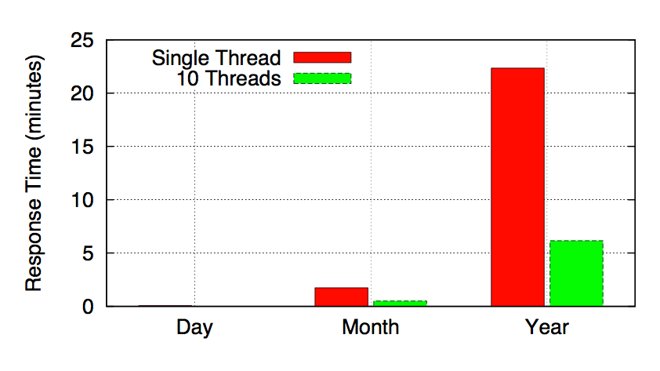
Performance
Example query, count # ipv4 queries per day.
select concat_ws(’-’,day,month,year), count(1)
from dns.queries
where ipv=4
group by concat_ws(’-’,day,month,year)
Query response times
1 Year of data is 2.2TB Parquet ~ 52TB of PCAP
Notes:
Most queries are aggregation type queries and tend to be CPU bound
But with aggregation query Impala uses only single core per node!, break up queries when possible and join results afterwards.
Here is an example query with response times for 1 thread and 10 threads
Example qry count number of ip version 4 dns queries for day, month and year
When looking at parallel queries, scale is in minutes:
Day : only few seconds
Month: less than 1 minute
Year: less than 7 minutes
This query for 1 year processes 2,2TB of parquet data which comparable to 52TB of pcap data.

Slide 19
ENTRADA Status
Name server feeds | 1
Queries per day | ~150M
Daily PCAP volume(gzipped) | ~33GB
Daily Parquet volume | ~6GB
Months operational | 18
Total # queries stored | > 71B
Total Parquet volume | > 3TB
HDFS (3x replication) | > 9TB
Cluster capacity | ~150B-200B tuples

Slide 20
Use Cases
Focussed on increasing the security and stability of .nl
Visualize DNS patterns (visualize traffic patterns for phishing domain names)
Detect botnet infections
Real-time Phishing detection
Statistics (stats.sidnlabs.nl)
Scientific research (collaboration with Dutch Universities)
Operational support for DNS operators
Notes:
The ENTRADA use cases are Focussed on increasing the security and stability of .nl
Detect botnet infections (detect botnet infections and report these to abuse information exchange (https://www.abuseinformationexchange.nl/english))

Slide 21
Example Applications
DNS security scoreboard
Resolver reputation
Notes:
Example ENTRADA applications we have developed are:
DNS SECURITY DASHBOARD : which visualizes dns patterns for malicious activity
RESOLVER REPUTATION: tries to detect malicious activity in resolver behaviour.

Slide 22
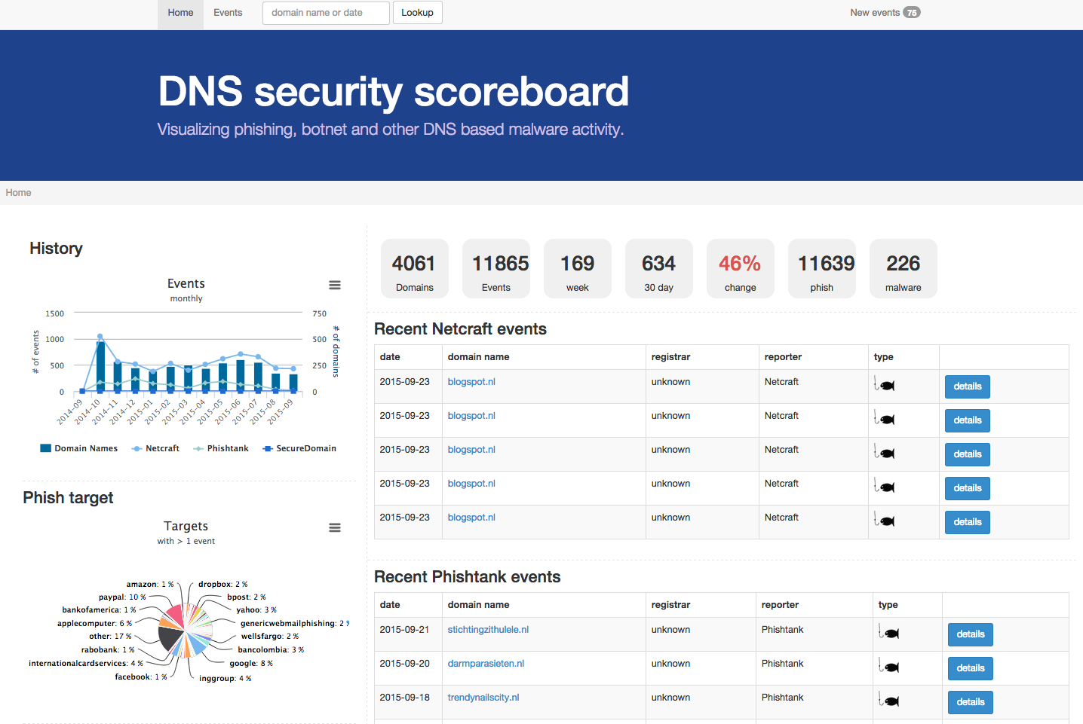
DNS Security Dcoreboard
Goal: Visualize DNS patterns for
malicious activity
How: Combine external phishing
feeds with DNS data
Notes:
Current focus of the security dashboard is on fishing activity
it uses two external feeds: Netcraft and phishtank
Every phishing alert comes with attributes such as its intended target “amazon” hosting details e.d. (show details)
We enrich the report with a dns traffic analysis for the reported phishing domain name.

Slide 23
Architecture
Security
feed I
Security
feed II
Hadoop
new event
new event
enrich with DNS data
PostgreSQL
Event
Analyzer
save enriched event
REST API
retrieve event data
Web UI

Slide 24
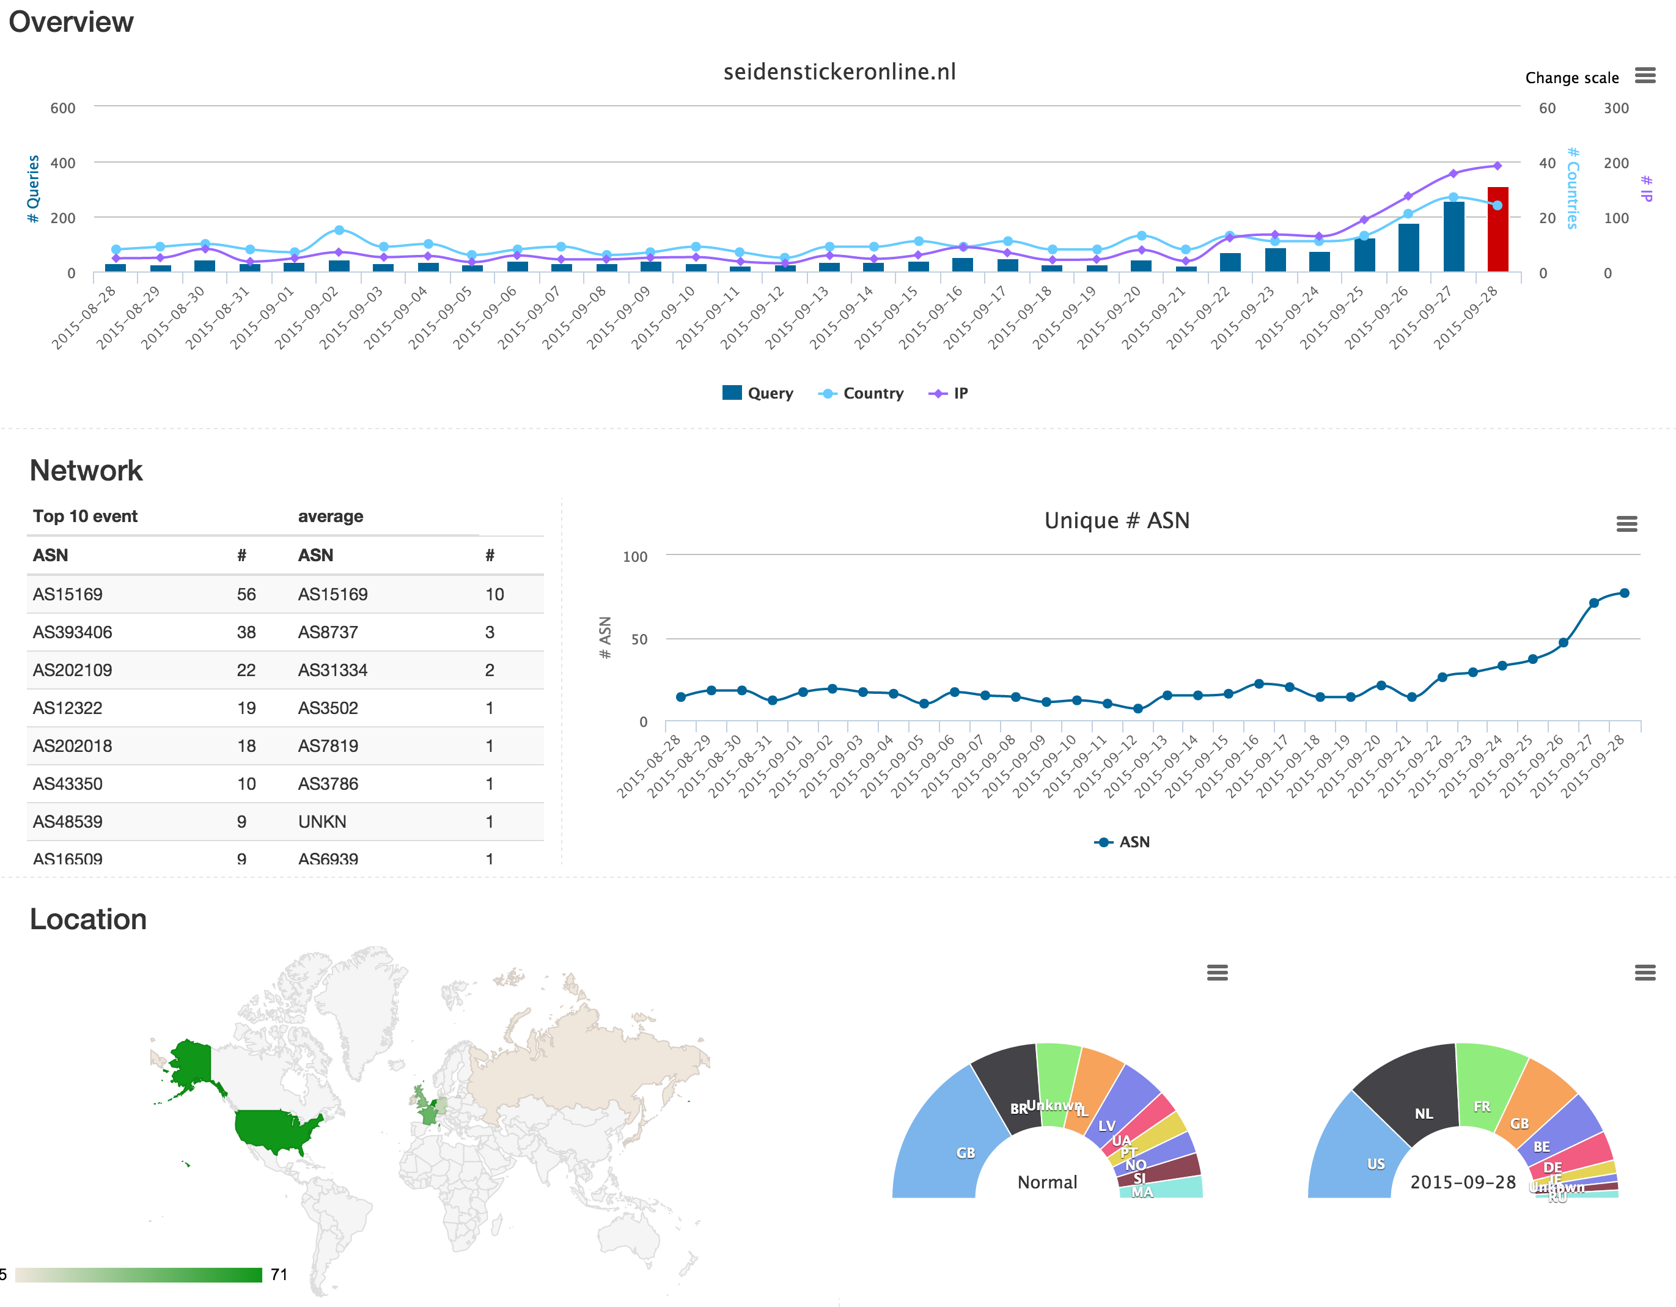
Traffic Visualization
Notes:
This screenshot shows the impact of a phish on the DNS traffic of a compromised domain name
Top
Bar shows the number of queries for each day, the red bar is the day the phish was reported.
Before the red bar there is a visible rampup in traffic
This could be used as an indicator for automatic detection
The same is true for the number of unique networks (ASN) query the domain name
The geographical distribution of clients (resolvers) also chages when there is a phish
this behaviour can be used to automatically detect malicious activity

Slide 25

Resolver Reputation (RESREP)
Goal: Try to detect malicious activity by assigning reputation scores to resolvers
How: “fingerprinting” resolver behaviour
Notes:
Another example application is called resolver reputation
Currently used to detect botnet activity

Slide 26









RESREP Concept
.nl Registry
Malicious activity:
  Spam-runs
  Botnets like Cutwail
  DNS-amplification attacks
ISP Resolvers
Authoritative
DNS .nl
DNS questions
and responses
Notes:
Conceptual it looks like this:
benign and malicious clients can use shared ISP resolvers or may have local/ builtin resolvers
both types of clients send query's to the authoritative name servers of .nl (sidn)
This traffic may contain evidence of Malicious activity such as:
Spam-runs
Botnets like Cutwail
DNS-amplification attacks

Slide 27






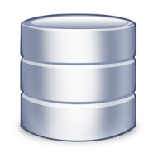

RESREP Architecture
.nl Privacy Board
Root operator
ISP network
RESREP Privacy Policy
❷
❸
RESREP service
Resolvers
❹
❹❺
ENTRADA Platform
AbuseHUB
Abusedesk
❶
❺
❽
❻
❼
❾
HTTP
User
Child operator (example.nl)
www.example.nl
Notes:
This is the highlevel architecture, we see:
1 Query's sent to .nl name servers are stored in the ENTRADA platform
2 the resolver reputation system uses smart algorithms to detect botnet activity
3 information about infected clients is passed along to AbuseHub
Abusehub is the platform of the Abuse Information Exchange, which is a dutch initiative of SIDN and the largest dutch ISP’s
It’s function is to collect abuse reports and forward these to abusedesk of the corresponding ISP.

Slide 28

Conclusions
Technical:
  Hadoop HDFS + Parquet + Impala is a winning combination!
Contributions:
  Research by SIDN Labs and universities
  Identified malicious domain names and botnets
  External data feed to the Abuse Information Exchange
  Insight into DNS query data
Notes:
Concluding we find that:
Hadoop HDFS /Parquet / Impala is a winning combination
It combines a distributed storage platform with an efficient storage format and a high performance query engine.
Resulting in a flexible platform with good performance when querying billions rows.
Contributions of ENTRADA sofar are: <see list>

Slide 29
Future Work
Combine data from .nl authoritative name server with scans of the complete .nl zone and ISP data.
Get data from more name servers and resolvers
Expand Open Data program
Notes:
The getter a better overview we want to combine multiple DNS data sources.

Slide 30
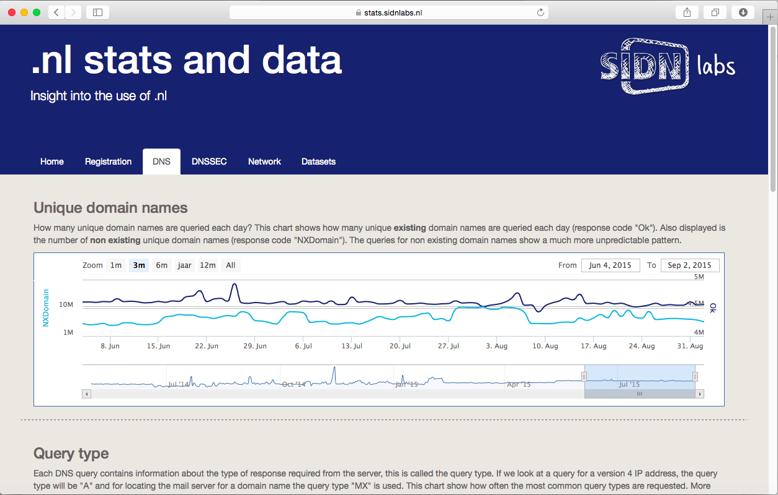

Questions and Feedback
  Maarten Wullink
  Senior Research Engineer
  maarten.wullink@sidn.nl
  @wulliak
  www.sidnlabs.nl
https://stats.sidnlabs.nl

