Slide 1
The Last Link in the DNSSEC Chain of Trust
Stub Resolver or ISP cache?
Andrew White / Charter Communications
DNS OARC 25
Dallas, TX
16 Oct 2016

Slide 2
Is DNSSEC practical?
DNSSEC provably makes DNS reflection attacks worse
Stub resolvers today generally do not validate DNSSEC responses
Stub resolver’s failure validate responses allows potentially undesirable behavior such as NXDOMAIN redirection from the ISP
DNSSEC does not solve privacy issues with DNS even with stub resolver validation
No motivation for implementation until DANE is adopted by ISP caching servicers and stub resolvers

Slide 3
Potential Solutions
Adoption of DANE and RFC5934 for management of DNS-sourced trust anchors
Stub resolvers could validate DNS responses if root trust anchors were preloaded like C.A. certs are with browsers
Ditch DNSSEC for DNS over TLS (RFC 7858)
Other options include DNSCurve, DNSCrypt, Confidential DNS, IPSECA, DNSoD
Caveat with all: Adoption only likely if popular apps (browsers) or operating systems provide it out of the box. Users are not generally interested in privacy (unfortunately).

Slide 4
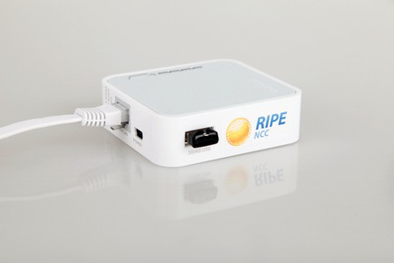
Two non-sequiturs
Please support the RIPE Atlas project -- get probes in your network!
Please find me if you have interested in discussing the problems of IPv6 synthetic response (RFC-1912 recommendations)

