Slide 1
The Dark Side of the DNS
Jaeson Schultz

Slide 2
Who Am I?
Jaeson Schultz – jaeson@cisco.com
@jaesonschultz (Twitter)
  Technical Leader with Cisco Talos
  Over 20 years specializing in thwarting abuse of Internet protocols like SMTP, HTTP, and DNS
  Former manager of the SpamCop DNSBL – An IP address-based blacklist which has taking the fight to the spammers for over a decade
  Assisted in design and development of the Cisco IronPort Anti-Spam content scanner, and Cisco’s Web Security Appliance, Cloud Web Security & Next Generation Firewall products

Slide 3
DNS
Data Exfiltration
Notes:
This presentation concerns the abuse of DNS, and the first topic we will cover is Data Exfiltration.

Slide 4
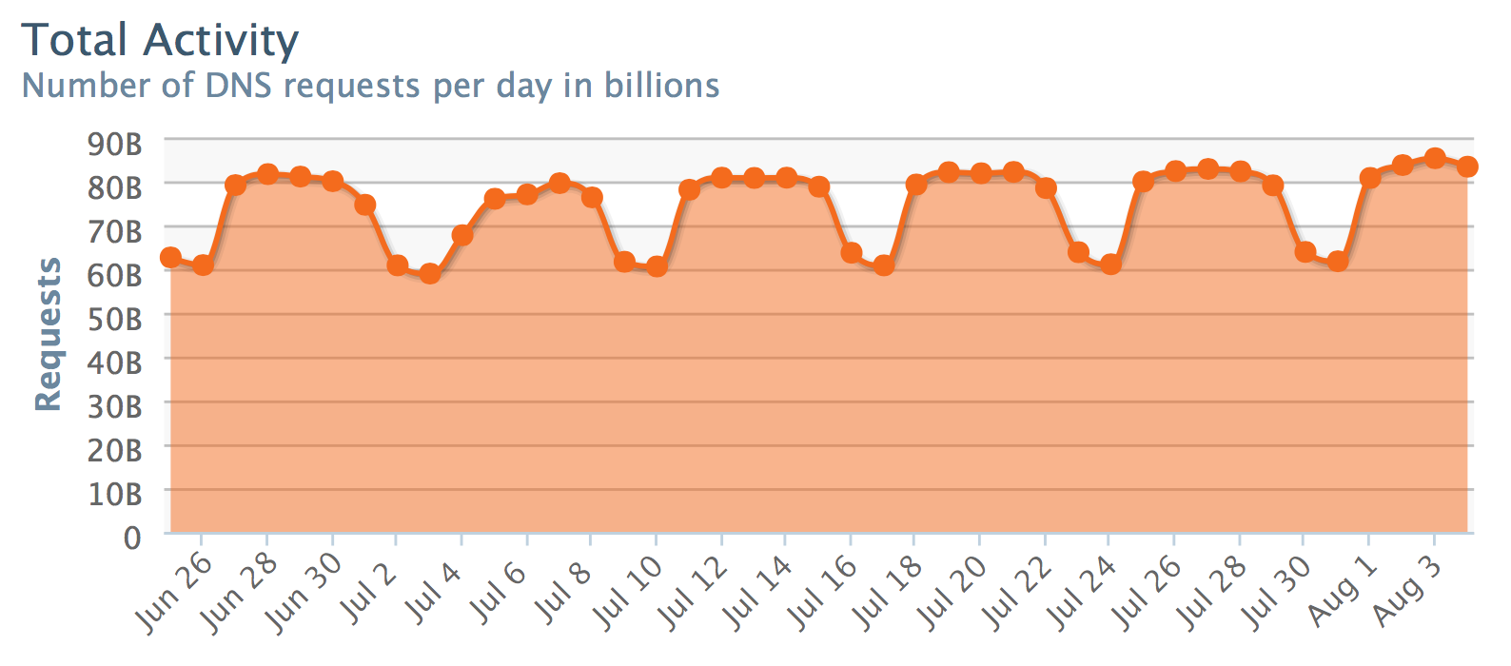
Let’s go Hunting
Lets look for ‘long’ domain names.
Oh great there are 100 million!

Slide 5
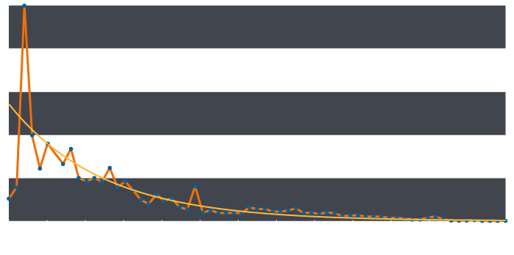
Observed length distribution
Best fit curve
e^{-λx}
Combined Subdomain Length
Notes:
If we take a hostname from a DNS lookup and exclude the registered 2nd (or 3rd) level domain name we are left with a “combined subdomain”. The orange line shows the distribution of combined subdomain lengths from single up to 65 characters. Although it is obviously not an exact fit, this distribution approximates to the smooth exponential curve shown in yellow. We can use this curve as our model of normality and compare our observed values to this curve in order to spot anomalies.
Immediately we can see that subdomains of three characters in length are far more common than we would expect. Understandably, this corresponds to the length ‘www’, a very common subdomain string. To measure how more frequent this observation is than we would expect, we can divide the observed value by that predicted from our curve in order to calculate a metric of how unusual this observation is.

Slide 6
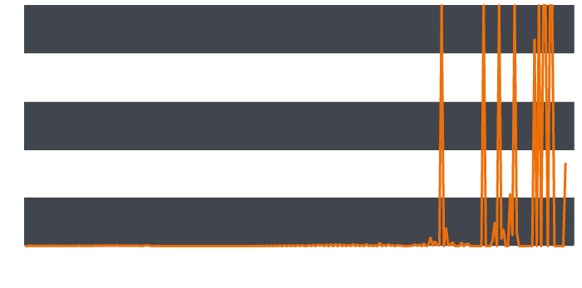
anomalies
Observed data ÷ expected value
(best fit curve)
Combined Subdomain Length Divergence
Notes:
Continuing this calculation for all the combined subdomain length values and plotting this gives a graph showing how much reality diverges from our expectations of normality for each subdomain length.

Slide 7
Multigrain Domain Names
log.nu6timjqgq4dimbuhe.3ikfsb---redacted---cg3.7s3bnxqmavqy7sec.dojfgj.com
log.nu6timjqgq4dimbuhe.otlz5y---redacted---ivc.v55pgwcschs3cbee.dojfgj.com
lll.nu6toobygq3dsnjrgm.snksjg---redacted---dth.ejitjtk4g4lwvbos.amouc.com
lll.nu6timrshe4timrxhe4a.7vmq---redacted---hit.w6nwon3hnifbe4hy.amouc.com
ooo.nu6tcnbug4ytkobxhe4q.zrk2---redacted---hxw.tdl2jg64pl5roeek.beevish.com
ooo.nu6tgnzvgm2tmmbzgq4a.rkgo---redacted---tw5.5z5i6fjnugmxfowy.beevish.com
Notes:
Multigrain is a Point of Sale malware that was uncovered back in April 2016. Multigrain scrapes RAM for bank card data. The financial data is then exfiltrated using base-32 encoded DNS queries. In contrast to base-64 encoding, base-32 encoding ensures that no characters that may be illegal in a host name are present. Here are a few examples of hostnames found in passive DNS that were used by Multigrain to exfiltrate financial information.

Slide 8
Active Exfiltration
Known Multigrain
POS malware domain
log.nu6timjqgq4dimbuhe.3ikfsb---redacted---cg3.7s3bnxqmavqy7sec.dojfgj.com
lll.nu6toobygq3dsnjrgm.snksjg---redacted---dth.ejitjtk4g4lwvbos.amouc.com
ooo.nu6tgnzvgm2tmmbzgq4a.rkgo---redacted---tw5.5z5i6fjnugmxfowy.beevish.com
Previously unknown
domains
Base32 encoded machine identifier
m=3753560948
Base32 encoded & RSA 1024 encrypted credit card information

Slide 9
DNS
Command & Control
Notes:
Malware has also recently been observed using DNS as a C2 channel

Slide 10
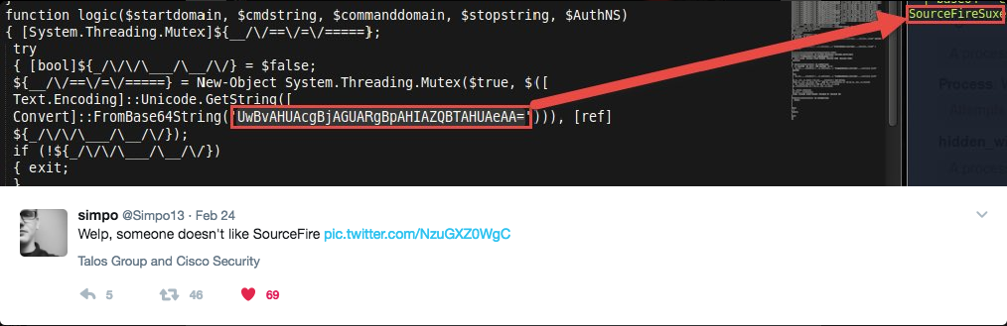
DNSMessenger
Notes:
What initially drew our interest to this particular malware sample was a tweet published by security researcher on Twitter (thanks simpo!) regarding a Powershell script that he was analyzing that contained the base64 encoded string 'SourceFireSux'. Interestingly enough, Sourcefire was the only security vendor directly referenced in the Powershell script. We searched for the base64 encoded value 'UwBvAHUAcgBjAGUARgBpAHIAZQBTAHUAeAA=' which was referenced in the tweet, and were able to identify a sample that had been uploaded to the public malware analysis sandbox, Hybrid Analysis.

Slide 11
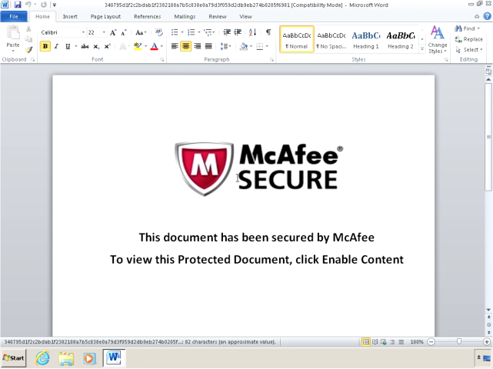
DNSMessenger
Notes:
This Maldoc from DNSMessenger contains a malicious macro. The macro contains code that is passed to Powershell via the command line. This allows the code to be executed without ever requiring it to be written to the filesystem of the infected system.

Slide 12
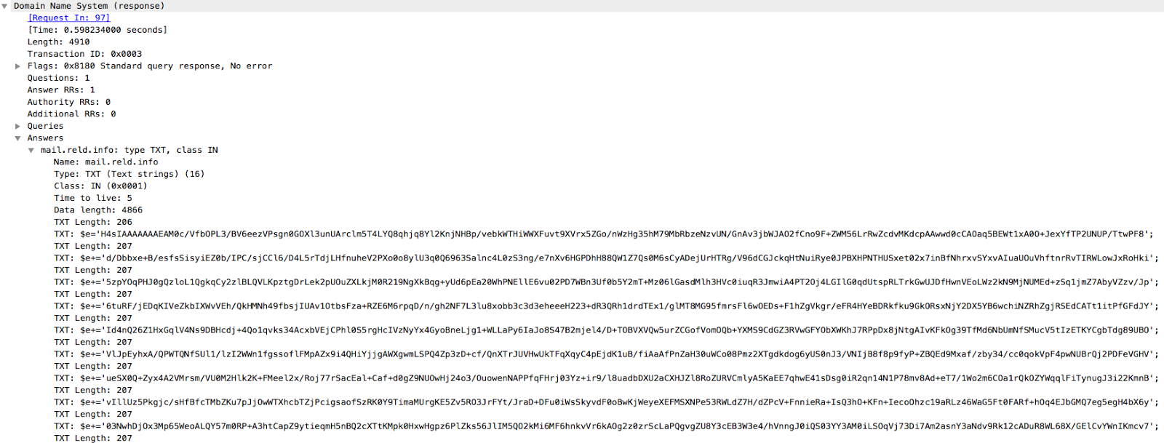
Notes:
The code reaches out and obtains additional code to run via a TXT query. In this case a variable $e is being loaded up with the next stage of malware.

Slide 13
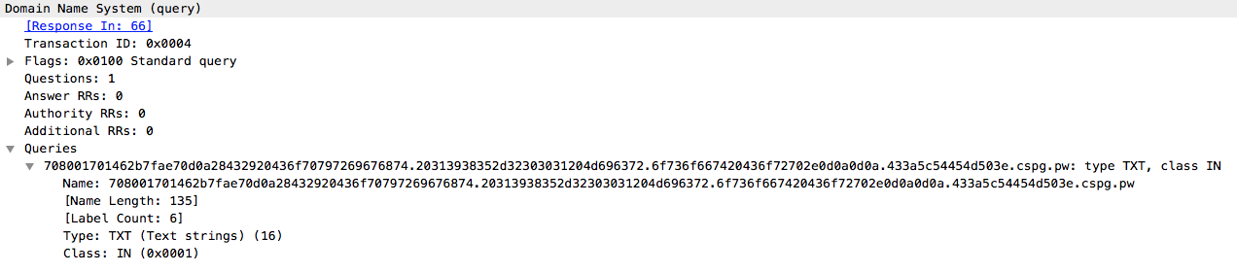
Notes:
One the malware is decoded an ran, it establishes a command and control channel, also using TXT records. This is one of the messages it sends.

Slide 14
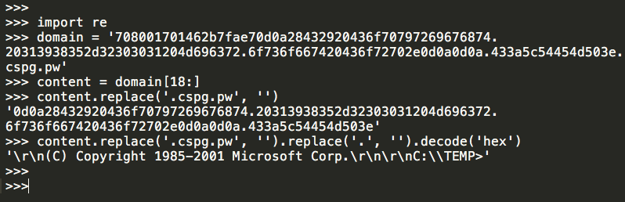
Decoded Message
Notes:
If we take the DNS request query and run it through a decoding function, we can clearly see that it is the output of the Windows Command Line Processor being sent to the C2 server.

Slide 15
DNS
What isn’t being detected?
Notes:
All of this malware using the DNS got me thinking about other ways DNS might be abused…

Slide 16
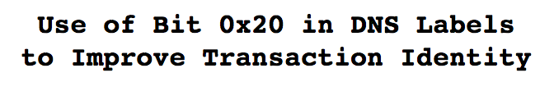
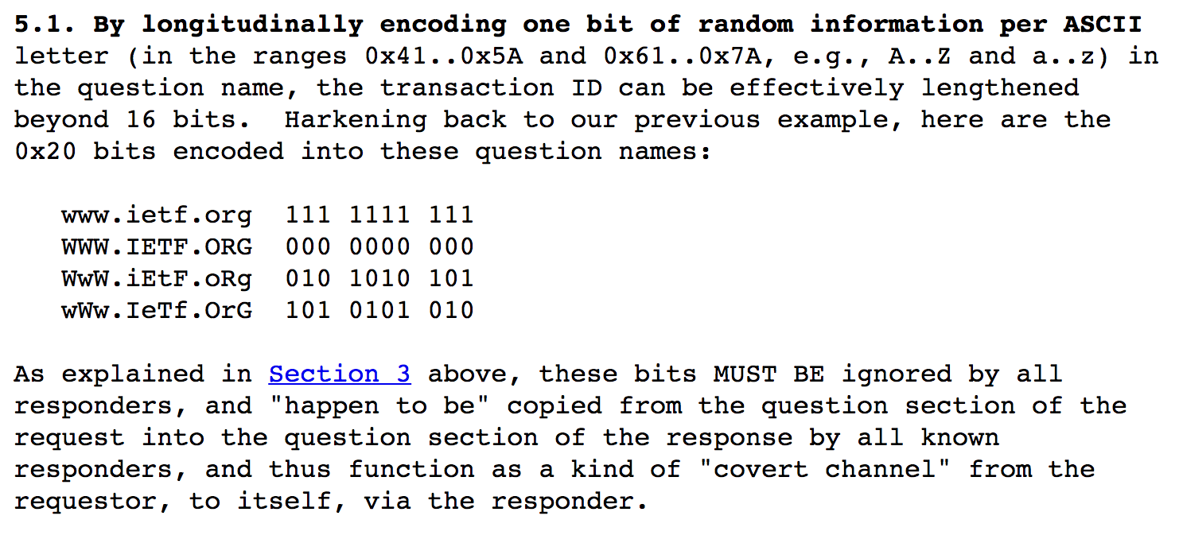
Notes:
One potential channel for data exfiltration or even rudimentary bidirectional communication exists in DNS 0x20 encoding of DNS labels

Slide 17
DNS 0x20 at Google Public DNS
For some name servers, the response does not match the exact case of the name in the request.
Other name servers respond handle equivalent names differently depending on case in the request, either failing to reply at all or returning incorrect NXDOMAIN responses that match the exact case of the name in the request.
70% of DNS traffic at Google Public DNS is to “whitelisted” servers that honor DNS 0x20.
Notes:
Some nameservers will not respect 0x20 encoded queries, but the majority do. According to Google, 70% of their DNS traffic involves DNS 0x20 compliant DNS servers.
https://developers.google.com/speed/public-dns/docs/security

Slide 18
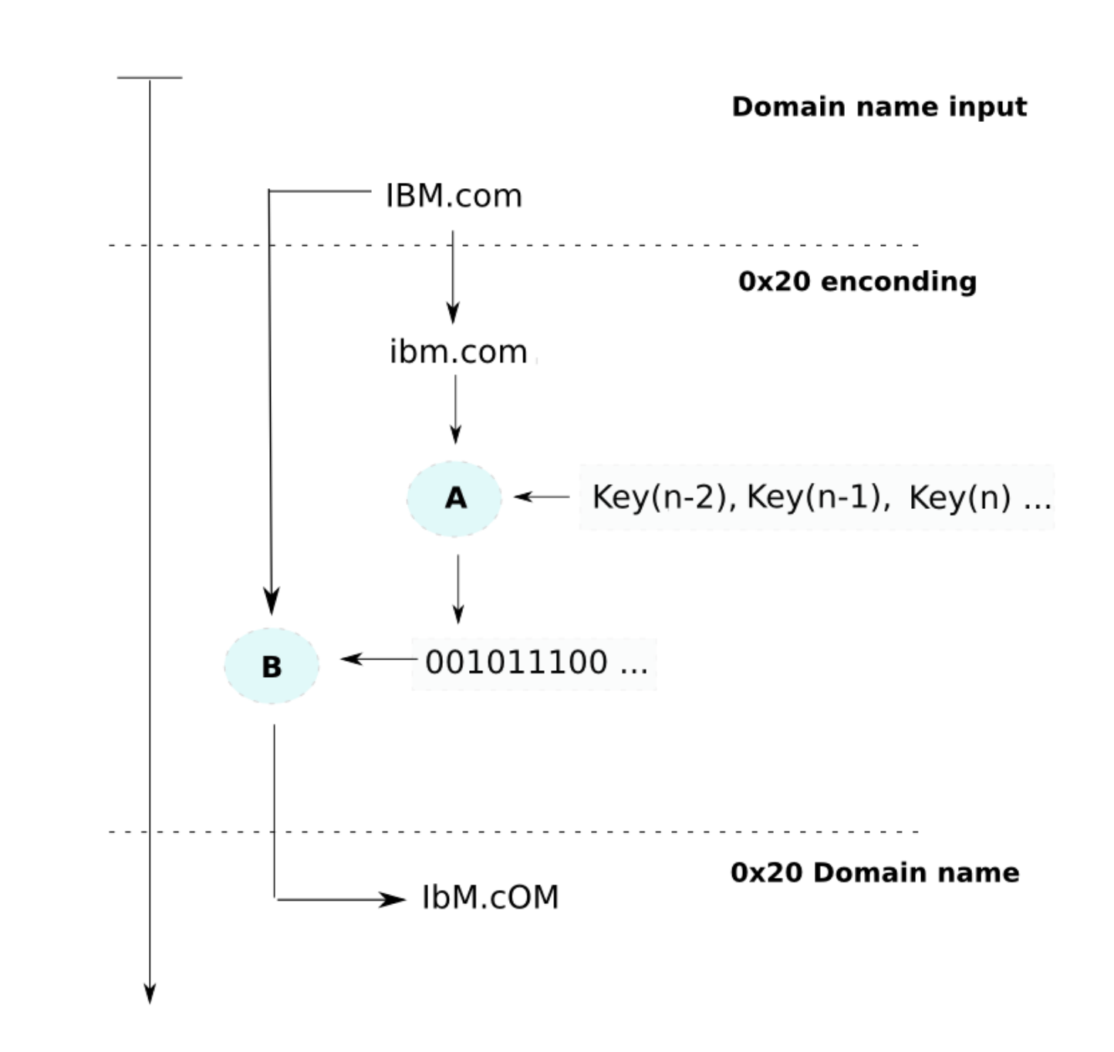
encoding
SECRET DATA
IBm.Com
Notes:
This is the proposed algorithm for the 0x20 encoding of a DNS query name. In the proposed algorithm the requested name is converted to lowercase, and then encrypted, perhaps with AES, using some key (or keys) shared between DNS requests. The cyphertext bits are read and used to encode the query name. If the bit is 0, a capital letter is produced, and a bit of 1 results in a lowercase character.
If an attacker was somehow able to manipulate the input for the 0x20 encoding process, then they could replace the original cyphertext with a cyphertext/plaintext of their own. Fortunately DNS 0x20 is usually not implemented at the client level, so mixed-case queries originating here may arouse additional suspicion.

Slide 19
Extended Query ID (XQID)
Extends the DNS query ID with 24 to 63 alpha-numeric [a-z0-9] characters into the query/response question name (QNAME) making the range of possible transactions IDs so extremely large that any brute force "guessing" or birthday attack attempts are futile.
Ex. QNAME: xqid—q.ml6ah36sk9jlznx1jswibslu.www.example.com
At Google’s Public DNS, “such requests make up less than 3% of outgoing requests, assuming normal traffic”
Notes:
Exfiltrating data using 0x20 bits is going to be somewhat slow only 255 bits at most can be transmitted per DNS query name. Attackers could instead use XQID format queries to increase the bandwidth of their communications. However, this extra bandwidth would come at the expense of greater visibility with respect to network defenders. It seems that XQID queries are somewhat rare, making up less than 3% of outgoing requests at Google’s Public DNS.
https://developers.google.com/speed/public-dns/docs/security

Slide 20
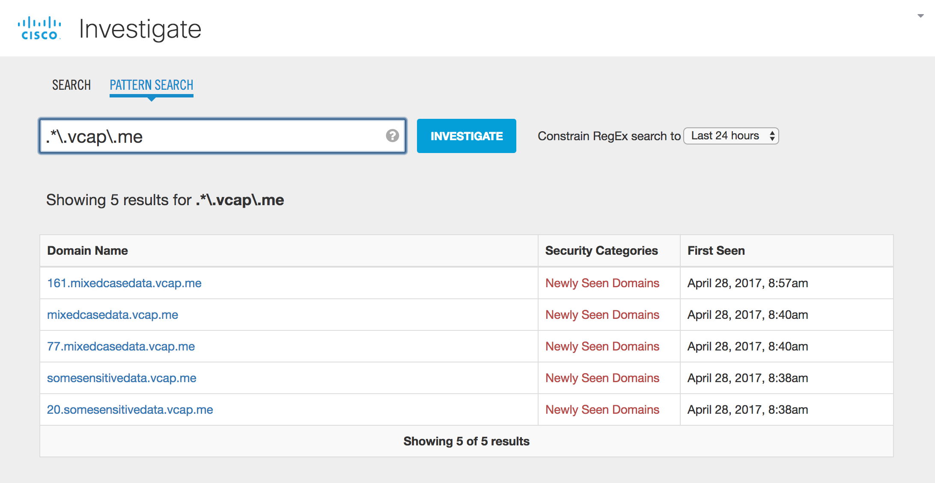
Passive DNS Dead Drops
Notes:
According to Wikipedia, a dead drop is a method used to pass items or information between two individuals using a secret location, thus not requiring them to meet directly and thereby maintaining operational security. Why take the chance of registering your own domain when you can borrow others’ domains to conduct your data exfiltration? Any wildcarded domain has the potential to be used as a passive DNS dead drop. Also, as you can see in this example, passive DNS databases will often normalize the names that are requested. Thus if we were using 0x20 encoding in our names, it would NOT appear in the normal passive DNS interfaces used by most security analysts. The case (0x20) of the QNAMEs can only be viewed using the raw passive DNS data.

Slide 21
DNS
Malware In-The-Wild
Notes:
The idea of manipulating DNS traffic to accomplish nefarious goals has been around for many years... Dan Kaminsky’s Dark Ops of DNS was presented 13 years ago. Since then we have seen examples of malware using DNS as a means to tunnel traffic from one location to another.

Slide 22
Data Set
Analyzed the previous 6 months of samples run through the Talos malware sandbox
Samples that scored between 65-100 (those considered malicious) were further analyzed by extracting the hostnames and IP addresses they contacted.
~1 Million malware samples in total

Slide 23
Malware: Contacted Domains
1,699,712 com
330,704 net
108,543 org
106,291 eu
65,524 pl
57,274 top
53,924 cn
53,482 ru
52,726 info
49,397 la
25,635 pw
21,479 io
19,742 de
17,569 biz
12,869 br
12,001 nu
9,484 su
9,477 cc
8,949 work
8,638 to
Notes:
Here is the distribution of TLDs in the domain names that were contacted. There were 3.5 million hostnames in the dataset.

Slide 24
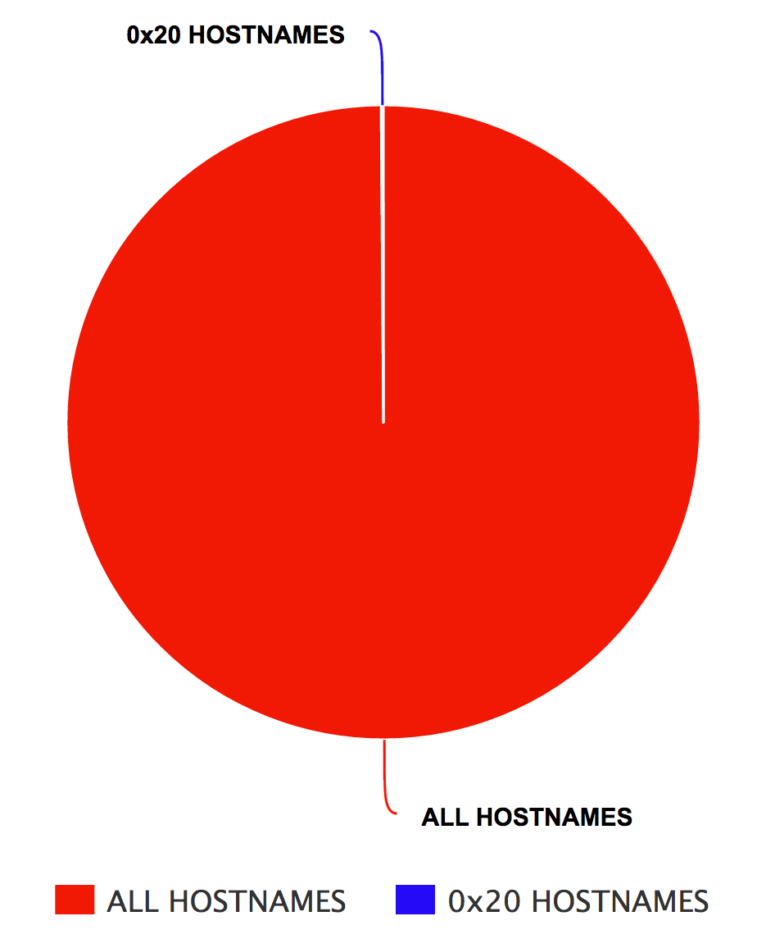
Malware: Contacted Domains
(0.1%)
Notes:
I went through 6 months of malware sandbox samples at Talos, paying specific attention to the samples that scored between 65-90 (were considered malicious by the sandbox). During that time the malware we analyzed had reached out to more than 3.5 million hostnames. Only 0.1% of those hostnames had mixed case. There were zero XQID queries in the set

Slide 25
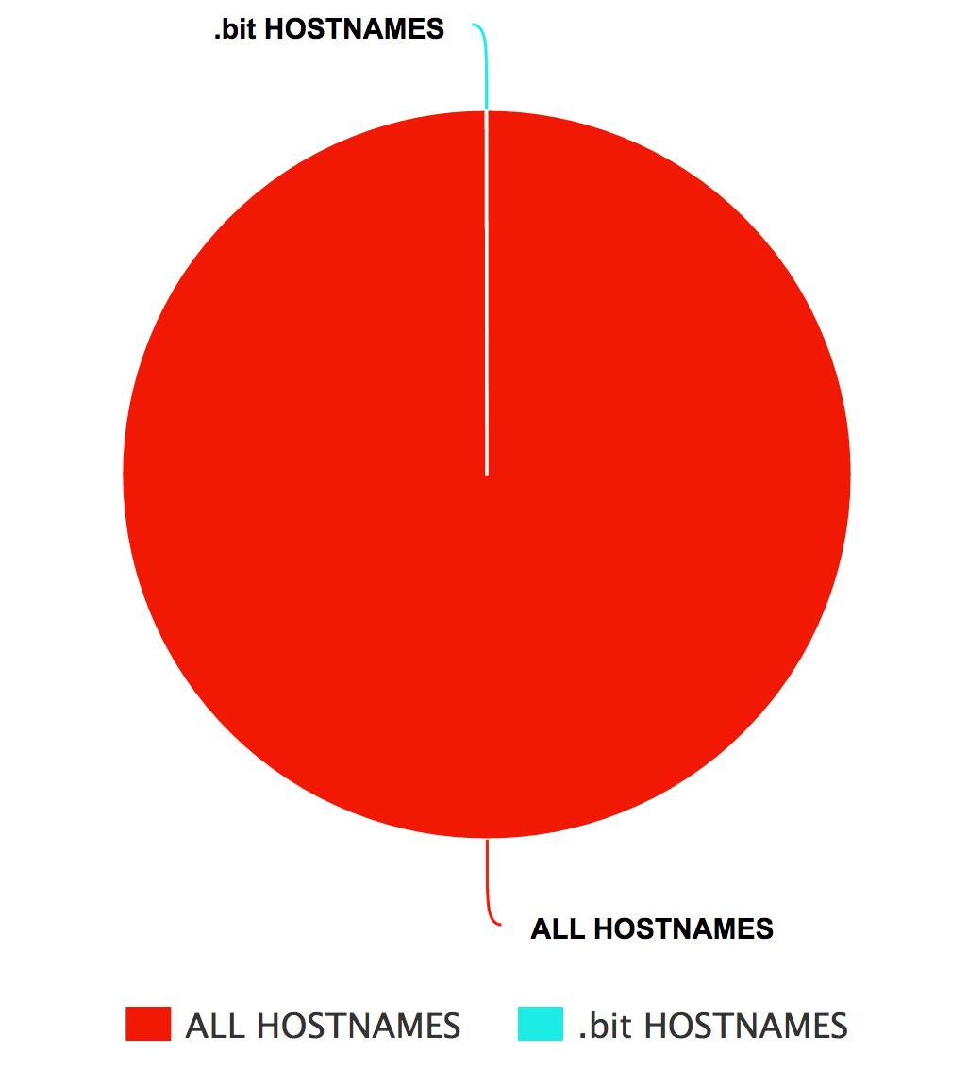
Malware: Contacted Domains
(0.03%)
Notes:
Only 0.03% of those hostnames involved .bit domain names. When I went and looked at the individual samples, the DNS queries for .bit domains were issued to DNS servers that were enhanced to be able to resolve .bit domains. Enforcing that DNS requests are made to the assigned DNS server would prevent these from resolving.
I also downloaded a copy of the namecoin blockchain, and extracted the approximately 3400 IP addresses in it, and cross referenced that with the IP addresses contacted by malware. Of the samples we found reaching out to IPs hosting .bit domains, there was no evidence that the malware was in any way working off of a copy of the namecoin blockchain and thereby evading DNS.

Slide 26
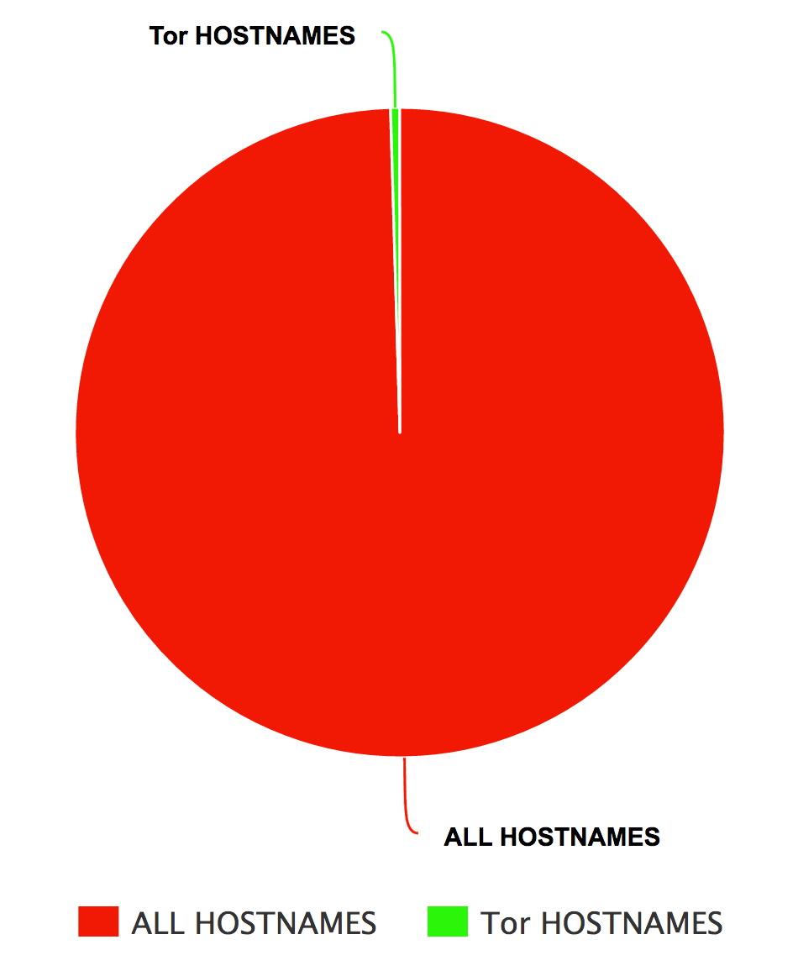
Malware: Contacted Domains
(0.5%)
Notes:
0.5% of the hostnames contacted by malware involved Tor-related domain names. The vast majority of these were using Tor2Web whereby they can append a TLD like .to to an onion link. That will resolve to the IP address of a server which, when contacted, will fetch the .onion link over Tor and relay the content back to the victim.

Slide 27
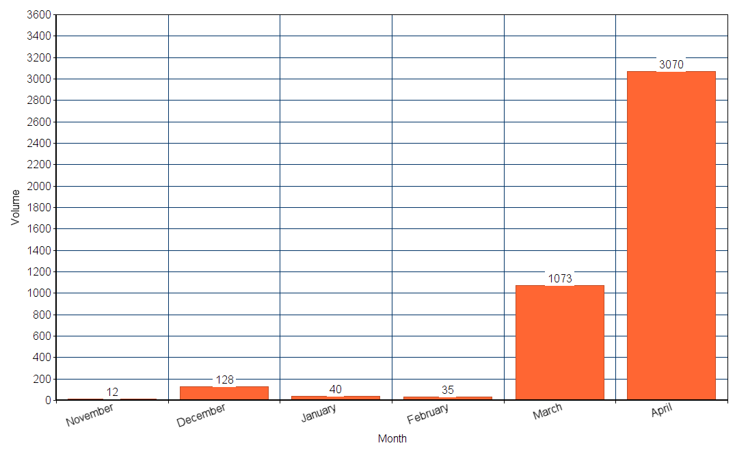
Malware: Contacted Domains
Notes:
Looking deeper at the Tor2Web domains, the vast majority of the samples using this technique were witnessed in April 2017, when they absolutely exploded in use relative to other months.

Slide 28
Tor2Web TLDs
11,844 onion.nu
8,458 onion.to
12 onion.link
3 onion.pw
3 onion.cab
1 onion.rip

Slide 29
Internationalized Domain Names
Only 0.002% of malware from the Talos sandbox
was observed reaching out to IDN domains.
However, by decoding IDN domains witnessed in passive
DNS we found hostnames masquerading as Punycode such
as the following, which were involved in a blog comment
URL spamming operation:
xn--------------------------------gmbr539ysay4291w.awelder.info
xn--------onqu75bcvap11j.centralyp.info
Notes:
It is certainly also possible to abuse IDN domain names, besides homographs. Since many of the tools commonly used in the DNS security world do not decode Punycode we normally see only the encoded version. Even if tools did decode the Punycode, many security analysts would not be able to read the multiple foreign languages that would result. Of course the IDN portion could also be potentially used to exfiltrate data, using the characters appearing after the “xn--” in the hostname. This would not necessarily arouse any suspicion if encountered in most DNS logs.

