Slide 1
DNSSEC Operations in .gov
Scott Rose, NIST
27th DNS-OARC Workshop
San Jose CA

Slide 2
Topics Covered
Signing algorithm usage
Including algorithm rollovers
DS Hash algorithms in use
NSEC/NSEC3 Usage
NSEC3 parameter choices and changes
Question: Is DNSSEC being used properly in .gov? If not, what needs to be improved?

Slide 3
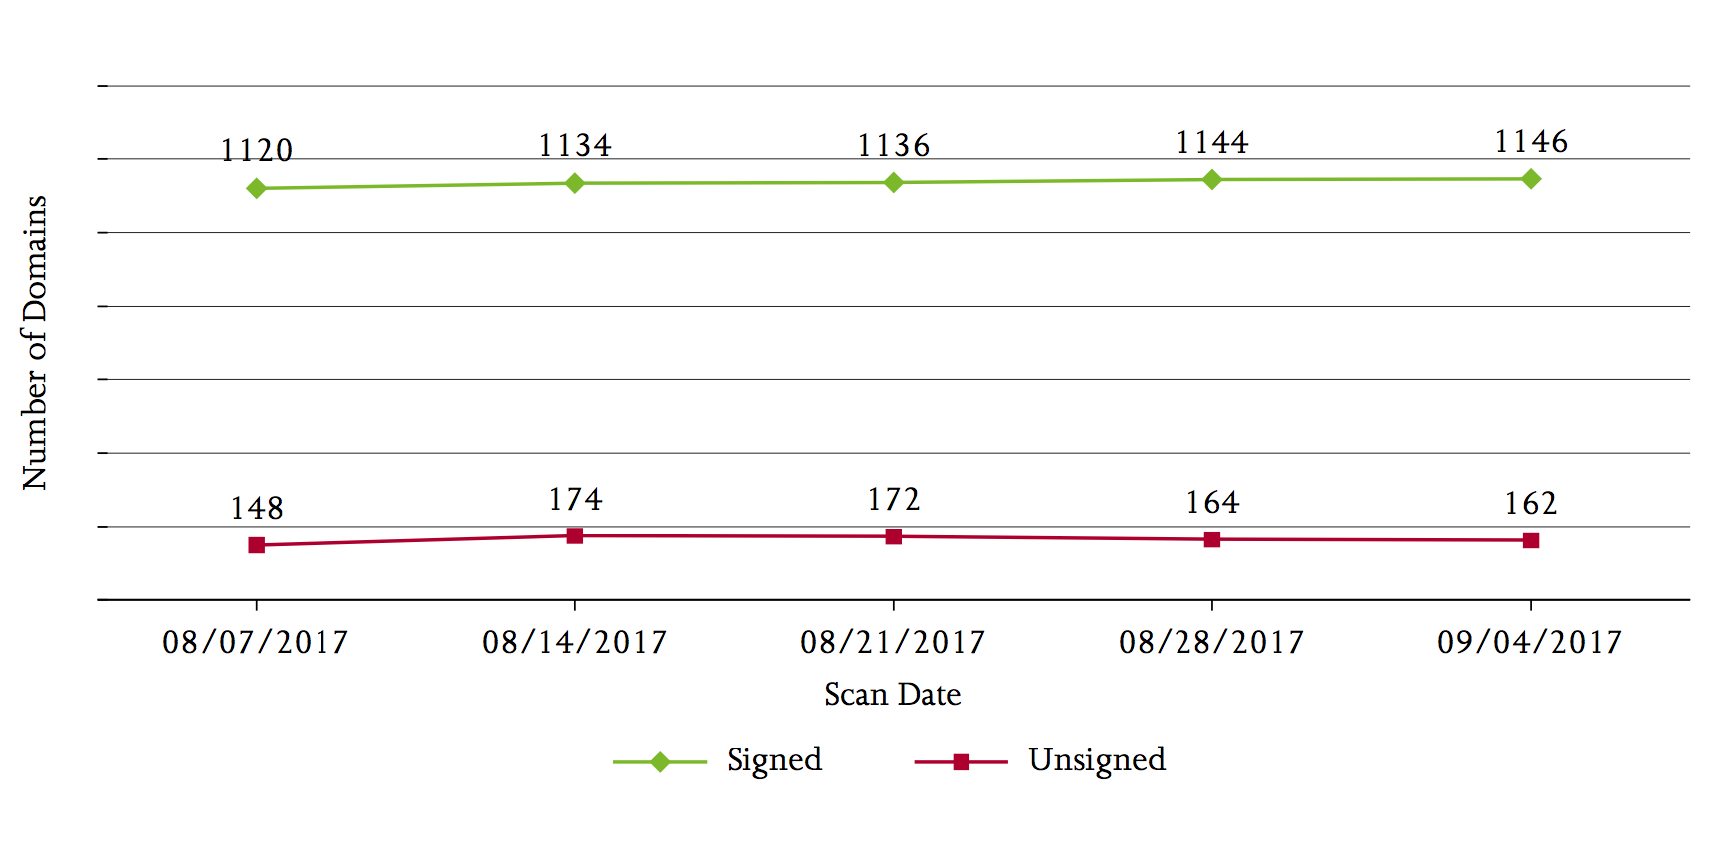
DNSSEC Deployment in .gov
Holding steady at ~84% for federal, ~20% overall

Slide 4
Algorithms used in .gov
 | 2015* | 2016 | 2017
None | 226 | 3919 | 2936
RSA/SHA-1 (5) | 63 | 76 | 83
RSA/SHA-1 NSEC3 (7) | 510 | 521 | 456
RSA/SHA-256 | 525 | 618 | 603
RSA/SHA-512 | 1 | 5 | 6
ECDSA P-256** | 0 | 1 | 1
Totals | 1325 | 5140 | 4085
*Monitored list contained only federal .gov domains until 2016, when a larger list including state and local .gov delegations was published.
**ECDSA with Curve P=256 was only recently allowed for upload to .gov registrar

Slide 5
Algorithm rollover 2015-2017
From->To | 2015->2016 | 2016->2017
5 ➢ 7 | 3 | 1
5 ➢ 8 | 4 | 7
7 ➢ 5 | 0 | 9
5 ➢ 0 | 0 | 1
7 ➢ 10 | 0 | 1
7 ➢ 8 | 22 | 51
8 ➢ 5 | 0 | 2

Slide 6
DS RR Hashes Used
Hash Algorithm Used | Number of Zones
Neither | 23
SHA-1 only | 114
SHA-256 only | 93
Both | 915
(June, 2017)
Technically, SHA-1 is still allowed for use in DS RRs due to the fact that the security in the DS RR is in the RRSIG over the DS RRset, not the DS RR itself. The hash in the DS RR is there to identify the DNSKEY RR in the child delegation.

Slide 7
NSEC3 Parameters – Iterations
Note: From RFC 5155 (Sec 10.4) the Iterations value SHOULD be below 500.

Slide 8
NSEC3 Parameters – Salt Length

Slide 9
NSEC3 Usage: Changes to Salt/Iterations
Changes in Salt Values and/or Number of Iterations in .gov Delegations that use NSEC3 (June 2017 – Aug 2017, 968 zones monitored).
Operation | Num. Zones
Changed Salt | 553
Changed Iterations | 20
Of those zones, 18 zones changed both during this period
Every zone also rotated keys (even those that did not change parameter values) – so it isn’t always synced with ZSK rollovers

Slide 10
What Should be Done?
Nothing (i.e. not a problem)?
Get automated NSEC3 parameter changes built into appliances?
Promote best common practices?

