Slide 1
Negative Trust Anchors
March 2018
Joseph Crowe
Technology Product Xperience – Comcast

Slide 2
DNS at Comcast
That’s a lot of queries!
Over 500B queries per day across our footprint
DNSSEC Validation since 2012
DNSSEC Does scale.

Slide 3
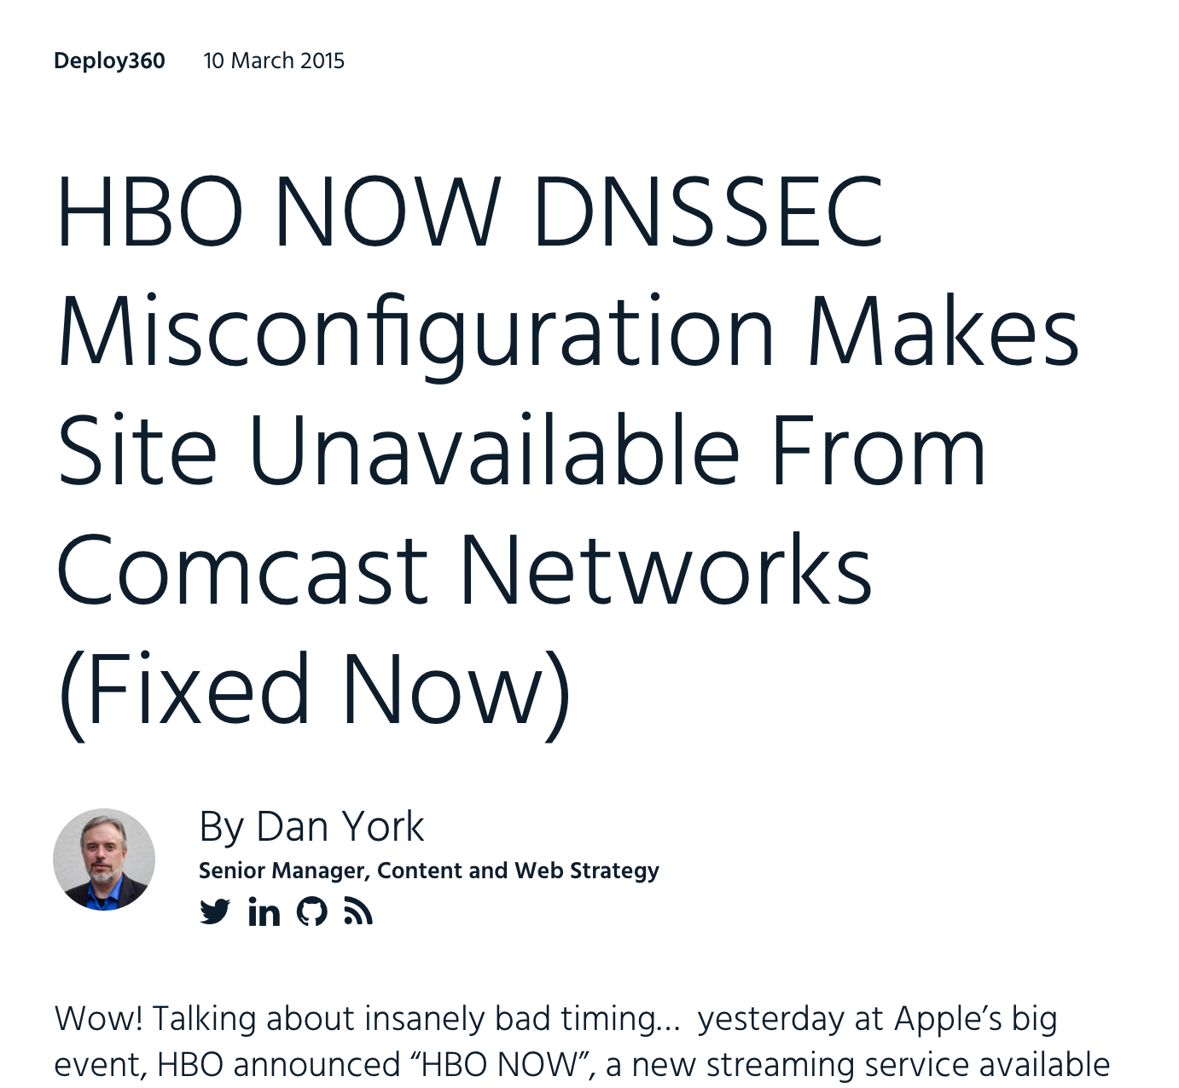
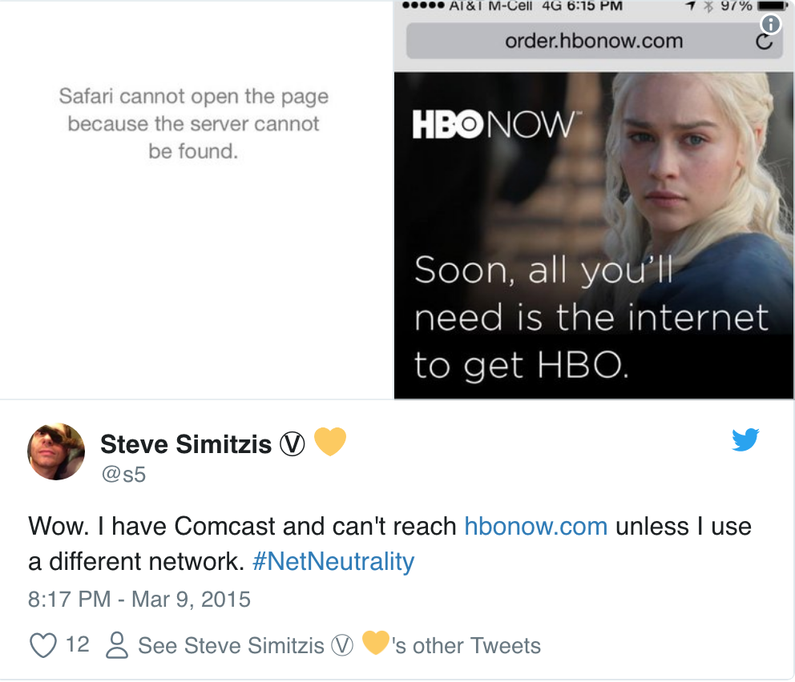
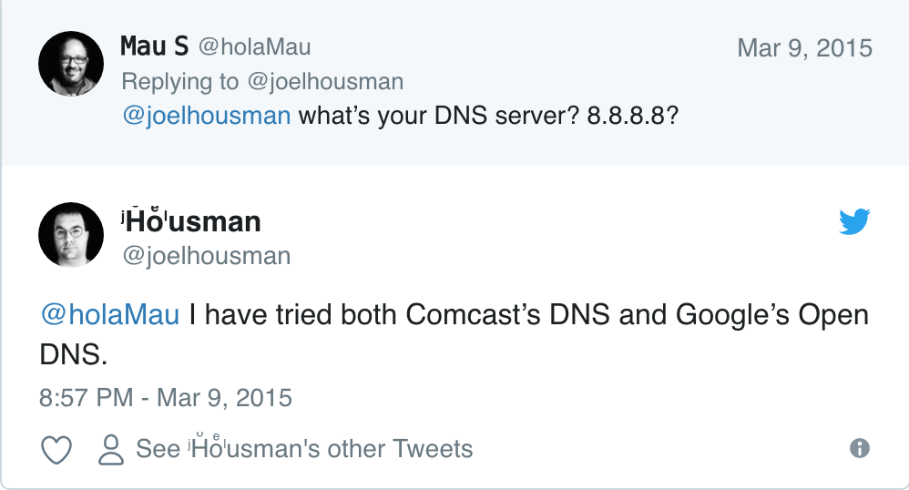
What does that mean for Comcast?
When dnssec validation fails, we get the blame
Customers will believe we are “blocking” websites
When big companies break DNSSEC, Comcast customers will reach out, QUICKLY
Suggested “Fixes”
Switch to a non-validating resolver
Guess what?! Google’s public resolvers will fail to resolves as well
Temporarily ”Fix” with a Negative Trust Anchor (RFC 7646) and allow for the zone to be repaired
Re-sign the zone and update DS record
Allow for TTL to expire (Improper key roll-over)
Remove DS record at registrar

Slide 4
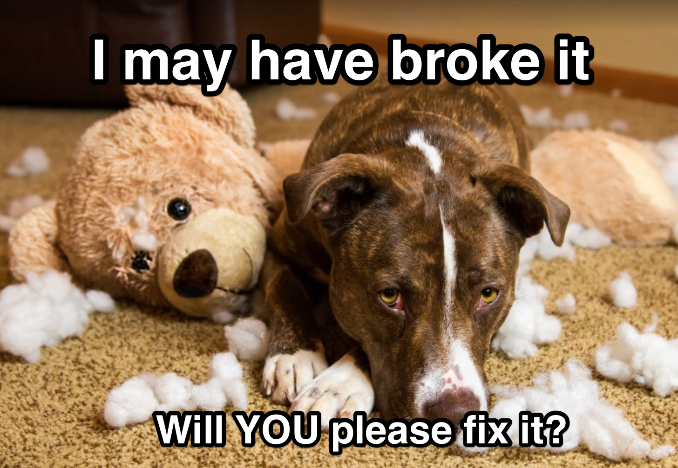
DNSSEC Validator Woes
Implementing DNSSEC has been known to cause operational issues in some instances
Though an authoritative issue, DNSSEC validators get the first round of blame
Non-validating resolvers work just fine and end users almost ALWAYS say “…but it works <insert some non-validating resolver here>, why not yours?! You’re breaking my DNS!”

Slide 5
What is a negative trust anchor?
Being too big too fail
If a major domain fails DNSSEC validation:
There may be a major security issue
There may be an operational error
There may be a process error
There may be a technical error
DNSSEC Failure experience
Most DNSSEC failures are a result of an error
Very rarely have noticed security related issues
Customer complaints can be very vocal, especially with social media and phone calls
What do we do?
There are a few options:
Just let the domain to continue to fail
Turn off DNSSEC validation
Use a Negative Trust Anchor and turn off validation for that one domain

Slide 6
Implementing a negative trust anchor
Processes are a good thing
Initiate conversation
Come up with when and why
Figure how to implement within your resolvers
Stay consistent with processes and revisit as new things may shape a new process
Standard process
Understand the risks of keeping a domain fail DNSSEC
Reach out to the domain owners and let them know that DNSSEC is failing
Usually allow them time to fix the issue
Update the community via our @ComcastDNS twitter handle that we are aware of an issue
AUTOMATE ALL THE THINGS!
Automation is a major key to success
If a Negative Trust Anchor is approved to be put in, updating one location is better than multiple
After domain is fixed use the same automation to remove the Negative Trust Anchor
Do NOT rush to implement a Negative Trust Anchor

Slide 7
Troubleshooting DNSSSEC
Can you dig it?
DNSSEC Failure will result in a SERVFAIL
Appending a +cd to dig will disable DNSSEC checking and confirm a DNSSEC issue
Test with another DNSSEC validating resolver
dnsviz.net is your friend
Third-party tool that allows you to show the customer that it’s not just your resolver.
Provides information on what is broken and where
If a key-roll over issue
Cache flush may fix DNSSEC failure – just for your resolvers

Slide 8
Some light reading material
https://www.internetsociety.org/blog/2015/03/hbo-now-dnssec-misconfiguration-makes-site-unavailable-from-comcast-networks-fixed-now/
https://tools.ietf.org/html/rfc4035
https://tools.ietf.org/html/rfc7646
HTTP://dnsviz.net

