Slide 1
Root KSK Rollover Update (or, We're really doing it this time)
Matt Larson
VP of Research, Office of the CTO, ICANN
OARC 28 Workshop, San Juan, Puerto Rico
8-9 March 2018

Slide 2
September 2017
Verisign analyzed RFC8145 trust anchor report data sent to A & J root servers
Very small number of resolvers reporting trust anchor data (<1500 unique per day)
But significant percentage (~7-8%) had only KSK-2010
ICANN OCTO analyzed B, D, F and L root traffic for entire month of September 2017
11,982 unique IP addresses (8,908 IPv4 and 3,078 IPv6) reporting
500 reported only KSK-2010 (4.1%)
27 September 2017: The ICANN org postpones the root KSK roll
Need to understand reasons why so many resolvers have only KSK-2010

Slide 3
October–December 2017
The ICANN org attempts to contact operators of the 500 resolvers from September 2017
Findings:
Tracking down operators based on just IP is hard
Operators for only 20% (100 addresses) could be contacted
Of those:
60% in address ranges known to host devices with dynamic IPs
25% from resolvers forwarding queries from other resolvers
No “smoking gun” single cause
No obvious path forward
E.g., bug fix by resolver vendor, new communication messages, etc.

Slide 4
December 2017–January 2018
With no clear path forward, the ICANN org decided to solicit community input
Input and discussion on acceptable criteria for proceeding with the KSK roll took place on ksk-rollover@icann.org
Results of discussion:
Agreement there is no way to accurately measure the number of users who would be affected by rolling the root KSK
But a belief better measurements may become available for future KSK rollovers
Consensus was that the ICANN org should proceed with rolling the root zone KSK in a timely fashion
And continue outreach to ensure rollover news reaches as wide an audience as possible

Slide 5
1 February 2018
The ICANN org published a draft plan to proceed with the KSK rollover:
Roll the root zone KSK on 11 October 2018
No specific measureable criteria emerged during community discussion
Continue extensive outreach
We will keep publicizing the root KSK roll
Publish more observations for trust anchor report data
Now publishing monthly snapshots of the RFC 8145 trust anchor report data received from most of the root servers
Public comment period on the draft plan currently open
Closes 2 April 2018
https://www.icann.org/public-comments/ksk-rollover-restart-2018-02-01-en

Slide 6
Root KSK Rollover Proposed Schedule (draft)
Date | Action
1 February 2018 | Draft plan published, public comment opened
10-15 March (ICANN61) | Hold session for community feedback
2 April | Comment period ends; revise plan, as necessary
Mid April | Publish staff report on public comment and revised plan
10 May (Board workshop) | Request Board resolution to ask SSAC to review and comment on the plan by 1 August
24-28 June (ICANN62) | Hold another session for community feedback
1 August | Receive SSAC feedback; revise plan, as necessary
Mid August | Publish final plan, with message that roll is contingent on Board resolution
14 September (Board workshop) | Request Board resolution directing ICANN org to roll the root KSK on 11 October 2018
11 October 2018 | Rescheduled date for root KSK roll

Slide 7
RFC8145 Trust Anchor Reports
ICANN OCTO has access to RFC8145 data from 11 root servers
A, B, C, D, E, F, I, J, K, L, M
Initial analysis (late 2017) used pcap data from B, D, F
Now using stats collected by Duane Wessels’s excellent rzkeychange plug-in for dnscap
Plug-in reports every 60 seconds via DNS query
Timestamp, resolver source IP, configured trust anchors and node ID encoded in QNAME
Destination is a zone operated by ICANN OCTO
1520174596.109-169-54-6.1._ta-4a5c-4f66.meb01.l-root.[ZONE-NAME]
1520174596.109-169-54-7.1._ta-4a5c-4f66.meb01.l-root.[ZONE-NAME]
1520174596.116-206-41-6.1._ta-4a5c.meb01.l-root.[ZONE-NAME]
1520174596.49-213-19-144.1._ta-4a5c-4f66.meb01.l-root.[ZONE-NAME]

Slide 8
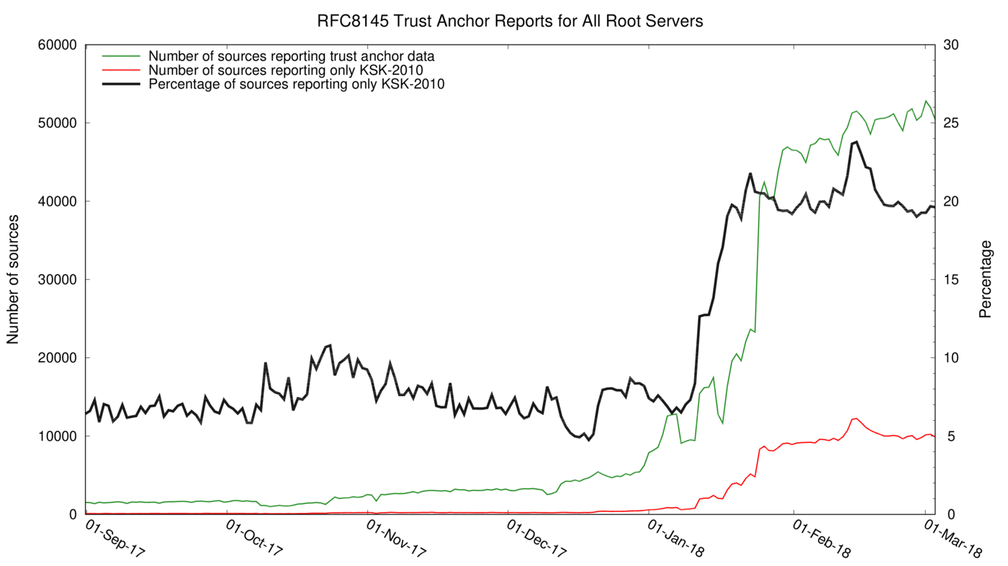
RFC8145 Data For All Root Servers

Slide 9
Why the Jump in January?
Best hypothesis: Unbound 1.6.8 released on 19 January 2018
“Fix for CVE-2017-15105: vulnerability in the processing of wildcard synthesized NSEC records”
Patch related to security, so perhaps strong motivation to upgrade?
But why no drop-off in KSK-2010 after 30 days?
RFC5011 support should update trust anchor store after ~30 days
Hypothesis: upgrade in place means unbound-anchor not run again, so configuration might still have only KSK-2010
Maybe many of these are ephemeral VMs or containers?
They never run long enough for RFC5011 add hold-down timer to complete

Slide 10
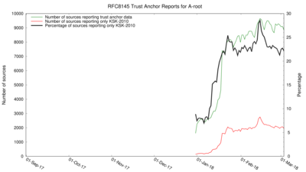
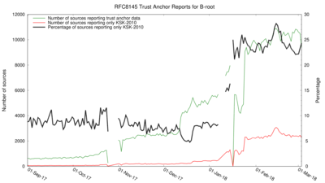
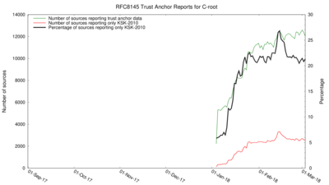
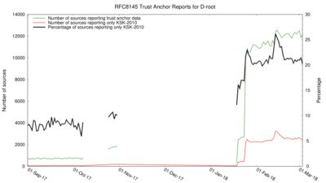
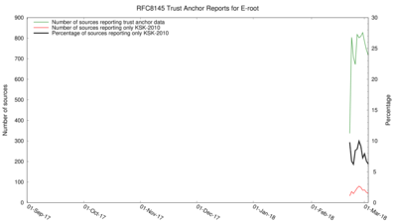
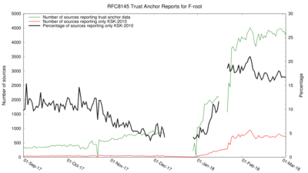
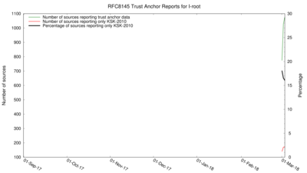
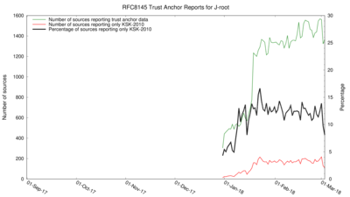
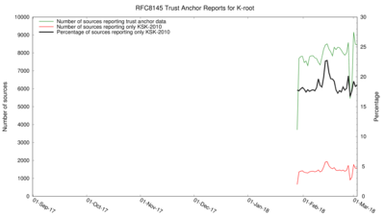
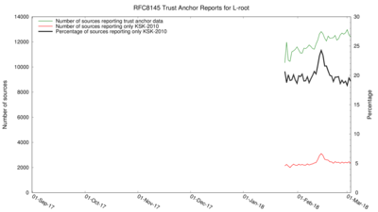
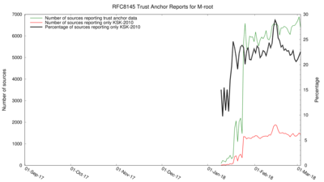
RFC8145 Data For Individual Root Servers

Slide 11
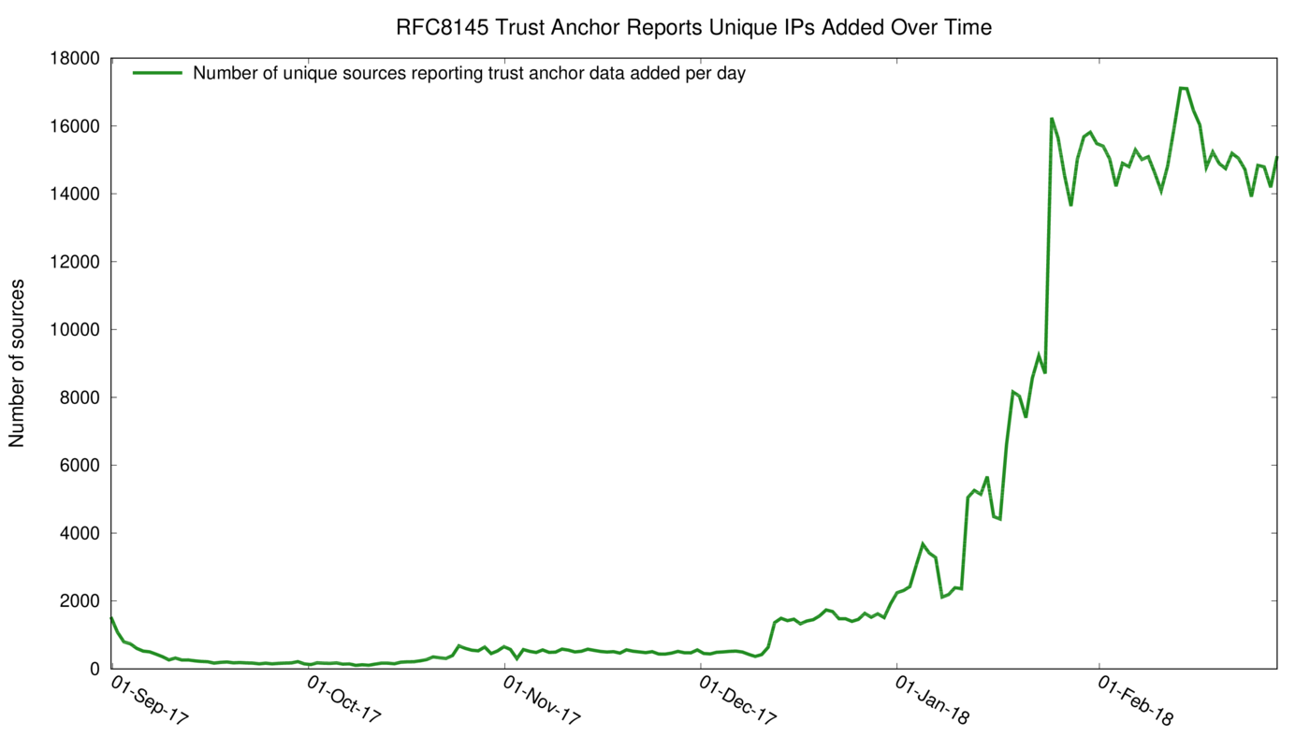
Unique IPs Added Per Day

Slide 12
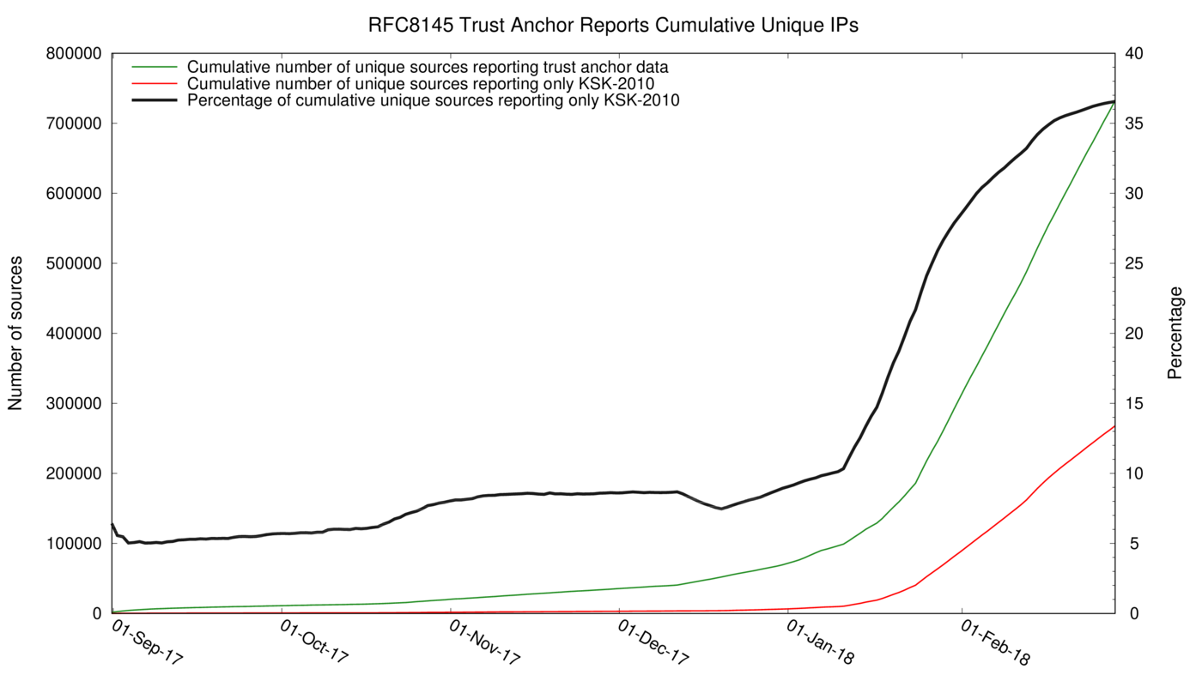
Cumulative Unique IPs Over Time

Slide 13
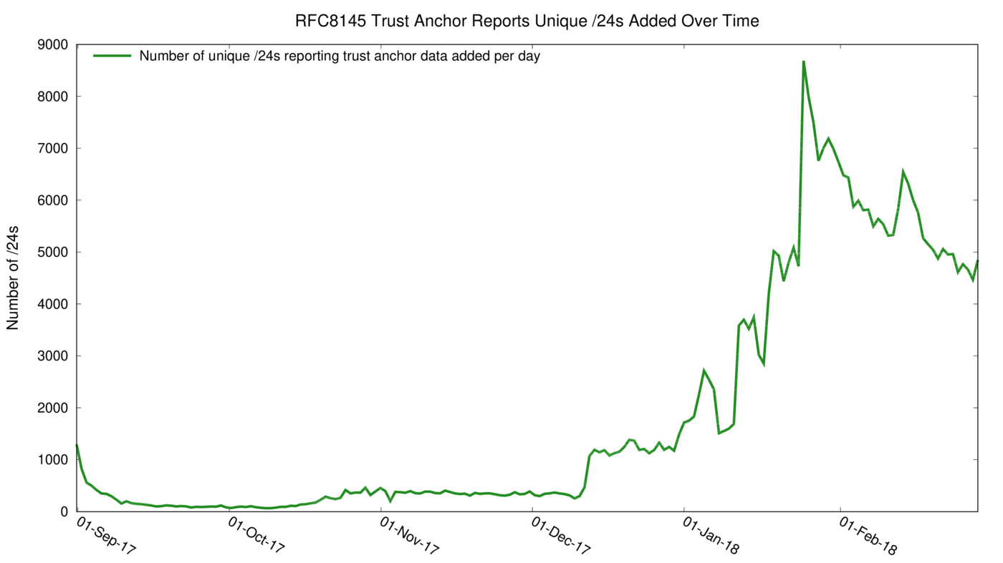
Unique /24s Added Per Day

Slide 14
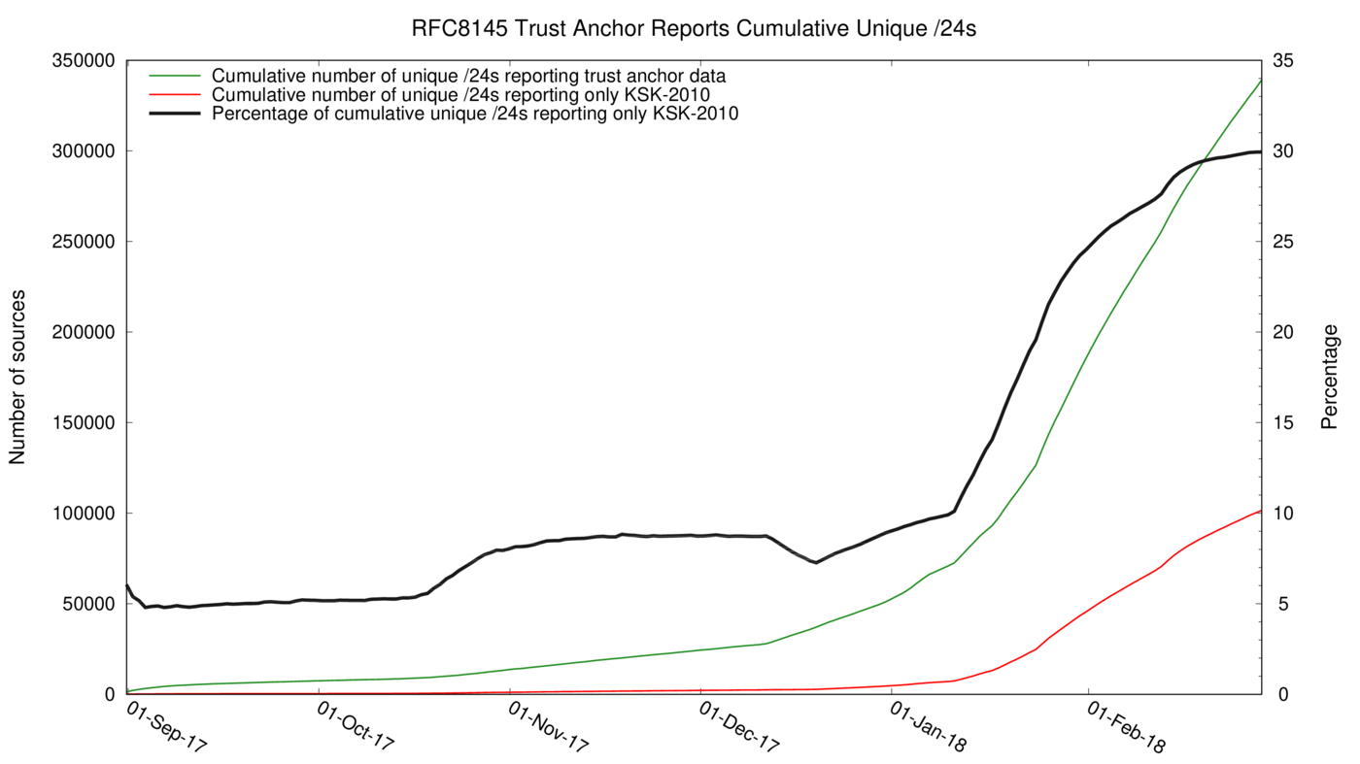
Cumulative Unique /24s Over Time

Slide 15
That’s a Lot of Addresses
Since 1 September 2017:
There’s a difference because some IPs report both KSK-2010 and KSK-2010+KSK-2017
Forwarders?
Started with only KSK-2010 but then changed configuration to add KSK-2017?
IPs reporting KSK-2010 | 267,815
IPs reporting KSK-2010+KSK-2017 | 464,701
Total | 732,516
Total unique IPs | 730,957
Difference | 1,559

Slide 16
RFC8145 Graphs Now Published
http://root-trust-anchor-reports.research.icann.org
Updated weekly

Slide 17
Top 30 ASNs Sending RFC8145 Data
Number of sources | ASN | AS description | Country
41,462 | 55836 | RELIANCEJIO-IN Reliance Jio Infocomm Limited | IN
22,279 | 3320 | DTAG Internet service provider operations | DE
16,084 | 35819 | MOBILY-AS Etihad Etisalat Company (Mobily) | SA
9,808 | 45609 | BHARTI-MOBILITY-AS-AP Bharti Airtel Ltd. AS for GPRS Service | IN
9,761 | 25019 | SAUDINETSTC-AS | SA
9,099 | 39891 | ALJAWWALSTC-AS | SA
9,054 | 7922 | COMCAST-7922 - Comcast Cable Communications, LLC | US
7,981 | 28885 | OMANTEL-NAP-AS OmanTel NAP | OM
7,344 | 22394 | CELLCO - Cellco Partnership DBA Verizon Wireless | US
6,858 | 16135 | TURKCELL-AS Turkcell A.S. | TR
6,593 | 21928 | T-MOBILE-AS21928 - T-Mobile USA, Inc. | US
6,587 | 43766 | MTC-KSA-AS | SA
6,410 | 6830 | LGI-UPC formerly known as UPC Broadband Holding B.V. | AT
6,142 | 6805 | TDDE-ASN1 | DE
6,042 | 3209 | VODANET International IP-Backbone of Vodafone | DE
5,883 | 45595 | PKTELECOM-AS-PK Pakistan Telecom Company Limited | PK
5,802 | 26599 | TELEF√îNICA BRASIL S.A | BR
5,211 | 9121 | TTNET | TR
5,129 | 3215 | AS3215 | FR
5,049 | 50010 | NAWRAS-AS Sultanate of Oman | OM
4,945 | 8452 | TE-AS TE-AS | EG
4,704 | 36873 | VNL1-AS | NG
4,502 | 20057 | ATT-MOBILITY-LLC-AS20057 - AT&T Mobility LLC | US
3,996 | 45271 | ICLNET-AS-AP Idea Cellular Limited | IN
3,886 | 4761 | INDOSAT-INP-AP INDOSAT Internet Network Provider | ID
3,734 | 5384 | EMIRATES-INTERNET Emirates Internet | AE
3,685 | 29256 | INT-PDN-STE-AS STE PDN Internal AS | SY
3,678 | 2856 | BT-UK-AS BTnet UK Regional network | GB
3,657 | 7303 | Telecom Argentina S.A. | AR
3,619 | 9829 | BSNL-NIB National Internet Backbone | IN

Slide 18
Community Assistance
We have distributed a list of IP addresses reporting only KSK-2010
ISPCP and RIRs willing to help track down operators
Two purposes:
Get systems updated with KSK-2017
Continue to look for root causes of non-updating and adjust outreach and actions, as necessary
Making the list more widely available still under consideration

Slide 19
Next Steps
Keep investigating RFC8145 data
Why do some roots (E, J) have a lower percentage reporting KSK-2010?
More analysis of sources at ASN level
Contact ASNs with the most sources reporting only KSK-2010
Encourage and assist others investigating sources reporting only KSK-2010
Continue publicizing the root KSK roll
Keep listening to the community

Slide 20
How You Can Help
Comment on the plan through the ICANN public comment process
Closes 2 April 2018
https://www.icann.org/public-comments/ksk-rollover-restart-2018-02-01-en
Join the ksk-rollover@icann.org mailing list to stay updated

Slide 21
Email: matt.larson@icann.org

