Slide 1
“DNS Flag day”
A tale of five ccTLDs
Hugo Salgado, .CL
Sebastián Castro, .NZ
DNS-OARC 29, Amsterdam

Slide 2
What is EDNS?
RFC 6891
Defines a backward compatible mechanism to signal support for new DNS options
Original specification includes support for DNS responses larger than 512 bytes, extended response codes, etc.

Slide 3
How is it used?
Current extensions:
NSID -- RFC 5001, nameserver identification string
DNSSEC -- DO bit, signals supports or interest for DNSSEC-related records
Client-subnet, RFC 7871, signals the network the query comes from
Keep-alive, RFC 7828, variable timeouts for DNS over TCP
Cookies, IETF Draft, lightweight security mechanism
and more to come

Slide 4
So, what’s the problem?
Authoritative DNS servers block responses, or don’t answer, or answer with the wrong packet.
In general, bad implementations of DNS not following the standards
Poorly implemented firewalls on the way, poor firewall rules blocking valid traffic or unaware of the standards
Resolvers have to send a query, wait for a timeout and retry using a different method: TCP or discard EDNS
Forces delays and thwarts innovation and deployment of new features

Slide 5
What’s DNS Flag day?
DNS implementations decided to remove workarounds in a coordinated way
BIND, Unbound, PowerDNS and Knot will release new versions with the workarounds removed
Feel the pain
If you run inadequate software, your domains will break

Slide 6
How many domains could be affected?
Coordinated effort to measure impact in .CL, .CZ, .SE, .NU and .NZ
Many thanks to Petr Špaček from CZ.NIC for the Compliance Scanner, the .CZ, .SE and .NU data and the feedback
Comparison against existing measures from ISC around root servers and TLDs nameservers

Slide 7
Measurement methodology
“DNS Compliance Testing” tool written by ISC https://gitlab.isc.org/isc-projects/DNS-Compliance-Testing
Only check for EDNS compliance at this stage
“EDNS Compliance scanner for DNS zones” from CZ.NIC:
https://gitlab.labs.nic.cz/knot/edns-zone-scanner/tree/master
Uniquely test all addresses of a nameserver
Preprocess a TLD zone and generate the minimal set of nameserver tests
Test multiple times to discard transient errors

Slide 8
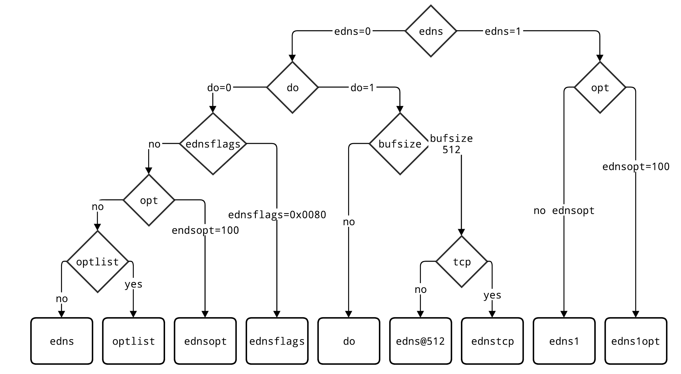
Test hierarchy
Different values and flags are added to the query
There are dependencies, increasing the complexity of the test
edns1opt requires edns1 and endsopt=100 to pass

Slide 9
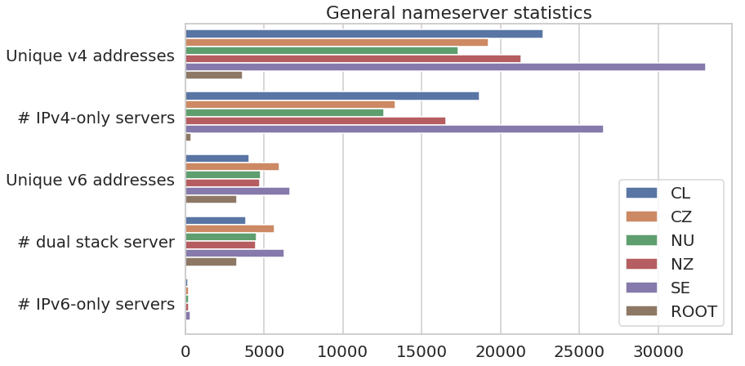
General statistics

Slide 10
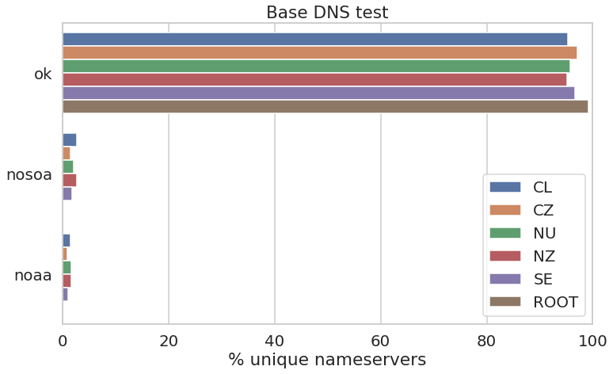
DNS test results
dig +noedns +noad +norec SOA <ZONE>
ok: We got a good answer
nosoa: Response didn’t have SOA record
noaa: no AA bit in response

Slide 11
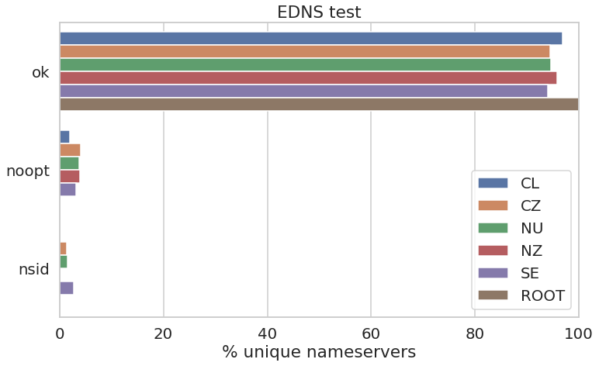
DNS vs EDNS
DNS: dig +noedns +noad +norec SOA <zone>
EDNS: dig +edns=0 +nocookie +noad +norec SOA <zone>

Slide 12
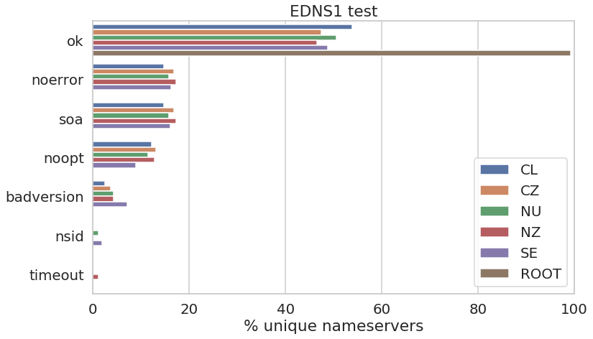
EDNS0 vs EDNS1
EDNS0: dig +edns=0 +nocookie +noad +norec SOA <zone>
EDNS1: dig +edns=1 +noednsneg +nocookie +noad +norec SOA <zone>

Slide 13
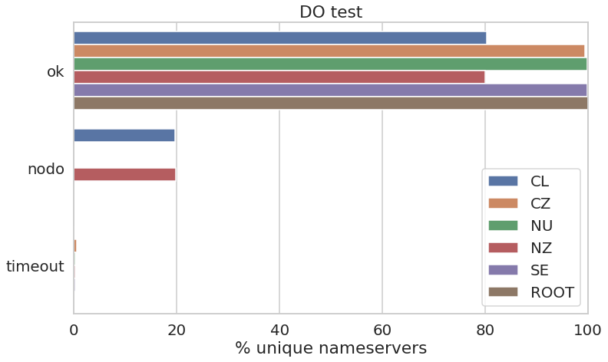
EDNS vs DO
EDNS: dig +edns=0 +nocookie +noad +norec SOA <zone>
DO: dig +edns=0 +nocookie +noad +norec +dnssec SOA <zone>

Slide 14
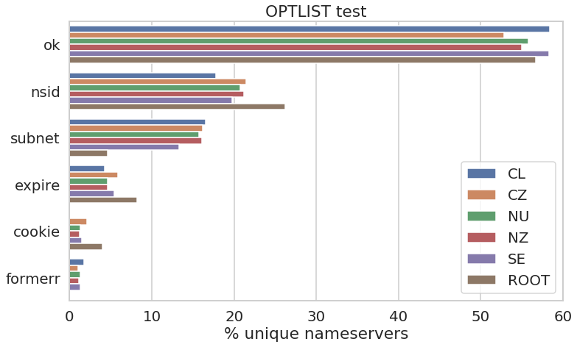
EDNS vs OPTLIST
EDNS: dig +edns=0 +nocookie +noad +norec SOA <zone>
OPTLIST: dig +edns=0 +noad +norec +nsid +subnet=0.0.0.0/0 +expire +cookie=0102030405060708 SOA <zone>
Notes:
Esta prueba es truculenta, pues envia 4 opciones, y cuenta individualmente si las pruebas vuelven. Una respuesta OK no basta en este caso, todas deberian retornar “nsid”, “subnet”, “expire” y “cookie+badcookie” porque la cookie enviada parece que estuviera incorrecta!

Slide 15
IPv4 vs IPv6
Is the behaviour of a given nameserver different depending on which address family was queried? Are they differences between IPv4 and IPv6
We can explore the tests that passed against the family of the address.

Slide 16
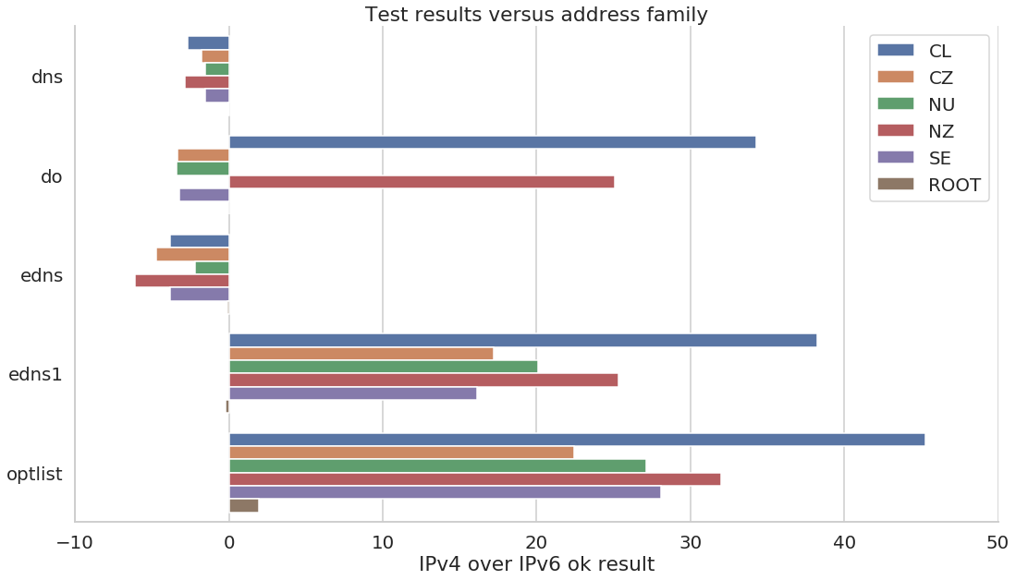
IPv4 vs IPv6
DNS and EDNS tests finish more successfully in IPv6 than IPv4!
EDNS1 and OPTLIST complete a lot more in IPv4 than IPv6!

Slide 17
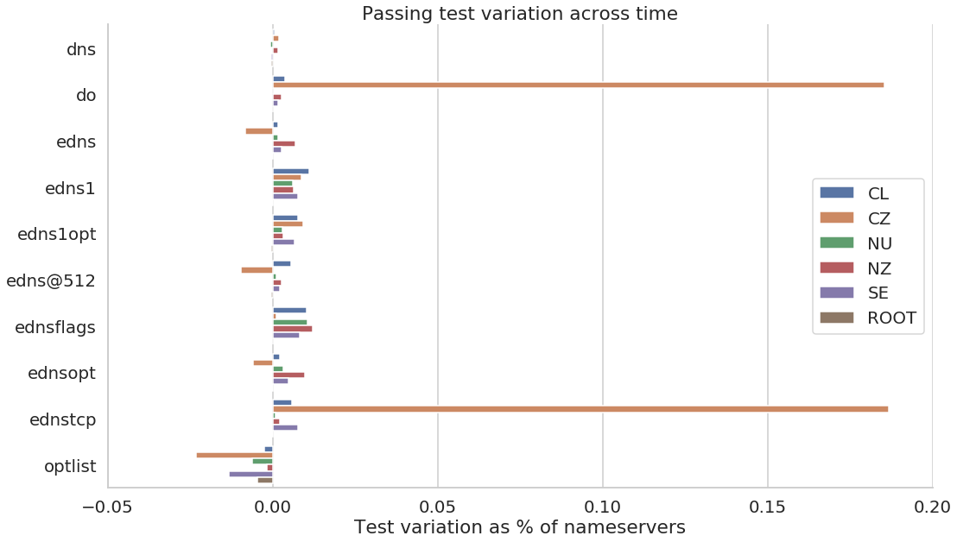
How the results change with time?
First data point is from May to July depending on the ccTLD
Last data point is from October.
CZ is seeing the improvements of their communication campaign.

Slide 18
How can I correct the errors?
Use a modern implementation of DNS software
Use software that follows the standards
Fix your firewall rules, especially around DPI of DNS traffic
Re-test

Slide 19
Future work
We plan to continue the collection monthly to identify trends
Communication campaign to reduce the number of errors.
We encourage other namespace operators (ccTLDs) to check their domains
Watch the world burn on February 1st 2019

Slide 20
Questions
https://dnsflagday.net
Hugo Salgado, hsalgado@nic.cl
Sebastián Castro, sebastian@internetnz.net.nz

