Slide 1
Root Zone KSK Rollover update
Matt Larson
VP of Research, ICANN
…and many, many others at ICANN and Verisign

Slide 2
When Does the Rollover Take Place?
On 16 September 2018, the ICANN Board passed a resolution directing the organization to proceed with its plans to change or “roll” the key for the DNS root zone
On 11 October 2018 at 1600 UTC, the new KSK signature over the root DNSKEY RRset was published for the first time
This is an informal overview of what happened during that day from the perspective of the Root Zone Management Partners

Slide 3
Timeline of events (UTC)
13:00 Root Zone Management Partners join conference bridge
13:00 Verisign generates root zone file
13:15 Verisign inspects root zone file
13:30 Verisign sends root zone file to ICANN
13:30 ICANN inspects root zone file
15:30 ICANN Go/No-go call
15:45 ICANN approves the zone for publication
15:45 Verisign reminds root server operators of scheduled zone push
16:00 Verisign approves root zone file push
16:05 Verisign informs root server operators zone file has been pushed

Slide 4
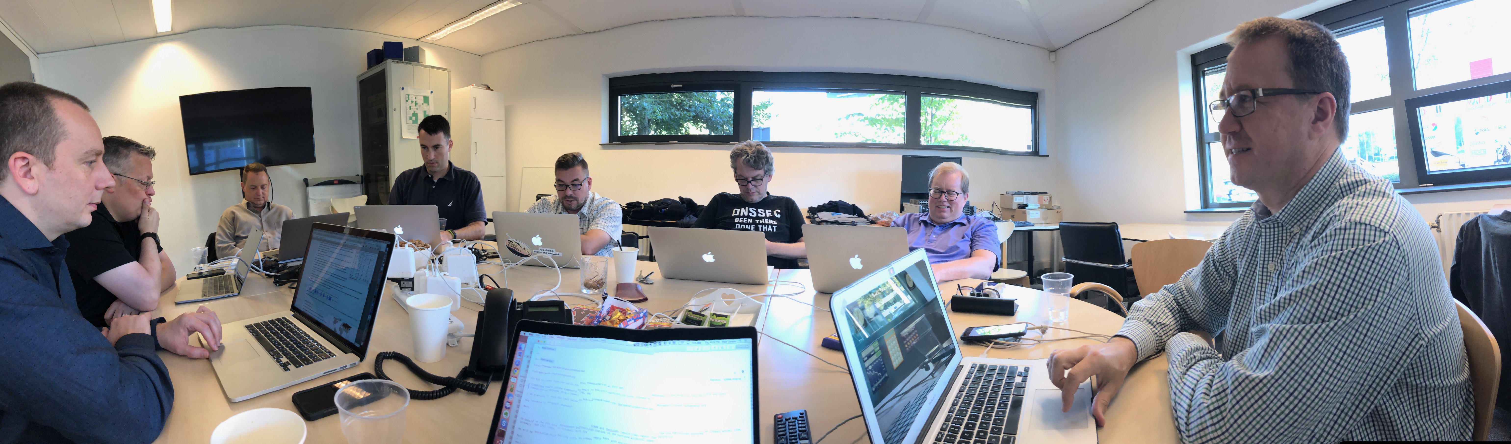

Amsterdam team

Slide 5
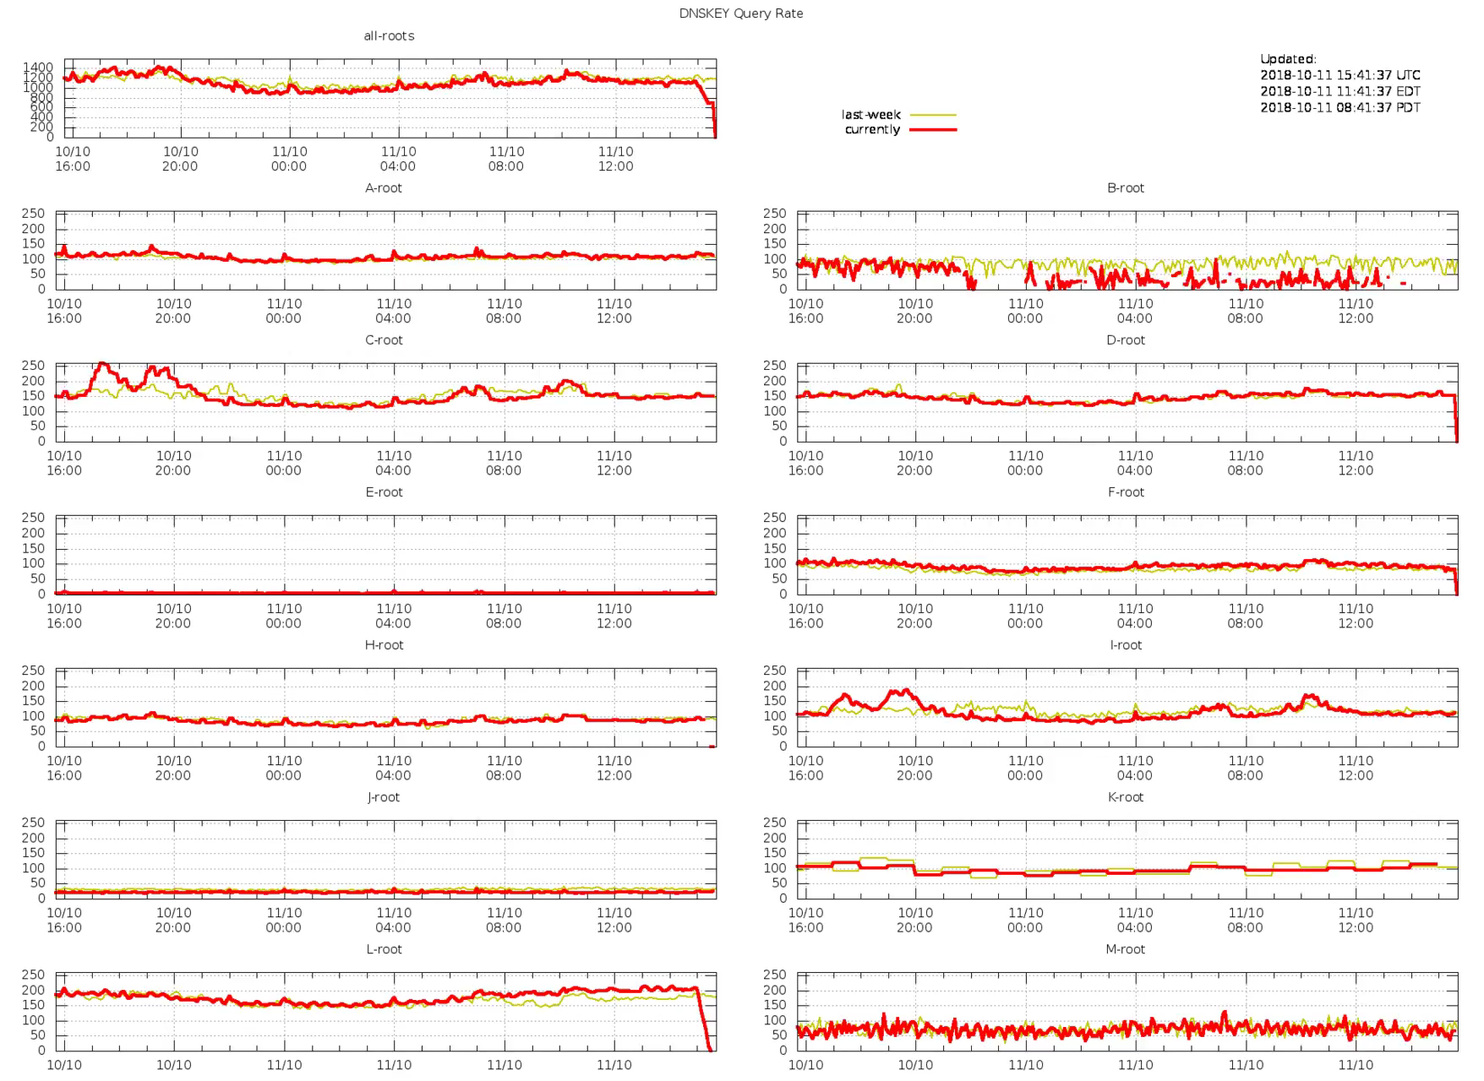
Monitoring

Slide 6
Known issues
No direct reports to ICANN yet
Various other reports via Twitter
Old DNSSEC enabled browsers and plugins:
  Bloodhound (based on Firefox) is old, unsupported code
  DNSSEC-Validator is old, unsupported code
  Both did not have the new key
Debian dnsruby package was updated overnight
Some monitoring tools had the old KSK hardcoded and started warnings
  No report of broken resolvers
Some (two) issues mentioned on mailing lists and IRC

