Slide 1
Trust Anchor Signals from Custom Applications
Barber, Thomas, Weinberg, Wessels
October 14, 2018

Slide 2
Email from ICANN
Subject: [EXTERNAL] Important DNSSEC information about unprepared DNS resolvers in AS7342
On 11 October 2018, ICANN will change or "roll over" the DNSSEC key signing key (KSK) of the DNS root zone. Based on information from your network received at the DNS root name servers [1], we believe that there may be at least one recursive resolver (also referred to as a recursive name server or caching name server) with DNSSEC validation enabled in AS7342 that is unprepared for the KSK rollover. If that resolver is not updated before 11 October 2018, users of that resolver will not be able to resolve any DNS queries, resulting in an outage for them.
To repeat this important point: any DNS resolvers on your network with DNSSEC validation enabled that are not properly updated to use the new KSK will fail on 11 October 2018 or shortly thereafter.

Slide 3
How could this be?
grep 7342 http://root-trust-anchor-reports.research.icann.org/rfc8145-addresses.txt
ASN | 28-day Count | Address | Also saw both TAs
7342 | 3 | 2620:74:3a:100::217 | False
7342 | 1 | 2620:74:3a:100::220 | False

Slide 4
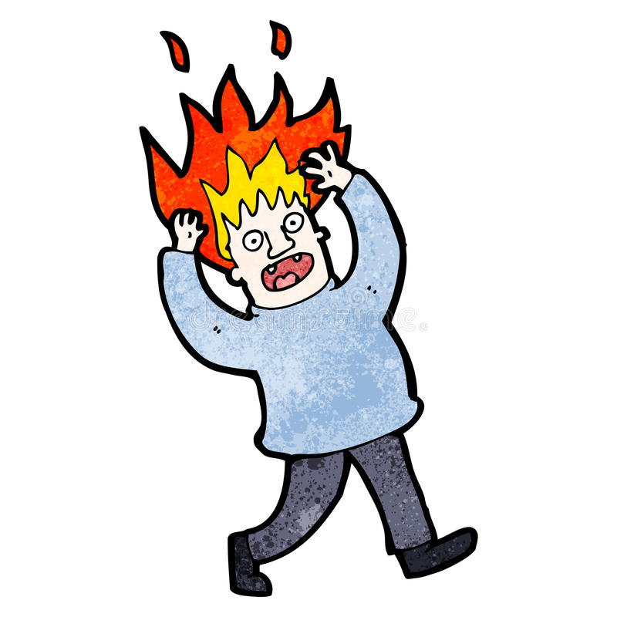
How could this happen?
CC all the people
look at Recursive DNS boxes
check config
check root.anchor file
No problems found
Image source: https://www.123rf.com/photo_16158365_cartoon-character-of-a-man-with-hair-on-fire.html

Slide 5
What if...
...the signal didn’t originate with us?
...a recursive client, perhaps?

Slide 6
Packet Capture Time!
$ tcpdump | grep ‘NULL.*_ta-4a5c\.’
10:04:25.210307 IP XX.137.123.172.43229 > 64.6.64.6.53: 64810+ [1au] NULL? _ta-4a5c. (37)
10:04:25.210307 IP XX.137.123.172.23078 > 64.6.64.6.53: 33478+ [1au] NULL? _ta-4a5c. (37)
10:04:25.210307 IP XX.137.123.172.48291 > 64.6.64.6.53: 8738+ [1au] NULL? _ta-4a5c. (37)
10:04:25.211316 IP ZZ.7.73.217.13327 > 192.5.5.241.53: 26701% [1au] NULL? _Ta-4a5c. (37)

Slide 7
What other queries come from XX.137.123.172?
$ tcpdump | grep XX.137.123.172
10:04:23.189356 IP XX.137.123.172.54540 > 64.6.64.6.domain: 2+ AAAA? dns.msftncsi.com. (34)
10:04:23.212666 IP XX.137.123.172.34455 > 64.6.64.6.domain: 3+ A? dns.msftncsi.com. (34)
10:04:23.572534 IP XX.137.123.172.24622 > 64.6.64.6.domain: 40858+ [1au] TXT? updates.moneropulse.net. (52)
10:04:23.573544 IP XX.137.123.172.57112 > 64.6.64.6.domain: 40185+ [1au] TXT? updates.moneropulse.co. (51)
10:04:23.573544 IP XX.137.123.172.18723 > 64.6.64.6.domain: 7901+ [1au] TXT? updates.moneropulse.org. (52)
10:04:23.573544 IP XX.137.123.172.35646 > 64.6.64.6.domain: 37488+ [1au] TXT? updates.moneropulse.se. (51)
10:04:25.208288 IP XX.137.123.172.6024 > 64.6.64.6.domain: 14979+ [1au] TXT? updates.moneropulse.org. (52)
10:04:25.208288 IP XX.137.123.172.14259 > 64.6.64.6.domain: 23079+% [1au] TXT? updates.moneropulse.org. (52)
10:04:25.209297 IP XX.137.123.172 > 64.6.64.6: ICMP XX.137.123.172 udp port 18723 unreachable, length 556
10:04:25.209297 IP XX.137.123.172.43460 > 64.6.64.6.domain: 1390+% [1au] TXT? updates.moneropulse.org. (52)
10:04:25.210307 IP XX.137.123.172.43229 > 64.6.64.6.domain: 64810+ [1au] NULL? _ta-4a5c. (37)
10:04:25.210307 IP XX.137.123.172.23078 > 64.6.64.6.domain: 33478+ [1au] NULL? _ta-4a5c. (37)
10:04:25.210307 IP XX.137.123.172.48291 > 64.6.64.6.domain: 8738+ [1au] NULL? _ta-4a5c. (37)
10:04:25.210307 IP XX.137.123.172.52658 > 64.6.64.6.domain: 55282+% [1au] TXT? updates.moneropulse.org. (52)
10:04:25.210307 IP XX.137.123.172.16817 > 64.6.64.6.domain: 34291+% [1au] TXT? updates.moneropulse.org. (52)
10:04:27.769329 IP XX.137.123.172.56725 > 64.6.64.6.domain: 2+ AAAA? dns.msftncsi.com. (34)
10:04:27.853466 IP XX.137.123.172.33297 > 64.6.64.6.domain: 3+ A? dns.msftncsi.com. (34)
10:04:33.854205 IP XX.137.123.172.35104 > 64.6.64.6.domain: 2+ AAAA? dns.msftncsi.com. (34)
10:04:33.855214 IP XX.137.123.172.52980 > 64.6.64.6.domain: 12094+ A? time.nist.gov. (31)
10:04:33.886635 IP XX.137.123.172.36501 > 64.6.64.6.domain: 3+ A? dns.msftncsi.com. (34)
Hmmm… Monero…?

Slide 8
What is Monero?
Open-source cryptocurrency
Blockchain, proof-of-work, etc.
Ranked 10th in market capitalization per coinmarketcap.com
https://github.com/monero-project/monero
libunbound is a dependency
Unbound enabled RFC 8145 signaling by default as of v1.6.7 (Oct 2017)
Monero logo: https://getmonero.org/press-kit/

Slide 9
Monero has a hard-coded trust anchor
src/common/dns_utils.cpp:
/*
* The following two functions were taken from unbound-anchor.c, from
* the unbound library packaged with this source. The license and source
* can be found in $PROJECT_ROOT/external/unbound
*/
[...]
/** return the built in root DS trust anchor */
static const char*
get_builtin_ds(void)
{
return
". IN DS 19036 8 2 49AAC11D7B6F6446702E54A1607371607A1A41855200FD2CE1CDDE32F24E8FB5\n";
}

Slide 10
Monero emits trust anchor signals at startup
20:38:36.261509 IP 45.56.70.104.28395 > 173.255.199.5.53: 36362+ [1au] A? seeds.moneroseeds.li. (49)
20:38:36.261930 IP 173.255.199.5.53 > 45.56.70.104.28395: 36362 NXDomain 0/1/1 (111)
20:38:36.263128 IP 45.56.70.104.6731 > 66.228.53.5.53: 54801+ [1au] A? seeds.moneroseeds.ae.org. (53)
20:38:36.263390 IP 66.228.53.5.53 > 45.56.70.104.6731: 54801 NXDomain 0/1/1 (115)
20:38:36.263917 IP 45.56.70.104.41930 > 72.14.188.5.53: 26564+ [1au] A? seeds.moneroseeds.ch. (49)
20:38:36.265010 IP 45.56.70.104.65371 > 72.14.188.5.53: 59840+ [1au] A? seeds.moneroseeds.se. (49)
20:38:36.265161 IP 45.56.70.104.60189 > 72.14.188.5.53: 20577+% [1au] DNSKEY? . (28)
20:38:36.265194 IP 45.56.70.104.54616 > 173.255.199.5.53: 40475+ [1au] NULL? _ta-4a5c. (37)
20:38:36.265288 IP 45.56.70.104.8754 > 173.255.199.5.53: 59865+% [1au] DNSKEY? . (28)
20:38:36.265515 IP 45.56.70.104.10562 > 72.14.188.5.53: 9525+ [1au] NULL? _ta-4a5c. (37)
If linked with Unbound 1.6.7 or later

Slide 11
Does Monero work with a bad trust anchor?
Maybe? Sort of...?
Monero uses DNS for
  Software updates (TXT)
  Checkpoints (TXT)
  Segregation height in wallet code (TXT)
  Address lookups (A, AAAA)
load_txt_records_from_dns() logs a warning and doesn’t return unvalidatable answers
2018-09-05 19:00:52.869 [P2P1] WARN net.dns src/common/dns_utils.cpp:509 WARNING: no two valid MoneroPulse DNS checkpoint records were received
In functions like node_server(), dnssec_valid return flag is not checked.

Slide 12
Monero output with bad TA
- Modified source code to use a bad trust anchor
2018-09-07 10:00:26.494 [P2P1] INFO global src/cryptonote_protocol/cryptonote_protocol_handler.inl:310 [70.49.140.40:53878 INC] Sync data returned a new top block candidate: 1656021 -> 1646386 [Your node is 9635 blocks (13 days) ahead]
SYNCHRONIZATION started
2018-09-07 10:00:27.317 [P2P2] INFO global src/cryptonote_core/blockchain.cpp:1534 ----- BLOCK ADDED AS ALTERNATIVE ON HEIGHT 1646385
id: <17034c69f9a43840d0cd63e9ab556d143455d833845cd92b2c45f20b82ae6b24>
PoW: <a9c8f5a5add64e44f80ae1caf69b009e287739ebc6db7a4a87a2100100000000>
difficulty: 53596510308
2018-09-07 10:00:27.318 [P2P2] INFO global src/cryptonote_protocol/cryptonote_protocol_handler.inl:1561 SYNCHRONIZED OK
2018-09-07 10:54:34.322 [P2P8] WARN net.dns src/common/dns_utils.cpp:509 WARNING: no two valid MoneroPulse DNS checkpoint records were received
2018-09-07 11:54:34.437 [P2P7] WARN net.dns src/common/dns_utils.cpp:509 WARNING: no two valid MoneroPulse DNS checkpoint records were received
2018-09-07 11:55:26.333 [P2P8] INFO global src/cryptonote_core/blockchain.cpp:1534 ----- BLOCK ADDED AS ALTERNATIVE ON HEIGHT 1591490
id: <87c752cdeee4c9ba7aefc879ca1285e39563e1a5c752fc6d8d743a2be452812d>
PoW: <db280407898f1f66f1ef1a8cf74f0001913b0c97fcd5cc691820300600000000>
difficulty: 46963208575
2018-09-07 12:54:50.514 [P2P7] WARN net.dns src/common/dns_utils.cpp:509 WARNING: no two valid MoneroPulse DNS checkpoint records were received
2018-09-07 13:37:42.970 [P2P2] INFO global src/cryptonote_core/blockchain.cpp:1534 ----- BLOCK ADDED AS ALTERNATIVE ON HEIGHT 1656128
id: <82567e414b4c8c634fbec5749eb6d8f3a3661b8d5d6069f3b57264ae6de8c673>
PoW: <ee5c9960d9c63b87e956f564d8deca7cbf43169adbd5723ff9a2e70100000000>
difficulty: 66702392438
2018-09-07 13:56:25.337 [P2P9] WARN net.dns src/common/dns_utils.cpp:509 WARNING: no two valid MoneroPulse DNS checkpoint records were received
2018-09-07 14:59:23.618 [P2P1] WARN net.dns src/common/dns_utils.cpp:509 WARNING: no two valid MoneroPulse DNS checkpoint records were received

Slide 13
Opened a github issue
Marked as duplicate, Roy Arends (ICANN) beat us to it (10 days)
  Roy opened hundreds of issues on similar projects (thanks Roy!)
Developer was unsure of DNSSEC specifics and bad trust-anchor consequences
  “The code does enforce validation if there is a DNSSEC signature, but accepts unsigned data IIRC.”

Slide 14
Thoughts / Lessons

Slide 15
TA signals from applications
RFC 8145 trust anchor signaling perhaps did not fully anticipate signals from applications vs validating name servers.
It’s good to see validation in applications.
kskroll-sentinel won’t find applications with bad trust anchors.

Slide 16
Applications and TA updates
How should applications keep trust anchors updated?
This is tied up with the way Unbound works and is distributed.
For the name server, an unbound-anchor service generally runs alongside.
Unix applications can depend on libunbound, which doesn’t include the unbound-anchor service.
libunbound doesn’t provide a TA.
Applications must provide their own TAs.
Can this be improved?

Slide 17
Not checking validation status
An application that sends TA signals but doesn’t enforce validation leads to confusion.
RFC 8145 treats validation as black / white
  Either you (always) validate, or you don’t

