Slide 1
Updates to ‘dnscap’
Duane Wessels
DNS-OARC Workshop Dublin
May 12, 2013

Slide 2
What is dnscap?
DNS-specific tcpdump
Splits output files by time/count
Start/Stop at specific times
Select/exclude by direction, address, query name, etc.
Supports IPv6, TCP, fragments, VLANs
Reads from multiple interfaces

Slide 3
Traditional Design
packet sources
dnscap process
pcap files
on disk

Slide 4
Plugin Design
packet sources
dnscap process
plugin outputs
?

Slide 5
Plugin API
function | description
getopt() | command line processing
usage() | summary of options and args
start() | called once at program start
stop() | called once at program exit
open() | called at start of each collection interval
close() | called at end of each collection interval
output() | output or process a packet

Slide 6
Plugin Complications

Slide 7
Packet Selectors
dnscap main process has various packet selection options
source/destination addresses
queries/responses
names, opcodes, etc
Different plugins may have different selection criteria
Plugin “A” wants queries and responses
Plugin “B” wants only queries

Slide 8
Packets vs Messages
Prior to plug-ins, dnscap’s goal was to save packets to disk.
IP fragments are written but dnscap does not de-fragment.
This means all fragments are written, not just DNS fragments.
TCP state is held only to make packet selection decisions. dnscap does not perform full TCP reassembly.
Should dnscap do reassembly and pass fully formed messages to the plugins??
Then you can’t have a “pcapwriter” plugin

Slide 9
Command line becoming unwieldy
dnscap -6fT \
-t 600 \
-i eth0 \
-z 192.168.1.1 –z dead:beef::1 \
-P plugin1.so \
-f foo \
-b bar \
-- \
-P plugin2.so \
--xyzzy \
--plugh
Time for a config file?

Slide 10
Root Server Scaling Measurements

Slide 11
Root Zone Scaling Measurements
“RSSAC have identified an initial set of parameters that they believe would be useful to monitor for the root zone scaling concern, as identified by SSAC and the ICANN Board, and where monitoring should be implementable without major changes within the root zone system.
The latency in the distribution system
The size of the overall root zone
The number of queries
The response size distribution
The number of sources seen”
http://www.icann.org/en/groups/rssac/root-scaling-measurements-07dec12-en.pdf

Slide 12
rssm plugin
Counts # of udp/tcp ipv4/ipv6 queries/responses
query/response size distribution in 8-byte buckets
Full list of all source IP addresses

Slide 13
Example Usage
$ dnscap \
-6fT \
-t 600 \
-i eth0 \
-z 198.41.0.4 –z 2001:503:ba3e::2:30 \
-P plugins/rssm.so \
-w /data/dnscap/rssm \
-s /data/dnscap/sources
-P rssm.so load ‘rssm’ plugin
-w … write counters to files prefixed with /data/dnscap/rssm
-s … write sources to files prefixed with /data/dnscap/sources
output files are suffixed with timestamp of first packet

Slide 14
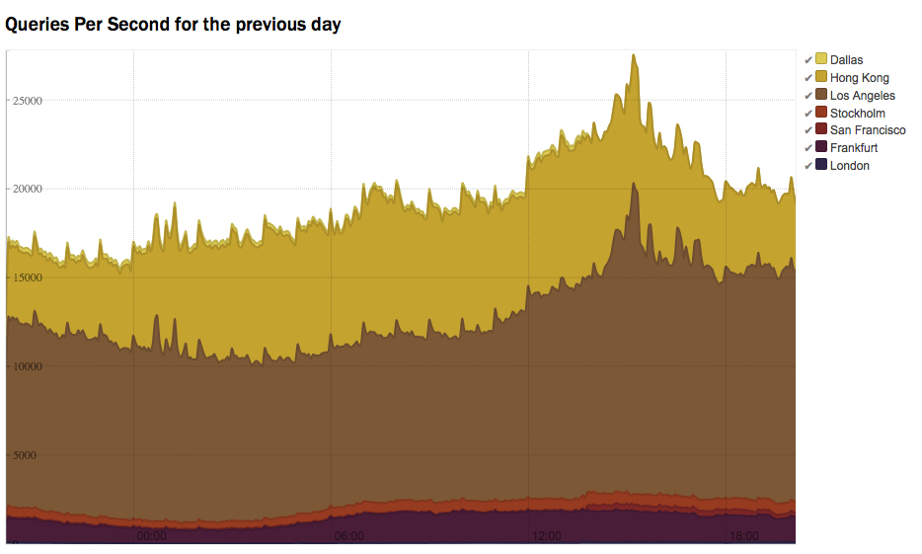
A-root stats via dnscap/rssm
DRAFT

Slide 15
Code
Current dnscap code lives at github:
https://github.com/verisign/dnscap/
$ git clone https://github.com/verisign/dnscap.git
$ cd dnscap
$ ./configure && make
$ cd plugins/rssm
$ make
Mailing List:
https://lists.dns-oarc.net/mailman/listinfo/dnscap-users

