Slide 1
ICANN’s Preparedness for Signing the Root
September 24, 2008
DNS OARC Meeting, Ottawa, CA
richard.lamb@icann.org

Slide 2
DNSSEC Activity
Calls from the community to sign the root.
TLD’s sign their zones
Close cooperation with DNSSEC deployment and security experts to develop signing system for .arpa and root
Signed root publicly available at ns.iana.org for over a year
Presentations describing system and seeking feedback at various fora
DNSSEC and root zone management are part of ICANN Strategic Plan – a primary part of our business
DNSSEC @ ICANN paper published (7/24)
Interim-TAR (almost there), RZM (ongoing)
Kaminsky (8/5)
ICANN submits proposal to sign the root (9/2)
NTIA response (9/9) http://www.icann.org/correspondence/

Slide 3
elements of root signing
Important elements of a root-signing solution are transparency, public consultation, broad stakeholder participation (e.g. key ceremony), flexibility, reliability, and trust;
Solution has to balance various concerns, but must provide for a maximally secure technical solution and one that provides the trust promised by DNSSEC;
An open, transparent and international participatory process will allow for root zone management to adapt to changing needs over time as DNSSEC is deployed throughout the Internet and as new lessons are learned.

Slide 4
Preservation of Trust
Maintain trust from TLD operator to signed root. Any chain is only as strong as its weakest link.
Increased confidence in DNS will depend more on this chain.
Eliminate avenues for potential corruption during transmission between organizations.
Keys (DS) should not have to go to another organization before being protected by signing.
So the validator of changes signs the zone. A conclusion other DNSSEC deployers have come to.
Will allow for timely and accurate TLD key replacement in the face of compromise
Introduction of new gTLDs will stress this link

Slide 5
Transparency
Open and transparent process for technical infrastructure design and signing oversight functions.
KSK’s not under control of one organization.
No security through obscurity: open source and designs
Continuous collaboration with DNSSEC experts to evolve design as lessons are learned.
Regular auditing and reports

Slide 6
Preparedness
IANA’s “business” is root zone management. DNSSEC is part of ICANN’s Strategic Plan.
IANA signed root was developed closely with DNSSEC experts. Publicly available for 15 months.
Interim-TAR during the testing period (almost done! delayed by very effective TLD recursive resolver and patch effort – thank you Kim+OARC+operators!)
RZM would be modified to be ready to handle DS records incorporating technology and lessons from I-TAR
Automation: signing, ZSK rollover (to avoid costly risk of service failures and errors), monitoring, notifications
Kept the process and design simple
Final design and ongoing modifications would be based on public consultation process with experts
Plan on regular audits and reports on system operation and security

Slide 7
Behind ns.iana.org
2-3 INSTANCES
vetting process, accept/reject
HSM KSK
HSM ZSK
CLASS 5 IPS CONTAINER
ROOT DB
System status at: https://ns.iana.org/dnssec/status.html
SIGNER
SIGNER
ADMIN
RZM
NS
NS
SIGNER, NS, ROOT DBs: DELL 1950 /w 2xPS, 2XSAS, 2xCPU
I-TAR
ns.iana.org
208.77.188.32
HSM: AEP KEYPER FIPS 140-2 Level 4 (Disposable)
pch-test.iana.org anycast
24 hr manned multiple biometric controlled facility, NSA NSTISSP #10, GSA Class 5 Safe (approved for Top Secret)
TEST A
TLDs
TEST M

Slide 8
Key Ceremony
Keys are not under the control of a single organization. IANA is key custodian only.
Fresh key generation hardware each KSK gen. Dispose or recycle old.
Community decides how, where, when, and who
Any Interested stakeholders, auditors, publishers. Key has value only when witnessed and published by all.
Filmed and broadcast
Keys cannot be extracted, cloned or otherwise. Private key in FIPS 140-2 level 4 HSM (used by UN treaty org, etc). Key never leaves HSM. Tamper attempt destroys contents.
Backup HSM’s configured during Key Ceremony
Community decides how, where, and who for backup and disaster recovery
Other schemes using other equipment (e.g., M of N) supported via PKCS11 standard interface.

Slide 9
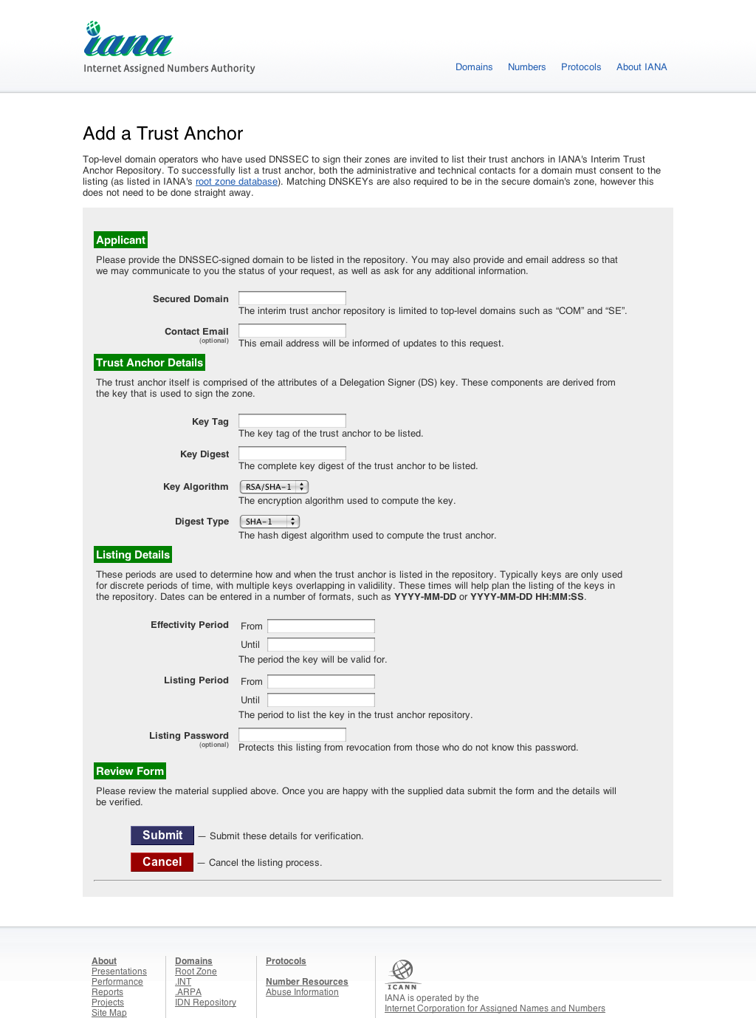

Slide 10
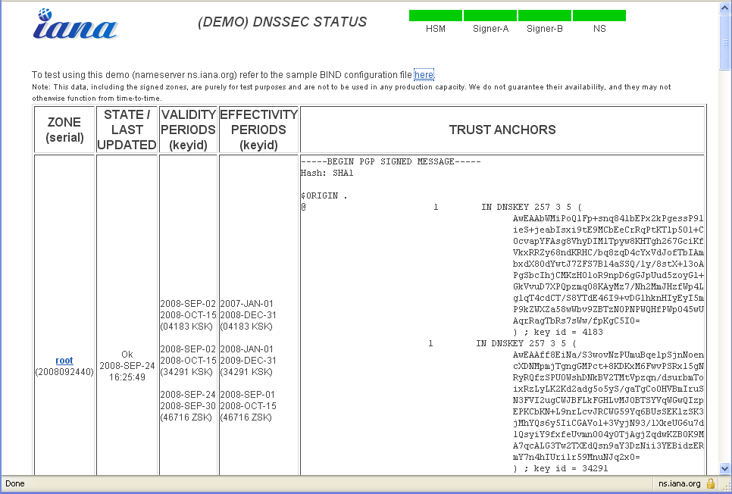

Slide 11
Wasn’t done alone: Thanks to: Paf, Olaf, Roy, Jakob, Dickinson, Russ, Soltero (.pr), Crocker, drc, Don Davis, David Miller, …
Thank you for listening
Questions ?

