Slide 1
Building Trust with Anchors
Eric Osterweil
Dan Massey
Lixia Zhang

Slide 2
What is DNSSEC and How it Works
Just kidding…
Does anyone really want another DNSSEC 101?
First, background on how DNSSEC actually works

Slide 3
What Do We Have Today
Zone admins know their own DNSKEYs
Nominally, this info is held in a local file
Some software is starting to bundle DNSKEY sets in local config files to bootstrap resolvers
Lets resolvers verify DNSSEC data out of the box
Useful in some ways, but…
What’s the shelf-life of those keys?
Don’t change that file, or when you update, you get your changes overwritten

Slide 4
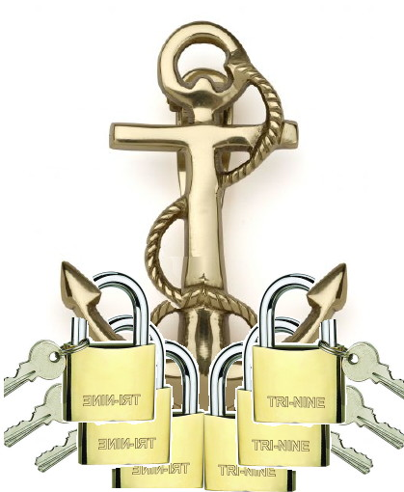
Key Configuration Today
Software key file
Locally managed configuration

Slide 5
Using Local Files for Verification
Thus, our starting point today is a set of two types of local files
This structure has some clear benefits
Local verification can be done without introducing external (especially single) points of failure
Local knowledge can take precedence over 3rd party data
Ops can even remove keys that use “undesirable” crypto algorithms (i.e. GOST vs. RSA)

Slide 6
One More Step Completes the Spectrum
What about keys that an operator believes should override or supplement the distro file, but not based on local knowledge?
Keys from web pages, newspapers, Ms. CleoTM, etc.
One more type of file gives a sufficient set of basic trust management components
A TAR keys file

Slide 7
Adding TARs to This
Vendor key file
Local config
Keys from TAR
(in the sky)

Slide 8
Managing Trust Anchors
Will we always need local TAs?
I think yes (consider local knowledge if nothing else)
Trust management should be done locally
Isolation from 3rd party failures
Local ground truth
Local policies
Three basic elements facilitate this
Local configuration key file + TAR key file + vendor key file
Now resolvers can function out of the box
In addition, can still use local knowledge, preferences, and expertise to enhance operations

Slide 9
Thanks

Slide 10
Backup

Slide 11
DNSSEC Background
DNSSEC provides origin authenticity, data integrity, and secure denial of existence by using public-key cryptography
Origin authenticity:
Resolvers can verify that data has originated from authoritative sources.
Data integrity
Can also verify that responses are not modified in-flight
Secure denial of existence
When there is no data for a query, authoritative servers can provide a response that proves no data exists

Slide 12
How DNSSEC Works
DNSSEC zones create public/private keys
Public portion goes in DNSSEC record type: DNSKEY
Zones sign all RRsets and resolvers use DNSKEYs to verify them
Each RRset has a signature attached to it: RRSIG
So, once a resolver has a zone’s DNSKEY(s) it can verify that RRsets are intact by verifying their RRSIGs

Slide 13
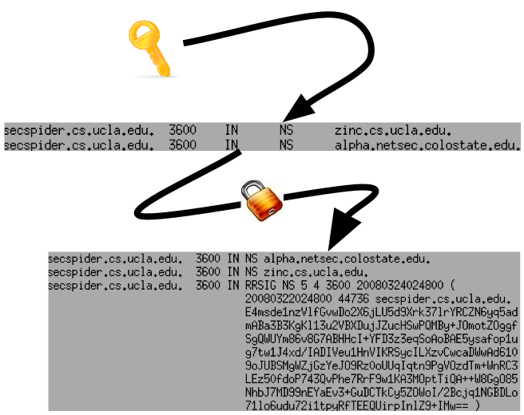
Signing Example
Using a zone’s key
on a standard RRset
(the NS)
Signature (RRSIG) will only verify with the
DNSKEY if no data was modified

Slide 14
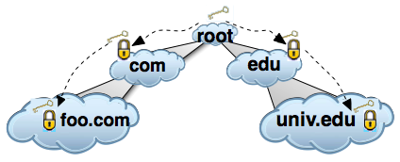
Getting the Keys
Until a resolver gets the DNSKEY(s) for a zone, data can be spoofed
How can a resolver know that the DNSKEYs themselves are not being spoofed?
DNSSEC zones securely delegate from parents to children
Zones that have no secure parents are called trust anchors
When a zone is a trust anchor the zones that it delegates to (and itself) form an island of security

