Slide 1
Security, For DNS and by DNS
ZHOU Yonglin
Beijing, Dec 6th, 2009

Slide 2
DNS and Security
FOR DNS
BY DNS
SECURITY

Slide 3
SECURITY, FOR DNS
DNS attack Handling
Vulnerability Handling
DNS Monitoring

Slide 4
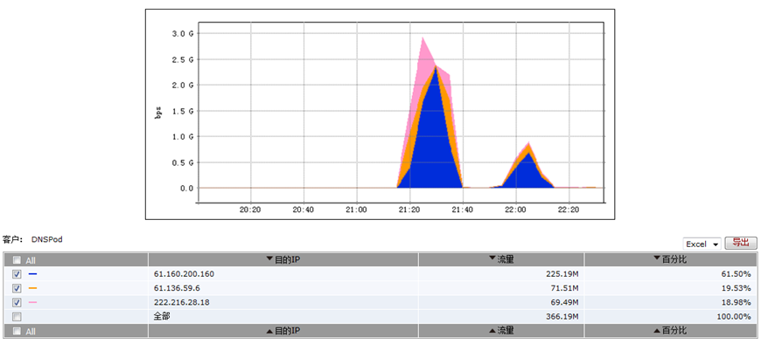
5.19 “Storm Gate”: Attack Flow Against DNSPOD
2009/05/18 21:00

Slide 5
5.19 “Storm Gate”: General View of Recursive DNS Query Flow of China networks
05/18-05/19

Slide 6
Emergency Response
2009/5/19
Monitor the abnormal flow against the DNS Servers
Analyze the abnormal flow against the DNS Servers
2009/5/22
Trace the attack origins against DNSPOD
2009/5/25
Provide evidence for case cracking, prosecution

Slide 7
Other Attack Cases Against DNS
2009/6/9 9:30
DDos attack against 4 DNS servers of XinWangHuLian, Beijing(www.dns.com.cn)
0.5 million domain names got resolution failures
2009/7/3 3:00
DDos attack against DongNanRongTong, Xiamen
Attack Volume 300M, service outage lasting 7 hours or so
2009/6/10- /6/12
DDos attack against XiWang Dynamic DNS Service System
Service outage influences millions of enterprises and customers

Slide 8
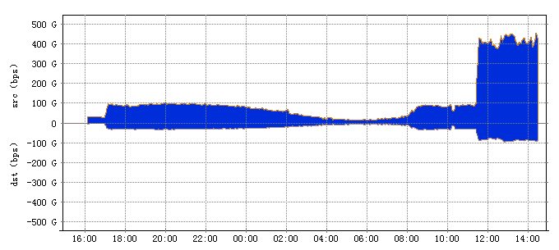
DNS Spoof Vul. Published by Dan Kaminsky

Slide 9
Metasploit 3.2

Slide 10
Emergency Response
2008/7/28
Publishing the Vulnerability Report on CNCERT web site
Convening telecommunication operators, DNS Registry/Registrar for information sharing
2008/7/29
Monitoring Domain Name Hijack
Monitoring attack flow against DNS service

Slide 11
Bind Dos Vul.(CVE-2009-0696)
Report：2009/07/28
Debian Bug report logs - #538975 bind9 dies with assertion failure (db.c:579)
Detail:：
db.c:659: REQUIRE(type != ((dns_rdatatype_t)dns_rdatatype_any)) failed exiting (due to assertion failure).
Affected Systems:
ISC BIND 9.x(0<=x<=6)

Slide 12
Emergency Response
2009/7/29
Verify and analyze vulnerability
Publish BIND 9 critical vulnerability report
Convene telecommunication operators for information sharing
2009/7/30
Publish BIND 9 Vulnerability danger level and scope
Convene registry and registrar for information sharing and response proposal
2009/7/31
Track the vulnerability patch progress

Slide 13
Bind Dos Vul. Patch Application Monitoring
07/31-09/17

Slide 14
DNS Status and Domain Name Hijack Monitoring

Slide 15
SECURITY, BY DNS
Conficker Worm Monitoring
Passive Domain Monitoring
Malicious Server Handling

Slide 16
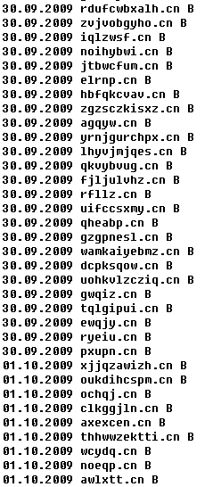
Conficker Sinkhole Based on DNS Support
.B(40+)+.C(400+)

Slide 17
Passive DNS Monitoring by Telecommunication Operator
Analysis on Abnormal Domain Name
DNS Server Status Analysis
IP Reverse Resolution
Behavior based Botnet Controller Analysis
Request number for specific domain names
Request Client number for specific domain names
Botnet Controller Domain Name Derived from IP
Tracking of Malicious Domain Name

Slide 18
Behavior Based Controller Abnormal Domain Name Analysis
darkroot.3322.org 117.11.227.119
zjddos.3322.org 121.12.127.173
haoj8.3322.org 124.234.102.22
ashly.9966.org 221.236.6.230
magic365.9966.org 74.208.171.169

Slide 19
DNS Server Status Analysis

Slide 20
Statistics of TLD Request - TOP10
TLD | Request Times | Percentage
com | 1004715 | 70.21%
cn | 183685 | 12.84%
net | 120863 | 8.45%
org | 26518 | 1.85%
in-addr.arpa | 25217 | 1.76%
info | 6144 | 0.43%
tv | 5843 | 0.41%
biz | 4578 | 0.32%
cc | 4538 | 0.32%
ws | 4237 | 0.30%
2009-11-04T20-55

Slide 21
Statistics of Second Level Domain Name Request - TOP10
SLD | Request times | Percentage
qq.com | 455506 | 31.83%
com.cn | 59997 | 4.19%
sandai.net | 40742 | 2.85%
baidu.com | 30941 | 2.16%
tencent.com | 28032 | 1.96%
360safe.com | 20741 | 1.45%
xunlei.com | 20521 | 1.43%
sohu.com | 11543 | 0.81%
3322.org | 11442 | 0.80%
taobao.com | 10565 | 0.74%
2009-11-04T20-55

Slide 22
IP Reverse Resolution
Select distinct domain_name, time form pasv_dns_table where ip= ‘60.13.152.131’
2009-11-05T06-25 www3.caishow.com
2009-11-05T06-25 www.msjyfund.com.cn
2009-11-05T06-25 s18.wo99.com
2009-11-05T06-25 www.1mi1.cn
2009-11-05T06-25 wwwxjrsf.cn
2009-11-05T06-25 q8me.igap.bihu.com
2009-11-05T06-25 wap11.qqmail.com
2009-11-05T06-25 b0bfac4.iprophesy.com.cn
2009-11-05T06-25 event50.wanmei.com
2009-11-05T06-25 pfad.netmovie.com.cn
2009-11-05T06-25 www.60.13.152.131.com
2009-11-05T05-50 gxway168cn.net
2009-11-05T05-50 e891.p.akamaiedge.net
2009-11-05T05-50 www.ebank.95599.cn
2009-11-05T05-50 a1293.g.akamai.net
2009-11-05T05-50 a151.ce.w.tl88.net

Slide 23
Tracking Malicous Domain Name Record
Select distinct time, domain_name, ip form pasv_dns_table where domain_name= ‘114pc1.3322.org’
2009-11-05T06-05 114pc1.3322.org 61.164.109.4
2009-11-05T06-10 114pc2.3322.org 60.191.196.227
2009-11-05T06-15 114pc3.3322.org 61.164.108.213
2009-11-05T06-20 114pc4.3322.org 60.191.239.123
2009-11-05T06-25 114pc5.3322.org 60.191.196.227
2009-11-05T06-30 114pc6.3322.org 60.191.232.166

Slide 24
Malicious Server Handling by Hitting Domains
In the past 12 months, about 567 domains that used by malicious servers have been stopped.
WHO
CNCERT、CNNIC、Chinese Registrars
WHAT
Trojan or Botnet Control Serves
Maware sample download source
Phishing page host site, etc
WHEN
General Duty
Special Events Assuarance
Beijing Olympics
National Day Celeberation
National Games, … etc

Slide 25
Malicious Domain Name BlackList
2009-11-05-domain-black-list.txt
rbl.efnet.org
rbl.efnetrbl.org
s.rizon.net
shrikehosting.Com
uploader.me.uk
waxs.kaist.ac.kr
www.AbleNET.Org
www.Thoing.com
www.a0hell.net
www.ablenet.org

Slide 26
SECURITY, FOR DNS AND BY DNS
S
C
U
R
I
T
Y
E
DNS attack Handling
Vulnerability Handling
DNS Monitoring
Conficker Worm Monitoring
Passive Domain Monitoring
Malicious Server Handling

