Slide 1
Anycast on a shoe string
Nat Morris
10th May 2014 @ DNS-OARC

Slide 2
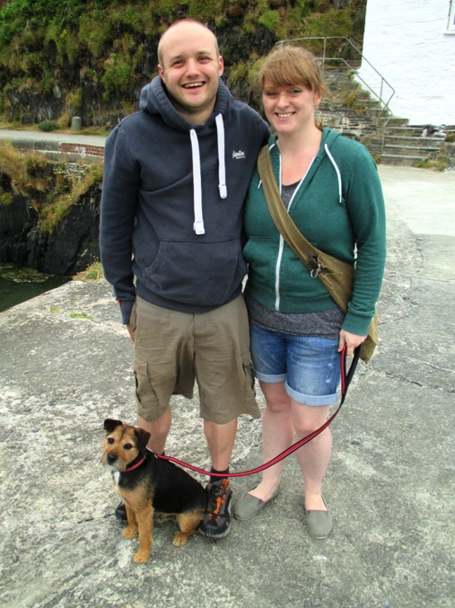
About me
Consultant, Esgob Ltd
Engineer, Cumulus
Board member, UKNOF
Based in West Wales
Aspiring lighthouse keeper

Slide 3
Summary
Fancied deploying a DNS Anycast service
Motivated by:
Bill Woodcock
SANOG8: “Best Practices in DNS Anycast Service-Provision”
Dave Knight
RIPE64: “Dense Anycast Deployment of DNS Authority Servers”
Gain more experience automating distributed environments.

Slide 4
Thoughts
Can I do it without spending too much?
Does Claire need to find out?
Must be sub $1000/yr running cost
What to offer?
Initially only secondary DNS
IPv4 + IPv6 (yes Martin!)
Free service - no SLA

Slide 5
Requirements
Separation from existing management network - AS30746
Had spare PI /24 + /48
Applied for new ASN - got AS60564
Need highly automated framework
Wanted to play with new tools
Open source everything
https://github.com/esgob

Slide 6
DNS zone transfers
Master servers operated by others
Anycast nodes
AS60564
Zone transfer
Zone transfer
Zone transfer
ns0.esgob.co.uk
(only my zones)
axfr.esgob.com
AS30746
Supports notifies from masters

Slide 7
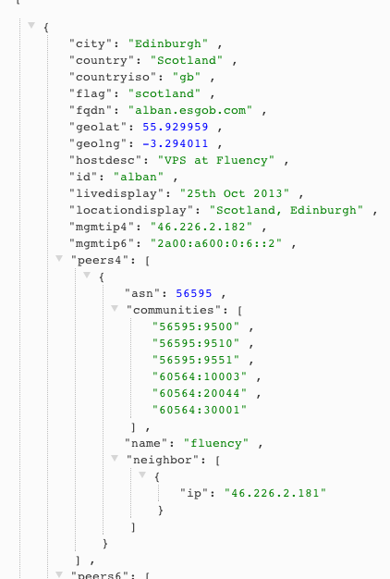
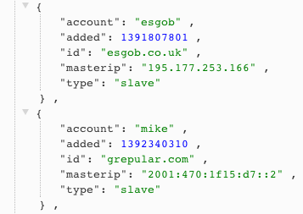
Store everything in JSON
Data stored in RethinkDB
Distributed JSON document database
Free form, easy to add attributes

Slide 8
Application design
REST API - Python + Flask framework
Beanstalk - Message queue
Add/change/removal of zones via API triggers job to be added to queues for each node
Daemons on AXFR + Anycast nodes monitor for jobs
New zones live on all nodes with 5 seconds
Website
Python + Flask
BeanstalkD
job
REST
API
job
Scripts
Config files
Jinja2 templates
RethinkDB
Python + Flask

Slide 9
Network
Each anycast node:
Static default route to the provider
Announce /24 + /48 via BGP
All management traffic inside OpenVPN
Additional RFC1918 loopback per node
No need for TSIG from AXFR to anycast nodes
Protects beanstalk traffic, collectd, zone transfers
axfr.esgob.com
AS30746

Slide 10
Where to host the anycast nodes?
Can’t cost too much each month
Ruled out renting co-lo / dedicated servers
Virtual machines
Swap with friends?
Low cost hardware

Slide 11
Mythic Beasts
UK clueful hosting company
£7/month = £84/yr = $141/yr
512mb RAM, 1 CPU, 10gb HDD, 75gb BW
Bought a VM, opened a support ticket
BGP not listed on the website.
Me: “I have a /24 + /48 of PI, can you set me up a BGP session?”
Them: “Peer with these IPs, sessions are ready!”
Too easy!

Slide 12
Quest to find more friendly VM hosts
LowEndBox.com
Blog / adverts for VM providers, all < $10 month
Usually OpenVZ based
Need KVM/XEN/VMWare to support Quagga/BIRD
LowEndTalk.com
Message board, various small scale VM hosts
Google
“vps bgp session”

Slide 13
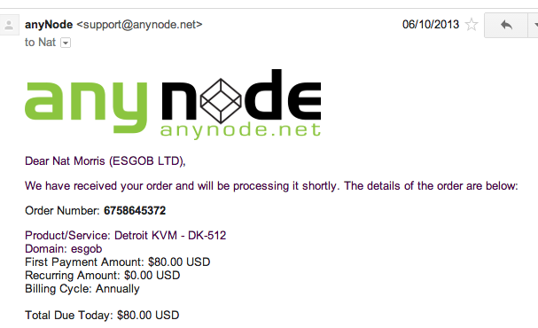
Anynode in Detroit
Listing on LowEndTalk
Asked if they could support BGP.
Yes on any VPS!!
$80/yr, 1 CPU, 512mb, 40gb HDD, 500gb BW

Slide 14
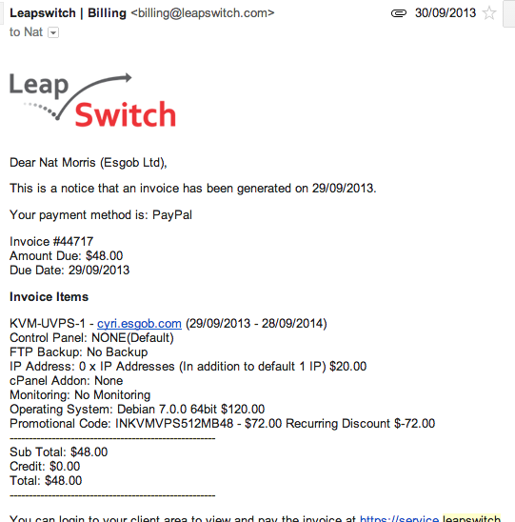
Indian bargin!
LeapSwitch, based in Pune, India.
New VPS host, saw an offer advertised
$120/yr, 1gb RAM, 20gb HDD, 500gb BW

Slide 15
Growing
Up to 4 VMs
London A (on existing KVM server)
London B
Detroit
India
Spinning up VM taking about 10 minutes
Add JSON entry into RethinkDB
Install Debian
Install Puppet (Collectd, BIND, Quagga, custom daemons etc)
Done

Slide 16
Friends
Offers to host VMs for free from:
Edinburgh @ Fluency
Boston @ TorwardEx
One swap:
Bremen, Germany @ Fremaks
Quickly up to 7 nodes after 1 month

Slide 17
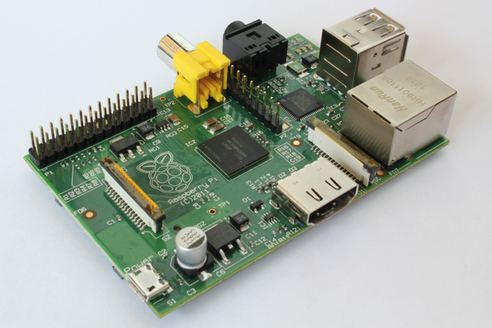
Friends
“We can host something, but not a VM”
Various issues:
Network engineers didn’t have access to VM hosts
No VM infrastructure at all
All VMs routed by hypervisor, can’t bridge to BGP routers
Solution…
Raspberry PI, $35
512mb / 16gb SD Card
800mhz (overclocked)

Slide 18
Raspberry Pi
Sent RPI to Belfast – David Farrell @ Tibus
Ran NSD3 great, ~200qps
Adding / removing zones with NSD3 required service restart ☹
Swapped to PowerDNS, testing went ok
pdns_control segfault’ing on ARM
Gave in and moved to BIND

Slide 19
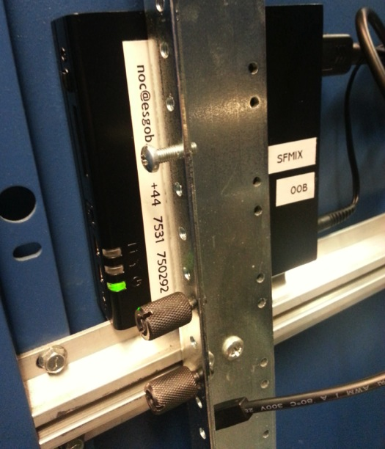
Time to peer
Offer of a node at SFMIX from Matt Peterson
San Francisco based IXP
Couldn’t turn this down.
Zero U install
Needed 2 NICs, IX + OOB
FitPC2i - perfect ☺
Atom 1.6ghz, 1gb RAM, 16gb SSD
$150 on eBay
Peering with:
HE.net, ISC, Unwired
Layer42, Lookout

Slide 20
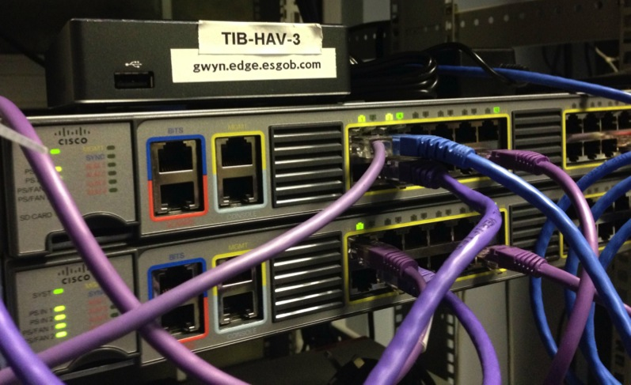
Pi problems
Puppet slow + loading zones taking too long
More offers to host h/w nodes
Manchester, Andy Davidson @ Allegro
Gigabyte BRIX
1.8ghz, 4gb RAM, 30gb MSATA
Swap out Belfast Pi

Slide 21
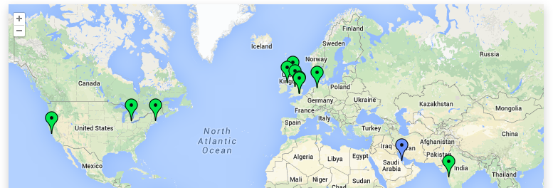
Still growing
11 live nodes
London C, VPS from Thomas Greer @ TSONE
Bahrain on its way

Slide 22
Fun along the way
First BGP customer for some of the LowEndTalk advertisers
Assisted educating them…
Prefer transit routes over customers, eek
Some hosts don’t have communities
Helping people get those implemented
RIPE Atlas
Scheduled measurements to look at latency + CHAOS id.server

Slide 23
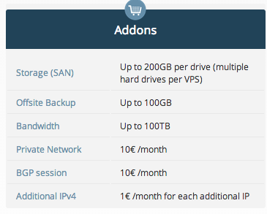
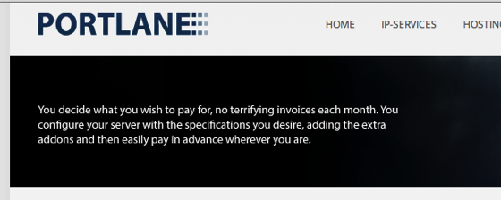
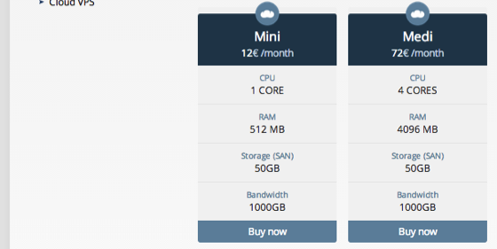
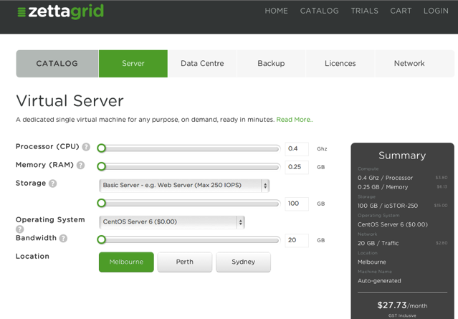
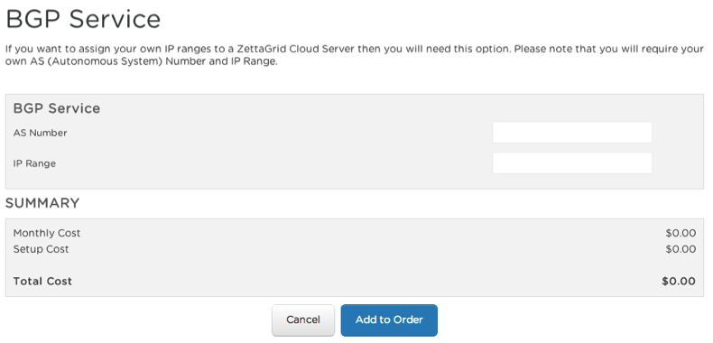
Market for VMs with BGP sessions

Slide 24
Discoveries
Easy to find budget anycasters
Webhost forums / LowEndTalk / bgp.he.net
“Interesting” deployment methods
Shared /24
Dedicated IP, custom fwd/rev DNS, slaved zones
Hosted /24
Same as above but customer provides /24 to announce
Shared /24, /32 tunneled
Dedicated IP, tunneled by anycaster to customer via GRE
Single /24
Anycaster only has one /24, website + mail + mgmt in same space. DNS answered at edge, other IPs tunneled to another VM/dedicated box.

Slide 25
Discoveries
Not all budget DNS hosting companies host every zone at the edge
Some host zones centrally and cache at the edge
Many tunnel all DNS traffic back to a single location
Looks like anycast
Poor DNS performance

Slide 26
Not just DNS?
Simple HTTP/HTTPS service to assist debugging
local.esgob.com
local4.esgob.com / local6.esgob.com
Returns JSON via lighttpd on each node
nat@enw:~ $ curl http://local.esgob.com
{
"city": "London",
"country": "England",
"countryiso": "gb",
"flag": "england",
"locationdisplay": "England, London, B",
"ref": "ql7f823b"
}

Slide 27
What next?
Keep honest – host every zone at the edge
Finish API + web interface
Open source more code
Support:
Multi master
TSIG inbound
Public SOA checker
Mix of routing and DNS daemons
configurable per node in RethinkDB
BIND, NSD4, KNOT, Quagga + BIRD

Slide 28
What next?
Move to BGP sessions to full table
Archive MRT dumps
Maybe BIRD, don’t need full table in the kernel
Crypto loopback file system on remote nodes
Fix v6 routing – peer with HE in Europe
Find more friendly hosts:
Eastern Europe
Transit in west coast US
Especially in Afria, Asia + South America
Wales!
Currently costing just under $480/yr

Slide 29
Questions?
https://noc.esgob.com
NAT-RIPE
@natmorris @esgobltd

