Slide 2
Random Subdomain Attacks Plaguing the Internet

Slide 3
Agenda
Brief Intro
Covered at last OARC
Attack overview
Latest data
Progress on open dns proxies in home gateways
Impact of Response Rate Limiting?
Chinese pornography sites
Hong Kong news site
Testing resolvers
(Over) ambitious idea!
What can we do?
Success filtering ingress traffic, some challenges
???

Slide 4
Random Subdomain Attacks
RANDOM
TARGET NAME
wxctkzubkb..liebiao.800fy.com
three labels
qzgziliv. 11hehe.com
two labels

Slide 5
Random Subdomain Attacks
Open DNS Proxies are the Vector for Attacks
Target
Web Site
Authoritative
Server
Compromised
hosting
3
NXD
responses
Internet
1
Query with
randomized
subdomains
2
Recursive
queries
ISP
ISP Resolver
Open DNS Proxy (Home Gateway)

Slide 6
Latest Data: Unique Names
Millions
Start of attack activity
Jan 28, 2014

Slide 7
Impact of Response Rate Limiting
Home
Gateway
Attacker
Border
Resolver
Authority
Bad Case
Spoofed IP
Query (UDP):
Ivatsnkb.web.pay1.cn
Proxy query,
translate IP
Recursion
Proxy query,
translates IP
Spoofed IP
NXD
NXD
NXD
Worse Case
Spoofed IP
Query (UDP):
Ivatsnkb.web.pay1.cn
Proxy query,
translate IP
Recursion
Response
Rate
Limiting
Truncate
Retry TCP
Proxy query,
translates IP
Spoofed IP
NXD
NXD
NXD

Slide 8
Attacks at Scale
Home
Gateway
Attacker
Border
Resolver
Authority
Spoofed IP
Randomized queries
Proxy query,
translate IP
Recursion
Truncate
Response
Rate
Limiting
Retry TCP
Resolver stress
TCP overhead
Authority
Fails
High traffic with TCP overhead
Resolver doesn’t
get responses,
tries new Authorities,
cascading failures

Slide 9
Hong Kong News Site
Sept 28, 2014 UTC
Height of Hong Kong democracy protests
Distinct shift in tactics – 98% of attacks on one domain
Typical day 4-6 domains attacked, usually gaming sites
Hong Kong online news Passion Times
Website offline 13 hours

Slide 10
Chinese Pornography Sites
Sept 25/26 2014 (UTC)
Another shift in tactics 42 domains attacked simultaneously
Attack lasted 6 hours
Most web sites went down
Motive for most attacks remains unclear
Monetization is likely very modest
Collateral damage across the Internet far exceeds revenue from DDoS for hire

Slide 11
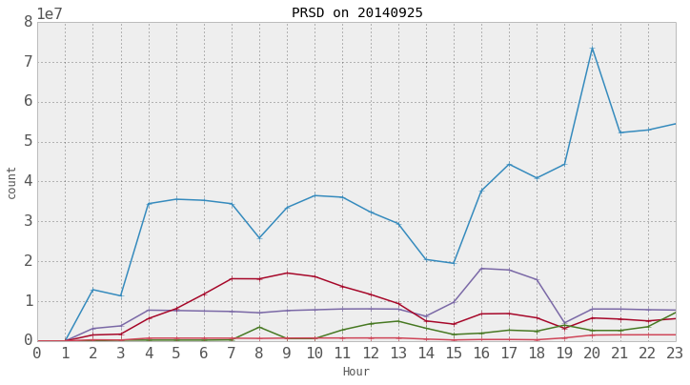
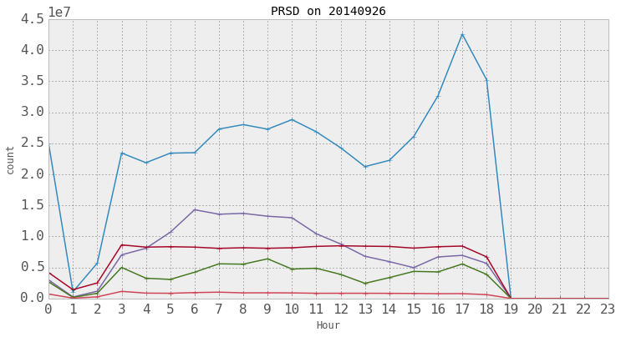
Sept 25/26 Attacks
80
40
10
Data from 5 providers
Volume of attack queries
In Millions
Small fraction of overall attack activity
Nominum est << 5%
45
25
5

Slide 12
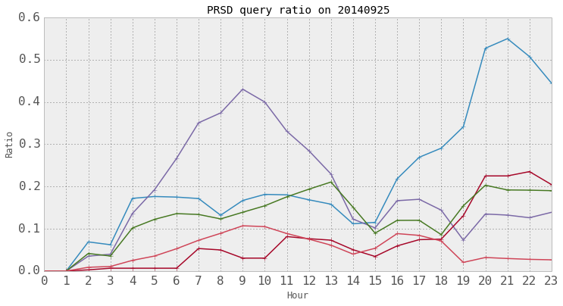
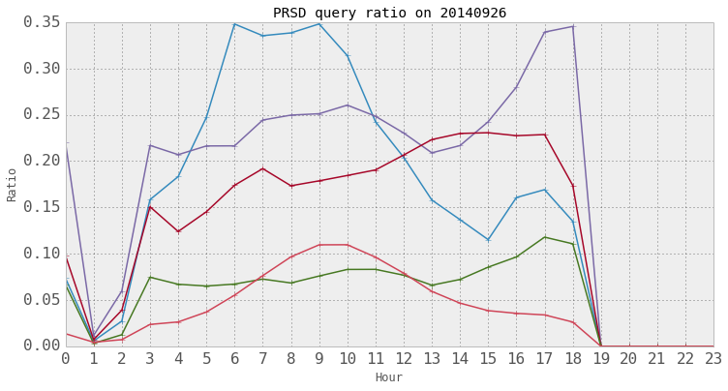
Sept 25/26 Attacks
60
30
10
Data from 5 providers
% attack queries
35
20
5

Slide 13
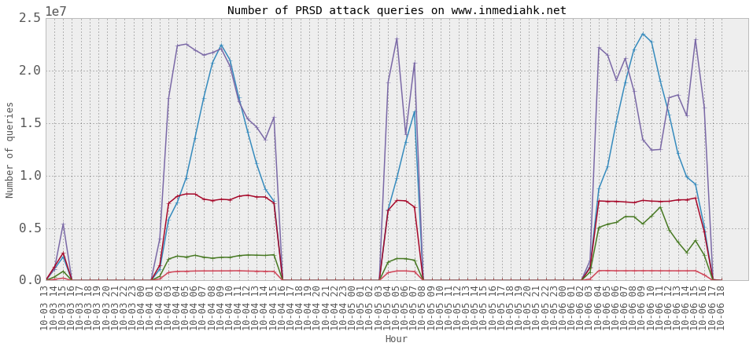
Oct 3- 6 Attacks
In-media is an Independent Hong Kong news site
25
15
5
millions

Slide 14
Many Problems to Address
Home Gateways mask the spoofed source IP
“Challenges”, “DNS cookies” won’t work at either resolvers OR authorities
Queries are from legitimate IPs – blacklisting eliminates all traffic for those IPs
Response Rate Limiting by authorities increases the workload for both resolvers and authorities
It was designed for attacks directly on authoritative servers
Rate limiting resolvers is counter productive
Surrounding recursion with too much logic can be problematic
Doesn’t address root cause
Collateral damage is observed:
Servers marked as non-responsive by recursor recovering but still not being used
Nameservers serving multiple domains taken out of service by traffic for one domain
Tendency for cascading failures
Authorities successively fail increasing stress on remaining authorities
This in turn increases stress on resolvers

Slide 15
Solutions
Filter traffic at ingress to the resolver
Near real time block lists
Randomized subdomains used for attacks
Protect good traffic
Whitelist
Fine grained policy
Tie the lists together: Block bad traffic Answer good traffic
IDEAS?

Slide 16
Testing Resolvers
Goal: Understand impact of PRSD on resolvers
BIND
PowerDNS
Undound
Vantio
Method: Simulate DNS E-E behavior
Attack behavior Easy
Resolvers Easy
Authorities Hard
Variability of Internet Very hard
Whoops!

Slide 17
Current Test Plan
Authoritative server answers up to threshold, then randomly drops
Authoritative server switches to TCP at threshold, then restricts tcp connection slots
Authoritative server drops traffic for attack domains, answers other domains
Authoritative server doesn’t answer, other servers for domain successively fail, vary latency response latency
IDEAS?

