Slide 1
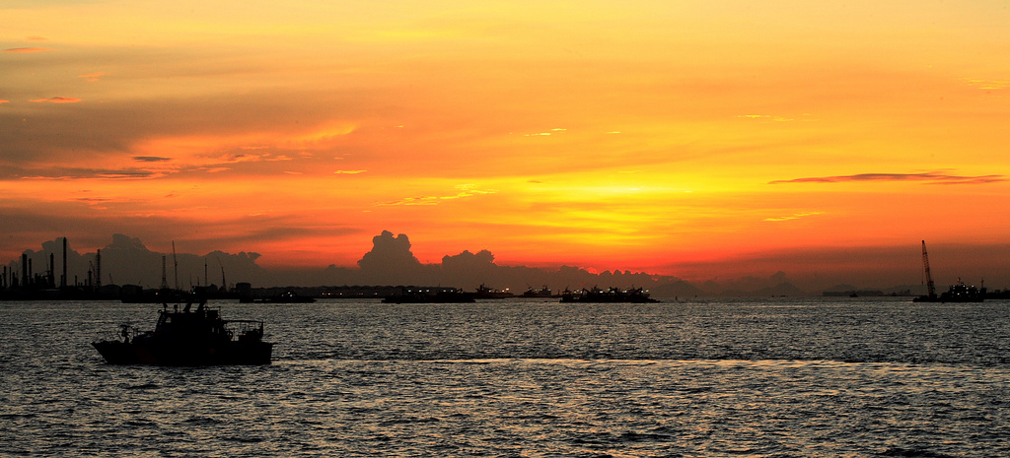
Sunset for the DLV?
November 2013

Slide 2
Background
(c) Interested Bystandr @flickr

Slide 3
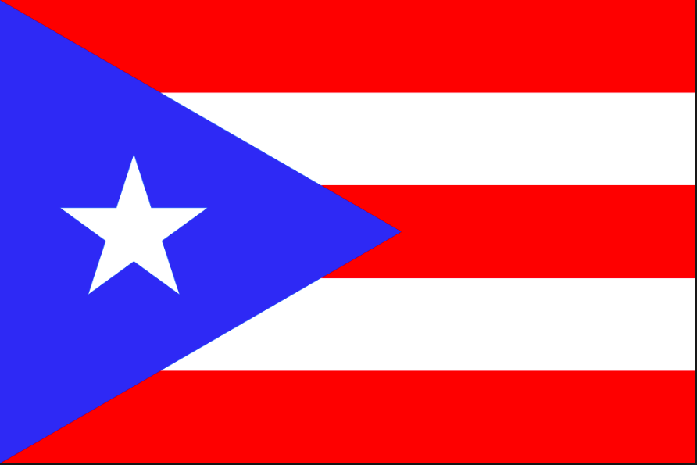
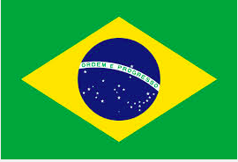
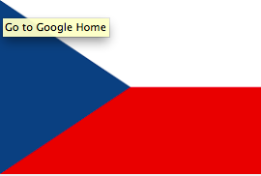
A lot has changed since 2006
DNSSEC bis
IETF Drafts
DLV
IETF Draft
NSEC3 IETF
Draft
DLV.isc.org
IANA ITAR
2004
2005
2006
2007
2008
2009
Root zone
signed
.com zone signed
ICANN requires new GTLDs sign
ISC begins decommissioning
DLV.isc.org?
.edu, .net signed
Google, Comcast verify DNSSEC
ITAR records removed
IANA ITAR
decommissioned
Over 100 ccTLDs are signed
642 TLDs are signed
2010
2011
2012
2013
2014
2015
Notes:
2005 - October
Sweden (.SE) enables DNSSEC in their zone. This make .SE the first ccTLD to deploy DNSSEC.
At the same time RIPE NCC (ripe.net) is in the process of deploying DNSSEC in the reverse zones.
2007 – ccTLD .pr (Puerto Rico) enabled DNSSEC, .br (Brasil) – September, .bd (Bulgaria) October
2008 – NSEC3 (RFC 5155 published)
2008 – Sept, .cz (Czech Republic) signs
2010 – Versisign and Educause enable DNSSEC for .edu, Verisign enables .net
2011 – March, .com is signed by Verisign (59 TLDs signed with trust anchors in the root zone, according to verisign web site)
2013 – Comcast begins dnssec validation for their customers
2013 – March, 90 TLDs now signed

Slide 4
Is DLV now DELAYING deployment?
Benefits
Disadvantages
Allows a signed zone to be validated even if the parent is not signed
Accepts DS records from anyone
Free service
Reduces pressure on parent to get signed
Reduces pressure on registrars to accept DS records
Validator has to perform an additional query to the DLV when validating

Slide 5
Who Needs the DLV?
Entities with signed zones under unsigned parent zones (i.e., signed 2nd level domains under unsigned parents)
Entities that Registrars that don't accept DS records. (Though the 2013 ICANN Registrar Accreditation Agreement require them to…)
Signed zones moving from one registrar to a new registrar may benefit from temporary coverage by DLV, esp if first registrar is uncooperative in the move

Slide 6
Registrar Support
Registrar support for DS records is available but not universal
Some DLV users will have to switch registrars, putting appropriate pressure on registrars to support DS records
Registrars that support end user ‭DNSSEC‬ management, including entry of DS records
https://www.icann.org/resources/pages/deployment-2012-02-25-en
Last updated: 15 December 2014
Updates to: dnssec@icann.org

Slide 7
Ready to Sunset DLV?
Root signed
TLDs signed (79%)
TLDs have trust anchors in root
Registrars supporting DNSSEC validation records for child domains
Announcing sunset plan for DLV will encourage this
Remaining gap with registrar transitions

Slide 8
1st Step = Clean Up the Zones
4568 zones configured
2867 fully configured/working zones
only 397 are in an unsigned parent
~20% fully validate from the root
Notify, and Remove unnecessarily delegated zones
Stop adding new zones
Eventually, remove all zones
dlv.isc.org
delegation records

Slide 9
Proposed timeline for shrinking the DLV zone list
Request owner remove the zone if:
If the zone already has DNSSEC records in the parent, and can be validated to the root outside of DLV.
The zone could be properly signed (i.e. all of the parent zones are signed up to the root), but for some reason isn't.
4. No new users or zones registered with DLV.
5. Existing zones that could be validated outside of DLV will be purged (~1 year notice)
3. No more new registrations for zones that could validate outside of DLV
6. Remaining DLV records will be removed (~1-2 yrs notice)
2015
|
2016
|
2017
|

Slide 10
Communications Plan
Discuss with participants at ICANN, DNS-OARC, RIPE, operator meetings
Email to DNS tech discussion lists
Notify current DLV users
Discuss with validating resolver publishers (incl OS packagers)

Slide 11
Any Concerns
Further suggestions about whom to notify?

Slide 12
dlv@isc.org

