Slide 1
ENTRADA: The Impact of a TTL Change at the TLD Level
Maarten Wullink| DNS-OARC Spring 2016 workshop

Slide 2
SIDN
    Domain name registry for the .nl ccTLD of the Netherlands
    5,6 million domain names
    .nl is the largest DNSSEC signed zone in the world in absolute numbers
    SIDN Labs is the R&D team of SIDN
Notes:
- Sidn is the domain name Registry for the .nl cctld and is responsible for the registration and delegation of .nl domain names.
- With 5,6 million names the 8th largest TLD
- 2,5 million .nl domain names are secured with DNSSEC. This makes the .nl zone the largest DNSSEC secured zone in the world.
- I am also a part of sidn labs, which is the r&d team of sidn
- goal: To help further increase the security and stability of the Internet in the Netherlands and beyond
With a focus on the DNS and other Internet technology

Slide 3
TTL Change for .nl
    Why?
      We changed the zone file update frequency from 2 hours to 1 hour
      Requested by our registrars
    Changes:
      Delegation TTL from 7200 to 3600 seconds
      SOA NXDOMAIN TTL from 900 to 600 seconds
    Impact: What effects does this policy change have on DNS traffic?
      We used ENTRADA to measure the effects
      We examined the impact on volume, QTYPE, NXDOMAIN and domainer activity
Notes:
We did not have a clear expectation of the effect of the changes other than: “the number of queries will probably increase”

Slide 4
ENTRADA
Notes:
ENTRADA is the Hadoop based DNS big data platform we have developed at sidn labs.
It uses a parallel query engine combined with a independent colomnar storage format.
This allows us to quickly process a large volume of network data
Data from the name servers is converted to parquet format and is stored on the Hadoop HDFS filesystem.
Now it can be analysed with the impala sql query engine
On top of entrada we have developed applications and services and we also use impala for research into operational changes such as
Discussed in this presentation.

Slide 5
ENTRADA@SIDN Labs
Operational for 2 years
Capturing data for 2 .nl name servers
130 Billion rows (DNS query+response pairs)
17 TB of data
Notes:
17TB using 3x HDFS replication

Slide 6
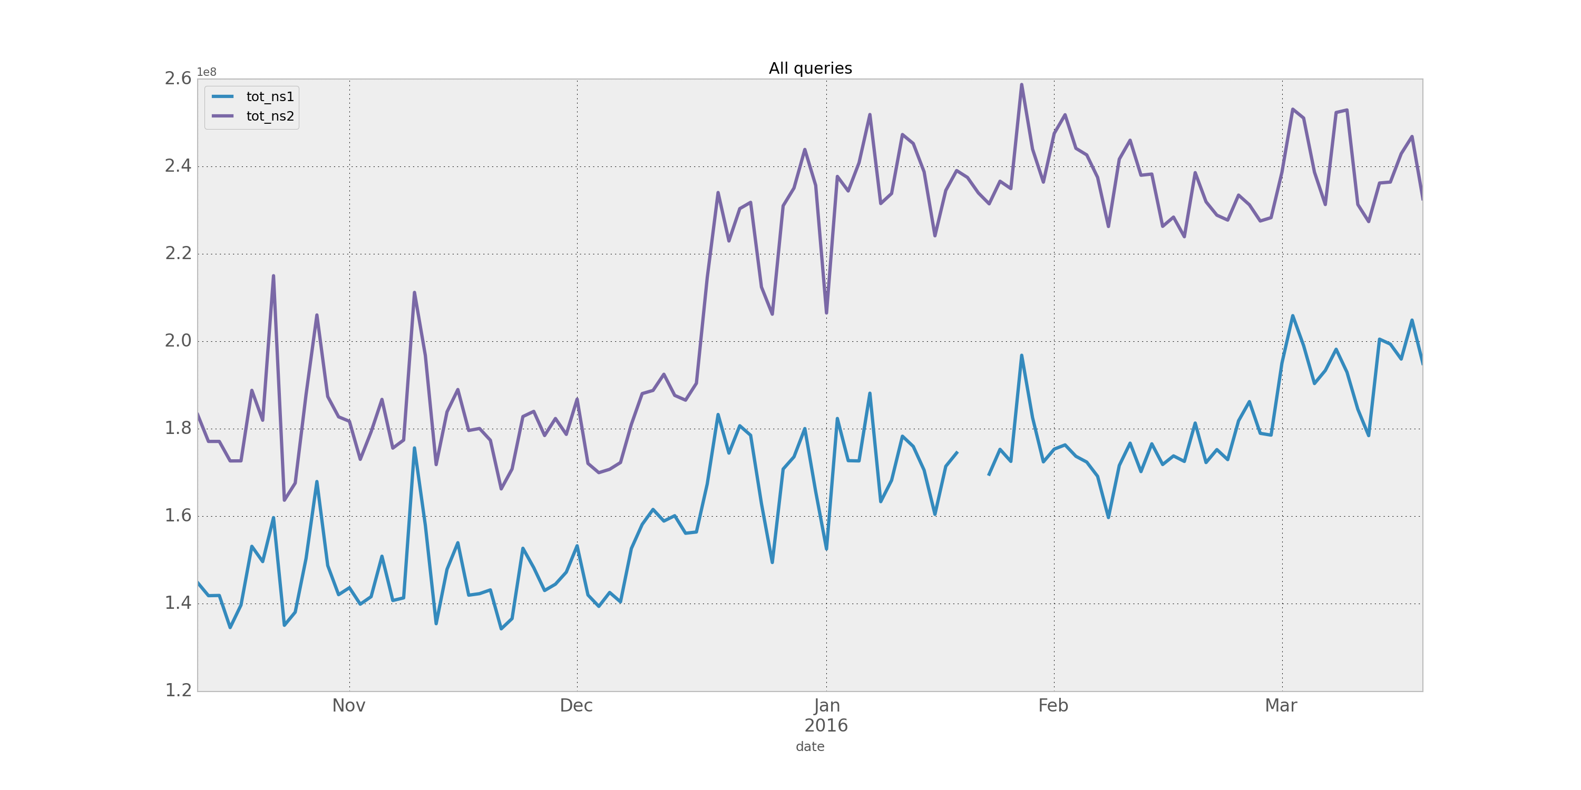
Effect #1: Increase in Number of Queries
    NS1: 22%
    NS2: 30%
  TLD-level TTL is most
  likely overruled by TTL
  from authoritatives
TTL change
Notes:
Reducing the TTL by 50% does not lead to a 100% increase in queries
Mention that each datapoint is a weekday, weekends show dip in queries and are therefore skipped.

Slide 7
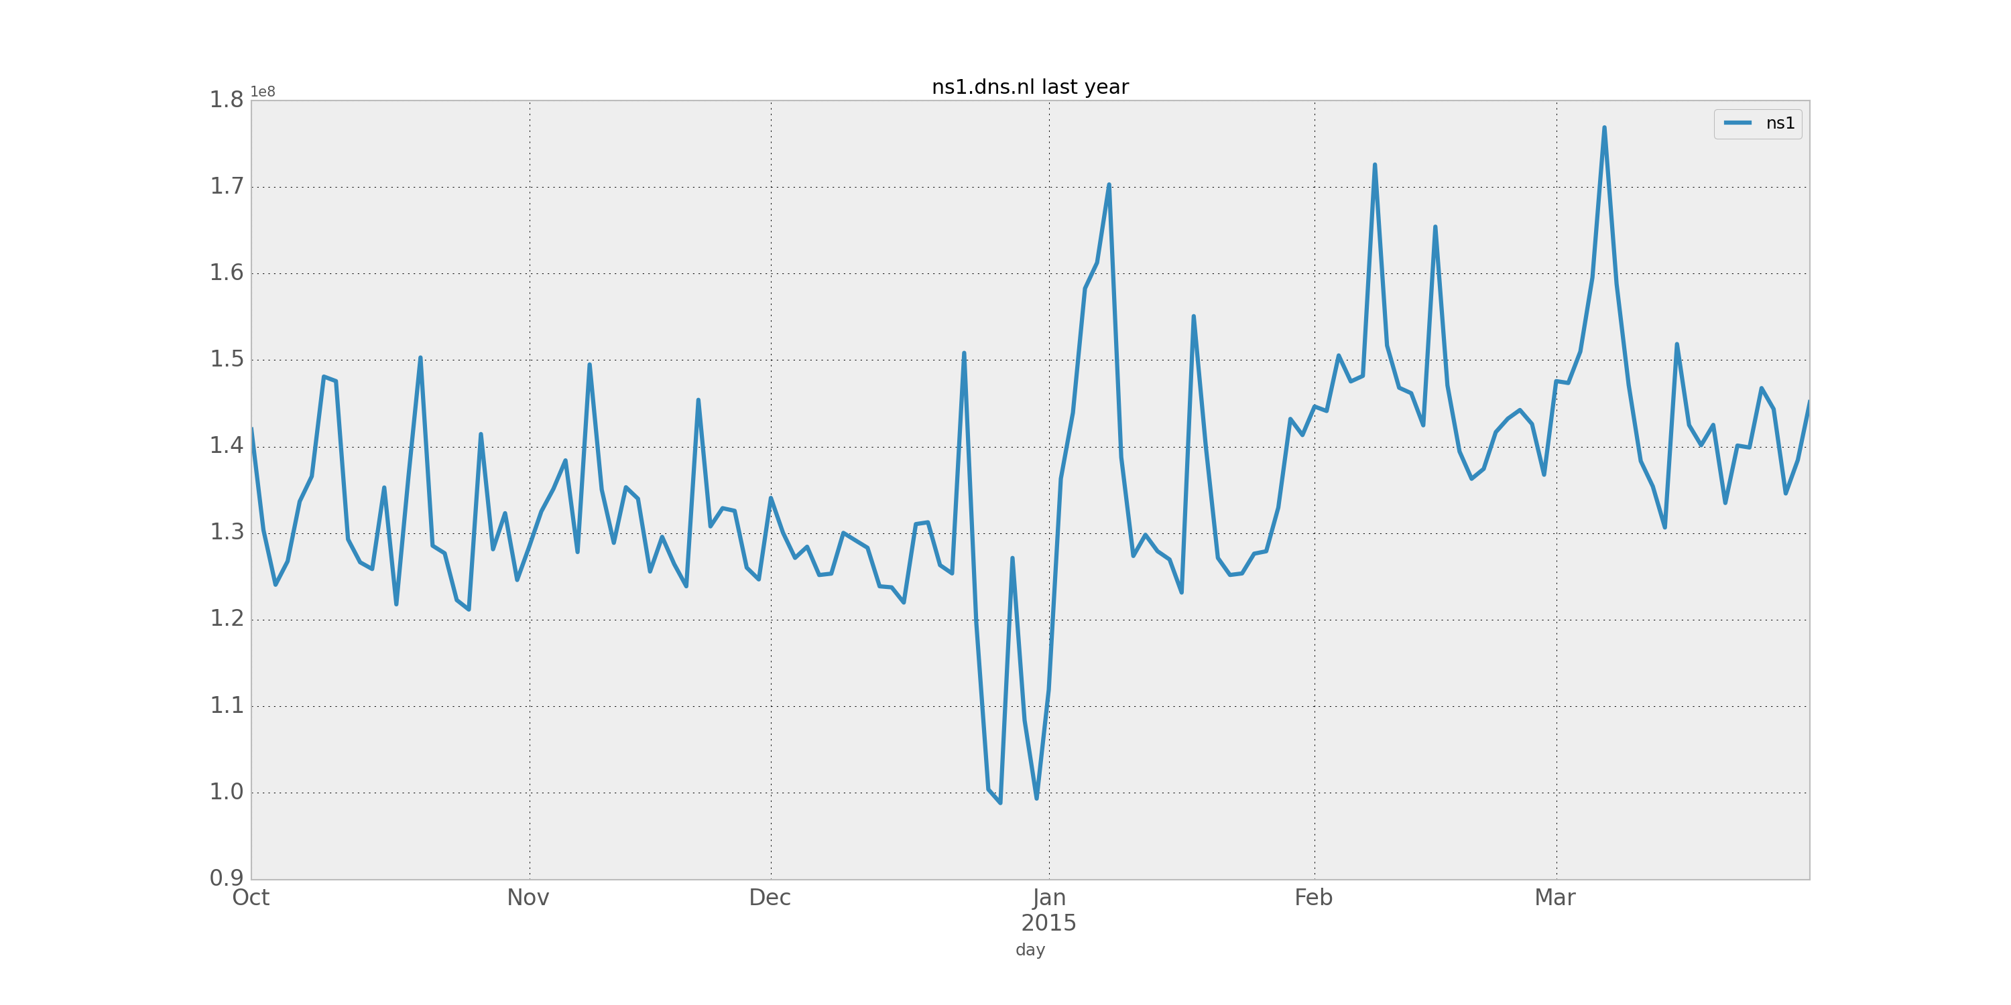
Effect #1: Query Increase Last Year
    NS1: 7%
    Same period last year
    we see a smaller increase
Notes:
No data for NS2 for this period because only ns1 data was captured at that time.
#within 2 std dev (95%)

Slide 8
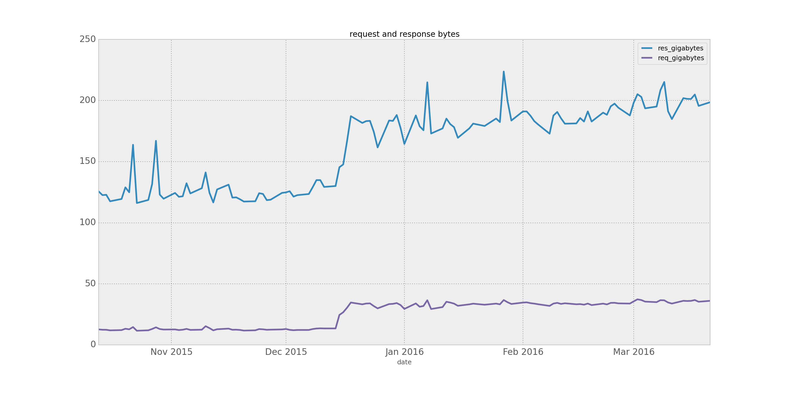
Effect #2: Data Volume
    Volume
    NS1+NS2
    Request: +156%
    Response: +47%
TTL change
Notes:
Request and response bytes for NS1+NS2 combined.

Slide 9
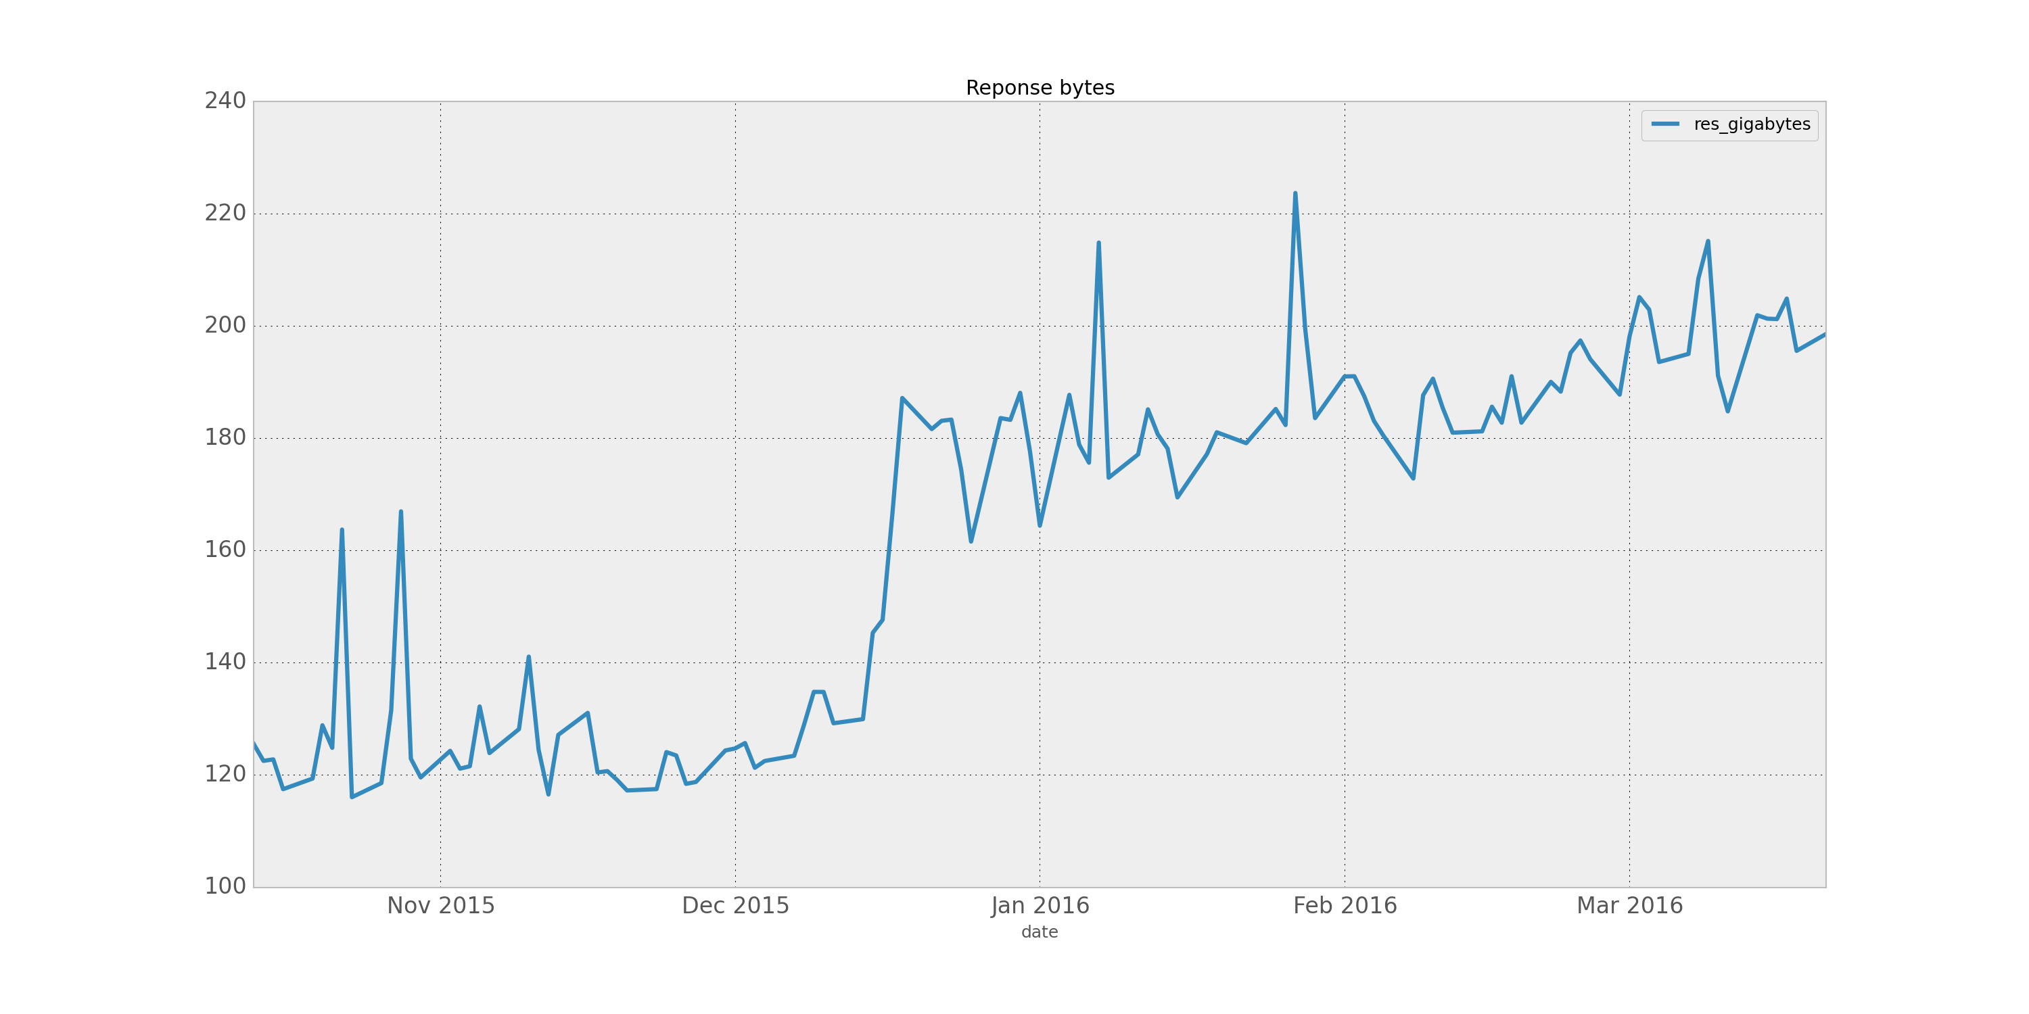
Effect #2: Data Volume
    Total volume
    NS1+NS2: +59%
    Total data volume has
    not doubled
TTL change
Notes:
Request + responses bytes for ns1+ns1 combined

Slide 10
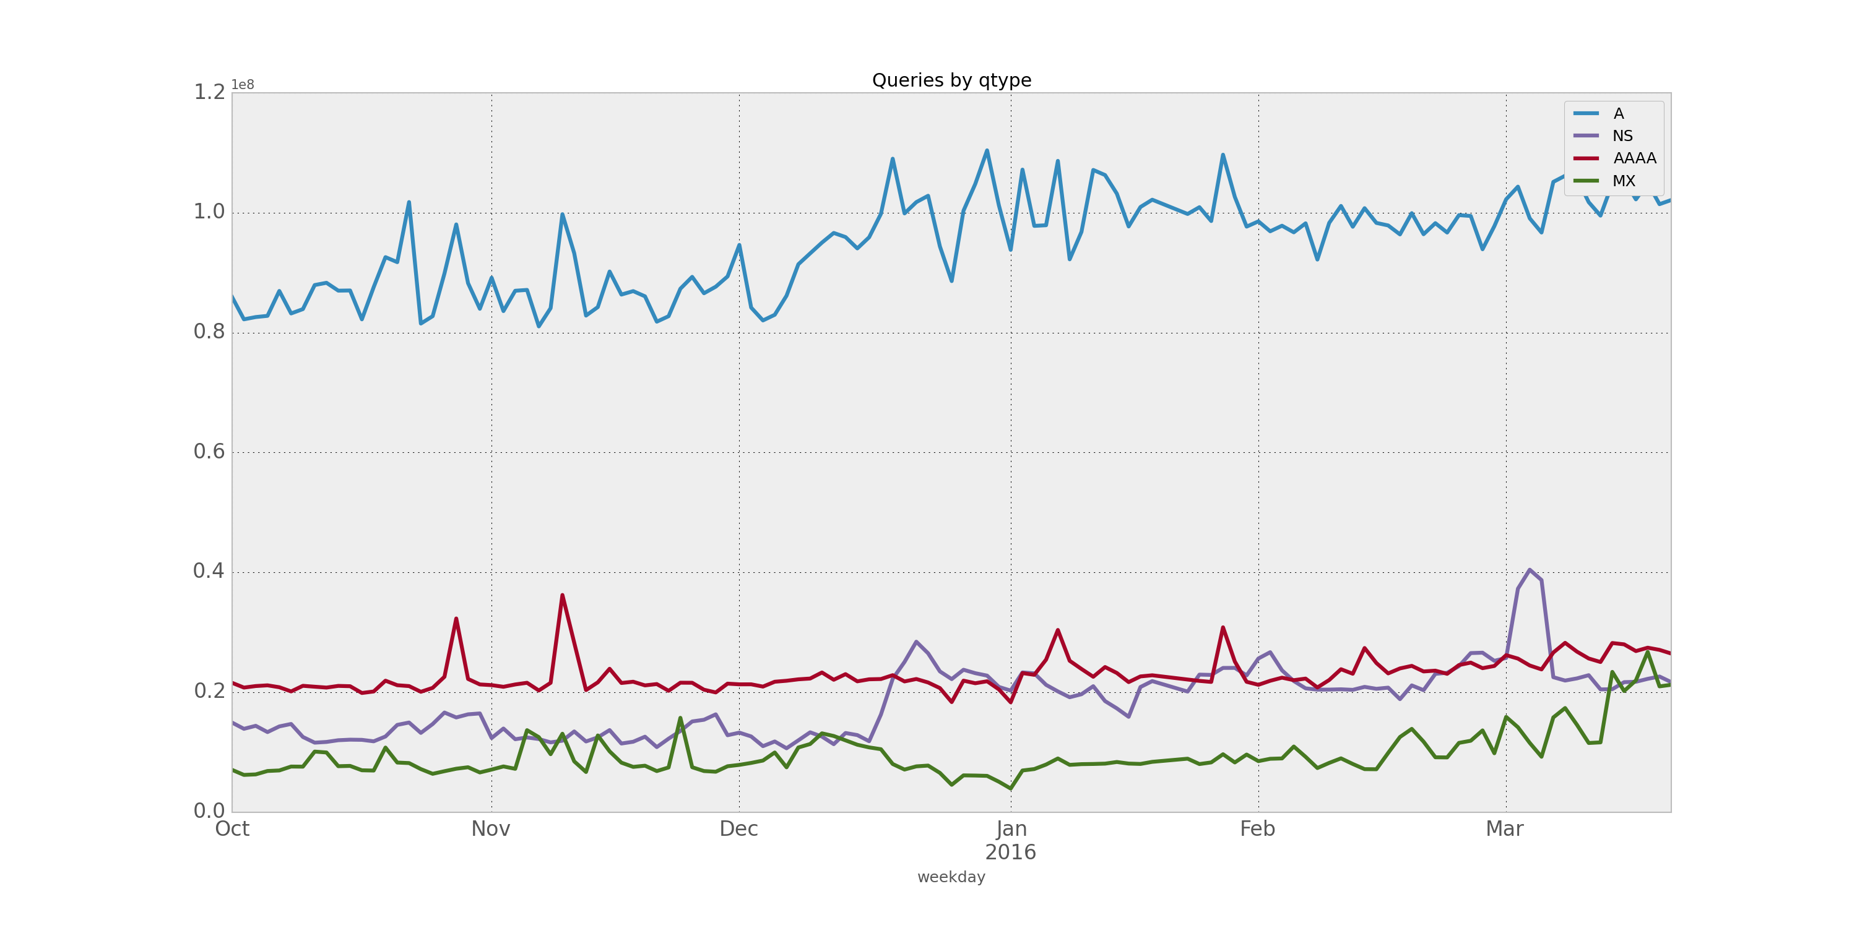
Effect #3: Qtype Distribution
    NS1:
QTYPE ∆
A: +14%
AAAA: +9%
NS: +75%
MX: +19%
As expected the NS QTYPE
shows largest increase
TTL change

Slide 11
Effect #3: Qtype Distribution
    NS2:
QTYPE ∆
A: +23%
AAAA: +6%
NS: +85%%
MX: +13%
TTL change

Slide 12
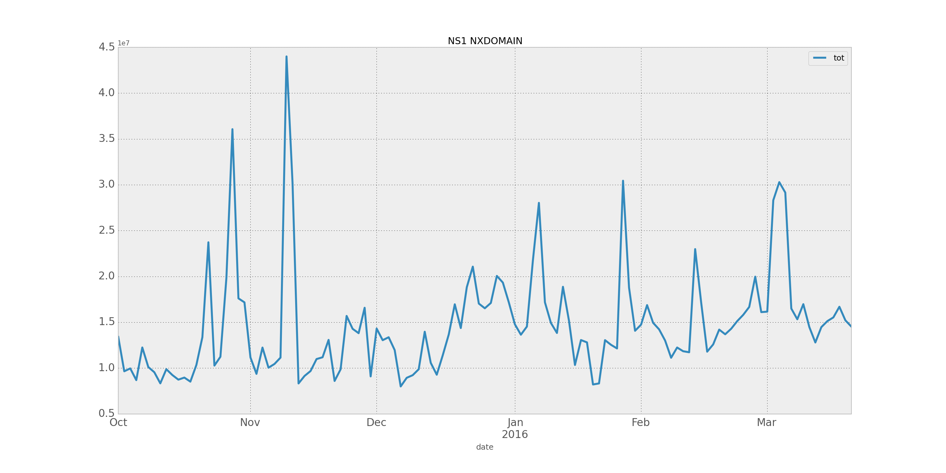
Effect #4: Increase in NXDOMAIN Responses
    NS1: ~ +30%
    Relatively small increase
    in NXDOMAINS
TTL change
Notes:
Y-axis is 10-millions
Calculated percentage by first removing outliers > 20 million

Slide 13
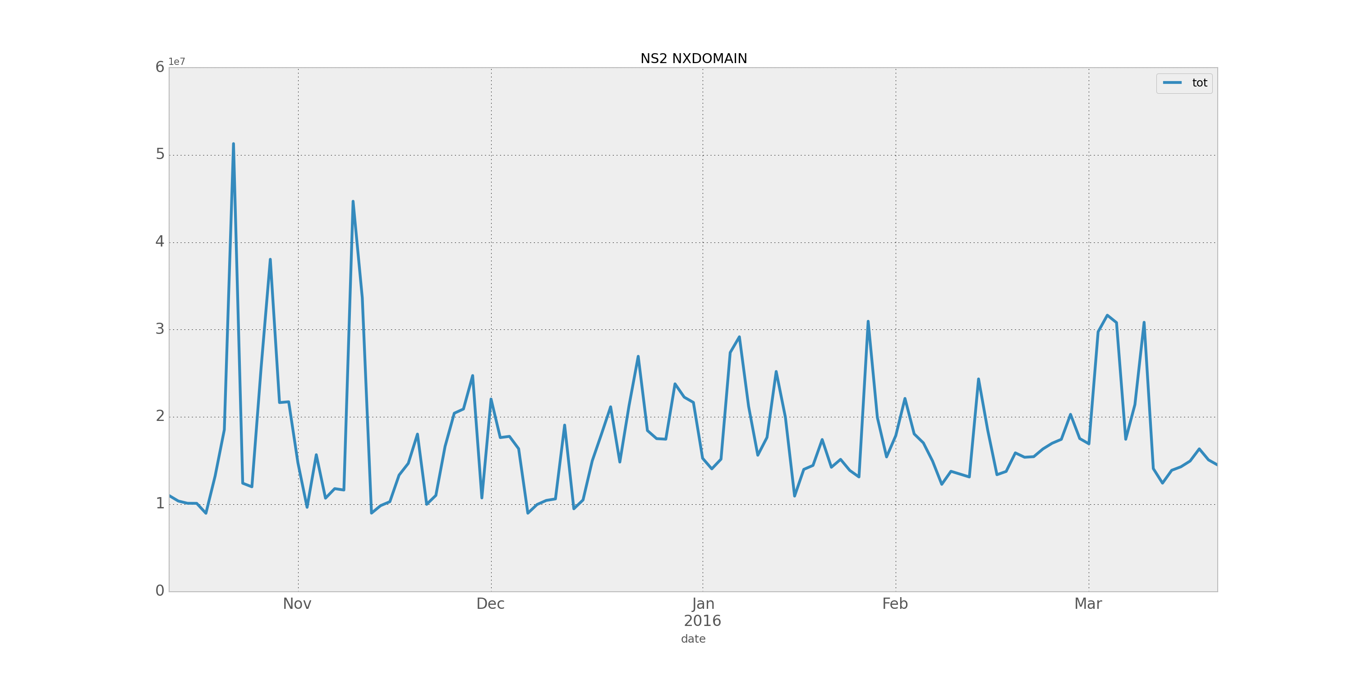
Effect #4: Increase in NXDOMAIN Responses
    NS2: ~ +24%
TTL change
Notes:
Y-axis is 10-millions
Calculated percentage by first removing outliers > 30 million

Slide 14
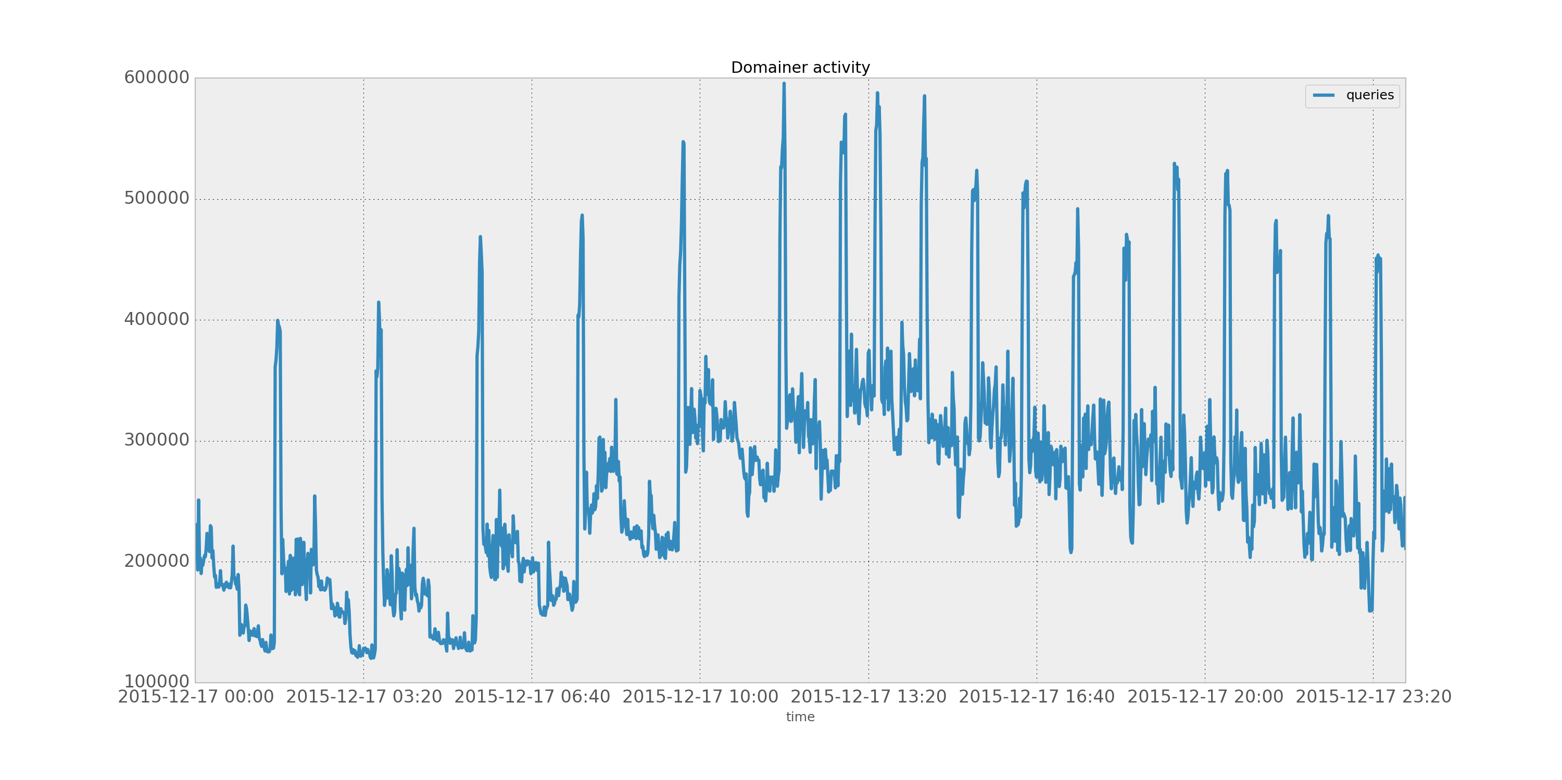
Effect #5: Domainer Activity
    Domainers cause
    more traffic peaks
TTL change
Notes:
Domainers check large parts of the zone every time the zone file is updated, this causes peaks every 2 hours
Domainers immediately detect change in TTL and increase their zone check to once per hour

Slide 15
Conclusions and Discussion
No significant impact on the operational DNS infrastructure
    TLD-level TTL is most likely overruled by TTL from authoritatives
    Total data volume has not doubled
    NS QTYPE shows largest increase
    Small NXDOMAIN increase
    Doubled domainer query peaks
ENTRADA proved to be very useful for measuring the effect of DNS policy changes
We are interested in the experiences of other DNS operators and registries
Notes:
Before the change we had no clear expectations about the effect other than: “we probably get some more queries”
With this knowledge of how DNS traffics reacts, we can plan future TTL changes better.
Discussion starts with: “We are interested in the experiences of other DNS operators and registries with similar changes”

Slide 16
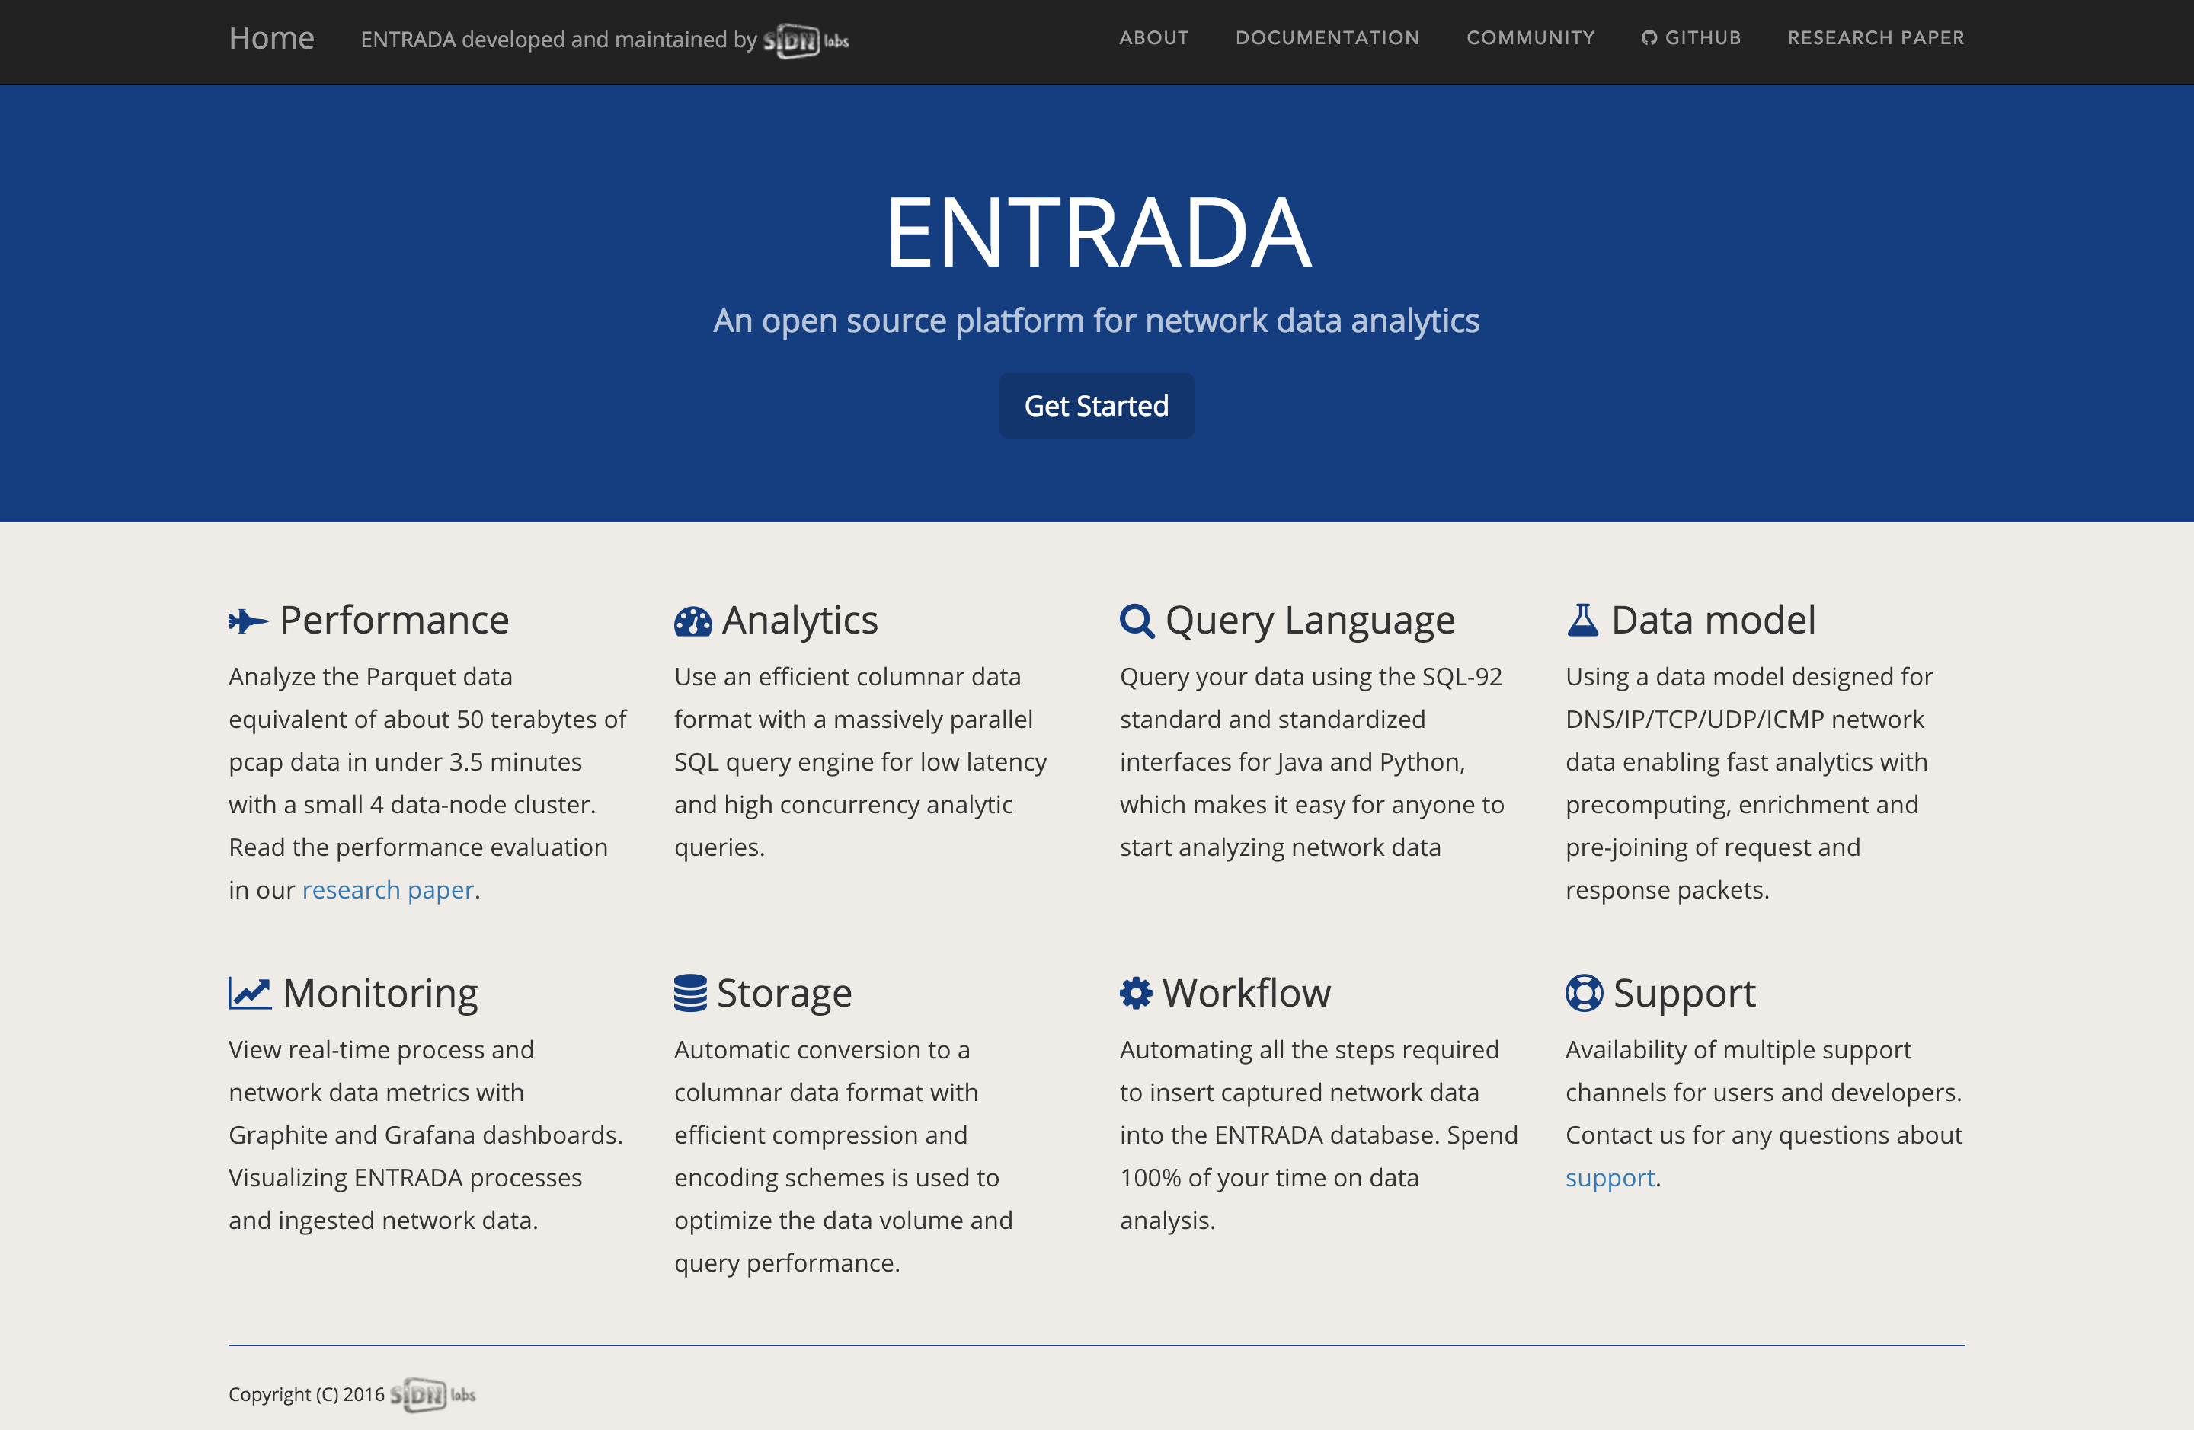
Now Available as Open Source!
entrada.sidnlabs.nl

Slide 17
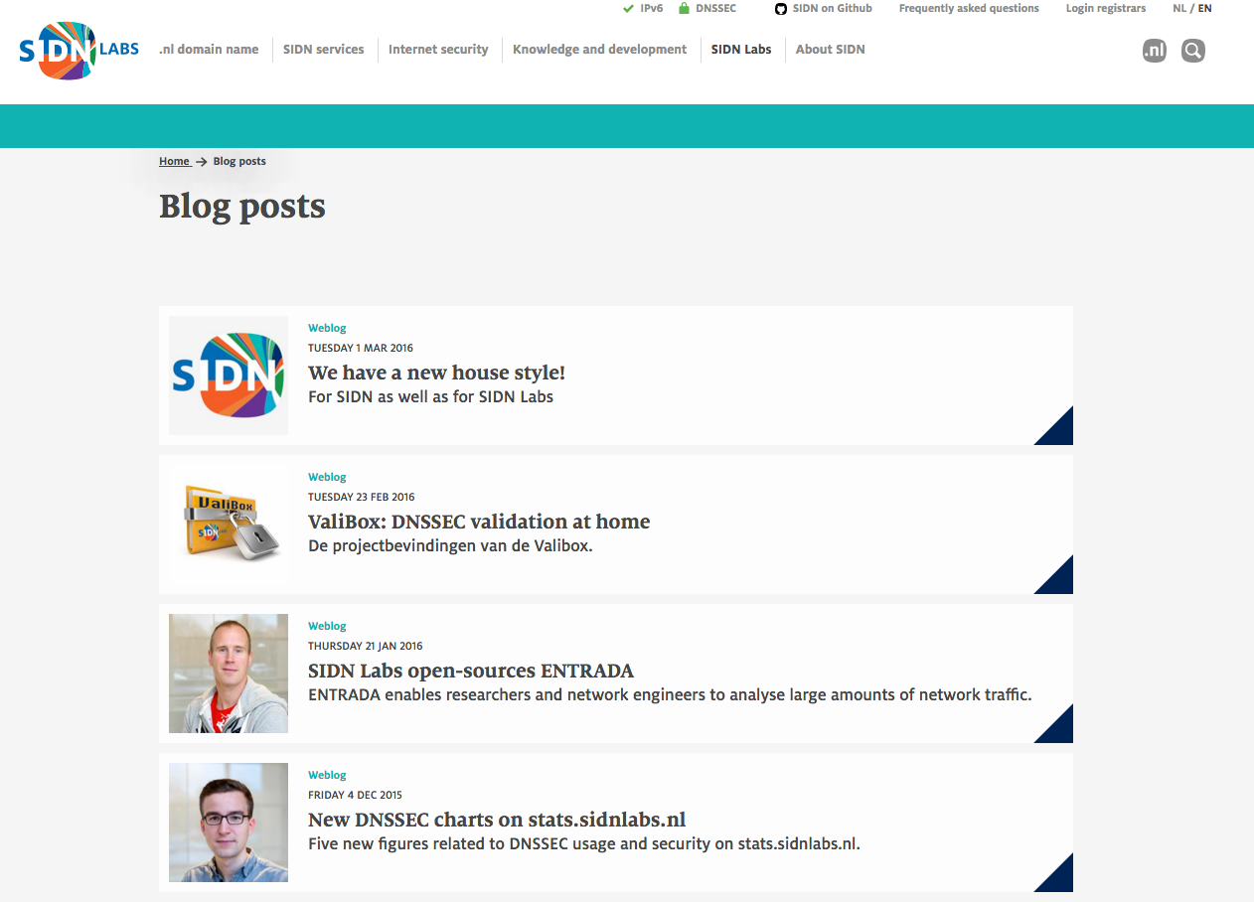

Questions?
  Maarten Wullink
  Research Engineer
  maarten.wullink@sidn.nl
  @wulliak
  www.sidnlabs.nl
Notes:
See our website for more information about sidn labs and our blogposts

