Slide 1
CDAR
Continuous Data-driven Analysis of Root Stability
Thursday March 31, 2016
DNS OARC 24, Buenos Aires
Bart Gijsen (TNO)

Slide 2
CDAR Study
Objective
Analyze the technical impact of the introduction of new gTLDs on the stability & security of the root server system
Approach
  Data-driven, using wide variety of DNS data
    RSSAC002, DITL ‘13, ‘14,`15 (, ‘16), RSO’s PCAP and DSC data,
    ATLAS / DNSMON, Zone File Repository, gTLD Registry reports,
    specific tools and public data sources
  Interaction with the broader tech community
    ICANN and advisory committees, RSOs, DNS-OARC, IEPG/IETF
  Using and expanding previous studies of RSS behavior
    DITL papers, L-Root scaling report, Name Collision report, …
    DNS Health reports and DNS threat analysis papers
Today’s objective:
Share observations
Obtain feedback

Slide 3
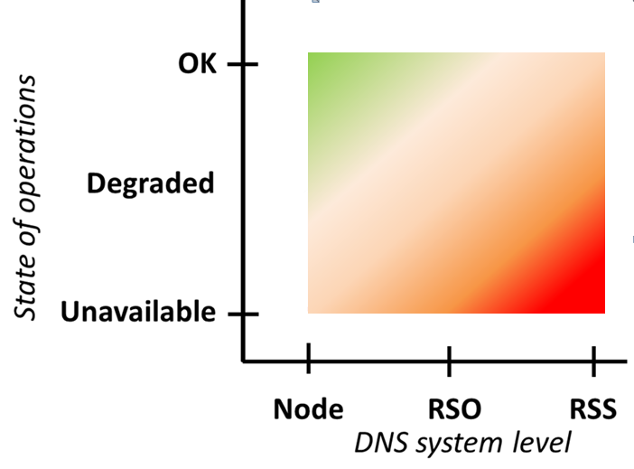
Stability of the Root Server System
Stability levels
Illustration of the distinction between macroscopic and microscopic scale for RSS stability
Example of RSS stability level:
Nov./Dec. ‘15 attack traffic

Slide 4
Possible Impact of New gTLD
Analysis of a range of RSS stability indicators
  As observed from the ‘outside’
RSS stability
Operational stability
DNS Data correctness
Missing responses
Response time stability
Query rate stability
Broken chain
Accuracy of root data
Valid queries
Incidental queries
Invalid queries
Zero-error
Consistency

Slide 5
Precaution: Limitations of Data Used
Limited data accuracy
  Measurement breakdowns don’t always add up to the total
  Different data collection methods lead to different results
Incomplete
  Collected data sets are not always complete
  Not all relevant stakeholders contribute to RSSAC002, DITL
  History of some data sets is relatively short
Lack of standardized data format
  Different sources use different data formats and collection
  Is improving with RSSAC002 and DITL

Slide 6
CDAR Analyses

Slide 7
CDAR Analyses Presented Today
What is impact of increased number of TLDs on the query rate to the root?
Is the ratio between #domains in a TLD and the query rate to the root comparable for New gTLDs and other TLDs?
  Are cache hit rates for New gTLDs comparable to cache hit rates for other TLDs?
What is the impact of a new gTLD’s initial delegation in the RZF on the query rate to the Root (in the delegation period)?
  What is the impact of a new gTLD’s initial delegation on the RTT?
Do DNSSEC validation errors (broken chain) occur more frequently for New gTLDs, than for other TLDs?
  What is the behaviour of resolvers with validation errors?

Slide 8
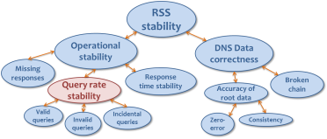
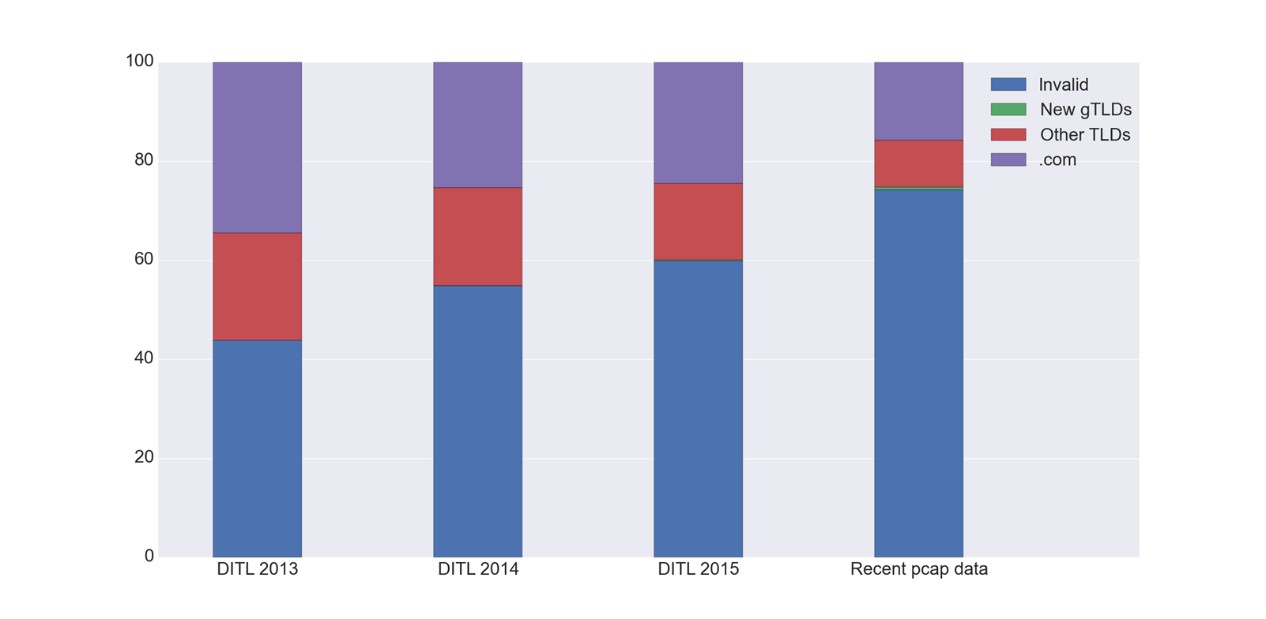

New gTLD Queries to the Root
The percentage of queries to New gTLDs has increased over time, but is still very low compared to other queries
Using DITL data offers possibility
to relate results to period prior
to new gTLD program
New gTLD
queries:
0.43%
New gTLD
queries:
0.20%
New gTLD
queries:
0.04%
New gTLD
queries:
0.00%
(H-root)
A note on historic “invalid queries”:
F-root analysis Jan2001: %Invalid = 20%
F-root analysis Oct2002: %Invalid = 19,6%
DITL Mar2009: %Invalid ≈ 30⁺ %

Slide 9
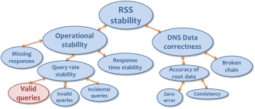
Rule of Thumb for Valid Query Rates
Data shows that a TLD’s valid query rate to the root is ‘bound’ by the number of domains in the TLD
  Example from DITL’15, K-root data:
More in general, this ratio rarely exceeds 10
  For any TLDs in each of the DITL‘13, ‘14, ‘15 and recent H-Root data sets
  Moreover, for new gTLDs the ratio is lower than for other TLDs
TLD | Nr. of queries / TLD | Nr. of domains / TLD | Query/domain ratio
.com | 779.171.677 | 120.585.440 | 6,46 E+00
.org | 91.095.714 | 10.569.583 | 8,62 E+00
.cn | 51.949.760 | 11.678.026 | 4,45 E+00
.br | 15.696.021 | 3.568.492 | 4,40 E+00
.club | 651.082 | 202.519 | 3,21 E+00
.xyz | 420.885 | 842.340 | 5,00 E-01

Slide 10
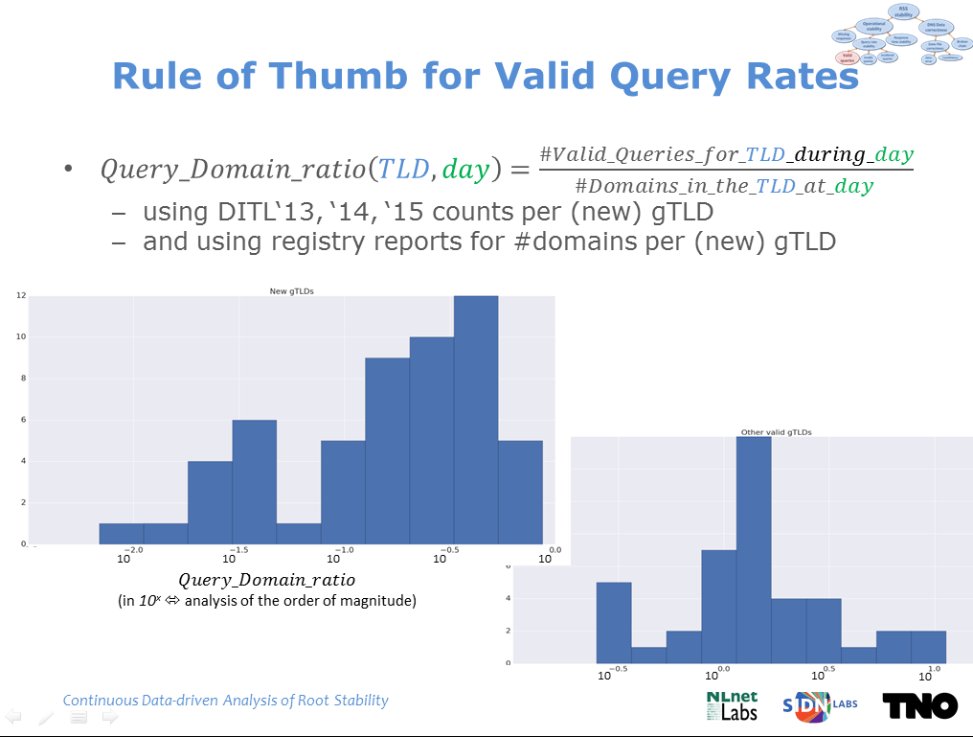
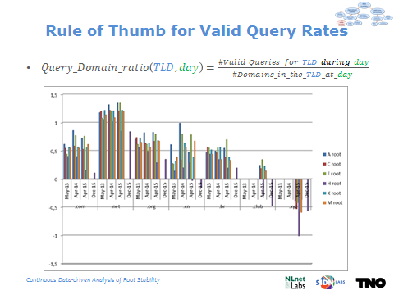
Rule of Thumb for Valid Query Rates
  A statistical rule of thumb
    Intuition: #valid TLD queries to the root is ‘bound’ by the TLDs ‘popularity’ (in terms of #domains)
    No conclusive DNS rational found for this observation, yet
  This observation provides an easily verifiable bound on valid queries to the root
  We’d be happy to go into the details, during coffee break …

Slide 11
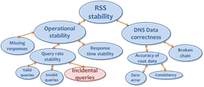
Impact of Initial Delegation (Query Rate)
The volume of root traffic for a new gTLD often decreases significantly after delegation (gTLDs A and B), but sometimes also increases (gTLD C) or increases temporarily (gTLD D)

Slide 12
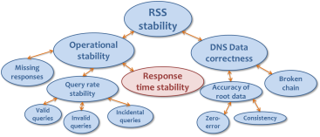
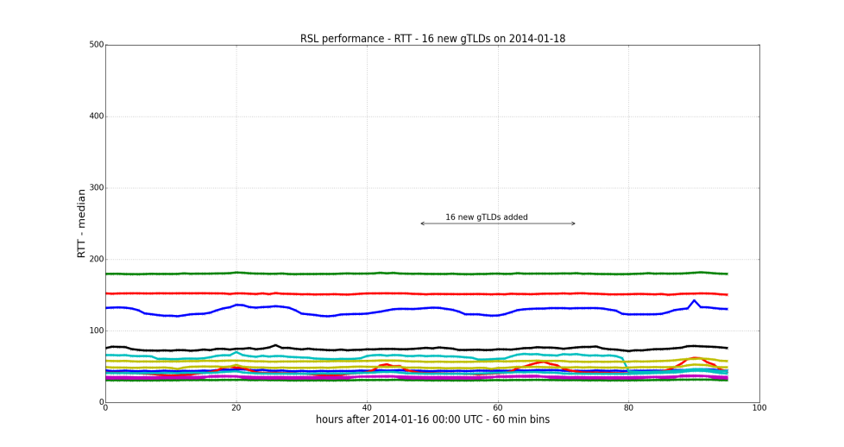
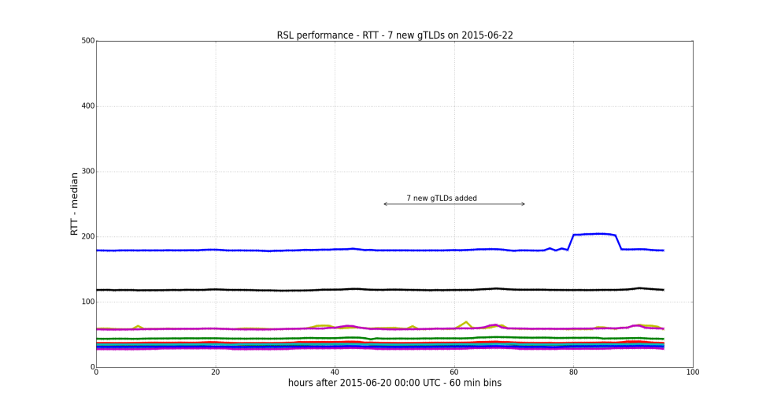
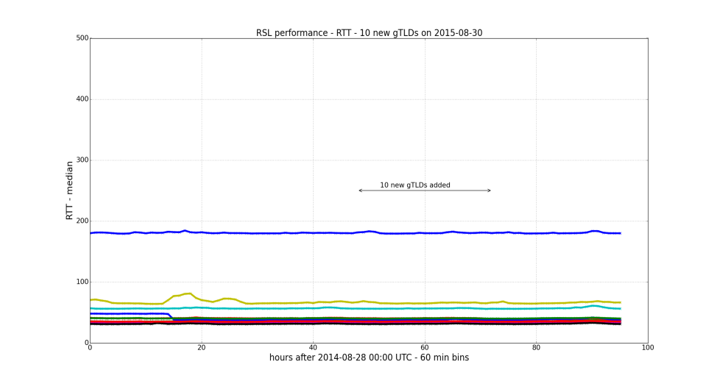
Impact of Initial Delegation (RTT)
RTT is not significantly affected after delegation of New gTLDs to the RZF
Considering 22 days in which 7 or more new gTLDs were delegated
Using RTT measurements from Atlas RIPE to all root servers
16 new gTLDs delegated on Jan 18, 2014
7 new gTLDs delegated on Jun 22, 2015
In general changes in the RTT before and after delegation are minor, both up and down
10 new gTLDs delegated on Aug 30, 2015

Slide 13
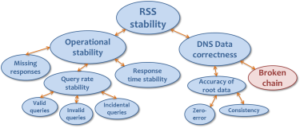
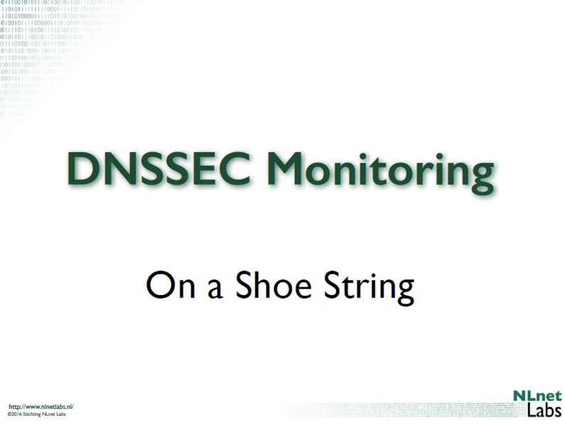
Impact on DNS Data Correctness
DNSSEC broken chain validation
  Structurally no more failures for new gTLDs than for other TLDs
  Some single failures on startup for new gTLDs

Slide 14
Summary
Data quality varies and completeness can be improved
  Encouraging is that standardization of data collection (DITL, RSSAC002) is improving
  Collecting & analyzing per-TLD data provides new insights
Preliminary conclusion
  So far, we did not observe significant stability or security impact of new gTLD on RSS scale
  In microscopic view some impact of new gTLDs is observed
    query rate fluctuations / DNSSEC validation errors around initial delegation
  The impact of new gTLDs on “invalid” queries to the Root remains an open issue
    For valid (new gTLD) queries an upper-bound is observed

Slide 15
Next Steps
Additional CDAR analyses
  Investigate impact of new gTLDs on “invalid” queries
    Analysis of resolver behavior
  Complement analyses with additional data
    DITL’16, historical DSC data, New gTLD monitor
    Geographic effects of regional new gTLDs
  Develop qualitative scenarios for further root zone expansion
More in depth session opportunities
  After this presentation
  IEPG meeting (Sunday)
  Continue outreach and community interaction
Challenges for the DNS community:
  Continuous improvement & standardization of data collection
  More continuous measurement

Slide 16
Questions and Discussion
CDAR Project Team
Bart Gijsen (TNO)
Benno Overeinder (NLnet Labs)
Cristian Hesselman (SIDN)
Daniël Worm (TNO)
Giovane Moura (SIDN)
Jaap Akkerhuis (NLnet Labs)
Coordinator
Bart Gijsen (Msc.)
+31 6 53 72 52 18
bart.gijsen@tno.nl
CDAR Home: http://www.cdar.nl

