Slide 1
Quest for missing keytags
Roy Arends | DNS-OARC | 1 April 2016

Slide 2
Pubquiz question:
What is a DNSKEY Key Tag
a 16 bit value in the DNSKEY RDATA
a physical tag that you’d hang on your key ring
a 16 bit value in the DS and RRSIG RDATA
a special variation of the game of tag.
Notes:
This is a simpler agenda slide, the outline for your presentation.

Slide 3
Why did I look into this?
2010, first root KSK published,
2015, I started working on my testbed
Notes:
Use this slide for diagrams or other graphic elements.

Slide 4
Why did I look into this?
2010
2015
Notes:
Use this slide for diagrams or other graphic elements.

Slide 5
Why did I look into this?
2010
2015
I wanted to use those as keytags for my testbed.
You can’t simply assign a keytag to a dnskey.
RFC4034:
“the algorithm for calculating the Key Tag is almost but not completely identical to the familiar ones-complement checksum used in many other Internet protocols.”
Notes:
Use this slide for diagrams or other graphic elements.

Slide 6
Simple loop
while true
do dnssec-keygen –a RSASHA256 –f KSK –b 2048 .
done

Slide 7
Simple loop
while true
do dnssec-keygen –a RSASHA256 –f KSK –b 2048 .
done
This only generated about 16K keys
I was expecting 64K keys
keytags 02010 and 02015 were absent

Slide 8
Simple loop
while true
do dnssec-keygen –a RSASHA256 –f KSK –b 2048 .
done
First clue by Duane Wessels:
dnssec-keygen won't generate a new key if:
the new key tag conflicts with an existing key tag + revoke bit
the new key tag + revoke bit conflicts with an existing key tag
Nice! Well observed.

Slide 9
Less Simple loop
while true
do dnssec-keygen –a RSASHA256 –f KSK –b 2048 .\
>> taglist
rm K\.+008*;
done
This simply removes keys after they’re created, but adds the tag to a list.

Slide 10
Less Simple loop
while true
do dnssec-keygen –a RSASHA256 –f KSK –b 2048 .\
>> taglist
rm K\.+008*;
done
This simply removes keys after they’re created, but adds the tag to a list.
sort –u taglist | wc –l
16387

Slide 11
Less Simple loop
while true
do dnssec-keygen –a RSASHA256 –f KSK –b 2048 .\
>> taglist
rm K\.+008*;
done
This simply removes keys after they’re created, but adds the tag to a list.
sort –u taglist | wc –l
16387
Wait, what? Not 16384?

Slide 12
It’s the tool, try a different one.
while true
do ldns-keygen –a RSASHA256 –k –b 2048 .
done
Nice and simple. No undocumented features.
Allows for foot shooting.

Slide 13
It’s the tool, try a different one.
while true
do ldns-keygen –a RSASHA256 –k –b 2048 .
done
Nice and simple. No undocumented features.
ls K.*private | wc –l
16385

Slide 14
It’s the tool, try a different one.
while true
do ldns-keygen –a RSASHA256 –k –b 2048 .
done
Nice and simple. No undocumented features.
ls K.*private | wc –l
16385
Still, not high enough.

Slide 15
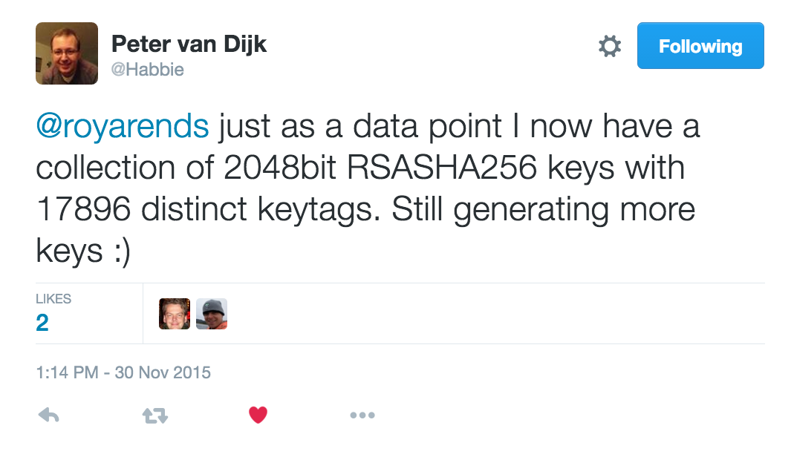
Meanwhile, via Twitter

Slide 16
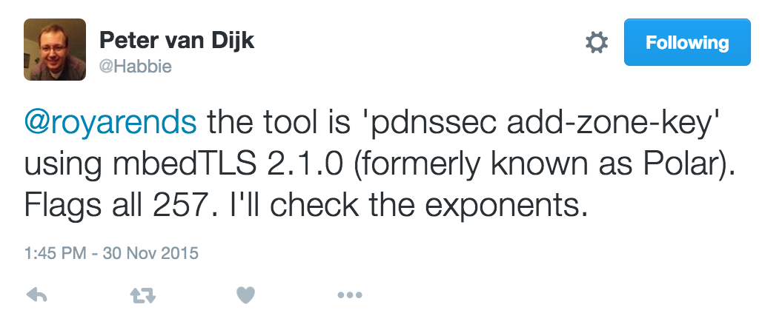
Meanwhile, via Twitter

Slide 17
So, it could be the library
DNSSEC-Keygen and ldns-keygen use OpenSSL
pdnssec uses mbedTLS
Is this a bug in OpenSSL?

Slide 18
So, it could be the library
DNSSEC-Keygen and ldns-keygen use OpenSSL
pdnssec uses mbedTLS
Is this a bug in OpenSSL?
“KEYSTARVE” [goes and registers name]

Slide 19
But…. On DNS-Operations
Peter van Dijk:
I now have ~130k (different!) keys, with 32201 unique key tags. This is almost twice as much as Roy had but it looks like it might top off around 32k.

Slide 20
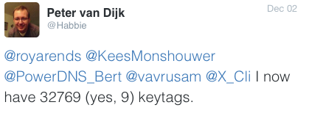
But…. On DNS-Operations
Peter van Dijk:
I now have ~130k (different!) keys, with 32201 unique key tags. This is almost twice as much as Roy had but it looks like it might top off around 32k.

Slide 21
Now what…
Three different tools
Two different libraries
Three issues:
Not enough keytags (expected 64K, got less)
Off by a few keytags (16387, 16385, 32769)
One library produces 50% of the other library

Slide 22
Is it the keytag function?
The keytag function is very similar to a radix minus one complement function. Very similar to the Internet Header Checksum.
So, generate 2048 random bits in pairs of 2 byte words and do an Internet Header Checksum over that.
while true
do jot -r 128 0 65535 | awk \
'{s+=$1} END {print (s + int(s/65536))%65535}’ \ >>test
done
sort –u test | wc –l
65536

Slide 23
It is not the keytag function
The keytag function is very similar to a radix minus one complement function. Very similar to the Internet Header Checksum.
So, generate 2048 random bits in pairs of 2 byte words and do an Internet Header Checksum over that.
It is not the keytag function

Slide 24
It is not the keytag function
The keytag function is very similar to a radix minus one complement function. Very similar to the Internet Header Checksum.
So, generate 2048 random bits in pairs of 2 byte words and do an Internet Header Checksum over that.
It is not the keytag function
It is not the library

Slide 25
It is not the keytag function
The keytag function is very similar to a radix minus one complement function. Very similar to the Internet Header Checksum.
So, generate 2048 random bits in pairs of 2 byte words and do an Internet Header Checksum over that.
It is not the keytag function
It is not the library
It is not the tools

Slide 26
It is not the keytag function
The keytag function is very similar to a radix minus one complement function. Very similar to the Internet Header Checksum.
So, generate 2048 random bits in pairs of 2 byte words and do an Internet Header Checksum over that.
It is not the keytag function
It is not the library
It is not the tools
(and hopefully not the user)

Slide 27
?

Slide 28
Florian Maury and Jérôme Plût
The Internet Header Checksum is equivalent to
addition modulo 65535

Slide 29
Florian Maury and Jérôme Plût
The Internet Header Checksum is equivalent to
addition modulo 65535
Assuming a 32 bit number ($num) this means:
($num AND 65535) + ($num >> 16)
is equivalent to
$num % 65535

Slide 30
Florian Maury and Jérôme Plût
$num % 65535
In our case, $num contains the RDATA of the DNSKEY.
For all the keys generated, the RDATA part contains a constant:
(RDLENGTH,PROTOCOL,ALGORITHM, EXPONENT)
And a variable part:
The RSA modulus, which consist of two prime factors P and Q

Slide 31
Florian Maury and Jérôme Plût
Therefore, we have
$num % 65535
Is equivalent to:
(constant + P*Q) % 65535
Is equivalent to:
(constant % 65535) + ((P*Q) % 65535 )

Slide 32
Florian Maury and Jérôme Plût
Ignoring the constant part we have:
(P*Q) % 65535
We know that P and Q are very large primes.
65535 has factors: 3, 5, 17, 257
Since (P, Q, 3, 5, 17 and 257)are co-prime,
P, Q can’t be divided by 3, 5, 17 and 257
and
(P*Q) % 3, 5, 17 or 257 will never be 0

Slide 33
Florian Maury and Jérôme Plût
(P*Q) % 3, 5, 17 or 257 will never be 0
(P*Q) % 3 has 2 solutions (not 3)
(P*Q) % 5 has 4 solutions (not 5)
(P*Q) % 17 has 16 solutions (not 17) and
(P*Q) % 257 has 256 solutions (not 257)
So, (P*Q) % 65535 has 2*4*16*256 solutions

Slide 34
Florian Maury and Jérôme Plût
(P*Q) % 3, 5, 17 or 257 will never be 0
(P*Q) % 3 has 2 solutions (not 3)
(P*Q) % 5 has 4 solutions (not 5)
(P*Q) % 17 has 16 solutions (not 17) and
(P*Q) % 257 has 256 solutions (not 257)
So, (P*Q) % 65535 has 2*4*16*256 solutions, or
32768 different keytags

Slide 35
Hoorah!
Three issues, one solved:
SOLVED: Not enough keytags (expected 64K, got less)
Off by a few keytags (16387, 16385, 32769)
One library produces 50% of the other library

Slide 36
Off by a few
Very similar is not exactly the same
The last part of the key-tag function in RFC4034 reads as follows:
ac += (ac >> 16) & 0xFFFF;
return ac & 0xFFFF;
If the previous line result in a carry (value > 65535), the latter line ignores it.
Hence, some off by a few keytags are a result of that.

Slide 37
Hoorah!
Three issues, two solved:
SOLVED: Not enough keytags (expected 64K, got less)
SOLVED: Off by a few keytags (16387, 16385, 32769)
One library produces 50% of the other library

Slide 38
Half the keyspace
Peter, using mbedTLS was able to produce twice as many keytags.
OpenSSL only generates safe primes:
P = 2 * P` + 1 where P` is also prime.
That implies that P mod 3 is never 1 (and thus always 2)
So: P*Q=M
(P mod 3) * (Q mod 3) = M mod 3
2 * 2 = 4 mod 3
M mod 3 is 1. Always

Slide 39
Half the keyspace
(P*Q) % 3, 5, 17 or 257 will never be 0
(P*Q) % 3 has 2 solutions (not 3)
(P*Q) % 5 has 4 solutions (not 5)
(P*Q) % 17 has 16 solutions (not 17) and
(P*Q) % 257 has 256 solutions (not 257)
So, (P*Q) % 65535 has 2*4*16*256 solutions, or
32768 different keytags

Slide 40
Half the keyspace
(P*Q) % 3, 5, 17 or 257 will never be 0
(P*Q) % 3 will always be 1
(P*Q) % 3 has 1 solution (not 3)
(P*Q) % 5 has 4 solutions (not 5)
(P*Q) % 17 has 16 solutions (not 17) and
(P*Q) % 257 has 256 solutions (not 257)
So, (P*Q) % 65535 has 1*4*16*256 solutions, or
32768 different keytags
16384

Slide 41
Hoorah!
Three issues, two solved:
SOLVED: Not enough keytags (expected 64K, got less)
SOLVED: Off by a few keytags (16387, 16385, 32769)
SOLVED: One library produces 50% of the other library

Slide 42
Thanks to
Warren Kumari
Ben Laurie
Florian Maury
Jérôme Plût
Jean-René Reinhard
Peter van Dijk
Bert Hubert
David Conrad
And all who have participated in the discussions on dns-operations

Slide 43
Questions?

