Slide 1
Publishing zone scan data using an open data portal
Sebastian Castro
OARC Workshop Montreal – Oct 2015

Slide 2
Motivation
NZRS is an InternetNZ company
Provider of:
Critical Internet infrastructure
Authoritative Internet data
Embracing open data
Helping NZ ecosystem to provide arguments with data
Enabling a new generation of research

Slide 3
Zone scan
Started on Aug 2013
Runs monthly
Governed by policy https://nzrs.net.nz/dns/zone-and-web-scanning
Based on a fork from dnscheck https://github.com/NZRS/dnscheck
DNS tests for configuration correctness + data gathering

Slide 4
Zone scan
Notable examples
Domain is broken, lame, has mail server
Name server status
Answers UDP, TCP, recursion, AXFR
DNSSEC
Signed domains, signed delegations, DNSKEY algorithms
Web server, mail server, name server addresses
Both v4 and v6

Slide 5
Zone scan
TTL distributions
NS RRset, MX RRset, “web” RRset
Geolocation of services
Name servers, Web servers, Mail servers

Slide 6
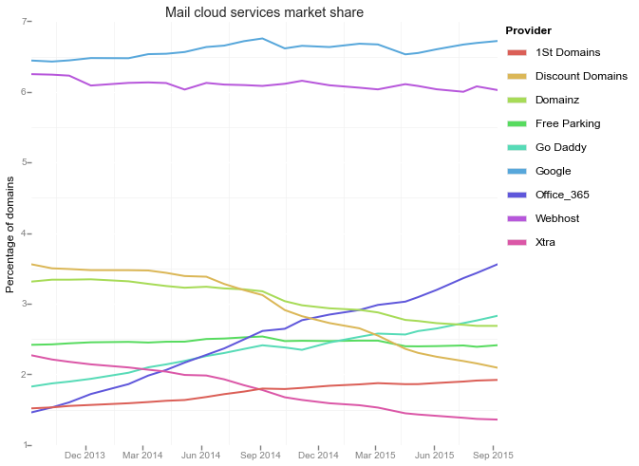
Cloud mail services market

Slide 7
Zone scan future
Collect data about “new” technologies
DANE, SPF, DKIM
Improve some of the collections
DNSKEY key length
Update the software
Give zonemaster a try

Slide 8
Internet Data Portal
http://idp.nz
Cloud solution provided by Socrata
Our efforts to support Internet research and share data openly
Two datasets at the moment
.nz zone scan
.nz registration data
Aggregated and anonimized

Slide 9
IDP - Examples
.nz Zone Scan Data Set
https://idp.nz/Domain-Names/-nz-Zone-Scan/ep35-2s5u
Zone scan visual explorer
https://idp.nz/view/d8mm-tt52

Slide 10
IDP - Examples
Domain level errors
https://idp.nz/Domain-Names/-nz-Zone-Scan-Domain-Errors/2cqk-jxpt
Name servers errors
https://idp.nz/Domain-Names/-nz-Zone-Scan-Nameserver-Errors/g8c6-rp3v
DNSSEC Status
https://idp.nz/Domain-Names/-nz-Zone-Scan-DNSSEC/jd96-epec
IPv6 adoption
https://idp.nz/Domain-Names/-nz-Zone-Scan-IPv6/rypa-4eiq

Slide 11
IDP - Examples
DNSKEY algorithms
https://idp.nz/Domain-Names/-nz-Zone-Scan-DNSKEY-algorithms/ari3-y5bk
TTL distribution sample
https://idp.nz/Domain-Names/-nz-Zone-Scan-TTL-Sample-/98tk-cy6d

Slide 12
IDP – Potential uses
Data is available for others to use
For example, server geo-location dashboard
Server geo-location animation
Interactive map
http://blog.nzrs.net.nz/visualizing-server-locations-for-nz-using-open-data/

Slide 13
IDP - Future
More datasets
Aggregated from .nz DNS traffic
Thanks SIDN for the inspiration
DNSSEC and IPv6 adoption for NZ from APNIC
Thanks Geoff!
String analysis of the registry
Levenshtein
Portfolios
Word segmentation and tagging
External visualizations using the data

Slide 14
sebastian@nzrs.net.nz

