Slide 1
The hunger for AAAA
Sebastian Castro – NZRS
DNS-OARC 25, Dallas, October 2016

Slide 2
It all started with
Offshore provider’s bill was 20% higher that the previous month
When you get billed by the query, it hurts.
Started checking for anomalies in the traffic
Using their snapshots and our own data
Common pattern
Large amount of AAAA queries for ns3.dns.net.nz and ns4.dns.net.nz

Slide 3
.nz delegation
7 nameservers
4 managed by NZRS and with instances in New Zealand
2 managed by one provider
1 managed by another provider
Only ns3 and ns4 didn’t have AAAA glue in the root zone

Slide 4
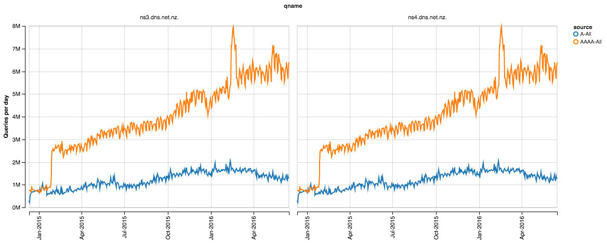
How bad it was?

Slide 5
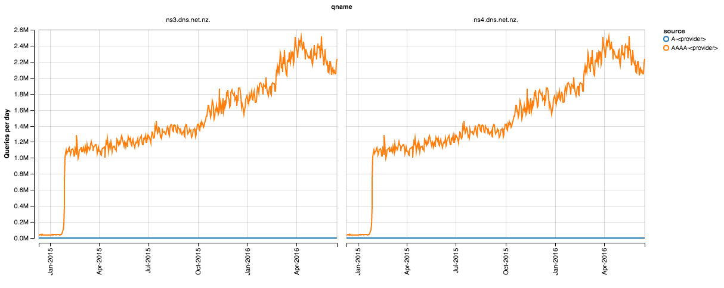
From one specific ASN

Slide 6
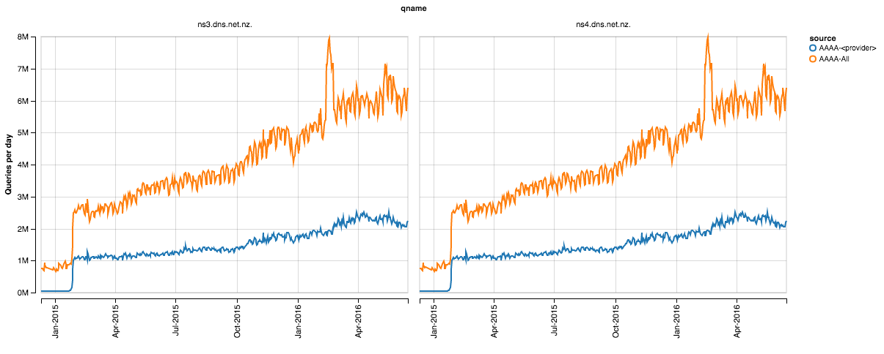
Combined

Slide 7
How to fix it
Option 1
Please <provider>, can you check why you suddenly started sending us million of queries and fix it?
Option 2
Add AAAA glue for the two nameservers
Not an easy fix, getting proper IPv6 connectivity in New Zealand is not that easy

Slide 8
Deployment of fixes
Option 1
Dear NZRS, we will take a look and see what we can do -- <provider>
Option 2
Use the v6 address of an existing nameserver as glue for ns3 and ns4 – temporarily
Speed up undergoing work to have real IPv6 connectivity
Kudos to Daniel Griggs and Dane Foster for making it possible

Slide 9
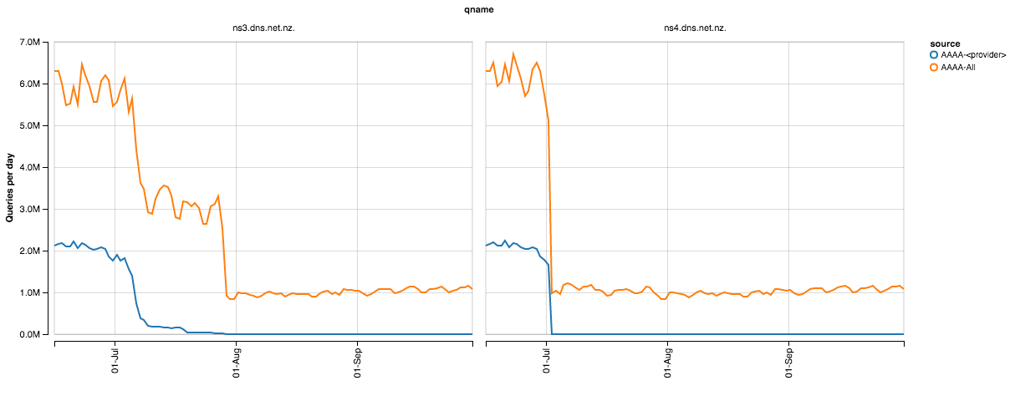
Combined solution
July 7th: <provider> fix starts to get deployed
July 29th: ns3 glue added to the root
July 1st: ns4 glue added to the root

Slide 10
Others affected?
Based on a copy of the root zone
There are 532 authoritative nameservers for TLDs without AAAA glue
Covering 330 different TLDs
It should be possible to verify if they are seeing large amount of traffic from eager sources

Slide 11
Open Questions
What the heck happened in Feb 2015?
Happy eyeballs?
OS update preferring AAAA over A
And not handling the empty response properly?
Negative TTL for .nz is 3600 seconds

Slide 12
Lessons learned
Don’t shoot yourself in the foot
Pay attention to anomalies
Keeping traffic counts helps a lot in forensics
Our Big Data platform made possible to go back in time

Slide 13
sebastian@nzrs.net.nz

