Slide 1
In the search of resolvers
Jing Qiao 乔婧, Sebastian Castro – NZRS
DNS-OARC 25, Dallas

Slide 2
Background
Domain Popularity Ranking
Derive Domain Popularity by mining DNS data
Noisy nature of DNS data
Certain source addresses represent resolvers, the rest a variety of behavior
Can we pinpoint the resolvers?

Slide 3
Noisy DNS
Long tail of addresses sending a few queries on a given day

Slide 4
Data Collection
To identify resolvers, we need some data
Base curated data
836 known resolvers addresses
Local ISPs, Google DNS, OpenDNS
276 known non-resolvers addresses
Monitoring addresses from ICANN
Asking for www.zz--icann-sla-monitoring.nz
Addresses sending only NS queries

Slide 5
Exploratory Analysis
Do all resolvers behave in a similar way
http://blog.nzrs.net.nz/characterization-of-popular-resolvers-from-our-point-of-view-2/
Conclusions
There are some patterns
Primary/secondary address
Validating resolvers
Resolvers in front of mail servers

Slide 6
Supervised classifier
Can we predict if a source address is a resolver?
14 features per day per address
Fraction of A, AAAA, MX, TXT, SPF, DS, DNSKEY, NS, SRV, SOA
Fraction of NoError and NxDomain responses
Fraction of CD and RD queries
Training data
Extract 1 day of DNS traffic (653,232 unique source addresses)
Base data

Slide 7
Training Model
LinearSVC
__________________________________________________________________________
Training:
LinearSVC(C=1.0, class_weight='balanced', dual=True, fit_intercept=True,
intercept_scaling=1, loss='squared_hinge', max_iter=1000,
multi_class='ovr', penalty='l2', random_state=None, tol=0.0001,
verbose=0)
train time: 0.003s
Cross-validating:
Accuracy: 1.00 (+/- 0.00)
CV time: 0.056s
test time: 0.000s
accuracy: 1.000
dimensionality: 14
density: 1.000000
classification report:
precision recall f1-score support
0 1.00 1.00 1.00 73
1 1.00 1.00 1.00 206
avg / total 1.00 1.00 1.00 279

Slide 8
Other Learning Algorithms
For the classification problem with less than 100K samples, LinearSVC is the first choice
We also benchmarked some other algorithms such as K-Neighbors and Random Forest.
All of them achieved 100% accuracy

Slide 9
Test the model
Apply the model to three different days
Resolver is represented as 1, and non-resolver as 0.
df = predict_result(model, "20160301")
df.isresolver_predict.value_counts()
1 645060
0 8172
df = predict_result(model,"20160429")
df.isresolver_predict.value_counts()
1 529757
0 6243
df = predict_result(model,"20151212")
df.isresolver_predict.value_counts()
1 453640
0 9279

Slide 10
Preliminary Analysis
Most of the addresses classified as resolvers
Possibly because the list of non-resolvers show a very specific behaviour
Model fitting specific behaviour, leaving any other address as resolver.
The next iteration of this work should to improve the training data to include different patterns.

Slide 11
Unsupervised classifier
What if we let a classifier to learn the structure instead of imposing
The same 14 features, 1 day’s DNS traffic
Ignore clients that send less than 10 queries
Reduce the noise
Run K-Means Algorithm with K=6
Inspired by Verisign work from 2013
Calculate the percentage of clients distributed across clusters

Slide 12
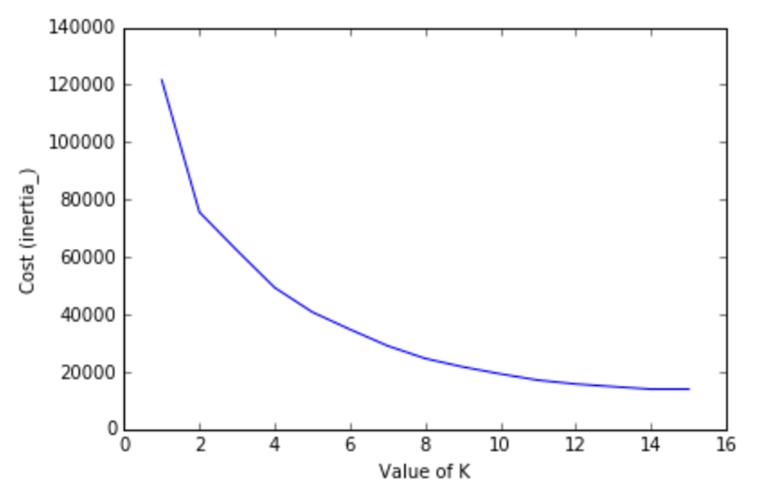
K-Means Cost Curve

Slide 13
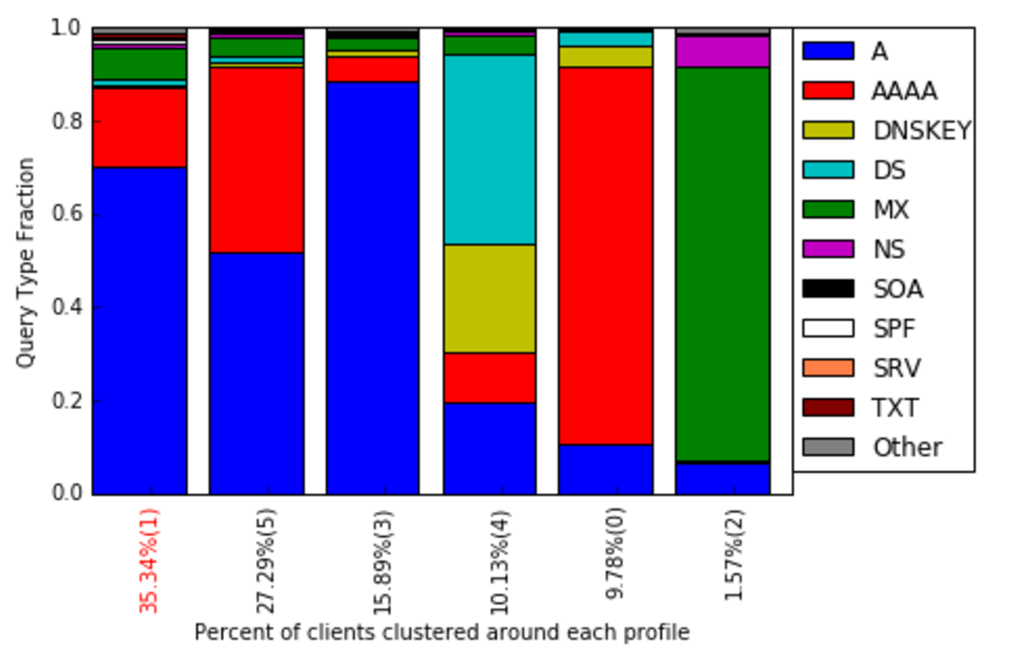
Query Type Profile per cluster

Slide 14
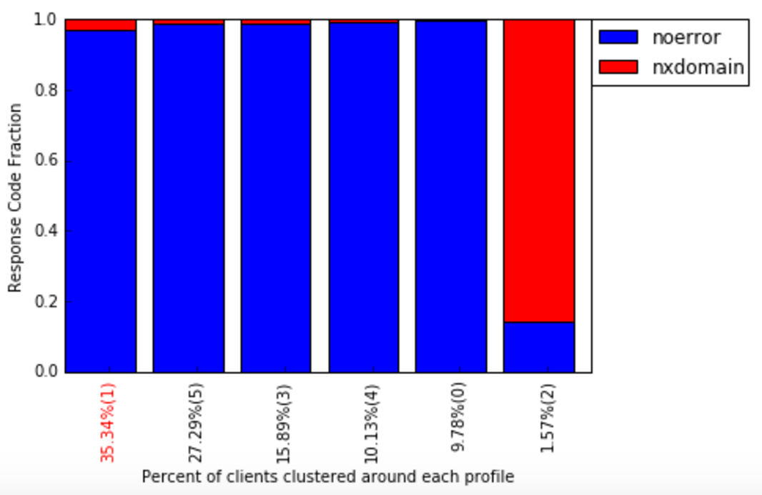
Rcode profile per cluster

Slide 15
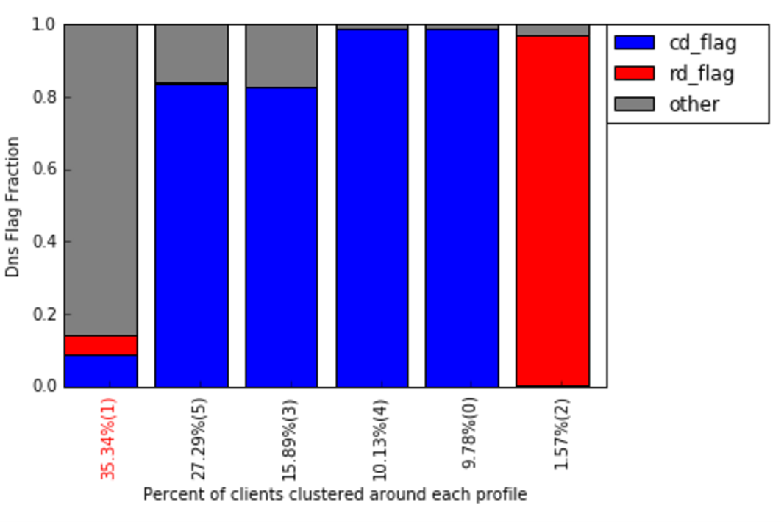
Flag profile per cluster

Slide 16
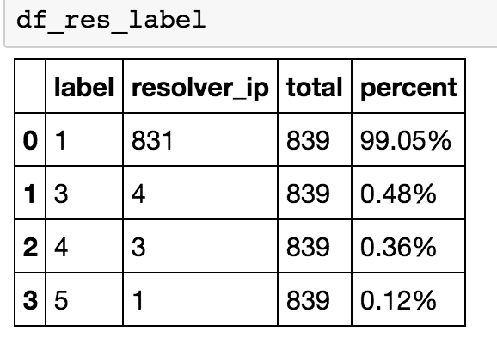
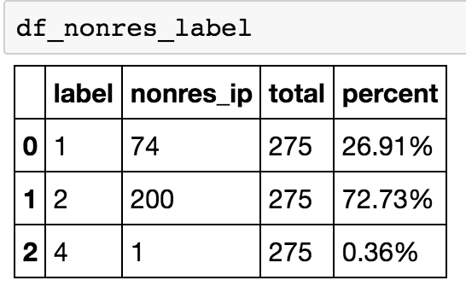
Clustering accuracy
How many known resolvers fall in the same cluster?
How many known non-resolvers?
Tested on both week day and weekend, 98% ~ 99% known resolvers fit in the same cluster

Slide 17
Client persistence
Another differentiating factor could be client persistence
Within a 10-day rolling window, count the addresses seen on specific number of days
Addresses sending traffic all the time will fit into known resolvers and monitoring roles

Slide 18
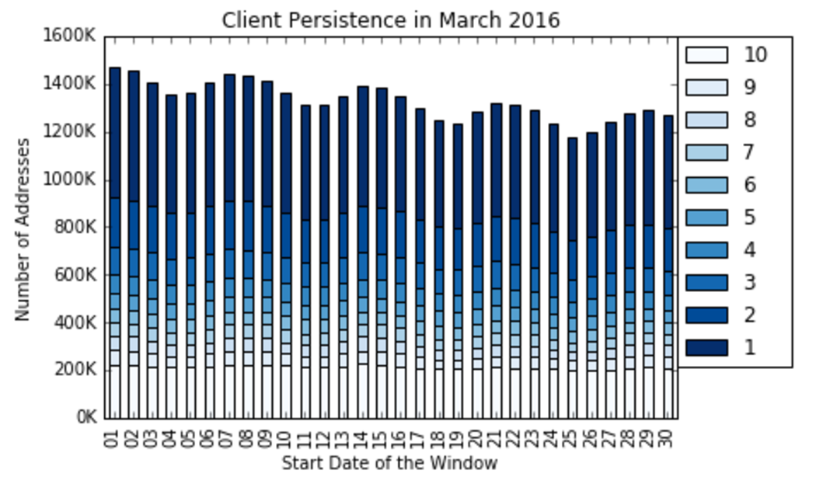
Client Persistence

Slide 19
Resolvers persistence
Do the known resolvers addresses fall into the hypothesis of persistence?
What if we check their presence in different levels?

Slide 20
Resolvers persistence

Slide 21
Future work
Identify unknown resolvers by checking membership to the “resolver like” cluster
Exchange information with other operators about known resolvers.
Potential uses: curated list of addresses, white listing, others.

Slide 22
Conclusions
This analysis can be repeated to other ccTLDs
Using open source tools
Code analysis will be made available
Easily adaptable to use ENTRADA

Slide 23
jing@nzrs.net.nz, sebastian@nzrs.net.nz

