Slide 1
What to do with SERVFAIL
The day wd2go.com fell off the Internet

Slide 2
What is wd2go.com

Slide 3
Personal cloud storage
Local Disk Storage for
  Backups
  Photos
  Etc
All content also accessible via Internet
Acts as a cloud to your devices

Slide 4
DNS Parameters (on a normal day)
Names
Query types
Name | %
www.wd2go.com. | 59.47
web.wd2go.com. | 11.77
api.wd2go.com. | 1.44
discovery.wd2go.com. | 0.94
relay-prod-apsoutheast2-3.wd2go.com. | 0.29
relay-prod-apsoutheast2-4.wd2go.com. | 0.28
device2998911-158c8433-local.wd2go.com. | 0.13
device2998911-158c8433.wd2go.com. | 0.13
Query Type | Number | %
A | 1 | 61.985895
AAAA | 28 | 38.010420
DS | 43 | 0.002190
DLV | 32769 | 0.000940
NS | 2 | 0.000523
CNAME | 5 | 0.000019
TXT | 16 | 0.000009

Slide 5

DNS Setup (before the event)

Slide 6
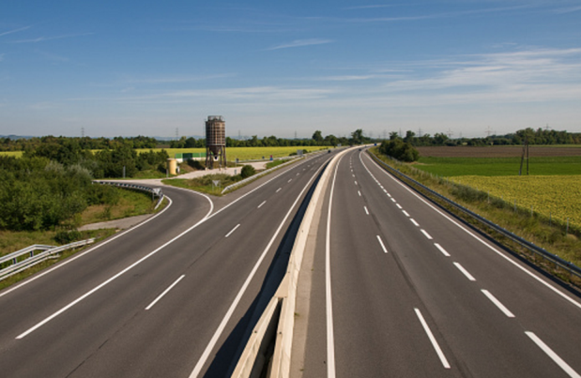
DNS Traffic (on a normal day)
Wd2go.com characterisitic | Result
Type of traffic | flat
Relative QPS | 0.002% - 0.06%
QPS per client (avg) | 0.003 – 0.01
Clients sending traffic | 0.03% - 0.5%
Notes:
No traffic in mobile networks. Most traffic in english speaking first world countries

Slide 7
The August 3 Oooops

Slide 8
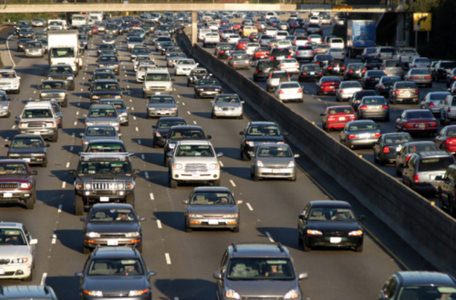
DNS Traffic on August 3
Type of Traffic | Spikey
Relative QPS | 4% - 43%
QPS per client (avg) | 3 – 20 qps
Clients sending traffic | 0.03% - 0.7%
Is this a problem
Normal traffic 0.2 qps per sub
  200kqps per 1 million subs
Now a few subs have more
  0.5% = 5000 clients
  5000 clients * 20 qps = 100kqps

Slide 9
Impact of problem
Normal traffic August 3
Normal traffic August 2
wd2go.com traffic August 3
wd2go.com traffic August 2
Notes:
Normal traffic means rcode=0 on this graph

Slide 10
DNS Parameters (during incident)
Names
Query types
Name | %
www.wd2go.com. | 3.037
relay-prod-eucentral1-20.wd2go.com. | 1.167
relay-prod-euwest1-12.wd2go.com.. | 1.162
web.wd2go.com. | 0.665
relay-prod-useast1-13.wd2go.com. | 0.265
relay-prod-apsoutheast2-4.wd2go.com. | 0.283
device3263568-9cfc0eee.wd2go.com. | 0.001
device1944395-96d9ffc1.wd2go.com. | 0.001
Query Type | Number | %
A | 1 | 98.4618319
AAAA | 28 | 1.5381624
A6 | 38 | 0.0000037
NS | 2 | 0.0000007
TXT | 16 | 0.0000005
DS | 43 | 0.0000004
SOA | 6 | 0.0000001

Slide 11

Summary of findings
A medium size domain going off can cause a lot of strain on the infrastructure
  Over provisioning still is good
  No IPv6 if things go south
Would be good if clients didn’t retry as hard and back off
How are servers responding to SERVFAIL storms caused by outages ?

Slide 12
How does different software handle this

Slide 13
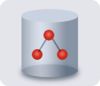


How to replicate the event in a lab
Create a domain where all the name servers are not reachable
Create a dnsperf file with a name that of that domain
Start a caching server
Fire up dnsperf
  Timout 5 seconds
  -q large enough to still sending when server doesn’t answer
  -Q 10000 qps
dnsperf -Q 10000 -c 100 -T 10 -q 250000 -t 5 -l 60 -S 1 -d oneservfail.q –s I.P.I.P
Authoritative
Servers
. (root)
ANS
Caching
Servers
com.
dnsperf
ANS
Vantio
kaputt.com.
ANS

Slide 14
First results in
Software | Packets answered | Packets not answered
Bind-9.9 | 0 (0.00%) | 600000 (100.00%)
Bind-9.10 | 0 (0.00%) | 600000 (100.00%)
Bind-9.11 | 50000 (8.33%) | 550000 (91.67%)
Cacheserve 7 | 598552 (99.76%) | 1448 (0.24%)
Powerdns-4.0 | 599476 (99.91%) | 524 (0.09%)
Unbund 1.5.10 | 66734 (11.12%) | 533266 (88.88%)
That looks weird…..
  Am I doing something wrong?
  Lets look at the details

Slide 15
Bind 9.11 details

Slide 16
Cacheserve 7 details

Slide 17
Powerdns 4.0 details

Slide 18
Unbound 1.5.10 details

Slide 19

Thinking and more tests
Looks like different server software has different personality
  Different cache servfail timers
    Longer timers means less work, but slower recovery
  Different levels of persistence in trying to get an answer
Test really didn’t reflect the outage
  More subdomains were asked
  Refine test to ask 5000 different subdomains
Fire
Notes:
Powerdns default is 60, Cacheserve is 2

Slide 20
More results in (5000 different subdomains)
Software | Packets answered | Packets not answered
Bind-9.9 | 260597 (43.43%) | 339403 (56.57%)
Bind-9.10 | 288966 (48.16%) | 311034 (51.84%)
Bind-9.11 | 599100 (99.85%) | 900 (0.15%)
Cacheserve 7 | 591961 (98.66%) | 8039 (1.34%)
Powerdns-4.0 | 587090 (97.85%) | 12910 (2.15%)
Unbund 1.5.10 | 348456 (58.08%) | 251544 (41.92%)
That looks more consistent…..
  With the exception of older bind and unbound
  Lets look at the details

Slide 21
Bind 9.9 details

Slide 22
Bind 9.10 details

Slide 23
Bind 9.11 details

Slide 24
Cacheserve 7 details

Slide 25
Powerdns 4.0 details

Slide 26
Unbound 1.5.10 details

Slide 27
Summary
Given enough traffic to bad domains most software will answer a lot
  Not answering is bad for most use cases
Machines will keep on retrying
Traffic increases
  Still good to over provision
Client coders really should do backoff strategies for SERVFAIL

Slide 28
Thank You

