Slide 1
DNS Service Monitoring at Salesforce
Diana Akrami (UC Berkeley), Han Zhang,
Tim Wicinski, Allison Mankin
Salesforce CONFIDENTIAL: Internal USE ONLY

Slide 2
Outline
Motivation and Background
Monitor DNS Services of Multiple Vendors
Real-time and Time-series Monitoring and Alerting Tools
Monitoring Results
1

Slide 3
Motivation
Software as a Service (SaaS) Cloud is the business of SFDC
Long history of using managed DNS services rather than operating our own
Associated with the data center architecture we’ve built
CNAME is important to us
Must be highly available
Several large DNS provider DDoS events in recent years
Led us to multi-vendor choice
The most recent DDoS events did not affect SFDC core, as a result of this choice
2

Slide 4
Background - Primary/Secondary
DNS Data Flow
Rest API
Salesforce
Database Replication
Portal
IXFR
Check SOA
Outbound
XFR
DNS Notify
Vendor A
Vendor B
3

Slide 5
Background - Active/Active
Rest API
DNS Data Flow
Database Replication
Vendor A
Salesforce
Rest API
Vendor B
4

Slide 6
Background - CNAME is Important to Us
foo.my.salesforce.com
foo.my.salesforce.com
Migration
Site Switching
na48.my.salesforce.com
na48.my.salesforce.com
na1.my.salesforce.com
5

Slide 7
Motivation
Monitor service status and performance
E.g. Whether DNS server responds to queries
Benchmark for services
E.g. Compare multiple DNS vendors’ services
Improve services
E.g. Share reports with DNS vendors
Find hidden problems
E.g. Undocumented Rest API behaviors
6

Slide 8
DNS Service Monitoring
Availability:
Name servers answer DNS queries
Vendor Rest API
Consistency:
Among the authoritative servers for a single vendor
Between two vendors when primary/secondary is configured
Local propagation Delay:
How long it takes for changes to appear on authoritative servers
7

Slide 9
Monitor Availability and Consistency
Availability:
Name servers answer queries: Periodically send DNS queries to every authoritative server via UDP and TCP
Vendor Rest API: Periodically login via Rest API
Consistency:
Periodically query SOA records from every authoritative server and compare the serial numbers
8

Slide 10
Refocus - Real-time Monitoring Tool
Open Source: https://github.com/Salesforce/refocus
Example: Monitor availability of DNS vendors (A: Vendor A, B: Vendor B)
Use for queries
9

Slide 11
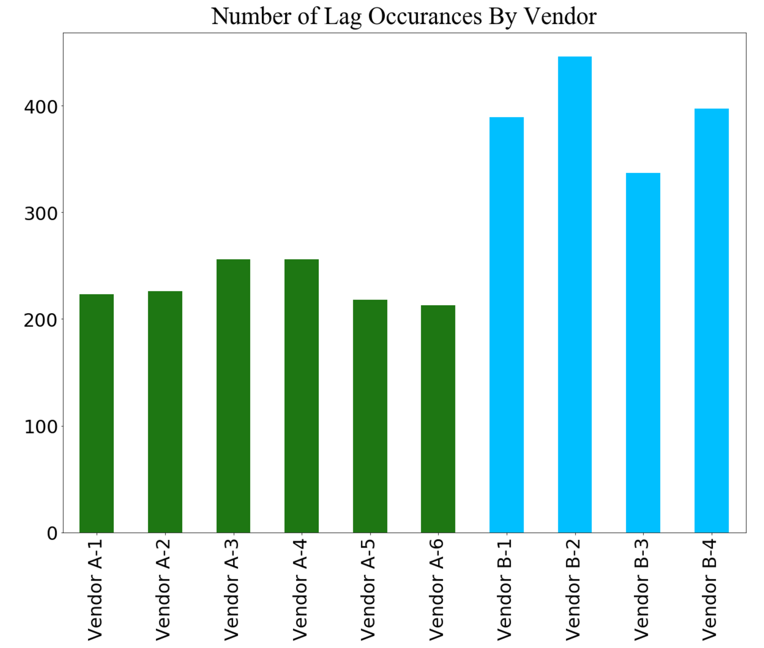
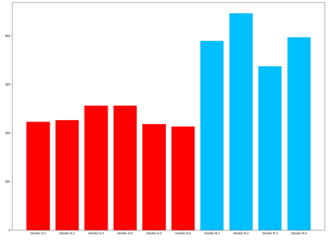
Availability and Consistency - Results
Vendor A: Primary, Vendor B: Secondary
Dataset: November 2016 to June 2017
Probed every two minutes
124,638 SOA records for each name server
Stats for the lag data only:
More than two minutes: 1,795, less than two minutes: 1,206
Vendor A: average: 2.7 minutes, standard deviation: 1.9
Vendor B: average: 16.9 minutes, standard deviation: 53.6
We expected only servers of secondary vendor lag
Primary vendor servers also lagged
We expected at least one server of vendor A should always have the latest serial number:
Only vendor B has the latest serial number, all the servers of vendor A lagged: 98 times
Vendor A
Vendor B
10

Slide 12
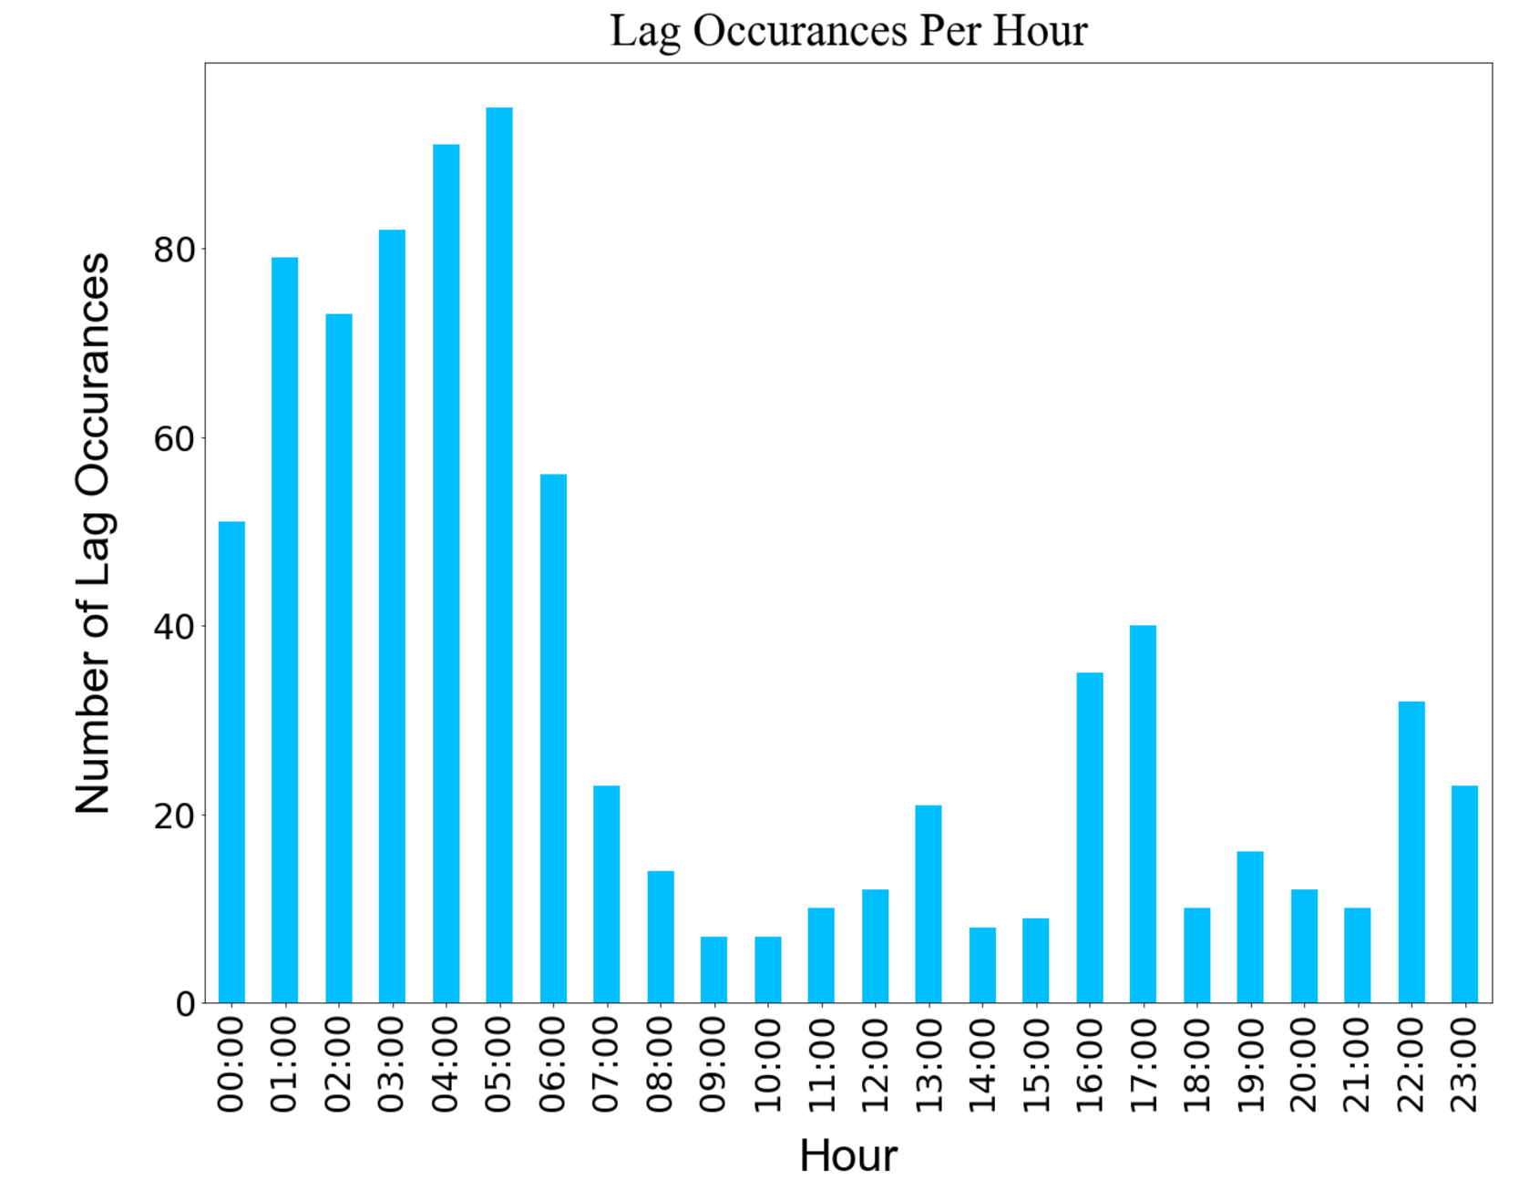
Availability and Consistency - Results
We expected to have more lags during peak hours, but found that there were actually more lags during off-peak hours
x-axis: timeline by hour, 12 am to 11 pm
y-axis: the number of lagged servers during that hour
11

Slide 13
Monitor Propagation Delay
Periodically create CNAME on three vendors via Rest API
Query the created CNAME from a single vantage point:
Right after creation
3 seconds after creation
10 seconds after creation
Then every 10 seconds until 240 seconds/4 minutes
How long it takes for the created CNAME to appear on the servers
12

Slide 14
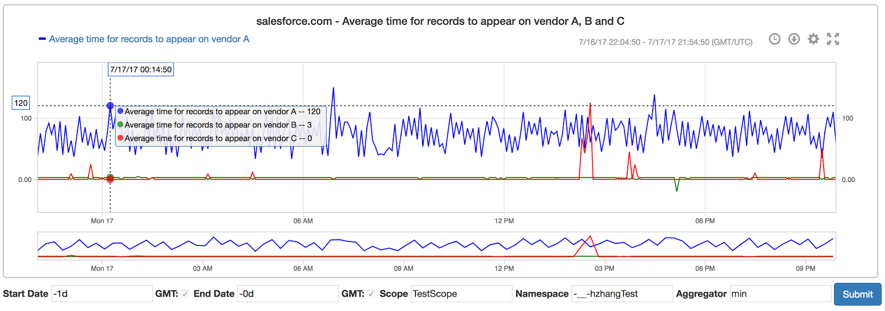
Argus - Time-Series Monitoring and Alerting
Open Source: https://github.com/salesforce/Argus
Propagation delays of three vendors
Specify
Lines
Specify Result
Zoom In
Various
Aggregators
Change
Duration
13

Slide 15
Propagation Delay - Vendor A
Vendor A provides us with 6 authoritative servers
All have high propagation delays
VendorA-03 and VendorA-04 almost always have the same delays
Periodic fluctuations for VendorA-03 and VendorA-04
14

Slide 16
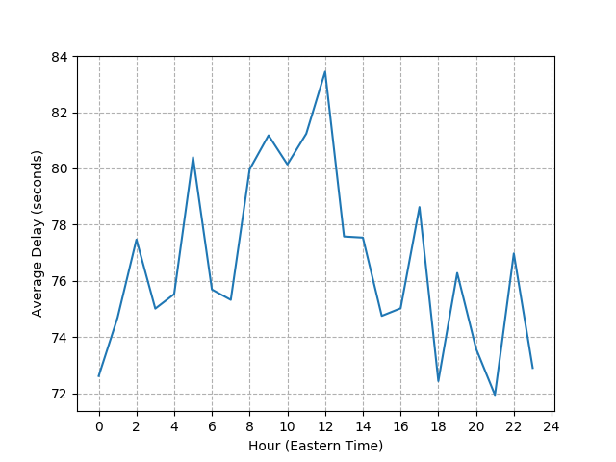
Propagation Delay - More Results
Average delay by hour
Vendor A: higher delays during daytime
Vendor B and C: very consistent
Consider 30 seconds as reasonable delay
Vendor | Average (second) | Standard Deviation (second) | % of Delays Less Than 30 seconds
Vendor A | 76.71 | 50.89 | 14.2%
Vendor B | 2.71 | 2.10 | 99.9%
Vendor C | 0.79 | 6.04 | 99.5%
15

Slide 17
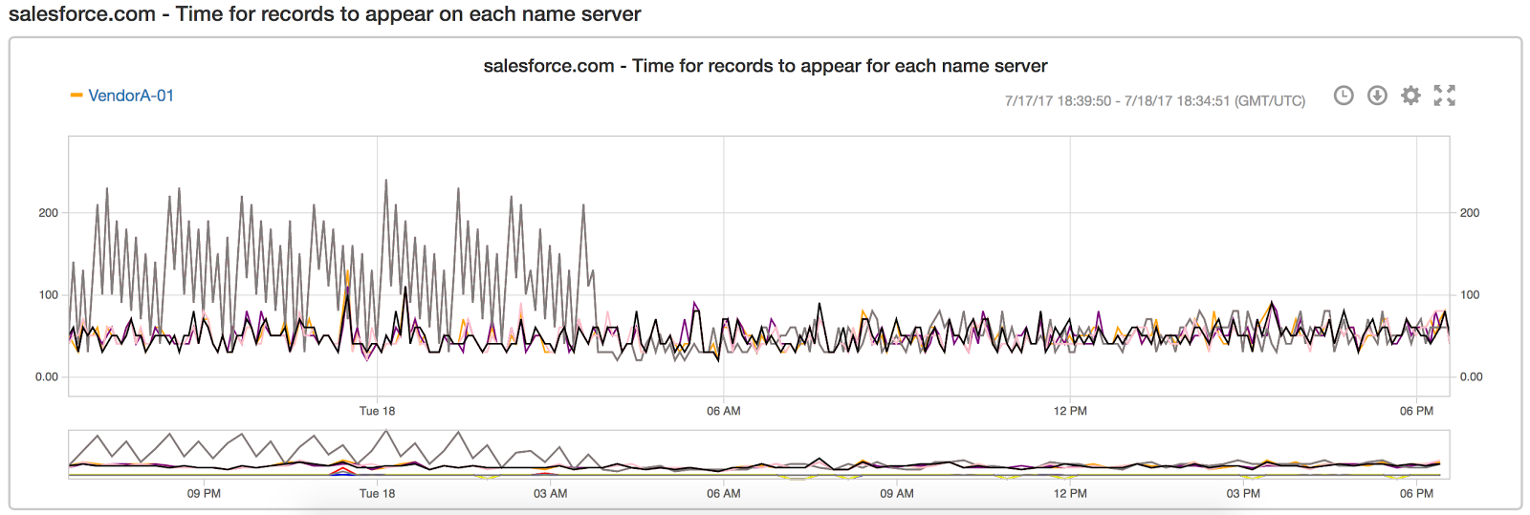
Benchmark and Improve Services
Benchmark the propagation delay for multiple DNS vendors
Share the report with vendors regularly after anonymization
Outcome: significantly improved propagation delay of vendor A
16

Slide 18
Find Hidden Problems
Vendor B is currently used as secondary
Can vendor B be used as primary? What is the performance?
Finding: Sometimes CNAME cannot be created
CNAMEs
not created
17

Slide 19
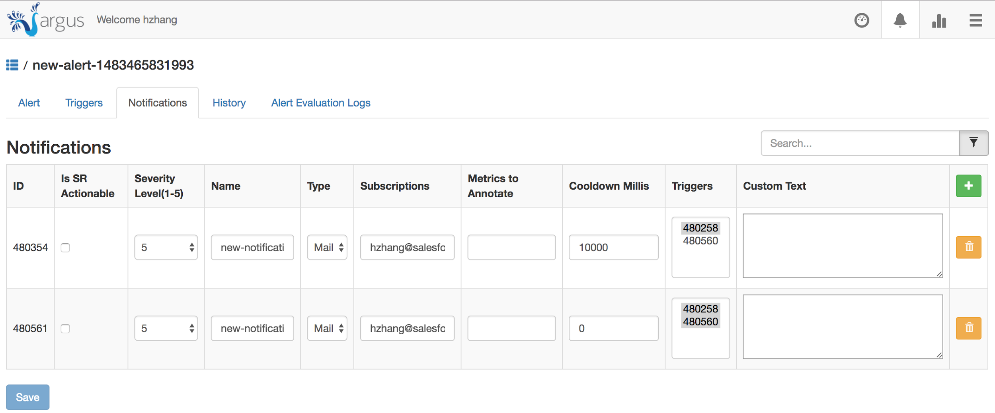
Argus - Alerting
18

Slide 20
Lessons Learned and Conclusion
Cannot get this monitoring data directly from vendor or internal logs
Sometimes authoritative servers lag, even for the primary vendor
Propagation delay is high for some vendor
Consistency and propagation delay have diurnal behavior
All vendors are not the same
Performance can vary significantly
Different Rest API behavior
Different advantages and disadvantages
Monitoring helps improve performance and find hidden problems
19

Slide 21
Future Work
More monitoring
IXFR/AXFR performance
Monitor more zones
Critical zones for Salesforce and acquisitions
Deploy more vantage points geographically
One vantage point every continent
Work with vendors to improve services
Propagation delays
Rest API
20

