Slide 1
DNS Security – It’s Hard
DNS OARC Bangkok
May 12, 13 2019
Ralf Weber

Slide 2
Agenda
A stroll down DNS memory lane
Personal
Not complete
It’s about bad stuff that happened
Categorize problems
Describe solutions

Slide 3
1983 Dawn of DNS
No more hosts.txt
Delegation of authority
Caching for speed
TTL for updates
It’s a name
By Henry Mühlpfordt - Own work, CC BY-SA 3.0,
https://commons.wikimedia.org/w/index.php?curid=1393975

Slide 4
1990s Protocol Issues
Problems
Reverse and forward tree
Additional section can’t be trusted
Cache poisoning
Numerous papers
Bellovin
Schneider
Schuba
Solutions
Started DNSSEC… Unfortunately not finished until 2005
By DXR - Own work, CC BY-SA 4.0,
https://commons.wikimedia.org/w/index.php?curid=37260236
Notes:
https://www.cerias.purdue.edu/assets/pdf/bibtex_archive/94-05.pdf
https://www.nap.edu/read/6161/chapter/1#ii
https://www.usenix.org/legacy/publications/library/proceedings/security95/full_papers/bellovin.pdf

Slide 5
~2000 D. J. Bernstein Notes on DNS
Solutions that were embraced
More entropy
Elliptic Curve - small and effective
Gluelessness
Solutions that weren’t embraced
Encoding keys in names
Keep resolution local
Implementations
Djbdns
Dnscurve, which eventually led to dnscrypt
Notes:
http://cr.yp.to/djbdns/notes.html
http://cr.yp.to/talks/2003.02.11/slides.pdf
http://dnscurve.org/

Slide 6
2000s Domain Hijacking
Problems
Use registrar credentials to hijack DNS
Sex.com
ICANN
Twitter
Others
DNS “Tasting”
Solutions
Not DNS protocol attacks
DNSSEC doesn’t help
DOT/DOH don’t help either
By William Croyle, California Department of Water Resources Public Domain,
https://commons.wikimedia.org/w/index.php?curid=56253570
Notes:
https://www.cnet.com/news/sex-com-domain-hijacker-captured/
https://www.icann.org/en/system/files/files/factsheet-dns-attack-08mar07-en.pdf
https://gnso.icann.org/sites/default/files/filefield_5842/gnso-initial-report-domain-tasting-07jan08.pdf

Slide 7
2000s Enterprise Issues
Problems
DNS Rebinding
Inside=Outside
DNS Tunneling
Exfiltrate data
Solutions
DNS protocol is not being compromised
Abuse is in the data
Policy helps
By Buonasera - Foto stammt vom Fotografen und Rechteinhaber des Bildes und wurde frei gegeben –
Buonasera, CC BY-SA 3.0, https://commons.wikimedia.org/w/index.php?curid=36391954
Notes:
https://crypto.stanford.edu/dns/dns-rebinding.pdf

Slide 8
2008 Kaminsky
Problem
Attackers force questions
Can’t trust anything
Resolution
Source Port Randomization
We should not have stopped there
Resimprove draft
TCP Switch
DNSSEC (!!!!!!)
Later validated using other vectors
Fragmentation
JPRS/CZ.NIC
By R. Clucas - https://web.archive.org/web/20051111095409/http://wrgis.wr.usgs.gov/dds/dds-39/album.html,
Public Domain, https://commons.wikimedia.org/w/index.php?curid=45293
Notes:
https://www.blackhat.com/presentations/bh-jp-08/bh-jp-08-Kaminsky/BlackHat-Japan-08-Kaminsky-DNS08-BlackOps.pdf
https://ripe67.ripe.net/presentations/240-ipfragattack.pdf
https://datatracker.ietf.org/doc/draft-fujiwara-dnsop-fragment-attack/

Slide 9
2010s DNS Amplification and DDOS
Problem
Massive DNS traffic floods
Large visible targets
Root server
Dyn (Twitter)
Spamhaus
Medicine available
RRL
Anycast
Deprecate ANY
Intelligent responses
By Tobin - [1], CC BY-SA 2.0, https://commons.wikimedia.org/w/index.php?curid=4789000
Notes:
https://www.icann.org/en/system/files/files/factsheet-dns-attack-08mar07-en.pdf
https://dyn.com/blog/dyn-analysis-summary-of-friday-october-21-attack/

Slide 10
2010s DNS Changer
Problem
Change resolver IP in router or OS
Also browsers soon…
Defense
DNSSEC
Validation in end devices / applications
By NOAA Photo Library - line6504, Public Domain, https://commons.wikimedia.org/w/index.php?curid=58416378

Slide 11
2013 Snowden
Problem
Pervasive surveillance
Solution
Broad IETF initiatives to protect privacy:
dprive wg
RFC7858 (2016)
Maybe also DoH… RFC8484
Only encrypting channel
Still have to trust endpoints
MITM still possible
By Laura Poitras / Praxis Films, CC BY 3.0,
https://commons.wikimedia.org/w/index.php?curid=27104645

Slide 12
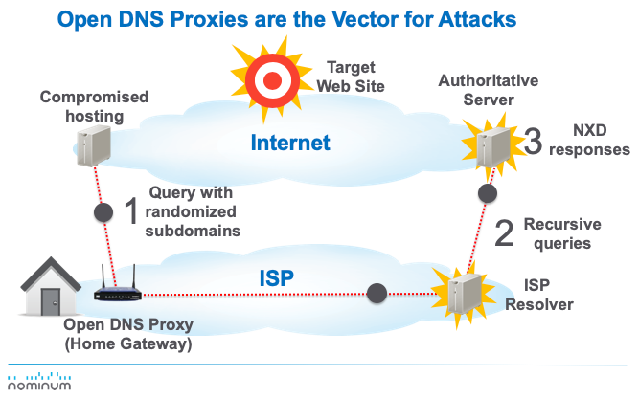
2014 Random Subdomain
Problem
Bring down authorities asking random questions
Bring down resolvers too!
Defense
Outbound Rate Limit
Intelligent Blocking
By R. Clucas - https://web.archive.org/web/20051111095409/http://wrgis.wr.usgs.gov/dds/dds-39/album.html,
Public Domain, https://commons.wikimedia.org/w/index.php?curid=45293

Slide 13
2018 DNSpionage
Problem
Multi faceted attack
Use Phishing to get credentials (for web or EPP)
Use creds to redirect auth server
Get a lets encrypt cert
Use cert for man in the middle
Solution
Needs multiple levels of response
Registrar/Registry (web/epp)
DNSSEC would have helped
DANE TLSA
Notes:
https://krebsonsecurity.com/2019/02/a-deep-dive-on-the-recent-widespread-dns-hijacking-attacks/

Slide 14
Some notes on attacks
Problem
Man in the middle (Mitm) is easy
Redirect local default gateway
Hijack route
Change DNS target
Still possible with HTTPS certificates
Making it easier to get certificates makes it easier to attack
Solution
DNSSEC can detect man in the middle attacks

Slide 15
Lets recap
Attack/Problem | DNS | Possible defence/solution
Domain Hijacking | No | Take care of your domain registration https://blogs.akamai.com/2019/02/protecting-your-domain-names-taking-the-first-steps.html
Cache Poisoing | Yes | DNSSEC
DNS Tunneling | Yes | Policies
DNS Re binding | Yes | Policies
DNS Changer | Yes | DNSSEC
Surveillance | Some | DNS over TLS
Pseudo Random Domain Attacks | Yes | Policies
DNS Amplification attacks | Yes | RRL, Policies
Multi Protocol Attacks | Some | DNSSEC

Slide 16
Summary
Modern resolvers need policies
There is just too much bad stuff out there
Encrypting DNS is not end to end authentication of data
DNSSEC helps with more attack scenarios
Man in the middle
Cache poisoning
Change of resolver
Please deploy DNSSEC
By Tobin - [1], CC BY-SA 2.0, https://commons.wikimedia.org/w/index.pp?curid=4789000

