Slide 1
Creating an audit trail for DNS record changes
https://dnstransparency.org

Slide 2
Mission statement: Make changes to the DNS visible and auditable

Slide 3
The problem
The DNS is a pull based system, allowing changes to go unnoticed
Short term changes can be missed, resulting in damage to domain owners and their users

Slide 4
The problem

Slide 5
The problem

Slide 6
The solution
Create an open, push based domain monitoring system

Slide 7
The solution

Slide 8
The solution - Certificate Transparency Model

Slide 9
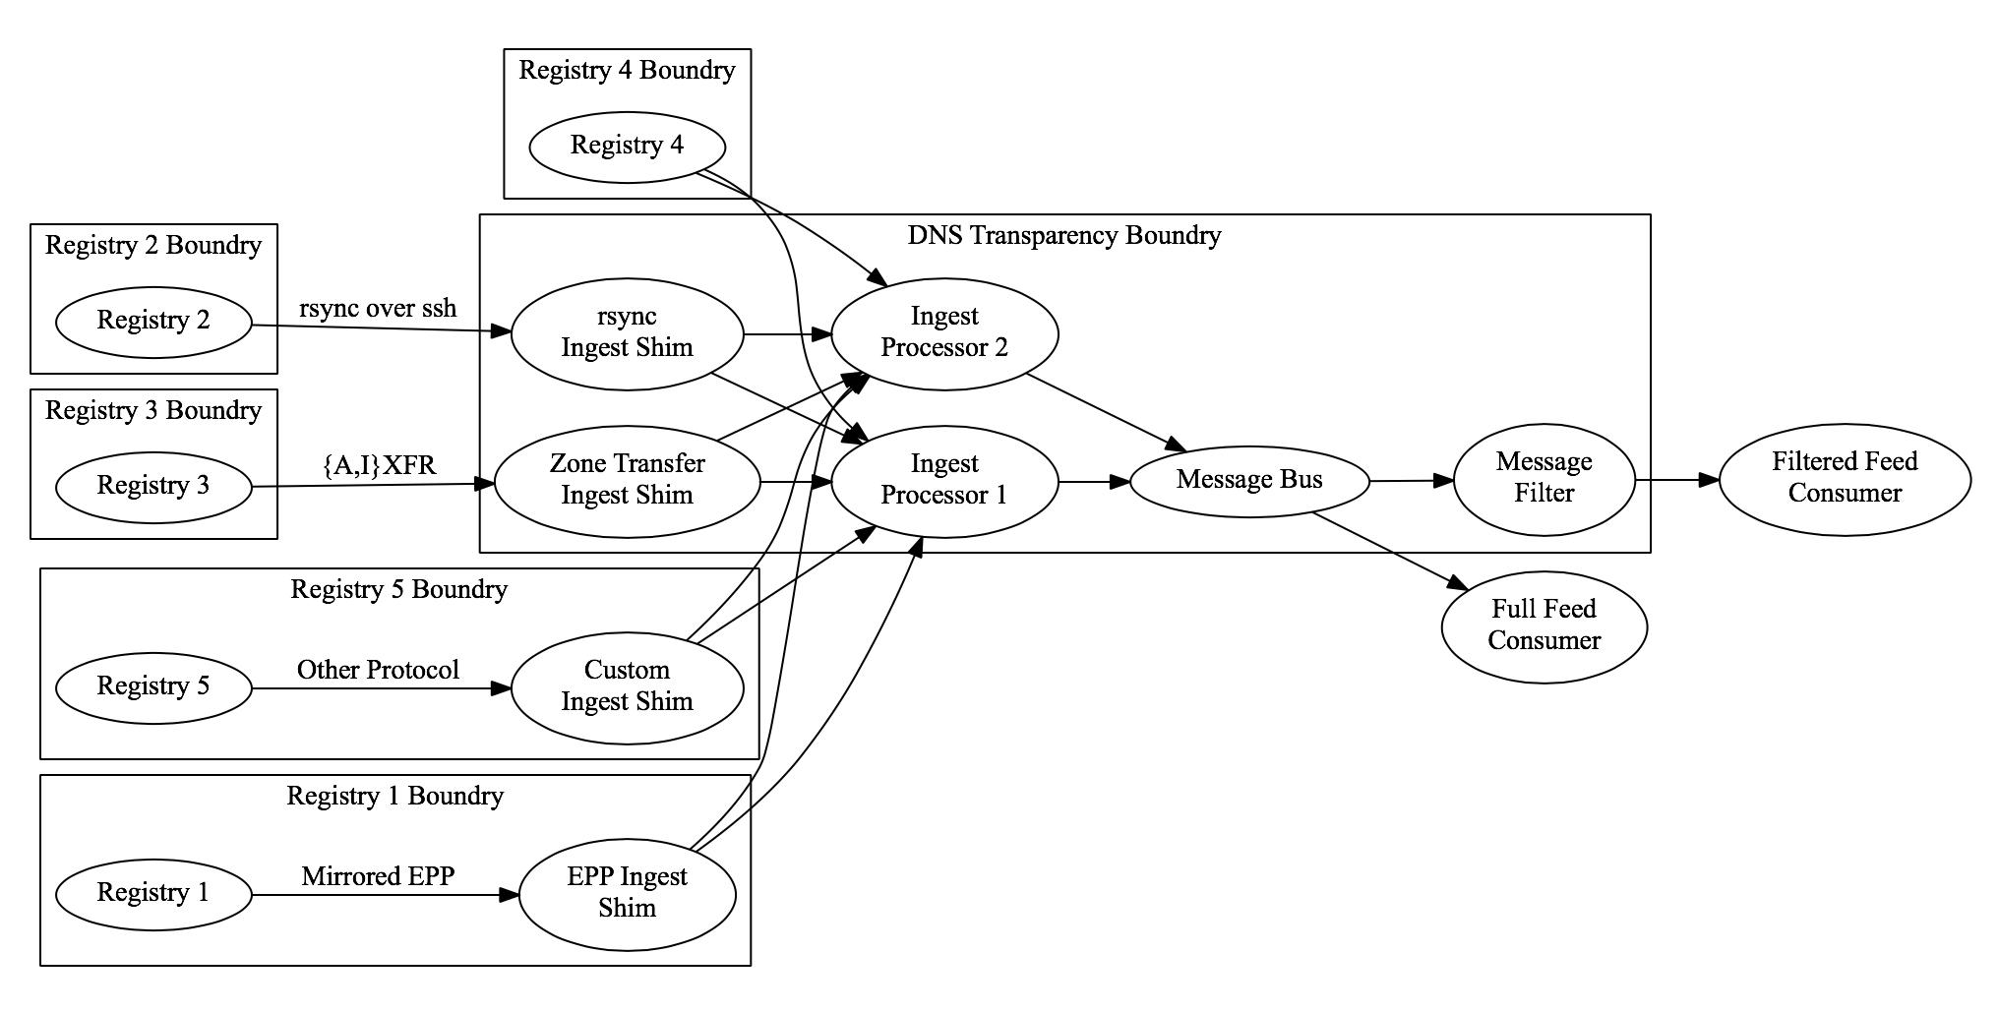
Current Architecture Sketch

Slide 10
Inputs
Registries to provide public zone updates in near real time*
*no contact information

Slide 11
Outputs
Raw feed of domain changes (ProtoBuf)
Filtered updates to interested parties (Email, SMS, Webhooks, etc) (JSON, xml, ...)

Slide 12
In Progress
Finding an Organizational home*
* People-Centered Internet

Slide 13
Whats Next
Building the PoC with registry partners

Slide 14
How can i help?
Registries:
Consider providing the project DNS Data
Registrants / Researchers:
Keep an eye our web page for our PoC availability

Slide 15
How can i help?
Interested Companies:
Consider donating money, services or development help.

Slide 16
Read More: https://dnstransparency.org
Contact Us: https://dnstransparency.org/stayinformed

