Slide 1
DNSSEC in ORG with a dash of COVID
Suzanne Woolf
OARC 32
9 June 2020

Slide 2
In our First episode…
June 2009
ORG zone signed (RSASHA1/NSEC3)
Oct. 2009
RFC 5702 published
June 2010
ORG zone accepts DS RRSets for child zones via EPP
July 2010
Root zone signed (RSASHA256/NSEC)

Slide 3
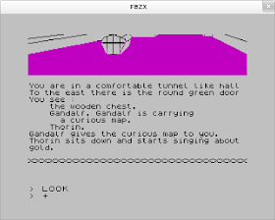
Time Passes….Tech Evolves….Stuff continues to work

Slide 4
In our last episode…
February 2020
OARC 32, PIR announces DNSSEC refresh in the ORG zone
COVID-19, PIR and Afilias close their offices, everybody sent to work from home, non-essential travel cancelled
February 2020
Researchers and other TLD operators get in touch to offer advice, experience and collaboration
March 2020

Slide 5
What did we want to achieve?
ORG had an enormous DNSKEY RRSet
Enormous enough that some guy called Geoff Huston once wondered aloud on stage in various conferences how .ORG even worked at all for an entire year to see if we would react
We should really make that smaller…
… but we’ll wait because we wouldn’t want to deprive Geoff of comedic material
ORG is signed using algorithm 7 (RSASHA1)
Rijmen, Oswald, “Update on SHA-1” January 2005
Wang, Yin, Yu, “Finding Collisions in the Full SHA-1” August 2005
Wang, Yao, Yao, “Notes on the Wang et al. 2⁶³ SHA-1 Differential Path”, August 2005
... and many other old-time favourites, including…
Leurent, Peyrin, “From Collisions to Chosen-Prefix Collisions – Application to Full SHA-1” April 2019
Leurent, Peyrin, “SHA-1 is a Shambles First Chosen-Prefix Collision on SHA-1 and Applications to the PGP Web of Trust” January 2020
ORG is signed using NSEC3
Negligible and increasingly unimportant protections against zone-walking
Opt-out sections make aggressive negative caching difficult
Complicates provisioning since zone size depends on DNSSEC uptake in children

Slide 6
Where were we heading?
ORG had an enormous DNSKEY RRSet
Identify operationally incomplete KSK rolls and complete them
Review pre-publication parameters for as-yet unused keys
Start lab testing different signer parameters to find out what else we could improve on
ORG is signed using algorithm 7 (RSASHA1)
Plausible targets are algorithm 8 and 13
All the cool kids are doing algorithm 13 though, and that will help with the DNSKEY response size. Let’s do that, we’re cool. Algorithm 8 is lame, etc.
Start lab testing to find the performance implications of algorithm 7 vs. 8 vs. 13
ORG is signed using NSEC3
NSEC is operationally less complicated
We’re fairly sure we are no longer concerned with the zone-walking problem
With 10,000,000 delegations, most of which are insecure, adding NSEC + RRSIG to each one means something like 20,000,000 additional resource records and 10,000,000 additional signatures
Start lab testing to find the performance implications of signing the NSECs
Start reviewing the edge capacity forecasts for memory footprint

Slide 7
Who should we work with?
Community Engagement
We want to make sure resolver operators are well aware of our plans
Let’s review the relative differences in the validator population when it comes to 8 vs. 13
We should do a bunch of lab testing, and if we’re going to do lab testing, we may as well make it a public lab– setting a good example, nothing to hide, etc.
Research Opportunities
ORG might have a more widespread base of dependent validators than the ccTLDs that have rolled to 13; perhaps there are interesting differences, there
We don’t know for sure, but we think that possibly there hasn’t been a production TLD roll from NSEC3 to NSEC, so perhaps that is new and exciting
Communications and Data Collection Partners
Started talking to the good people at DNS-OARC about our plans
Keith and Matt offered to host a mailing list
We started talking about how we might contribute funds to help with data collection exercises, if researchers suggested they were interested in data. More data always good!

Slide 8
BUT THEN OF COURSE
Huge performance impact of Algorithm 13 on Existing Signers
The current signing platform in use for .ORG has unoptimized support for ECDSA, and it shows
The new signing platform under development for other TLDs that would very likely not have this problem is still, well, under development
No Travel
Setting up a lab with new hardware is suddenly much more difficult
Crossing borders to increase edge capacity, memory footprints, etc suddenly also difficult
Changes to key management that involve people handling credentials seem unwise, even if they are practical
No Universities
Universities all over the planet start closing down and sending their students home
Campuses close, courses are suspended
Some regional universities have already cancelled lectures through the end of 2021
Everybody Suddenly Depends on the DNS Even More than they Used To
Let’s face it, this would be a particularly terrible time for anything to go wrong
Critical Critical Infrastructure

Slide 9
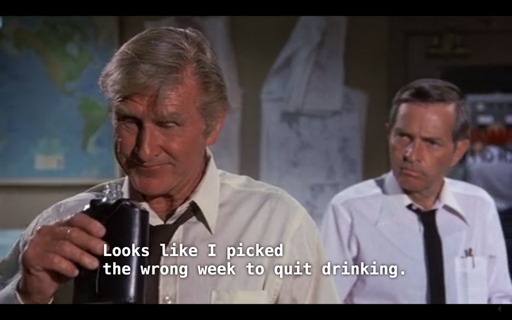
So Much for Q2 of 2020, REAlly.

Slide 11
What can we do THIS YEAR? (half left!)
We can review relevant parameters in the existing signers, like
Key pre-publication strategy
Signature lifetimes and zone-wide re-sign intervals
ZSK rollover policies
TTLs
We can test the performance implications of a roll to algorithm 8
We’ve already done most of this, in fact, and the differences are negligible
We can test the robustness of the algorithm rollover in the current signer
We could do this in private and publish the results
We could run a public testbed
We could do a dry run in some smaller TLDs
While we would take full precautions with any TLD, no matter how small, the impact of a problem in a much smaller TLD would be easier to mitigate and would affect far fewer end-users
We can do communications, outreach and coordination with researchers

Slide 12
What Have we been able to do?
We’ve gone deeper on the capabilities of the existing signers, like
How much work is it really to sign with NSEC?
Is a sequence of rolls (7 -> 8 -> 13) foreseeably feasible?
ZSK rollover policies and procedures
TTLs
We’ve documented that the performance implications of a roll to algorithm 8 are just as small as early results suggested.
We’ve put together roadmaps with Afilias, our Registry Services Provider, for whiteboard and lab work “as soon as feasible”
No way to tell when travel is possible again. We can do this remotely, it’s just lower bandwidth.
We are doing dry runs in some smaller TLDs
While we would take full precautions with any TLD, no matter how small, the impact of a problem in a much smaller TLD would be easier to mitigate and would affect far fewer end-users
We’ve continued to do communications, outreach and coordination with researchers

Slide 13
What SHOULD we do THIS YEAR?
You tell us what you would like to see (a unique opportunity to observe DNSSEC at scale!)
If you have experience to share, or
Interesting research questions to answer, or
Ideas about other things we could do, or
Observations about weirdness that you can’t explain
Please talk to us! We’re even considering a virtual meeting if email seems inadequate!
https://lists.dns-oarc.net/mailman/listinfo/org-algorithm-roll
Complete a feasibility study for a roll to algorithm 8
This is a much more incremental change than we were anticipating, but perhaps it’s a reasonable piece of work that other people considering a move away from SHA-1 might benefit from
It’s not often that this kind of planning work has such a direct and practical reason to include the kind of disaster scenarios that exist outside the window right now
If feasible, complete the roll
We would still love to get this done in 2020
We’re going to prioritise stability, however, and it’s always possible that the risk analysis will indicate that we are better off waiting

Slide 14
Questions?
Joe Abley <jabley@pir.org>
Suzanne Woolf <swoolf@pir.org>

