Slide 1
Localroot serve yourself the root+
Wes Hardaker
hardaker@isi.edu
USC/ISI

Slide 2
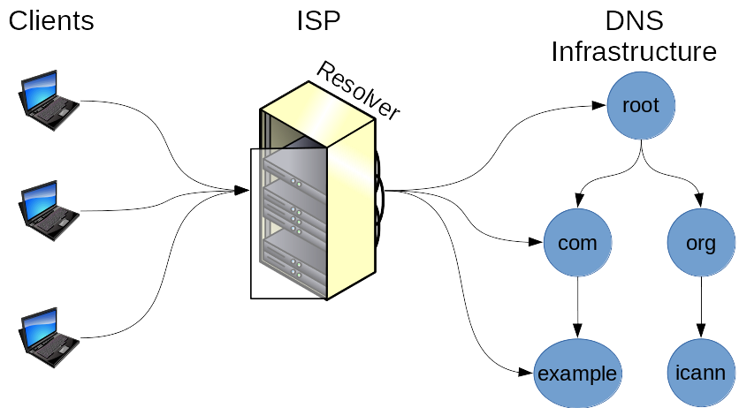
Classic DNS Resolution

Slide 3
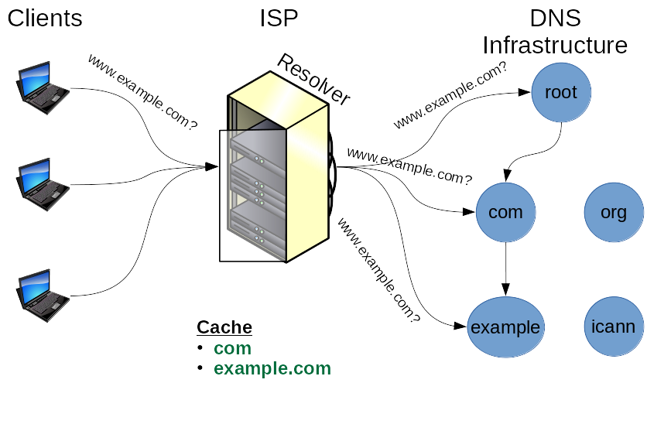
First request hitting the resolver starts from the top

Slide 4
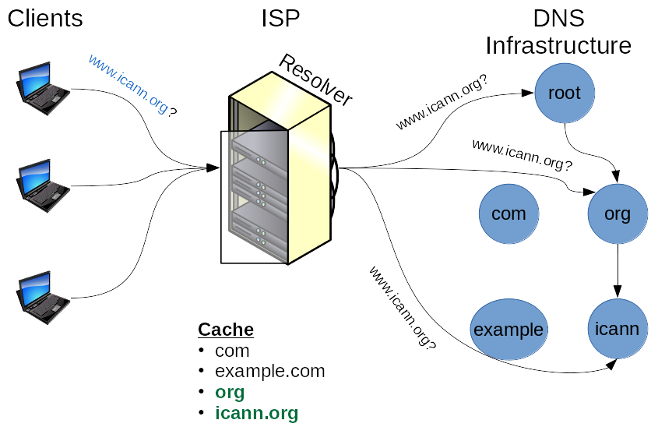
Second request may also start from the top (.org)

Slide 5
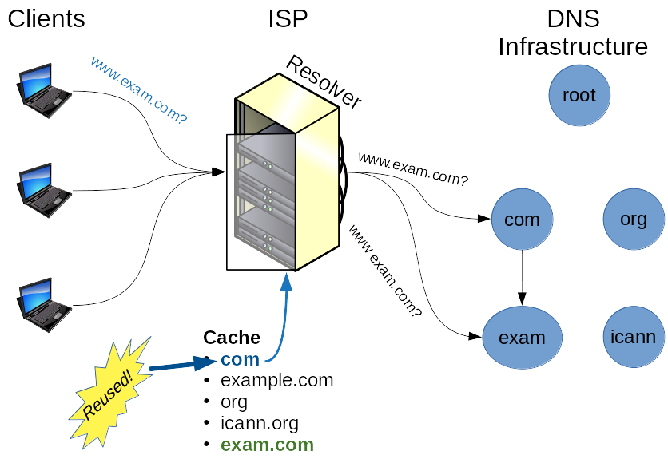
Cache Hit == Success

Slide 6
Cache Hit == Success
What if we could pre-cache everything??
(or at least a few zones)

Slide 7
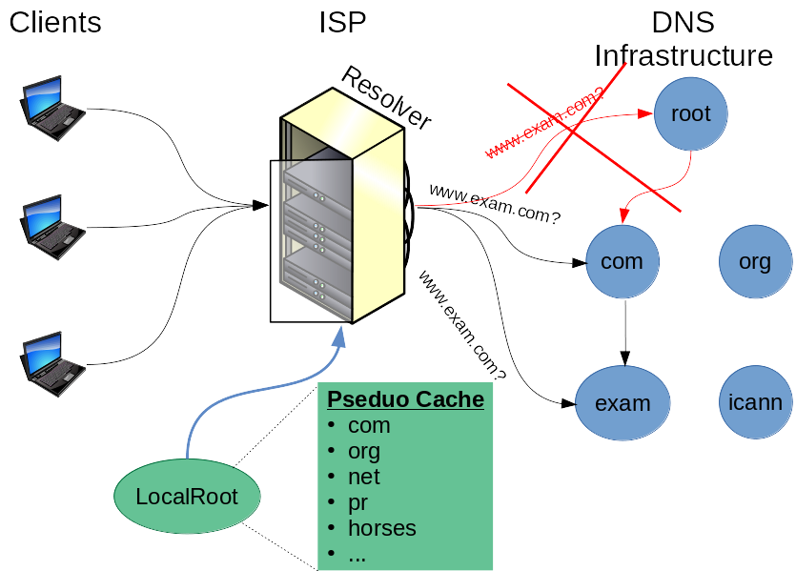
LocalRoot is a pseduo cache

Slide 8
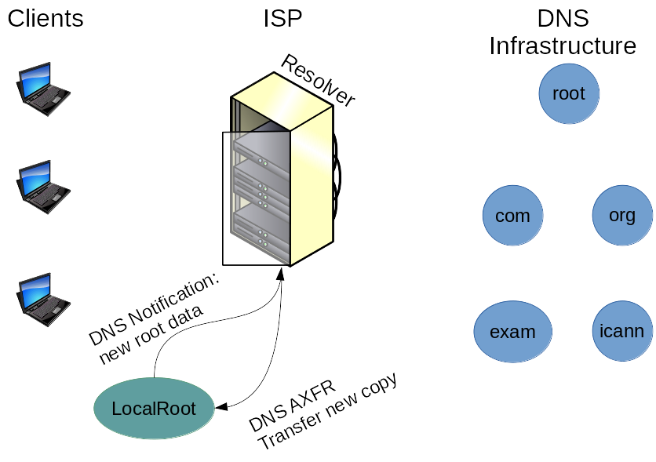
LocalRoot Extends RFC8806 -- add Security and Notifications
TSIG
Protected

Slide 9
Why Use LocalRoot
Benefits
“Psuedo-caching” of the root and other zones
Removes the need to query them frequently
Protects ISPs from outages
Faster DNS lookups for first TLD and other lookups
Faster NXDOMAIN results
Negative answers make up most root traffic
2020/05/06 DITL data: of 6.7B requests to b.root-servers.net, only 1.34B were valid
80% were NXDOMAIN answers == TLD didn’t exist!
Research project of your own?
Trigger events after root-change notification?

Slide 10
Real World Effects of Running LocalRoot
LocalRoot
enabled

Slide 11
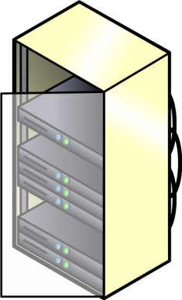
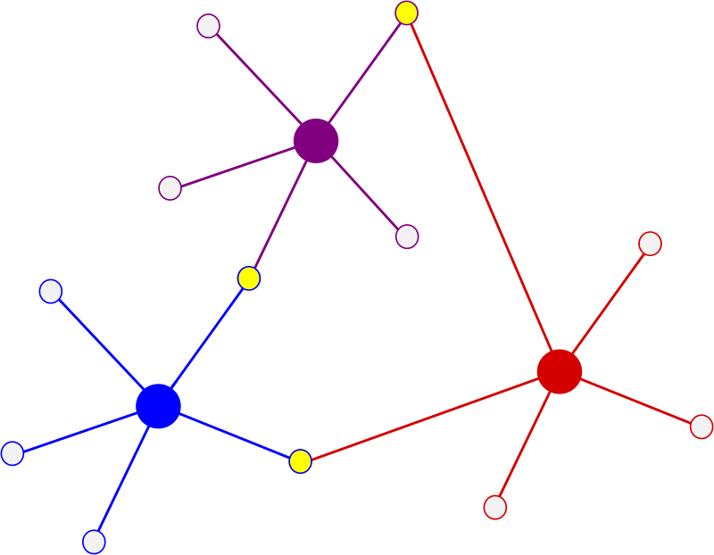
Recent Improvements to LocalRoot
LocalRoot Servers
IPv6 support
Three upstream production servers
2 new!
Authoritative
zones
zone transfers
for LocalRoot
zones
Your Clients
LocalRoot
pre-cache
other DNS requests
Your Resolver
The Internet

Slide 12
Recent Improvements to LocalRoot
Configuration support for bind, unbound and NSD
3 upstream servers (2 US west coast, one east)
Multiple zones supported:
the root zone
.arpa
root-servers.net
dnssec-tools.org
User preferences
E-mail notifications
Moved inside our production provisioning and service monitoring
UI and documentation Improvements

Slide 13
LocalRoot Home Page

Slide 14
Server List

Slide 15
Configuration Generator Options

Slide 16
Configuration Example

Slide 17
Account Preferences

Slide 18
Lessons Learned: things that got in the way
COVID-19
IP renumbering requirement was slowed significantly
Our IT department’s deployment of new 10G cabling slowed
Slowed our own ability to physically update our side
ReCaptcha
Presented LocalRoot at the ICANN DNSSEC Workshop
A bug in ReCaptcha processing meant errors got swallowed
Result was some users couldn’t create accounts
Conclusion: Captchas are a pain
Related: DNS Cookies probably are too

Slide 19
Outstanding Questions
What other zones would be useful to serve?
Currently only planning on serving zones with owner permission
In theory, anything with AXFR support would be served
What types of zones are best served by LocalRoot?
CC tlds?
Critical infrastructure zones?
Zone size limits
Clearly, huge zones are out of scope
What is the size boundary line?

Slide 20
Future Improvements
E-Mail notifications on out-of-date detection
Support for other small-medium zones:
Your zone here!
Contact me if interested
A REST API
Group accounts
Please send feature requests / feedback my way!
hardaker@isi.edu

