Slide 1
Independent Performance Verification of XDP-accelerated Knot DNS
Brad Ellis
Solutions Engineer
brad.ellis@cengn.ca

Slide 2
About Me
Brad Ellis, Solutions Engineer at CENGN
Center of Excellence in Next Generation Networks
Based in Canada
Non-profit org supported by government and industry
Mission: Help Canadian startups overcome technical challenges that are inhibiting their growth

Slide 3
Agenda
Project background
Test Methodology
Baseline & First attempts
What is XDP?
XDP-accelerated Knot
UDP & TCP performance on XDP-accelerated Knot
CZ.NIC – CENGN performance comparison
Questions

Slide 4
Project background
CIRA commissioned CENGN to:
Research methods to achieve 10 Gbps UDP response rate per DNS server (or get as close as possible)
Document setup procedures
Recommend system sizing for servers
Investigate possible DNS TCP speedup

Slide 5
Test Topology
(B)
+-------------------------------+
| Cisco UCS C240 |
| 2x Xeon 6140 Gold (36x2.3GHz) |
(A) | 384GB RAM @ 2666MHz |
+-------------------------------+ |<---| Intel X710 10Gbe |
| Cisco UCS C240 | | | |
| 1-2 Xeon 6140 Gold (N?x2.3GHz)| | | DNS load generator |
| 384GB RAM @ 2666MHz | | +-------------------------------+
| Intel XXV710 25Gbe |<----- (C)
| | | +-------------------------------+
| DNS server | | | Cisco UCS C240 |
+-------------------------------+ | | 2x Xeon 6140 Gold (36x2.3GHz) |
| | 384GB RAM @ 2666MHz |
|<---| Intel X710 10Gbe |
| | |
| | DNS load generator |
| +-------------------------------+
| (D)
| +-------------------------------+
| | Cisco UCS C240 |
| | 2x Xeon 6140 Gold (36x2.3GHz) |
| | 384GB RAM @ 2666MHz |
|<---| Intel X710 10Gbe |
| |
| DNS load generator |
+-------------------------------+
Vary # of CPU cores enabled on server
Three load generators → one server
Multi-thread (and multi-queue) the generators

Slide 6
Load Generators
Run multiple dnsperf/kxdpgun instances across multiple servers
Each load generator instance uses a dictionary derived from full zone
Records requested at random
100 outstanding queries, after that receive response (or time-out) before sending next request
Scripts start all load generation instances and aggregate the output of each

Slide 7
Baseline
BIND9 Authoritative TLD server with real, full zone
Baseline max UDP response of 120k QPS* * DNS Queries Per Second
Low network utilization (168 Mbps)
Low CPU and Mem utilization (35% and 4GB)
No obvious hardware bottlenecks

Slide 8
First attempts
Test several BIOS performance and power profiles
Land on I/O optimized profile
Turn hyper threading off
Results: ↑250k QPS (353 Mbps) ↑60% CPU
Make cloud-native
Build bare-bones BIND9 pod
Build Kubernetes deployment
Results (per K8s worker): ↑515k QPS (728 Mbps) ↑90% CPU
Baseline:
120k QPS (168 Mbps) 35% CPU

Slide 9
What is XDP?
"eXpress Data Path" aims to improve network performance
Moves many network functions lower in the 'stack' To kernel level or even into the hardware of the NIC in some cases
Frees up CPU and stack actions happen sooner
Very effective in packet filtering or routing applications

Slide 10
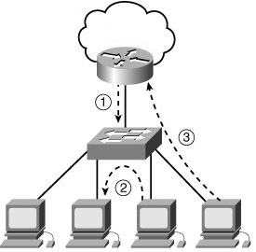
XDP Limitations
Comes with a wealth of caveats and restrictions
Direct access to NIC
Symmetrical packet paths
Kernel must support XDP AND have it enabled (CONFIG_XDP_SOCKETS=y in kernel config)
Application must support XDP to program it
Very hard to add to Kubernetes
Hard to enforce cluster-wide symmetric packet path
Network plugin must do XDP in place of application in pod

Slide 11
XDP-accelerated Knot DNS
CZ.NIC has been adding XDP support to Knot over the last year
Enabling XDP in Knot’s config is super easy: xdp: listen: <intf> # optional: tcp: on tcp-max-clients: 2000000 tcp-inbuf-max-size: 1000M
A faster server needs a faster tester – kxdpgun
XDP enabled DNS load generator
kxdpgun multithreads to number of queues configured on NIC by default

Slide 12
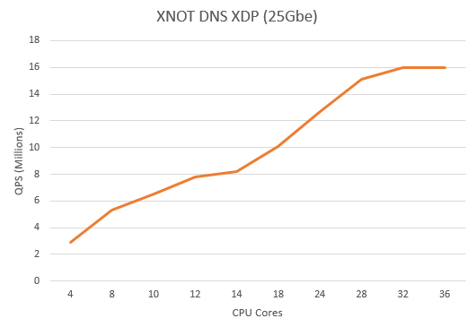
UDP Results on XDP-accelerated Knot
↑↑↑16M QPS 92% CPU
16M QPS = 25Gbps
25GbE NIC limited at ~32 cores
133.3x over baseline
Baseline:
120k QPS (168 Mbps) 35% CPU
NIC saturation

Slide 13
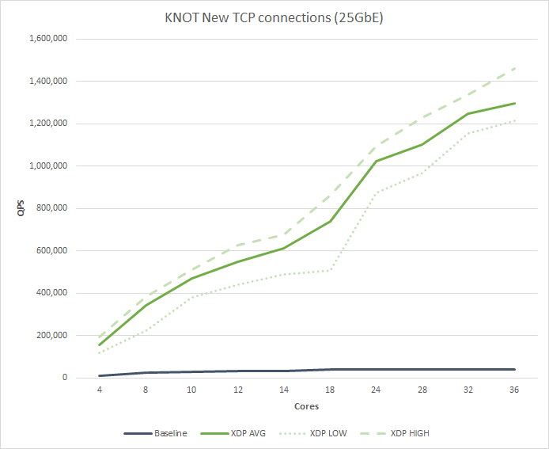
TCP Results on XDP-accelerated Knot
Baseline of 40k QPS with no XDP
Collaborated with CZ.NIC when they were developing Knot TCP XDP support
With XDP ↑↑↑1.3M QPS (32.5x over baseline)

Slide 14
Measuring up to CZ.NIC’s results
How do you compare apples and oranges?
Different core counts, speeds and architectures
Different NIC speeds
Best effort:
Compare the QPS when CPU-limited and adjust for total clock cycles: QPS/Core·GHz
Won’t account for NUMA or architecture (in)efficiencies
 | CZ.NIC | CENGN
CPU | 1x AMD | 2x Intel
Total cores | 64c x 2.0GHz | 36c x 2.3GHz
NIC | Intel 40Gbe | Intel 25GbE
UDP QPS | 22.4M | 16.0M
UDP QPS/c·GHz | 187k | 217k
TCP QPS | 2.5M | 1.3M
TCP QPS/c·GHz | 20.8k | 17.6k
CZ.NIC performance data sourced from:
https://www.knot-dns.cz/benchmark/

Slide 15
Final Questions?
CENGN | https://www.cengn.ca/
CIRA | https://www.cira.ca/
CZ.NIC | https://www.nic.cz/
dnsperf | https://www.dns-oarc.net/tools/dnsperf
Knot DNS Server | https://www.knot-dns.cz/
XDP | https://github.com/xdp-project

