Slide 1
Increasing DNS Resolver Resiliency: Challenges and Learnings
Arunkumar Singaram
arsingar@microsoft.com

Slide 2
Agenda
Implementing a dual-stack DNS resolver using Windows DNS Server (WinDNS) & Unbound
Learnings/Issues encountered during dual-stack implementation
Enabling serve-stale data from the cache (RFC 8767) in Unbound

Slide 3
DNS has a great burden to be extremely resilient !
Protect against:
zero-day vulnerabilities
dormant data plane bugs

Slide 4
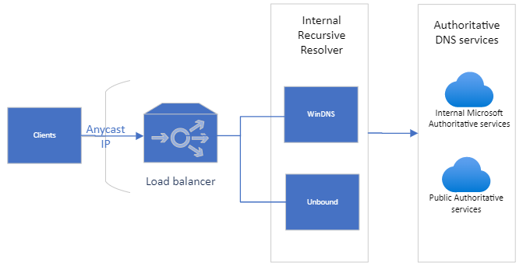
Architecture
High Volume
DNS Resolver processes requests (~8M QPS) from Microsoft online services
Global availability
Presence in all Azure regions; proximity ensures quicker response times, helps workloads that depends on Geo location like Azure Traffic Manager
Internal & External Authoritative DNS services
Contains forwarder & stub zones that are internal only

Slide 5
Development process
Evaluation
Development
Validation
Feature analysis of different resolvers
Performance testing
Containerization​
Query logs with Dnstap
Performance testing
Monitoring/Alerts
Compatibility with existing system

Slide 6
Validation
Gather DNS queries
Process responses
Manual analysis
Finesse Unbound
Submit
Ship
Reuse query logs from production
Send to both stacks in parallel
Auto-categorize difference in response
Identify acceptable differences
Tweak code/config to get desirable response
Repeat previous steps until satisfactory

Slide 7
Results
Majority match
Around 86% of responses were identical
Ignorable differences
SERVFAIL vs NXDOMAIN = Not a deal breaker
Compression difference = Not a deal breaker
Missing Glue records = You get the gist!

Slide 8
Learnings in Dual-Stack Ramp-up
Differing behavior between services – Two examples:
Query for type with large record set (>512 bytes)
drive.foo.com -> foo.contoso.com -> 40.113.200.201
query
query to auth
drive.foo.com CNAME?
foo.contoso.com
TC bit, NODATA
truncated response
drive.foo.com A Record?
foo.contoso.com
But with query minimization turned off…
query
query to auth
drive.foo.com CNAME?
TC bit, fill UDP
truncated response
foo.contoso.com
drive.foo.com A Record?
40.113.200.201
key
: UDP only DNS client (non-standard)

Slide 9
Learnings (continued...)
Tweak things outside the DNS software
Investment is > 2X the single stack​
Always follow Safe Deployment Practice​
Reload config due to zone changes are very expensive due to cache flush – use zone reload via unbound-control.
Optimize OS network parameters to avoid socket buffer overflow.
Initial investment to bootstrap dual stack is high ​
Feature development is just one part but testing/ monitoring will be shared
Ongoing investments needed to maintain compatibility with spec tests
Deploy to smallest region as first stage
Have sufficient bake time between stages
Run Perf Test before every release

Slide 10
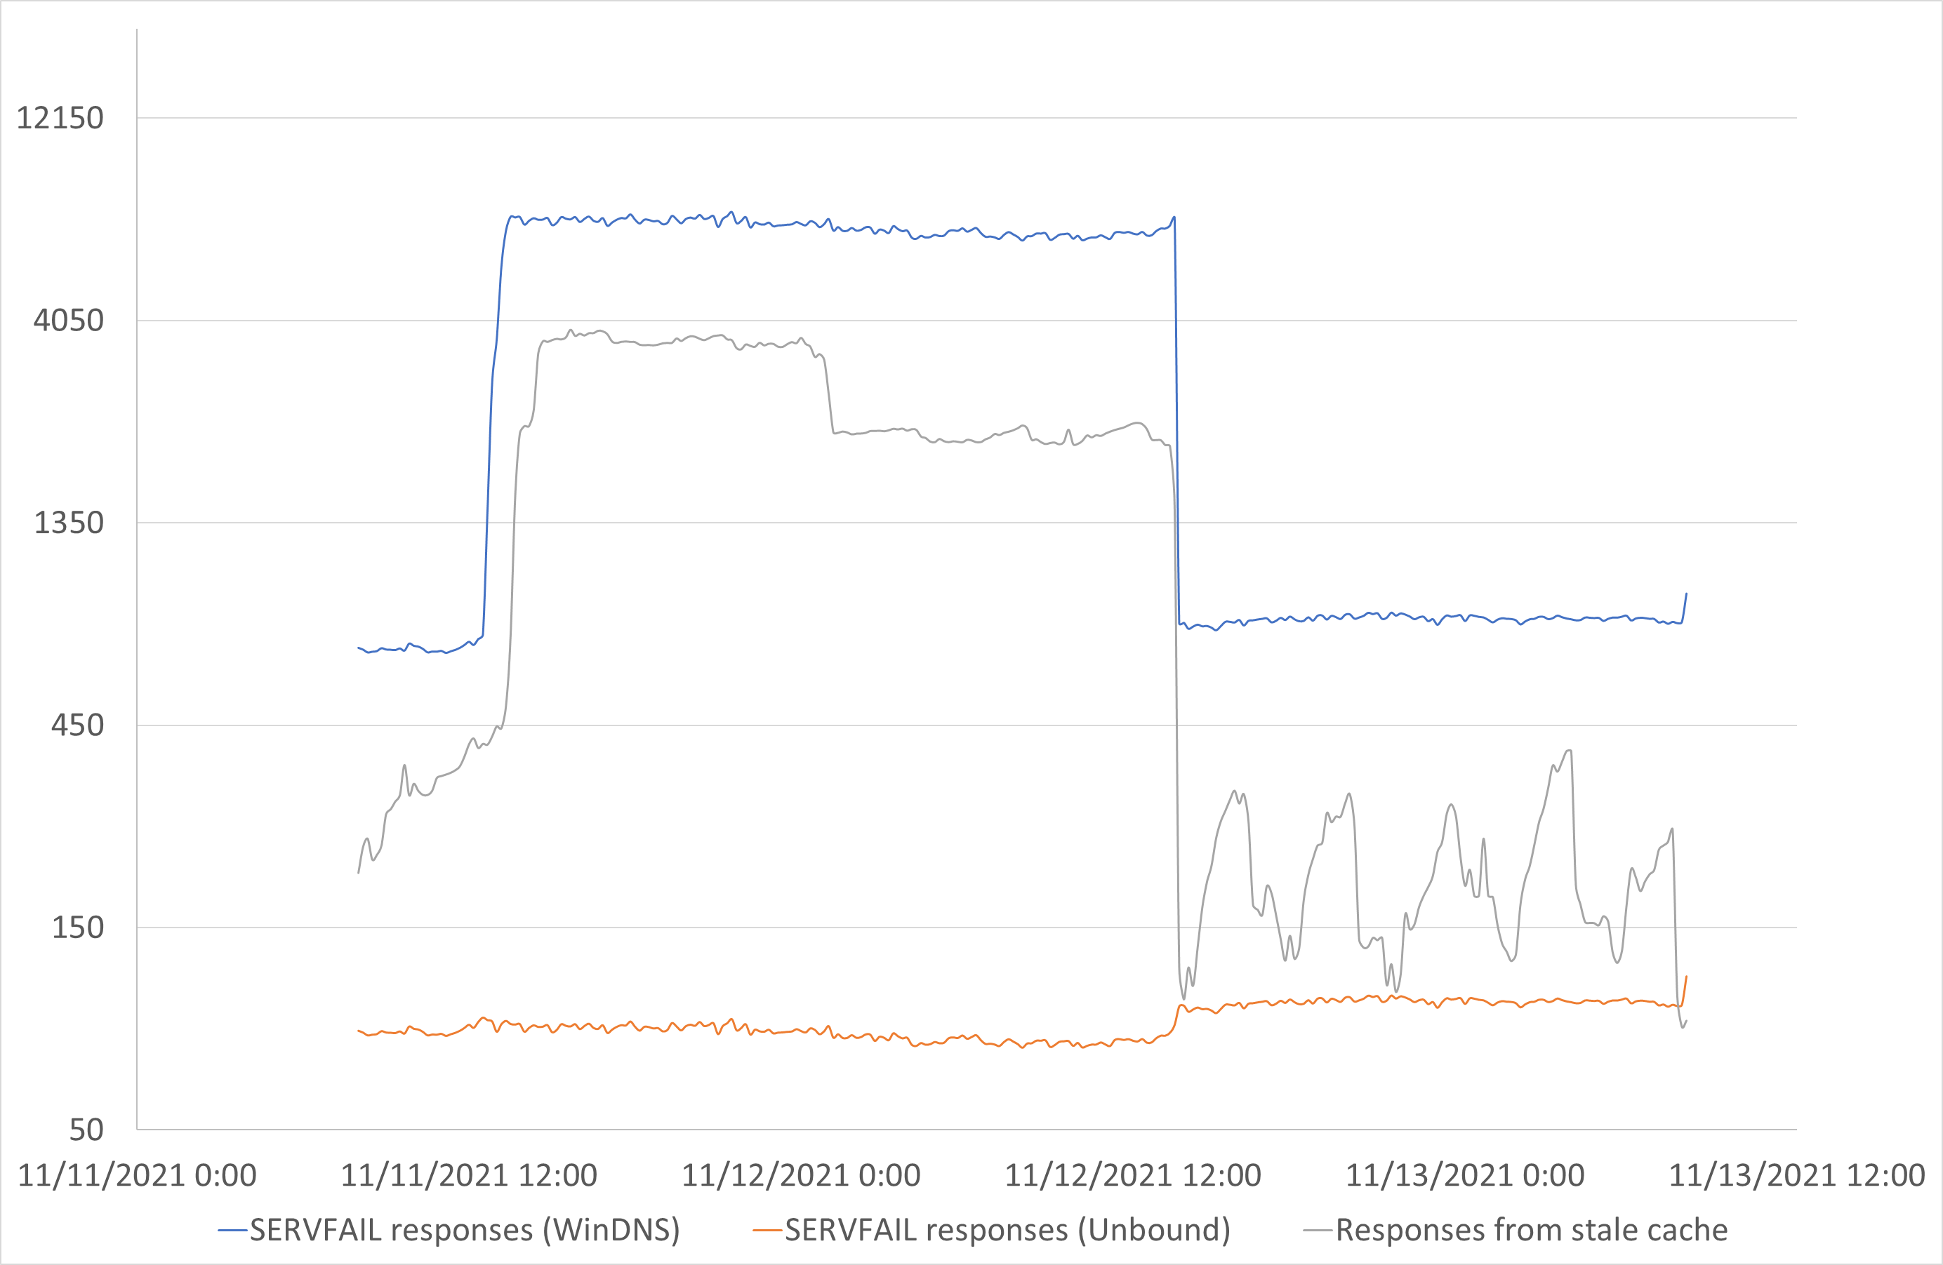
Additional Enhancements to increase resiliency with RFC 8767 (Serving stale data)
Reduce impact on Authoritative DNS performance degradation
Minimized impact of two separate instances of individual zone outages.

Slide 11
Thank you

