Slide 1
Find Bugs in Your Zone Files Before Deployment with GRoot
Siva Kesava Reddy Kakarla¹
Ryan Beckett²
Behnaz Arzani²
Todd Millstein^{1,3}
George Varghese¹
¹
University of California, Los Angeles
²
Microsoft
Intentionet
³
Notes:
Thanks for the intro,
Hello everyone, I’m going to talk about how you can find bugs in your zone files before deploying them with the help of our tool GRoot. This is a collobroation work with Ryan and Behnaz from Microsoft with my advisors Todd and George at UCLA. This work got published in SIGCOMM 2020 and won the best student paper award.

Slide 2
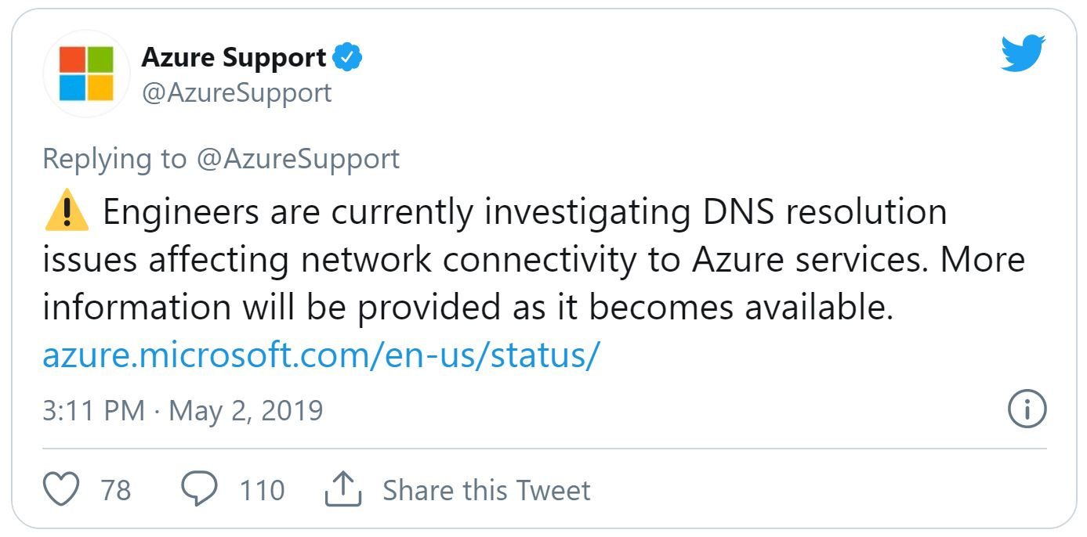
DNS Misconfigurations lead to Service Disruptions
Azure Global Outage, 2019
Notes:
It is well known that DNS Misconfigurations lead to service disruption.
I’m going to talk about a specific DNS outage that originally got us interested in the DNS space.
One of the worst outages due to DNS is the one that happened at Microsoft in 2019.
What happened was, on May 2, almost all of Microsoft’s services become unavailable for 20 hours. This included Azure (cloud computing), Xbox live, Office 365, dynamics, power BI and more.
So what happened here?

Slide 3
DNS Misconfigurations lead to Service Disruptions
Azure Global Outage, 2019
Storage
BLOB Storage
Azure Files
Premium Storage
20h impact duration
Data
SQL
Database
SQL Data
Warehouse
Cause: a one-line incorrect configuration change to a server during migration
Redis
Cache
Search
DocumentDB
Tables
Key Vault
Many key Azure services were unreachable
Notes:
Well, the problems started when connectivity to Azure storage services was lost.
Subsequently, services that depend on storage (basically anything running on a VM, so everything) started to fail and those services also became unreachable.
This whole thing lasted for 20 hours
After debugging the problem ultimately, the engineers found that the problem was due to a 1-line manual change to a DNS zone file during a routine migration.

Slide 4
DNS Misconfigurations lead to Service Disruptions
Azure Global Outage, 2019
Storage
BLOB Storage
Azure Files
Premium Storage
DNS misconfigurations are disastrous
DNS outages are global in nature (huge blast radius)
Caching makes mitigation difficult (long duration)
20h impact duration
Data
SQL
Database
SQL Data
Warehouse
Cause: a one-line incorrect configuration change to a server during migration
Redis
Cache
Search
DocumentDB
Tables
Key Vault
Many key Azure services were unreachable
Notes:
So there were two takeaways from this experience about why DNS misconfigurations are often disastrous.
The first was that DNS is inherently global in nature. If you can’t lookup the IP address for a service, then you lose connectivity world-wide. So DNS has a very unfortunate property of what we call “having a large blast radius”.
The second was that resolving DNS outages is extremely tricky (Azure outage took 20 hours). The primary reason is that DNS relies heavily on caching responses to queries (including negative caching). This means that when storage became unreachable, everyone cached this fact, making it hard to restore connectivity.

Slide 5
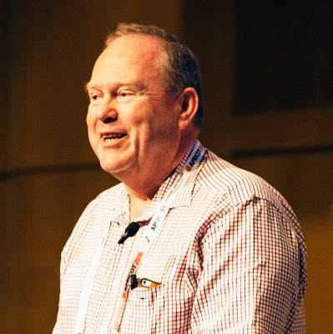
DNS is way more complex than people think!
Nondeterminism in which nameserver to ask next
Complex record types each with unique semantics
DNAME records: domain rewrite
CNAME records: alias another domain name
Wildcard records: match anything not otherwise matched
NS records: nameserver redirection
56 other records types across ~30 RFCs
The DNS is a lot like chess; it’s a simple game in terms of the rules, but phenomenally complex in the way it can be played.
Geoff Huston (APNIC)
Notes:
From the user's perspective DNS is a simple system: You send it queries and you get back answers. However, it is a very different view from that of an organization that is managing the zones for the DNS.
DNS is significantly more complex that people realize. It is essentially a very complex string rewriting system.
There are 2 sources for this complexity.
The first is that there is nondeterminism in the DNS. The resolver can choose any one of the available nameservers to resolve the query, which can lead to different responses.
The second is the complex record types and the subtle interactions among them. There are different kinds of rewrite records, alias records, wildcard records, and about 60 other kinds of records defined across about 30 RFCs.
As Geoff says,

Slide 6
Examples Zone File Properties
$φ_{1}≝$ ucla.edu. always resolves to 128.97.27.37
$φ_{2}≝$ All queries return a consistent answer (the answer should be the same irrespective of the nameserver taken)
$φ_{3}≝$ No query rewriting during resolution
Notes:
From an organization point of view, what are some of the properties that those organizations and operators wants to ensure about their DNS zone files.
UCLA DNS team might want to ensure that ucla.edu always resolves to this IP address using the UCLA zone files. Others might also want all their queries return the same answer regardless of nondeterminism. Or their query should not be rewritten at any point in the resolution. Before I talk about how we verify these properties, let me give a brief overview of how operators ensure them today.

Slide 7
Current DNS Management Practices
Black-box Testing & Monitoring
DNS Config Review
$$q_{1}, q_{2}, q_{3}, …q_{n}$$
DNS
$$a_{1}, a_{2}, a_{3}, …a_{m}$$
DNS Engineer
Only finds errors after they are live
Not exhaustive
Not automated
Error Prone
Notes:
There are two main approaches. One is to do testing and/or monitoring. So, you make a change, then you run some queries, or you actively monitor for connectivity. There are 2 big problems with this approach: (1) this is not proactive, so you will only find bugs that have already impacted the actual network and (2) is that this is not exhaustive. You might test some queries, but the question is had you tested them all. And it is not obvious how to test all relevant queries due to the complexity of DNS. The second approach is to do manual review of changes using best developer practices. However, humans make mistakes as we have seen earlier.

Slide 8
GRoot: A Fast Verifier for DNS
Zone Files
Certified
Bug found!
$$≈\sum_{i=0}^{253}{{38}^{i}} ×|T|$$
Too many queries to enumerate!
$$\left\langle \text{edu}\text{.,}\text{A}\right\rangle$$
$$\left\langle \text{edu}\text{.,}\text{NS}\right\rangle$$
$$\left\langle \text{ucla}\text{.}\text{edu}\text{.,}\text{MX}\right\rangle$$
$$\left\langle \text{ucla}\text{.}\text{edu}\text{.,}\text{TXT}\right\rangle$$
…
Property 𝜑
GRoot evaluates the behavior of all the queries by partitioning them into a small number of query equivalence classes based on zone files – a massive reduction
$φ_{1}≝$ucla.edu. always resolves to 128.97.27.37
$φ_{2}≝$All queries return a consistent answer
$φ_{3}≝$ No query rewriting during resolution
Notes:
In contrast, what we have done is built a tool called Groot that will do proactive and exhaustive verification of the correctness of DNS zone files. Groot takes in a set of zone files, possibly from many different nameservers. It also takes a specification of what the zone files should be doing. This includes user-defined properties like the ones shown earlier. Given these two inputs it either ensures that these properties will hold, or it gives counterexamples. The important thing to note here is that there are way too many queries to enumerate naively. A domain name is a string made of characters with about 38 different values, and a domain name can be up to 254 characters long. Plus, there are 60 record types. So, there are clearly way too many such strings to enumerate and test. The way we solve this challenge, and the key idea in GRoot is to first partition all the queries into query equivalence classes using the zone files. An EC is a set of queries that have the same DNS resolution. And then, evaluates the behavior of many queries at the same time. GRoot generates O(n) equivalence classes for a collection of zone files with n resource records providing a massive reduction in complexity.

Slide 9
Evaluation Results
Analyzed 564,714 records for 20,168 zone files in minutes
8104 cases of rewrite blackholing for CNAMEs
227 delegation inconsistencies, 4 cyclic zone dependencies
274 invalid records
Cloud
Analyzed 111,539 records for 896 zone files in 7 seconds
49 cases of rewrite blackholing for CNAMEs
49 delegation inconsistencies, 9 lame delegations
2 cases of CNAME loops, 1 missing glue record
1 typo (Delegation x.campus.ed.), 1 out-of-zone record
Campus
Analyzed 3.6 million records in around 3 minutes
Thousands of cases of rewrite blackholing
From not cleaning up records for deallocated resources
CDN
Notes:
We also have some good results so far using the tool. We have run it on three different organizations zone files: large cloud provider, large campus network, and a large CDN provider.
…
One challenge was that we didn’t have a spec in the sense what the IP addresses should be. So instead, we focused on finding behaviors that should basically always be wrong like loops, delegation consistencies, blackholes and so on.
…
In the campus network, one of the checks is to identify lookups that use an external name server that is a nameserver not under campus.edu. . Most of these nameservers belong to AWS or Cloudflare and are likely intentional. But one name server was x.campus.ed which looked suspicious; when asked the admin said: “Thanks for the information about the delegation. I’ve corrected the typo.”
In the CDNs zone files, GRoot revealed around thousands of blackholing issues, which was due to incomplete decommissioning of host names that are no longer in use, initiating a cleanup of the zone files.

Slide 10
University Results
Error | Number of bugs
Delegation Inconsistency | 49
Lame delegation | 9
Rewrite loops | 2
Missing glue records | 1
Rewrite blackholing | 48
Zero TTL records | 0
Decentralized management – Central (campus.edu.) and departmental (dept.campus.edu.)
Zone files of campus.edu. and 895 subdomains
120k resource records
4,259 CNAME records
63 wildcard records
Property | Number of warnings
No rewrite to outside domain | 378
No resolution at an external NS | 324
Number of rewrites ≤ 2 | 24
7 sec
Notes:
We applied Groot to the zone files of a large university. The zone files are managed in a decentralized fashion with departments managing their own zone files. We obtained the campus zone file and 895 subdomain zone files using zone transfer. There were in total 120 k… The result after checking property through Groot are as follows. The violation of properties in the first table are functional violations are considered bugs while the properties in the second table showcase GRoot’s ability to help operators explore and understand the behavior of their DNS configurations. Violations of these properties are not necessarily bugs but are interesting behaviors that an operator may be interested to examine.

Slide 11
University Results
Error | Number of bugs
Delegation Inconsistency | 49
Lame delegation | 9
Rewrite loops | 2
Missing glue records | 1
Rewrite blackholing | 48
Zero TTL records | 0
NS records mismatch and some servers incorrectly pointed to web server
Affects response time and redundancy
We haven’t noticed this discrepancy because we almost never use DNS names for DNS servers, we use IPs
Campus
DNS Engineer
Notes:
There were NS records mismatch between parent and child zone files and some of the NS records pointed towards a web server instead of a DNS name server. These bugs affect the visibility and redundancy of the zone and also increase the query response times. When asked the operator said that to check if a name server is working properly, they directly use the IP instead of the name so they never caught these issues.

Slide 12
University Results
Error | Number of bugs
Delegation Inconsistency | 49
Lame delegation | 9
Rewrite loops | 2
Missing glue records | 1
Rewrite blackholing | 48
Zero TTL records | 0
CNAME rewrite to itself !!
The short answer is negligence
Campus
DNS Engineer
Notes:
The operator in a straightforward manner reported that the reason is negligence

Slide 13
University Results
Error | Number of bugs
Delegation Inconsistency | 49
Lame delegation | 9
Rewrite loops | 2
Missing glue records | 1
Rewrite blackholing | 48
Zero TTL records | 0
48 cases returning NXDOMAIN after a rewrite
CNAME entries missed during prior retirement
Campus
DNS Engineer
Entries orphaned accidentally when the source server was removed a few years back
Campus DNS Engineer

Slide 14
University Results
Property | Number of warnings
No rewrite to outside domain | 378
No resolution at an external NS | 324
Number of rewrites ≤ 2 | 24
1 typo in delegation found as the external NS was x.campus.ed.
GRoot guarantees that only 24 cases under campus.edu. are rewritten more than twice
Notes:
Operators can use Groot to explore such properties to understand their configs better.

Slide 15
GRoot End-to-End Design
Example
a.gtld-servers.net.
com. IN SOA …
mybankcard.com. IN NS ns1.fnni.com
mybankcard.com. IN NS ns2.fnni.net
ns1.fnni.com. IN A 216.205.207.204
ns1.fnni.com.
ns2.fnni.net.
mybankcard.com. IN NS ns1.fnni.com
mybankcard.com. IN NS ns2.fnni.net
mybankcard.com. IN DNAME bankcard.com
mybankcard.com. IN NS ns1.fnni.com
mybankcard.com. IN NS ns2.fnni.net
mybankcard.com. IN DNAME bankcard.com
www.bankcard.com. IN AAAA 74d7::b94d::
www.bankcard.com. IN A 204.58.233.75
email.bankcard.com. IN A 66.161.21.26
*.bankcard.com. IN A 204.58.233.244
www.bankcard.com. IN AAAA 74d7::b94d::
www.bankcard.com. IN A 204.58.233.75
email.bankcard.com. IN A 66.161.21.26
*.bankcard.com. IN CNAME www.bankcard.com.
Notes:
So let me make this a little bit more concrete.
What I’m showing on the slide is the example files for 5 zones spread across 3 nameservers. There are DNAMEs, CNAMEs, wildcards and wildcard CNAMEs in this example.

Slide 16
Building the Label Graph For Query EC Generation
.
com
edu
𝛼
$$DNAME$$
fnni
𝛼
bankcard
mybankcard
fnni
𝛼
www
email
*
𝛼
𝛼
Special nodes and edges to account for wildcards & query rewrites
ns1
𝛼
ns1
𝛼
𝛼
𝛼
𝛼
𝛼
𝛼
Every path from root in the label graph forms an equivalence class (EC)
Theorem 1 (Soundness): All queries in an EC (path) have the same DNS resolution
Theorem 2 (Completeness): Every possible query belongs to exactly one EC.
Notes:
Here is an overview of how groot works.
We start by parsing the zone files and building a data structure called a label graph, which you can think of as roughly representing the union of all the records in the zone files.
However we also add special nodes and edges to this graph based on the wildcards and rewrites in the zones.
From this label graph, we generate what we call query equivalence classes. Each equivalence class is a compact representation for a (possibly large) set of queries that we prove that DNS will process in the same way.
From these zone files, we create the label graph, which is shown here. It contains all the records from the zone files plus the addition of special “alpha” nodes that represent an arbitrary sequence of characters.
We add an alpha node child to every node in the tree.
Finally, we add other edges for DNAME rewrites in this graph. For instance, since there is a DNAME rewrite from mybankcard.com to bankcard.com, we add a directed edge between these nodes (shown in purple).
Now we proved several theorems about this data structure. Basically the idea is that every path from the root in this graph to any node is an equivalence class of queries.
(1) In particular, we prove that all user queries corresponding to a path will have the same DNS resolution behavior (soundness).
(2) And also we prove that every possible query belongs to exactly one equivalence class (completeness).
This theorems mean that if we validate the behavior of each equivalence class, then we have exhaustively checked the correctness of the DNS for these zones.

Slide 17
An Algorithm for Verification
.
com
edu
𝛼
bankcard
mybankcard
fnni
𝛼
fnni
𝛼
www
email
*
𝛼
𝛼
ns1
𝛼
ns1
𝛼
𝛼
𝛼
𝛼
𝛼
𝛼
$$⟨α.mybankcard.com., \{A,MX, TXT, ..\}⟩$$
Notes:
Here I have shown one such path from the root. Each type is its own equivalence class, but GRoot executes the ECs for all record types at once using a compact bitset representation for types, splitting nodes when different types experience different behaviors.

Slide 18
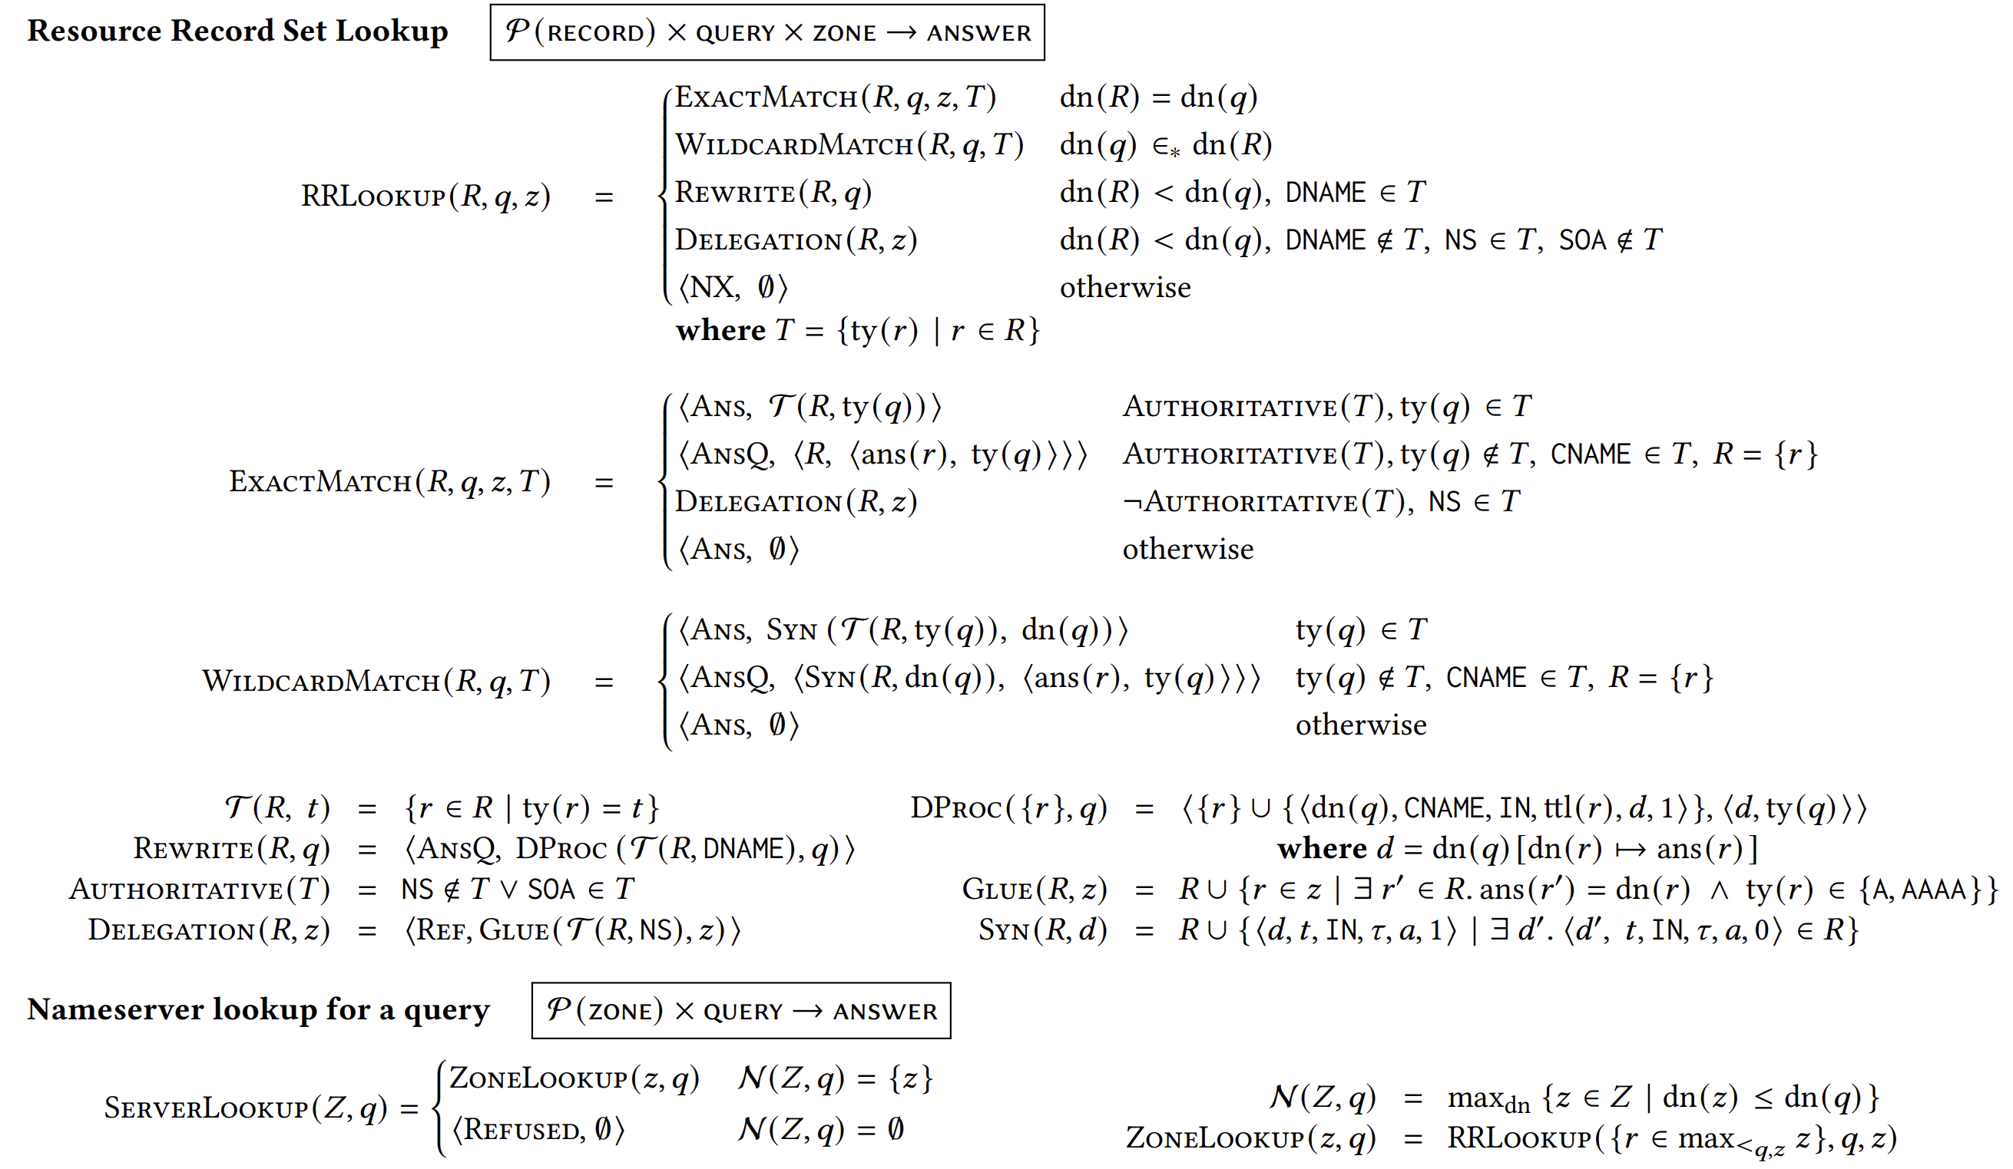
Executing an Equivalence Class
Notes:
Given this schematic query, we then execute (simulate) the DNS semantics on this query.
The way we did this is that we formalized the execution of DNS mathematically from the RFCs (i.e., how it should execute).
I’ll skip the exact details here, but show an example next.

Slide 19
Executing an Equivalence Class
$$⟨α.mybankcard.com., \{A,MX, TXT, ..\}⟩$$
Server: a.gtld-servers.net.
Query: <𝛼.mybankcard.com, {A,MX,TXT}>
Answer: <Referral>
Server: ns1.fnni.com.
Query: <𝛼.mybankcard.com, {A,MX,TXT}>
Answer: <Rewrite>
Server: ns2.fnni.net.
Query: <𝛼.mybankcard.com, {A,MX,TXT}>
Answer: <Rewrite>
Server: ns1.fnni.com.
Query: <𝛼.bankcard.com, {A}>
Answer: <Answer, {204.58.233.244}>
Server: ns1.fnni.com.
Query: <𝛼.bankcard.com, {MX, TXT}>
Answer: <Answer, {}>
...
Server: ns2.fnni.net.
Query: <www.bankcard.com, {A}>
Answer: <Answer, {204.58.233.75}>
Notes:
Here is the example equivalence class from before and now I’m going to show its execution.
We start with the root nameserver and the query is \alpha.mybankcard.com.
Because the answer is a nameserver referral, we now explore both possibilities. If we go to ns1.fnni.com, then we repeat the query at this nameserver.
From here, the execution rewrites \alpha.mybankcard.com to \alpha.bankcard.com using DNAME and then the execution splits based on the query type.
For an A record, we get an answer at this nameserver for the IP, and for the other types we get an empty answer (no answer).
The execution would then continue for the other nameserver.
A key insight we had here was that by pre-dividing the equivalence classes in this way, the execution of the DNS never needs to directly inspect the value of \alpha, so we can leave it opaque.

Slide 20
Property Checking
Answer Consistency
Different sink nodes must return same answer
Server: a.gtld-servers.net.
Query: <𝛼.mybankcard.com, {A,MX,TXT}>
Answer: <Referral>
Server: ns1.fnni.com.
Query: <𝛼.mybankcard.com, {A,MX,TXT}>
Answer: <Rewrite>
Server: ns2.fnni.net.
Query: <𝛼.mybankcard.com, {A,MX,TXT}>
Answer: <Rewrite>
Server: ns1.fnni.com.
Query: <𝛼.bankcard.com, {A}>
Answer: <Answer, {204.58.233.244}>
Server: ns1.fnni.com.
Query: <𝛼.bankcard.com, {MX, TXT}>
Answer: <Answer, {}>
...
Server: ns2.fnni.net.
Query: <www.bankcard.com, {A}>
Answer: <Answer, {204.58.233.75}>
Notes:
Next, we check properties on these graphs. Consider a simple property like “Answer Consistency” which means the user should receive a single response irrespective of the server he contacted. That property is represented as the graph property that different sink nodes must return the same answer

Slide 21
Property Checking
Answer Consistency
Different sink nodes must return same answer
No Rewrite Blackholing
No path from root to a leaf can have a rewrite and end with NX
Server: a.gtld-servers.net.
Query: <𝛼.mybankcard.com, {A,MX,TXT}>
Answer: <Referral>
Server: ns1.fnni.com.
Query: <𝛼.mybankcard.com, {A,MX,TXT}>
Answer: <Rewrite>
Server: ns2.fnni.net.
Query: <𝛼.mybankcard.com, {A,MX,TXT}>
Answer: <Rewrite>
Server: ns1.fnni.com.
Query: <𝛼.bankcard.com, {A}>
Answer: <Answer, {204.58.233.244}>
Server: ns1.fnni.com.
Query: <𝛼.bankcard.com, {MX, TXT}>
Answer: <Answer, {}>
...
Server: ns2.fnni.net.
Query: <www.bankcard.com, {A}>
Answer: <Answer, {204.58.233.75}>
Notes:
In this graph, we notice that different sink nodes return different responses so there is no answer consistency.
If you consider this another property which we called Rewrite Blackholing- it means, there is a path from the root in this graph to a leaf with goes through a rewrite and the leaf is an NX. There is no such thing in this graph so there are no rewrite balckholings.

Slide 22
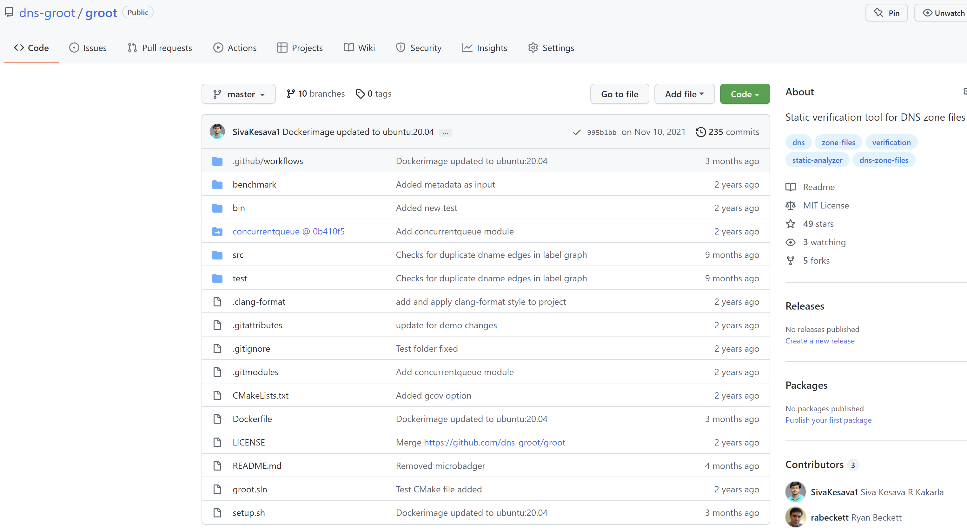
Implementation of GRoot
Notes:
We have an implementation of our tool Groot publicly available on GitHub
It is written in C++ and its quite fast. We can verify collection of zones with millions of records in a few minutes.

Slide 23
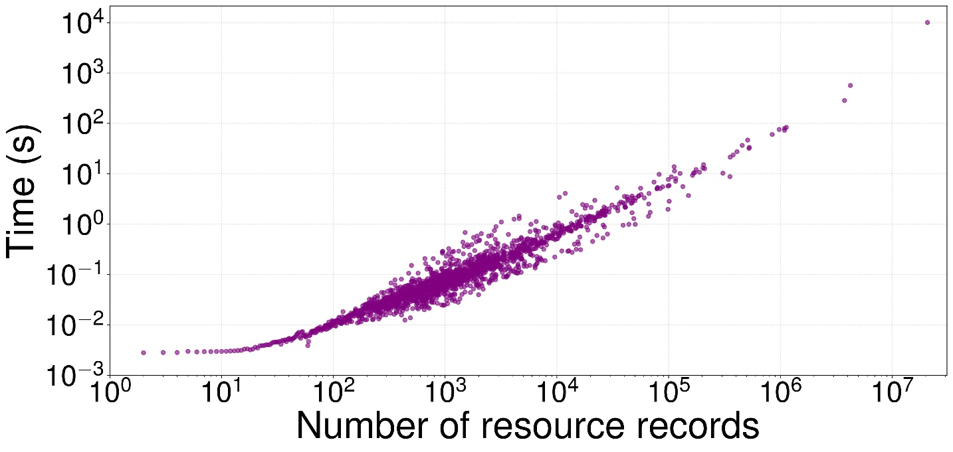
GRoot Performance
DNS Census – Publicly available DNS records
Created Zone files from CSV files
1,368,523 second-level domains (e.g., co.uk.)
65 million resource records
3.4 million CNAME records
218 DNAME records
GRoot can scale linearly to tens of millions of records
Notes:
Finally, to test Groot performance we created zone files from the publicly available DNS census records. We ran Groot on each of the 1.3 million second level TLds like co.uk and the results are shown in the graph.

Slide 24
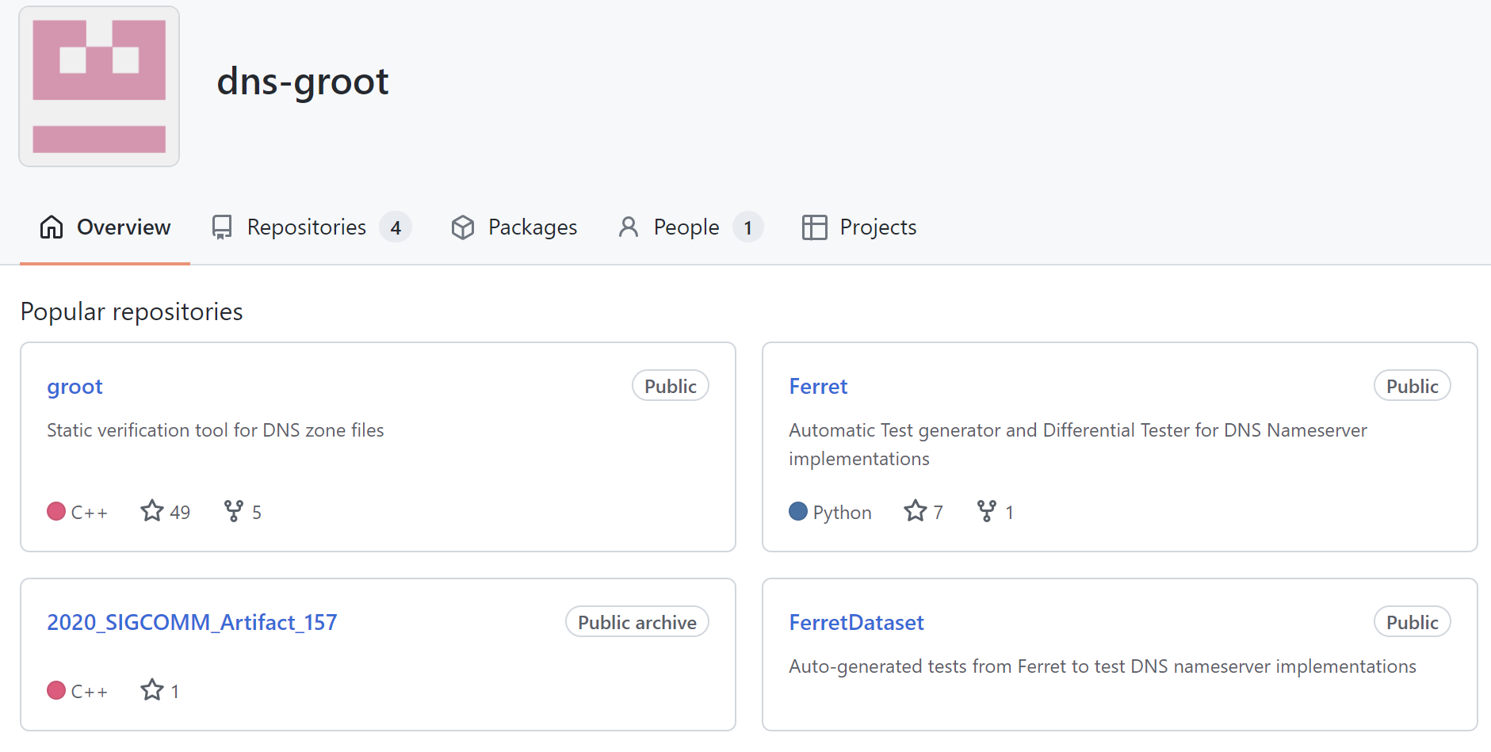
Conclusion
GRoot – Our tool for verification of DNS zone files
Proactive and Exhaustive
First formal model of DNS
Provides all queries that violate a property
Found 109 bugs in the live DNS zone files of a large campus
SIGCOMM 2020 Best Student Paper Award
https://github.com/dns-groot/groot
Reach me at: sivakesava@cs.ucla.edu
Ferret, uses GRoot’s formal model to find RFC compliance bugs in Nameservers
Talk at DNS OARC 35 “So you think your Nameservers are Correct?” : Finding Errors Automatically in Nameserver Implementations

