Slide 1







Adaptive DNSSEC
Yehuda Afek
Tel-Aviv University
Anat Bremler-Barr
Reichman University
Daniel Dubnikov
Tel-Aviv University
Supported By:
Notes:
Supported by

Slide 2
Motivation (1)
DNSSEC significantly degrades DNS performances
 | Max Queries Per Second
Plain DNS | 23,524
DNSSEC: NSEC | 9,510
DNSSEC: NSEC3 | 8,989
Notes:
On one machine

Slide 3

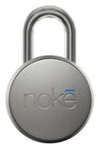


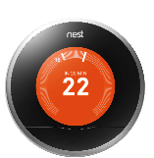

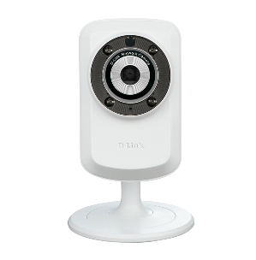

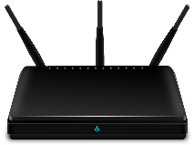


RANDOM DNS Request Flood
NXDomain Attack
Rxy1xhggsgVCER.sony.com
XVBY$&HGDRxy2.sony.com
Resolvers
FJH*^DHGAKRxy3.sony.com
www.cs.cs.tau.ac.il
RxUYQVMNLKAy4.sony.com
.com
RzHW$RE43CBJs$7.sony.com
ns.sony.com

Slide 4
Motivation (1)
DNSSEC significantly degrades DNS performances
  ➔ DDoS amplification
  * All measurements are under NX queries flood attack
 | Max Queries Per Second
Plain DNS | 23,524
DNSSEC: NSEC | 9,510
DNSSEC: NSEC3 | 8,989
Attacker
Resolver
NS
Notes:
Explain here why the dnssec is worse

Slide 5
Motivation (1)
Non Existent in DNSSEC?
Notes:
Explain here why the dnssec is worse

Slide 6
Motivation (1)
Non Existent in DNSSEC?
NSEC Record:
ABC.NAME.COM - LMN.NAME.COM
Notes:
Explain here why the dnssec is worse

Slide 7
Motivation (1)
Non Existent in DNSSEC?
NSEC Record:
ABC.NAME.COM - LMN.NAME.COM
Everything in between does not exist!
Notes:
Explain here why the dnssec is worse

Slide 8
Motivation (2)
Aggressive Caching (RFC 8198) – stops NX Attack
 | Max Queries Per Second
Plain DNS | 23,524
DNSSEC: NSEC | 9,510
DNSSEC: NSEC3 | 8,989
Aggressive Caching | Max Queries Per Second
DNSSEC: NSEC | 96,226
DNSSEC: NSEC3 | 93,756
Notes:
Aggressive Use of DNSSEC-Validated Cache
Large DNS providers
Disposable domains

Slide 9
Motivation (2)
Aggressive Caching (RFC 8198) – stops NX Attack
 | Max Queries Per Second
Plain DNS | 23,524
DNSSEC: NSEC | 9,510
DNSSEC: NSEC3 | 8,989
Aggressive Caching | Max Queries Per Second
DNSSEC: NSEC | 96,226
DNSSEC: NSEC3 | 93,756
Only Knot
Notes:
Large DNS providers
Disposable domains
Couldn’t run bind/unbound

Slide 10
Motivation (2)
Aggressive Caching (RFC 8198) – stops NX Attack
BUT: Enables Zone Walking
ABC.NAME.COM - LMN.NAME.COM
 | Max Queries Per Second
Plain DNS | 23,524
DNSSEC: NSEC | 9,510
DNSSEC: NSEC3 | 8,989
Aggressive Caching | Max Queries Per Second
DNSSEC: NSEC | 96,226
DNSSEC: NSEC3 | 93,756
Only Knot
Notes:
Large DNS providers
Disposable domains
Couldn’t run bind/unbound

Slide 11
Motivation (2)
Aggressive Caching (RFC 8198) – stops NX Attack
BUT: Enables Zone Walking
  Scalability Issues: Need to quickly find NSEC record
 | Max Queries Per Second
Plain DNS | 23,524
DNSSEC: NSEC | 9,510
DNSSEC: NSEC3 | 8,989
Aggressive Caching | Max Queries Per Second
DNSSEC: NSEC | 96,226
DNSSEC: NSEC3 | 93,756
Only Knot
Notes:
Large DNS providers
Disposable domains
Couldn’t run bind/unbound

Slide 12
Motivation (2)
How to stop Zone Walking?
Notes:
Large DNS providers
Disposable domains
Couldn’t run bind/unbound

Slide 13
Motivation (2)
How to stop Zone Walking?
  You can’t (without online signing*, Goldberg et al.)
* Goldberg et al.
Nsec5: Provably preventing dnssec zone enumeration
Notes:
Large DNS providers
Disposable domains
Couldn’t run bind/unbound

Slide 14
Motivation (2)
How to stop Zone Walking?
  You can’t (without online signing*, Goldberg et al.)
Black Lies, White Lies, NSEC5
* Goldberg et al.
Nsec5: Provably preventing dnssec zone enumeration
Notes:
Large DNS providers
Disposable domains
Couldn’t run bind/unbound

Slide 15
Motivation (2)
How to stop Zone Walking?
  You can’t (without online signing*, Goldberg et al.)
Black Lies, White Lies, NSEC5
NX.NAME.COM - NX.NAME.COM
* Goldberg et al.
Nsec5: Provably preventing dnssec zone enumeration
Notes:
Large DNS providers
Disposable domains
Couldn’t run bind/unbound

Slide 16
Motivation (2)
How to stop Zone Walking?
  You can’t (without online signing*, Goldberg et al.)
Black Lies, White Lies, NSEC5
Must sign the record on the fly
NX.NAME.COM - NX.NAME.COM
* Goldberg et al.
Nsec5: Provably preventing dnssec zone enumeration
Notes:
Large DNS providers
Disposable domains
Couldn’t run bind/unbound

Slide 17
Motivation (3)
Online Signing Algorithms – NX Attacks Amplified
 | Max Queries Per Second | % of Plain DNS
Plain DNS | 23,524 | 100%
DNSSEC: NSEC | 9,510 | 40%
DNSSEC: NSEC3 | 8,989 | 38%
DNSSEC: White Lies | 5,863 | 25%
DNSSEC: Black Lies | 7,206 | 30%
DNSSEC: NSEC5 | 6,324 | 27%

Slide 18
Motivation (3)
Online Signing Algorithms – NX Attacks Amplified
For security and scalability reasons online signing
might be the only option
 | Max Queries Per Second | % of Plain DNS
Plain DNS | 23,524 | 100%
DNSSEC: NSEC | 9,510 | 40%
DNSSEC: NSEC3 | 8,989 | 38%
DNSSEC: White Lies | 5,863 | 25%
DNSSEC: Black Lies | 7,206 | 30%
DNSSEC: NSEC5 | 6,324 | 27%

Slide 19
DNSSEC
Increase packet size
Increase response count
Add CPU load
-> DoS Amplification
NSEC/3
Aggressive Caching
Zone Walking
Scalability (for CDNs)
Disposable Domains
W/B Lies + NSEC5
Notes:
Add preslide about white/black lies

Slide 20
Proposed Solution
Remove all DNSSEC overheads
  Packet Size + Count
  CPU Load

Slide 21
Proposed Solution
Remove all DNSSEC overheads
  Packet Size + Count
  CPU Load
Use TLS
  Authoritative identifies once
  Traffic sent with Plain DNS

Slide 22


Proposed Solution - Hybrid
Resolver
High Traffic $→$ DNS over Secure TLS
Authoritative Nameserver
Low Traffic $→$ DNSSEC over UDP
Notes:
Join with previous slide

Slide 23
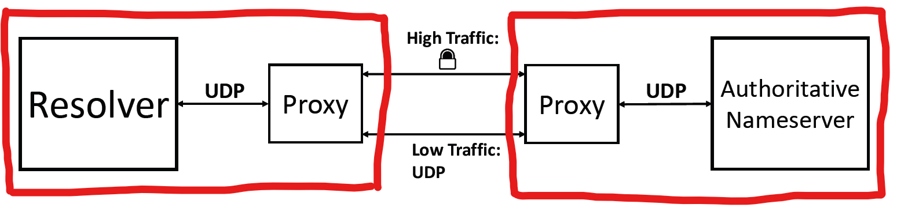


Proposed Solution – PoC (1)
Problem1: Can’t easily integrate with known resolver/auth implementations (Bind, Unbound, Knot, etc.)
Solution: proxy interface resolver - authoritative servers
Resolver Machine
Authoritative Machine

Slide 24
Proposed Solution – PoC (2)
Problem2:
  TLS overheads are high
  TLS suffers from Head-of-Line blocking
Notes:
TCP – send multiple messages on the same connection
HOL – one failed packet, everything stops to retransmit the failed packet

Slide 25
Proposed Solution – PoC (2)
Problem2:
  TLS overheads are high
  TLS suffers from Head-of-Line blocking
Solution: Use QUIC (similar to HTTP3)
  UDP Multiplexing (virtual connections)
  0-RTT: resume the connection with 0 round trip time
  No need for TCP integration (firewalls/IPS)
Notes:
TCP – send multiple messages on the same connection
HOL – one failed packet, everything stops to retransmit the failed packet

Slide 26
Proposed Solution – PoC (3)
Problem3: Teardown and restart QUIC connections

Slide 27
Proposed Solution – PoC (3)
Problem3: Teardown and restart QUIC connections
Solution: Keep connections alive
  QUIC has low overhead – long lived connections
  QUIC can resume quickly

Slide 28
Proposed Solution – PoC (4)
Problem4: Resource limit

Slide 29
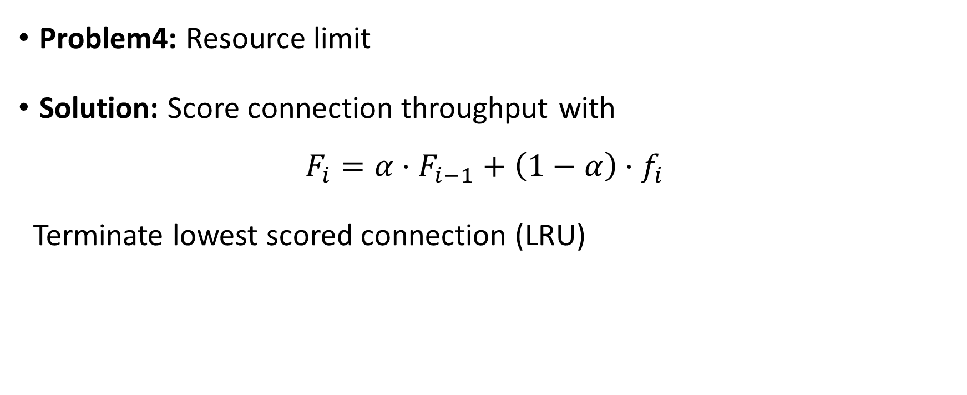
Proposed Solution – PoC (4)
Problem4: Resource limit
Solution: Score connection throughput with
$F_{i}=α⋅F_{i−1}+\left(1−α\right)⋅f_{i}$
Terminate lowest scored connection (LRU)
Notes:
Exponential weighted/moving average (low pass filter)

Slide 30
Measurements
Knot | Max Queries Per Second | % of Plain DNS
Plain DNS | 23,524 | 100%
DNSSEC: NSEC | 9,510 | 40%
DNSSEC: NSEC3 | 8,989 | 38%
DNSSEC: White Lies | 5,863 | 25%
DNSSEC: Black Lies | 7,206 | 30%
DNSSEC: NSEC5 | 6,324 | 27%

Slide 31
Measurements
With QUIC, using the same experiment (NX flood),
throughput is 87% of the plain DNS
Knot | Max Queries Per Second | % of Plain DNS
Plain DNS | 23,524 | 100%
DNSSEC: NSEC | 9,510 | 40%
DNSSEC: NSEC3 | 8,989 | 38%
DNSSEC: White Lies | 5,863 | 25%
DNSSEC: Black Lies | 7,206 | 30%
DNSSEC: NSEC5 | 6,324 | 27%
AdaDoQ (Our Solution) | 20,558 | 87%

Slide 32
Conclusions
DNSSEC degrades DNS performance
  Make NXDOMAIN attacks worse (DDoS amplification)
AdaDoQ – Hybrid Solution
  Light and fast connections
  One time encryption overheads
  Close to Plain DNS throughput
  No Security Compromises
    Zone Walking
  No Scalability Issues
Notes:
Leverage state of the art UDP connection protocol

Slide 33
Questions?

