Slide 1
Introducing IBDNS
October 22nd, 2022
The Intentionally Broken DNS Server

Slide 2
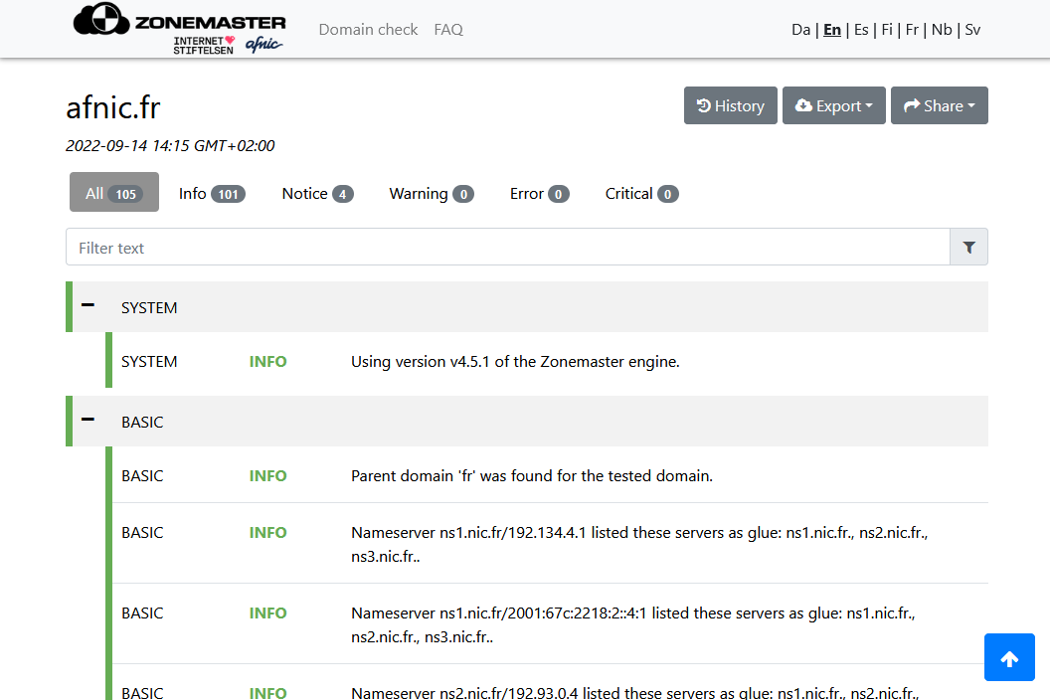
How to test testing tools?
Checking if diagnostics are correct requires:
ill-configured zones
broken servers
Zonemaster
(https://zonemaster.fr)

Slide 3
Some things can’t be done with faulty zones alone
Quoting from Zonemaster’s test specifications:
“[The BASIC04] test case will report problems found in the following areas:
Name Server not responding to a query without EDNS over UDP.
Name Server responding to TCP but not UDP.
Name Server not including SOA record of Child Zone in the answer section in the response on a SOA query for Child Zone.
Name Server not including NS record of Child Zone in the answer section in the response on an NS query for Child Zone.
Name Server not setting the AA flag in a response with SOA or NS in answer section.
Name Server responding with unexpected RCODE (any except "NOERROR") on query for SOA or NS for Child Zone.”
How to test these?

Slide 4
IBDNS’ current coverage
RFC 1034–1035
Other RFCs
(work in progress…)
(planned)
Responses with different case from query
Incorrect case-folding during lookups
Altering arbitrary flags in header; setting arbitrary RCODE
Wire format corruption
Not listening on both TCP and UDP

Slide 5
Architecture
Config file
points to
Zone files
subtree . (root) IN:
operate normally
subtree bit-flip.example.com. IN:
enable bit-flips (skip 2 octets, probability = 0.005)
subtree case-sensitive.example.com. IN:
enable case-sensitive search
populates
populate
Processing/defect DB
Zone DB

Slide 6
Architecture
Query for hello.bit-flip.example.com/A/IN:
IBDNS
1
Resolver
Core
6
query
nearest ancestor search of hello.bit-flip.example.com
configuration for bit-flip.example.com
lookup in zone DB
resource records (or error)
response
2
5
3
4
influences
Processing/defect DB
Zone DB

Slide 7
$ dig +nocmd +nostats +nord @127.0.1.1 TXT upper.answers.bad-case.test.
;; Got answer:
;; ->>HEADER<<- opcode: QUERY, status: NOERROR, id: 37253
;; flags: qr aa; QUERY: 1, ANSWER: 1, AUTHORITY: 0, ADDITIONAL: 0
;; QUESTION SECTION:
;upper.answers.bad-case.test. IN TXT
;; ANSWER SECTION:
UPPER.ANSWERS.BAD-CASE.TEST. 3600 IN TXT "My owner name is in uppercase"
$ dig +noall +question +answer +nord +nottl @127.0.1.1 TXT \
{LOWER,original}.answers.bad-case.test
;LOWER.answers.bad-case.test. IN TXT
lower.answers.bad-case.test. IN TXT "My owner name is in lowercase"
;original.answers.bad-case.test. IN TXT
OrIgInAL.answers.bad-case.test. IN TXT "My owner name is in original case"

Slide 8
$ dig +nocmd +nostats +nord @127.0.1.1 TXT aa0.bad-flags.test
;; Got answer:
;; ->>HEADER<<- opcode: QUERY, status: NOERROR, id: 31519
;; flags: qr; QUERY: 1, ANSWER: 1, AUTHORITY: 0, ADDITIONAL: 0
;; QUESTION SECTION:
;aa0.bad-flags.test. IN TXT
;; ANSWER SECTION:
aa0.bad-flags.test. 3600 IN TXT "Non-authoritative response?!"
$

Slide 9
$ dig +nocmd +nostats +nord @127.0.1.1 TXT aa0.bad-flags.test
;; Got answer:
;; ->>HEADER<<- opcode: QUERY, status: NOERROR, id: 31519
;; flags: qr; QUERY: 1, ANSWER: 1, AUTHORITY: 0, ADDITIONAL: 0
;; QUESTION SECTION:
;aa0.bad-flags.test. IN TXT
;; ANSWER SECTION:
aa0.bad-flags.test. 3600 IN TXT "Non-authoritative response?!"
$ zonemaster-cli --test Basic/basic04 --ns ns.test/127.0.1.1 aa0.bad-flags.test
Seconds Level Message
======= ========= =======
0.03 WARNING Nameserver ns.test/127.0.1.1 does not give an authoritative response on an SOA query.
0.03 WARNING Nameserver ns.test/127.0.1.1 does not give an authoritative response on an NS query.

Slide 10
$ dig +nocmd +nostats +nord @127.0.1.1 ANY no.bit-flip.test
;; Got answer:
;; ->>HEADER<<- opcode: QUERY, status: NOERROR, id: 8448
;; flags: qr aa; QUERY: 1, ANSWER: 5, AUTHORITY: 0, ADDITIONAL: 0
;; QUESTION SECTION:
;no.bit-flip.test. IN ANY
;; ANSWER SECTION:
no.bit-flip.test. 3600 IN A 192.0.2.1
no.bit-flip.test. 3600 IN A 192.0.2.2
no.bit-flip.test. 3600 IN AAAA 2001:db8::53
no.bit-flip.test. 3600 IN AAAA 2001:db8::1:53
no.bit-flip.test. 3600 IN TXT "Greetings from IBDNS!"

Slide 11
$ dig +nocmd +nostats +nord @127.0.1.1 ANY random.bit-flip.test
;; Warning: Message parser reports malformed message packet.
;; Got answer:
;; ->>HEADER<<- opcode: QUERY, status: NOERROR, id: 61611
;; flags: qr aa; QUERY: 1, ANSWER: 5, AUTHORITY: 0, ADDITIONAL: 0
;; QUESTION SECTION:
;random.bit-flip.test. IN ANY
;; ANSWER SECTION:
random.bit-flip.test. 3600 IN A 192.0.2.1
random.bit-flip.test. 3600 IN A 192.0.2.2
random.bit-flip.test. 3600 IN TYPE4124 \# 16 20010DB8000000000810000000000053
random.bit-flip.test. 3600 IN AAAA 2001:db8::1:53
random.bit-flip.test. 3600 IN TXT "GreetIngs\160from IBD\014S!"

Slide 12
$ dig +nocmd +nostats +nord @127.0.1.1 ANY random.bit-flip.test ;; Got bad packet: bad compression pointer
160 bytes
e3 8f 84 00 00 01 00 05 00 02 00 00 06 62 61 6e .............ban
64 6f 6d 08 62 69 74 2d 66 6c 69 70 24 74 65 71 dom.bit-flip$teq
74 00 00 ff 00 01 c0 0c 00 01 00 05 00 00 0e 10 t...............
00 04 c0 00 02 01 c0 0c 00 01 00 01 00 00 0e 10 ................
00 04 c0 00 02 02 c0 0c 00 1c 00 01 00 00 0e 10 ................
00 10 20 01 0d b8 00 00 00 00 00 00 00 00 00 00 ................
00 53 c0 0c 00 1c 00 01 00 00 0e 10 00 10 00 00 .S..............
0d b8 00 00 00 00 00 00 00 80 00 01 00 53 c8 0c .............S..
00 10 00 01 00 00 0e 10 00 16 15 c7 72 64 65 74 ............rdet
69 6e 67 73 20 66 72 6f 6d 20 49 42 44 4e 53 21 ings.from.IBDNS!

Slide 13
Fuzz testing Zonemaster
$ zonemaster-cli --ns ns.test/127.0.1.1 bit-flip.test

Slide 14
Fuzz testing Zonemaster
$ zonemaster-cli --ns ns.test/127.0.1.1 bit-flip.test
Seconds Level Message
======= ========= =======
[some messages omitted]
0.59 NOTICE There are neither DS nor DNSKEY records for the zone.
0.59 NOTICE The zone is not signed with DNSSEC.
[some more messages omitted]
0.77 NOTICE Child lists no nameserver that resolves to an IPv6 address. If any were present, the minimum allowed would be 2.
0.77 ERROR Delegation does not list enough (1) nameservers (ns.test) that resolve to IPv4 addresses (127.0.1.1). Lower limit set to 2.
0.77 NOTICE Delegation lists no nameserver that resolves to an IPv6 address. If any were present, the minimum allowed would be 2.
Segmentation fault
$

Slide 15
What caused the segfault
Flipping just the right bit turned
bit-flip.test. 3600 IN A 192.0.2.1
into
bit-flip.test. 3600 IN CAA \# 4 C0000201

Slide 16
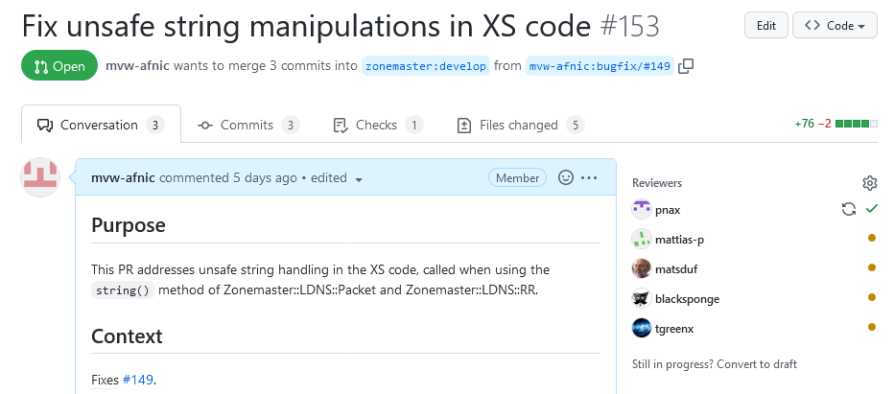
Eventually…

Slide 17
Contributions
Filling a void in DNS testing software
A project to help explore:
“Holes” in RFCs (esp. those published before RFC 2119)
Incorrect implementations of DNS
Bugs (vulnerabilities?) in DNS libraries
The value of fuzz testing, even when relying on mature libraries

