Slide 1

Welcome & Information
Keith Mitchell
DNS-OARC

Slide 2
Hybrid Event
DNS-OARC Conduct Policy
  Applies online as well as in-person
  https://www.dns-oarc.net/oarc/policies/conduct
Workshop is being recorded
  talks will be available on OARC YouTube channel a few weeks after event
Non-speakers are default muted during event
Physical event timezone is CEST = UTC+2
Social media hashtags: #LoveDNS #OARC39

Slide 3
On-site Information
WiFi: SSID Password
DNS-OARC OARC-Workshop
Break, lunch and toilet locations
Dietary restrictions
Emergency procedures

Slide 4
Covid-19 Precautions
All attendees have demonstrated they have had at least a 2-shot vaccination course
Free masks and tests are available at registration desk, please use them !
If you are not comfortable with these measures, attend online
Please contact Denesh if you have any health issues, concerns, or symptoms

Slide 5

Mattermost Chat
https://chat.dns-oarc.net/community/channels/workshops
Will be used for (both remote and in-person):
    Q&A
    talk rating polls
    (remote) speaker time-keeping
    general discussion
Public signup at:
    https://chat.dns-oarc.net/
Clients at:
    https://mattermost.com/download, or use browser

Slide 6
Questions
Speakers slots each include 5-10 mins Q&A
First-come, first-served, time-permitting
Please identify yourself and affiliation when asking
Slightly different Q&A protocol this time..
We have a single remote speaker session, with a remote session chair

Slide 7
In-person Questions
In-person attendee questions for In-person presenters
Step up to the microphone line
Wait for the Session Chair to ask you to speak

Slide 8
Remote Questions
Ask questions via Mattermost Chat:
  for all Remote attendees
  for all attendees for Remote speakers/sessions
  prepend your question with #questions in the workshops channel
The Session Chair will read out your question

Slide 9
Presentation Feedback
We will be using real-time Mattermost Polls for rating talks
  for both remote and in-person attendees, in workshops channel
Will be displayed during talk and Q&A – please vote ! 👍‍ 😐 👎‍
Data gathered really helpful for Programme Committee
General event feedback welcome at:
  https://bit.ly/oarc39-survey

Slide 10
The return of Lightning Talks !
We have 25 minute slot for these at end of Sunday
5-10 mins per talk, in-person speakers only
Please submit via: https://indico.dns-oarc.net/event/44/abstracts/
by 12:30 CEST Sun 23rd
PC will select and notify speakers

Slide 11
OARC Team @ OARC39
In Belgrade:
  Staff: Denesh, Jerry, Keith, Mike, & Boaris
  PC: John, Manu, Nils, Willem
  Board: Benno, Joao, Ray
Online:
  Staff: @matt, @rbcapetro, @stevos
  PC: @hazelesque, @pallaviaras
  Board: @jabley, @pebersman, @shuque

Slide 12
Online Social Event
We are using Spatial.Chat for a post-workshop social for remote attendees
Hang out after today’s proceedings
  17:10 to 19:00 CEST
  15:10 to 17:00 UTC
https://spatial.chat/s/oarc39 – access link via e-mail

Slide 13
In-person Social Event
In-person social will be held at Red Queen restaurant:
  https://rqbelgrade.rs/
  Belgrade Waterfront, BW Residences, AF1, 11000, Belgrade
  about 4km from hotel
  +381 66 247096
Badges required
  please collect laynards at registration desk for +1s
19:00 to 22:00 local/CEST
Bus from front of hotel: 18:20 boarding for 18:30 departure

Slide 14
OARC Update
Keith Mitchell
DNS-OARC

Slide 15
OARC's Mission Statement
The Domain Name System Operations Analysis and Research Center (DNS-OARC) is a non-profit, membership organization that seeks to improve the security, stability, and understanding of the Internet's DNS infrastructure.
DNS-OARC's mission is to:
promote and conduct research with operational relevance through data collection and analysis
offer useful services and tools
build relationships among its community of members
facilitate an environment where information can be shared responsibly
enable knowledge transfer by organizing open workshops
increase public awareness of the DNS's significance

Slide 16
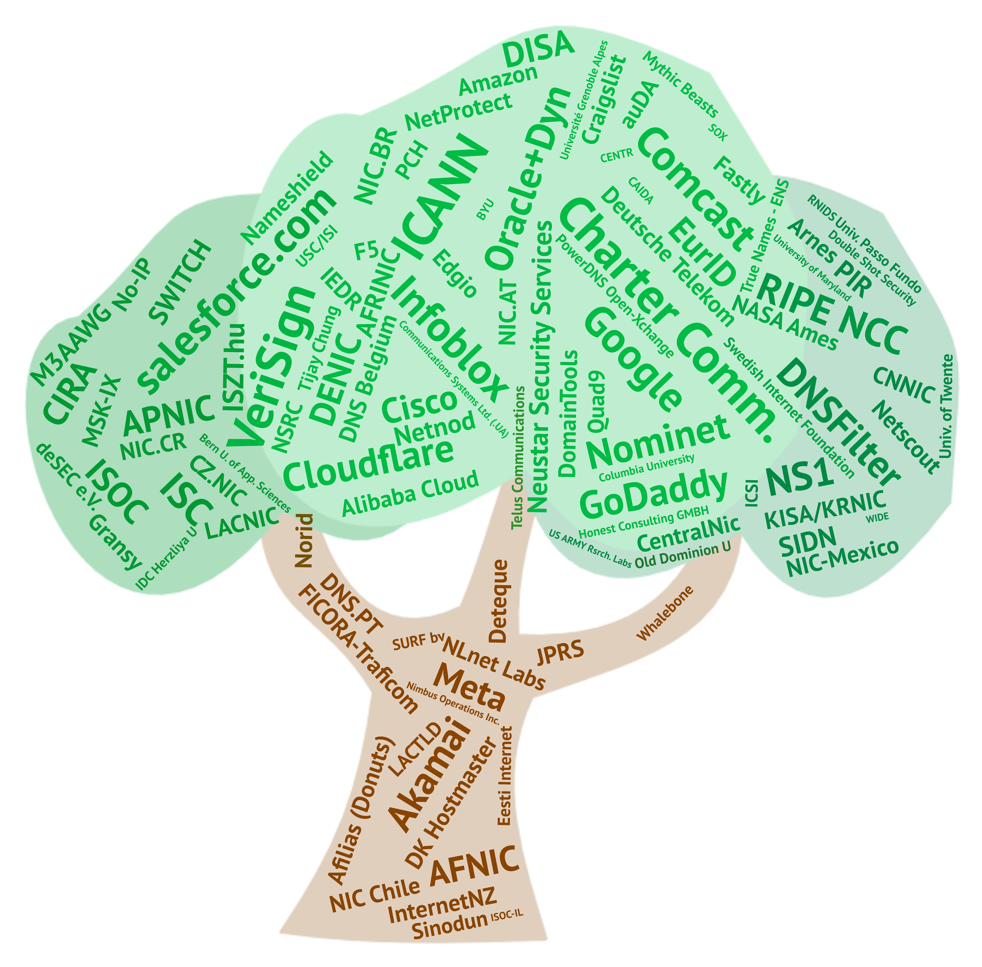
OARC's
Members
Notes:
An updated graphic for this slide is pending from Sue (delete this note once updated for upload)

Slide 17

2022 Achievements
Migrated workshops from online-only to hybrid format
DITL 2022 collection and dataset released
Ottawa site re-location, new routers purchased
Websites upgraded
Return to in-person Member/Community engagement
F2F internal planning meetings, including Fremont systems site visit
Added two new team members to OARC staff
Ceph Data Store ready for dataset transfer !

Slide 18
Committees & Board
2022-23 Board
  Joe Abley (Treasurer), Ray Bellis (PC Liaison), Joao Damas,
  Paul Ebersman, Benno Overeinder (Chair), Shumon Huque
2022 Programme Committee
  Pallavi Aras (Chair), Manu Bretelle, Hazel Smith, John Todd,
  Willem Toorop, Nils Wisiol, Suzanne Woolf
  Board will select 2023 Programme Committee during Nov 2022
  Self-nominations to <pc2023@dns-oarc.net> by 11th November
Privacy Committee
  Sara Dickinson, David Lawrence, Peter Lowe, George Michaelson,
  Benno Overeinder (Chair)
Notes:
We are seeking new PC members for 2018 – please speak to a Board member if interested.

Slide 19
2023 Membership Fee Increases
Inflation-based ~10% increment across most membership levels, approved at 2022 AGM
  takes effect 1st Jan 2023
Membership Category | Current Annual Fee | New Annual Fee
Blue | $1,100 | $1,250
Bronze | $6,500 | $7,200
Silver | $10,000 | $11,000
Gold | $15,000 | $16,500
Platinum | $25,000 | $27,500
Diamond | $50,000 | $50,000

Slide 20
Why Become an OARC Member ?
Access to and participation in the world's premier community of DNS technical experts
Influence development of open tools and services to support your infrastructure operations
Ability to share and analyze a unique dataset perspective into global DNS operations
Use of community co-ordination resources to respond to incidents and threats
Support a trusted neutral party free of vested interests in the DNS space
Notes:
This slide is for everyone in the room who is not yet a Member !
It's also for our Members to use to help make the case to others to join OARC.

Slide 21
OARC's Value Proposition
Member testimonials:
"As a newcomer to working with the DNS, DNS-OARC has been an excellent resource for me to get up to speed with the industry parts of how the DNS operates. The DNS-OARC community is quite welcoming to new people, and is happy to share knowledge. One aspect in particular that has been very helpful is the ability to easily have public discussions with other members, but also private discussions about potentially sensitive topics with industry experts."
“I would attend DNS-OARC conferences for the hallway track alone. Not because of the coffee, but because of all the super welcoming peers who are always willing to help me with their insights and knowledge.”
“OARC is a unique venue that brings together DNS vendors, operators of DNS services and researchers - the workshops provide a unique and valuable insight into the current state of the art of the DNS”
“Of all the work-related conferences I attend, @dnsoarc is reliably the one with the fewest uninteresting bits. Approaching zero.”

Slide 23
Wrap-Up
Keith Mitchell
DNS-OARC

Slide 24
OARC Workshops
We have successfully transitioned to hybrid format, and achieved OARC37, 38 & 39 this year
3 hybrid workshops per year is however proving demanding, and distracting from other activities
co-locating event externalities impacted 2022 workshop planning and timing
both in-person and online attendance reduced compared to 2020-21
current plan is just 2 hybrid workshops for 2023, and then review frequency/format for 2024 onward
Notes:
Please talk to Denesh about a promotion for 2018 workshop sponsorship if interested.

Slide 25
Future Workshops
Upcoming workshops:
  OARC40: co-located with NANOG86, Atlanta, Feb 16-17 2023
  CFP now open at: https://indico.dns-oarc.net/event/46/abstracts/
Future workshops:
  OARC41: H2 2023 TBC
Please consider supporting an OARC workshop via Sponsorship, Patronage, or a donation:
  https://www.dns-oarc.net/workshop/patronage-sponsorship
Notes:
Please talk to Denesh about a promotion for 2018 workshop sponsorship if interested.

Slide 26
THANK YOU !!
OARC Members and Supporters
Our OARC39 local hosts RNIDS and SOX
2022 Workshop Patron Verisign
Outgoing Board Members: Jacques Latour, Jaromír Talíř
Programme Committee
All our speakers
Attendee feedback encouraged at: https://bit.ly/oarc39-survey

