Slide 1



DareShark: Detecting and Measuring Security Risks of Hosting-Based Dangling Domains
Mingming Zhang, Xiang Li, Baojun Liu, Jianyu Lu, Yiming Zhang,
Jianjun Chen, Haixin Duan, Shuang Hao, and Xiaofeng Zheng
(Accepted by [ACM SIGMETRICS 2023])
Presenter: Xiang Li, Tsinghua University
February 16th, 2023
Notes:
Thank you.
Hello, everyone.
I’m Xiang Li, a Ph.D. student from Tsinghua University.
Today, I’ll share you guys with our latest research in the domain takeover topic, where we design a new system, called DareShark, to detect and measure security risks of hosting-based dangling domains.

Slide 2



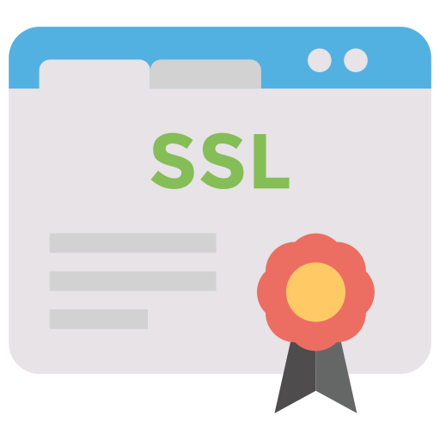
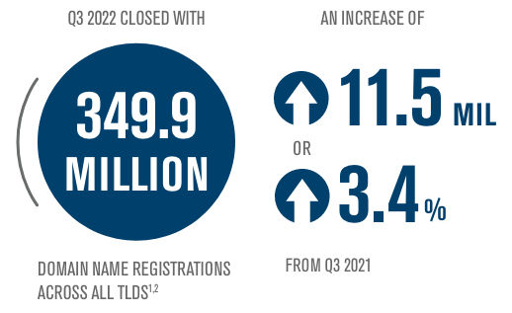



Domain Name
Domain name system (DNS)
  Entry point of many Internet activities
  Security guarantee of multiple application services
  Domain names are widely registered
Web
CDN
Email
Certificate
DNS
dns-oarc.net
64.191.0.66
Cited from verisign.com/dnib
Notes:
To start with, domain plays an important role in today’s Internet that provides a solid basis for multiple applications and services.
According to Verisign’s stats, about 350 million domain names have been registered.

Slide 3
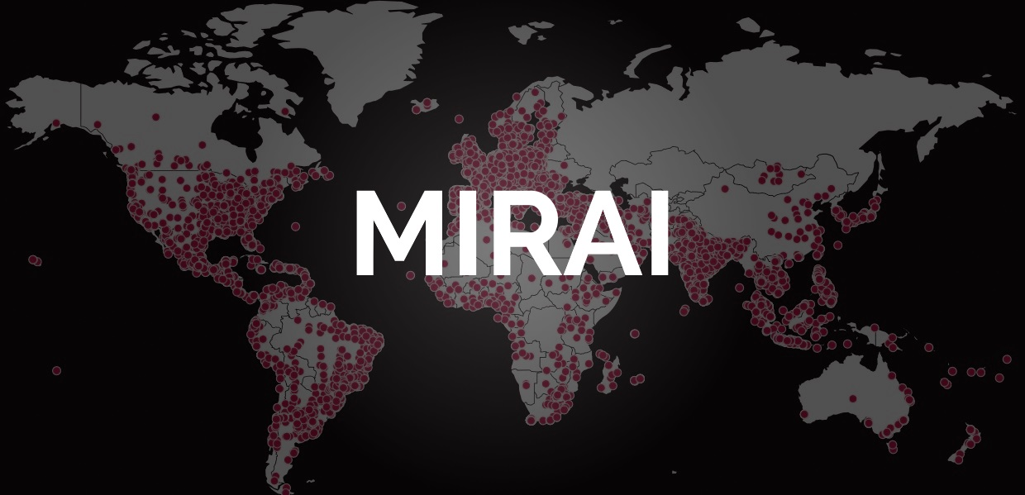
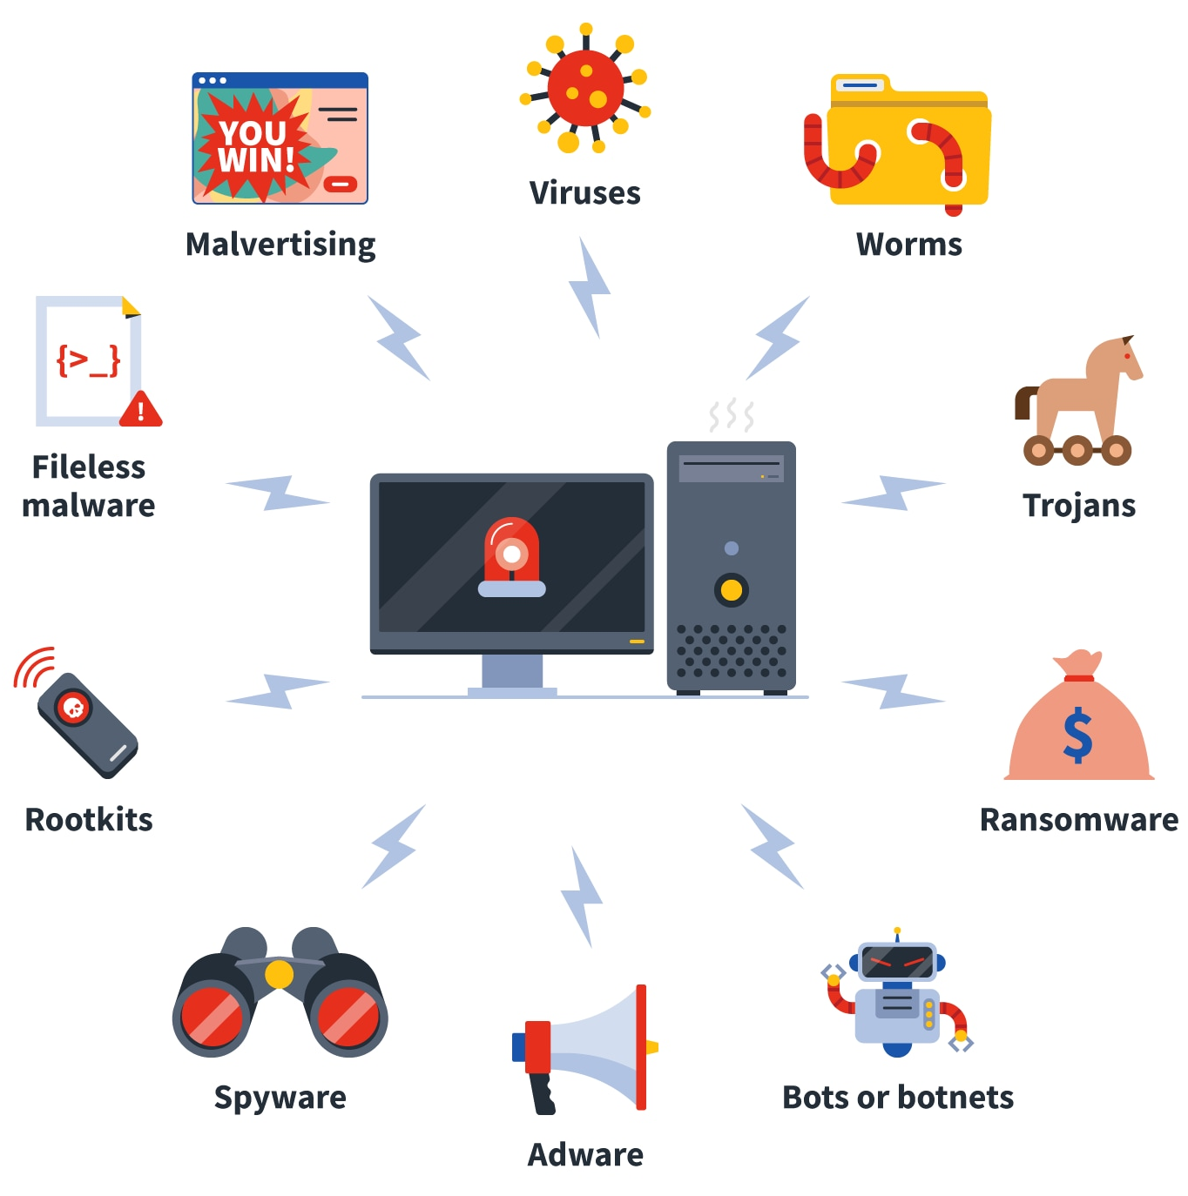

Domain Name Abuse
Adversaries could exploit the domains outside of their authority for malicious activities
  Botnet, phishing, malware distribution, etc.
Cited from bleepingcomputer.com
Cited from scmp.com
3
Cited from norton.com
Notes:
However, domains cut both ways.
They are also abused to perform criminal activities, such as botnet communication, phishing, malware distribution, etc.

Slide 4
Domain Name Abuse
Adversaries could exploit the domains outside of their authority for malicious activities
  Botnet, phishing, malware distribution, etc.
One of the powerful ways is domain takeover
Cited from bleepingcomputer.com
Cited from scmp.com
4
Cited from norton.com
Notes:
Specially, attackers could exploit domains outside of their authority to evict some regulation policies.
One of the powerful ways is domain takeover that controls other normal domains.

Slide 5
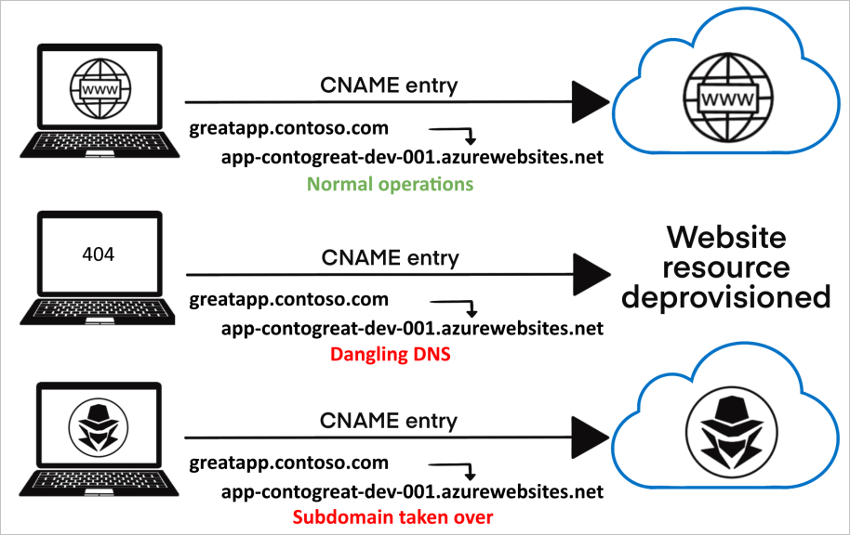
Domain Name Takeover
DNS Resource Records (RRs) → Use-After-Free
Cited from Microsoft
Security-sensitive Dangling DNS Records (Dares) → Domain Takeover
  A, CNAME, NS
All Your DNS Records Point to Us [CCS ’16]
5
Notes:
So, what’s domain takeover?
Domain takeover works like the use-after-free bug.
When a user, for example, wants to deploy a website in a public hosting service, he needs to connect his domain to this service, such as using a CNAME record. Then, everything is good, and the website runs well.
Afterwards, the user no longer needs the public hosting service, and cancels it, but forgets to remove the CNAME record, which becomes a dangling record with no valid destination.
Attackers thus could create the same CNAME alias with the former hosting service. Due to the existing CNAME, such a normal domain is controlled by attackers.
Referring to the paper from CCS ‘16, we also call these security-sensitive dangling records dares, such as type A, CNAME, and NS.

Slide 6
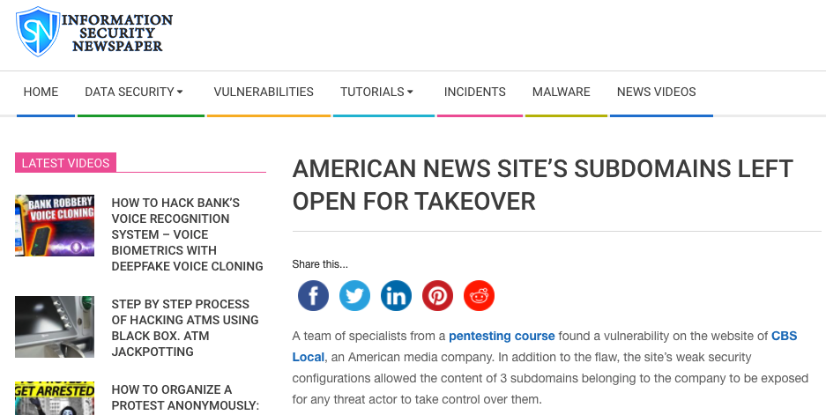
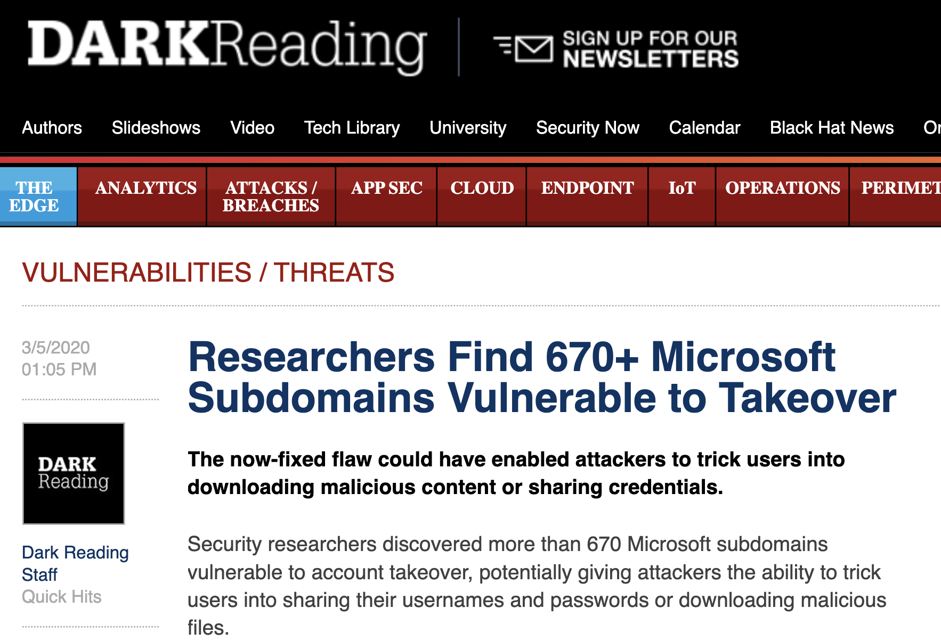
Domain Name Takeover
Many domain-takeover incidents occur in recent years
6
Notes:
Over these years, many domain-takeover incidents happen, even for large companies like Microsoft.
We are wondering why domain takeover is still prevalent.

Slide 7

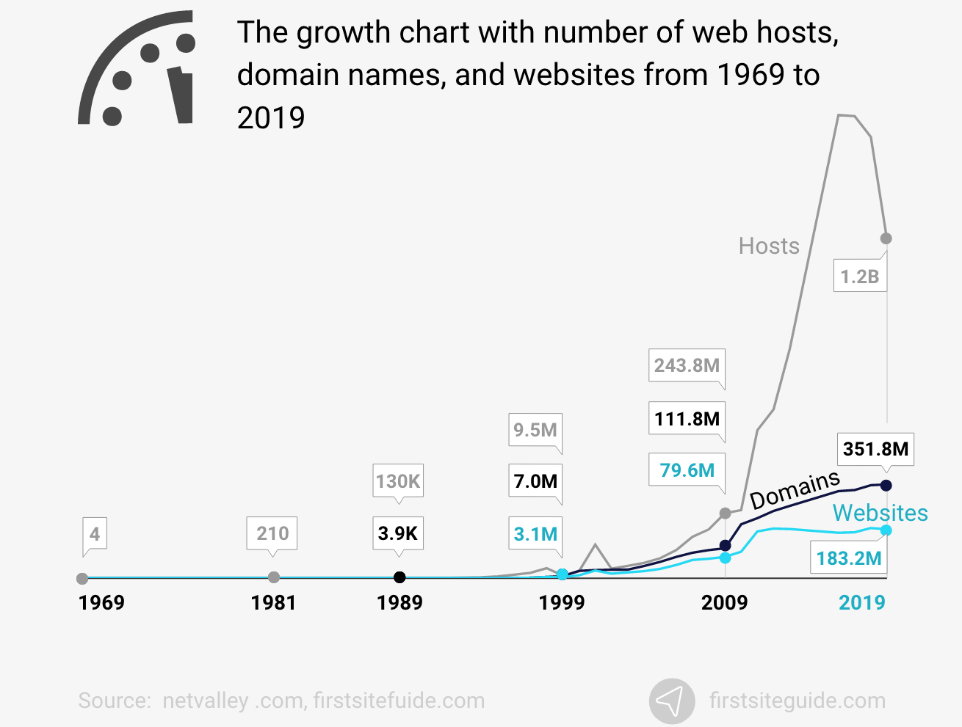
Domain Name Takeover
Many domain takeover incidents occur in recent years
7
Notes:
Among all websites, we find the web hosting service takes a majority and continues growing that becomes the potential domain takeover target.

Slide 8
Domain Name Takeover
Many domain takeover incidents occur in recent years
Narrowing down our vision to
hosting-based domain takeover issues！
8
Notes:
So, in this research, we narrow down our vision to hosting-based domain takeover issues.

Slide 9
What is hosting-based
domain takeover?
9
Notes:
First, I wanna explain what the hosting-based domain takeover is.

Slide 10
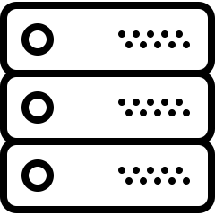



Public Hosting Service
Domain hosting procedures
_service_challenge.alice.com TXT RSAKNMDSOAMPOD
custom.alice.com CNAME custom-alice.service.com
_service_challenge.alice.com TXT RSAKNMDSOAMPOD
Hosting Platform
n check CNAME records
IP
aDNS
Server
l check challenge records.
o start
services
k add DNS records
NS
j add custom.alice.com
m allocate endpoints
CNAME
Alice
Domain Ownership
Validator
Domain Connection Checker
10
Notes:
To use a public hosting service, a client, let's say Alice, in step 1, adds her own domain to the hosting platform.
Then the platform assigns a token such as a TXT value to validate the domain ownership, and in step 2, Alice adds this token to her DNS nameserver.
Step 3, the platform validates the token and allocates endpoints such as CNAME for Alice connect.
Then Alice adds the CNAME record and connects her domain to this platform.
In the end, the service is hosted and starts.

Slide 11
Vulnerable Hosting Service
However, a hosting service might be vulnerable if:
_service_challenge.alice.com TXT RSAKNMDSOAMPOD
custom.alice.com CNAME custom-alice.service.com
Hosting Platform
n check CNAME records
It has no/flawed domain ownership validation when hosting a custom domain
Attackers could
reuse the endpoints
(e.g., CNAME, NS) that are allocated to victim users.
IP
aDNS
Server
l check challenge records.
o start
services
k add DNS records
NS
j add custom.alice.com
m allocate endpoints
CNAME
Alice
Domain Ownership
Validator
Domain Connection Checker
11
Notes:
However, a hosting service might be vulnerable if:
It has no or flawed domain ownership validation method.
And attackers could reuse assigned endpoints for victim users.

Slide 12

Hosting-based Domain Takeover
When Alice’s service expires, she doesn’t purge RRs
Dangling Records
_service_challenge.alice.com TXT RSAKNMDSOAMPOD
custom.alice.com CNAME custom-alice.service.com
Hosting Platform (Vulnerable)
IP
aDNS
Server
NS
CNAME
Domain Ownership
Validator
Domain Connection Checker
12
Notes:
In these cases, hosting-based domain takeover could happen if Alice doesn't remove assigned records when her service expires, which become the dangling records.

Slide 13

Hosting-based Domain Takeover
Domain takeover procedures
Dangling Records
_service_challenge.alice.com TXT RSAKNMDSOAMPOD
custom.alice.com CNAME custom-alice.service.com
Hosting Platform (Vulnerable)
m exploit undeleted CNAME records
IP
aDNS
Server
n take over Alice’s domain
k weak/no DOV
NS
l allocate the same endpoints
j add custom.alice.com
CNAME
Mallory
Domain Ownership
Validator
Domain Connection Checker
13
Notes:
Here are the takeover procedures.
Step 1, the attacker, let's say Mallory, adds the victim domain that has dangling records to the vulnerable hosting platform.
Since this platform has no or weak DOV, assigns same endpoints, and decides passing validation.
Then the victim domain is connected, and the service is controlled by Mallory.
The domain takeover succeeds.
That's hosing-based domain takeover.

Slide 14
Why domain takeover occurs ceaselessly？
“Domain takeover incidents are still on the rise, increasing by 25% from 2020 to 2021.”¹
¹https://blog.detectify.com/ 2022/03/22/subdomain-takeover-on-the-rise-detectify-research/.
14
Notes:
Meanwhile, we wonder why domain takeover occurs ceaselessly.

Slide 15

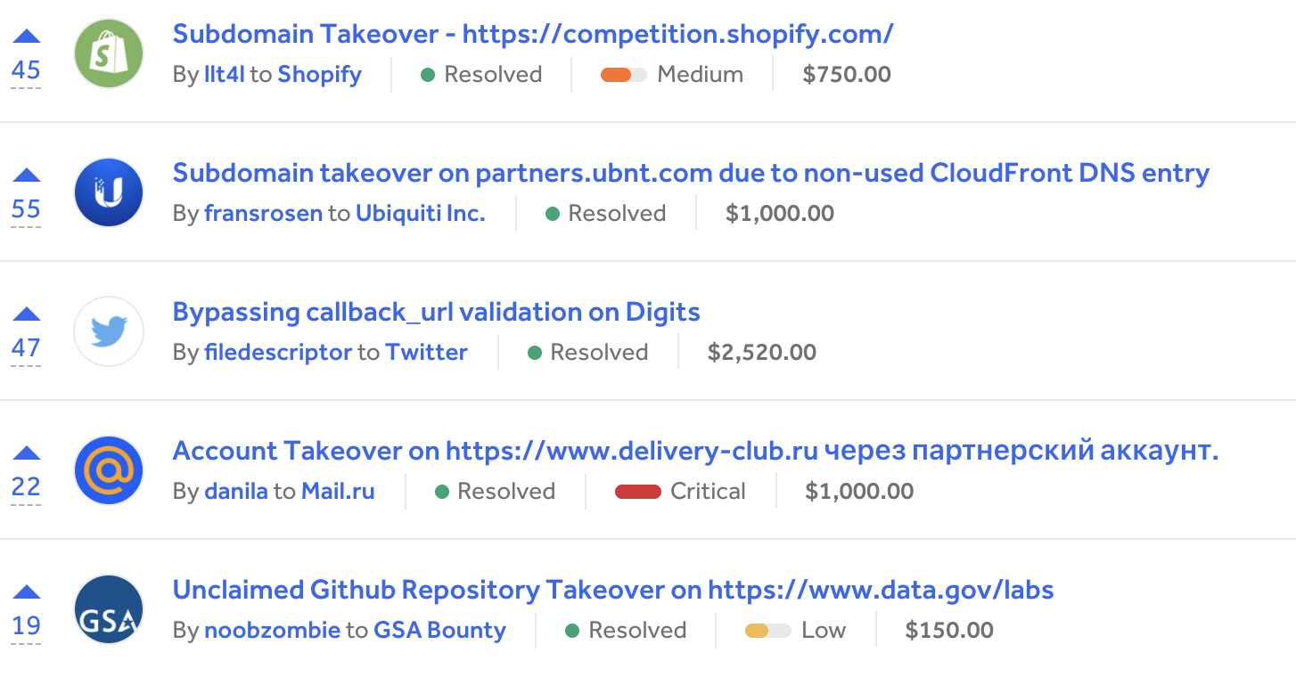


Motivation
A generic method for discovering third-party hosting services is needed
Various hosting service types
Ad-hoc hacktivity reports on HackerOne
Web
DNS
Email
Object
Various domain hosting strategies
Change domain name servers
user.domain.com
Add canonical names
Notes:
We found two main reasons.
First, it's not easy to identify vulnerable hosting services.
Because there are various hosting service types, strategies, and most previous takeover vulnerabilities are ad-hoc.
So, a generic method is needed.

Slide 16
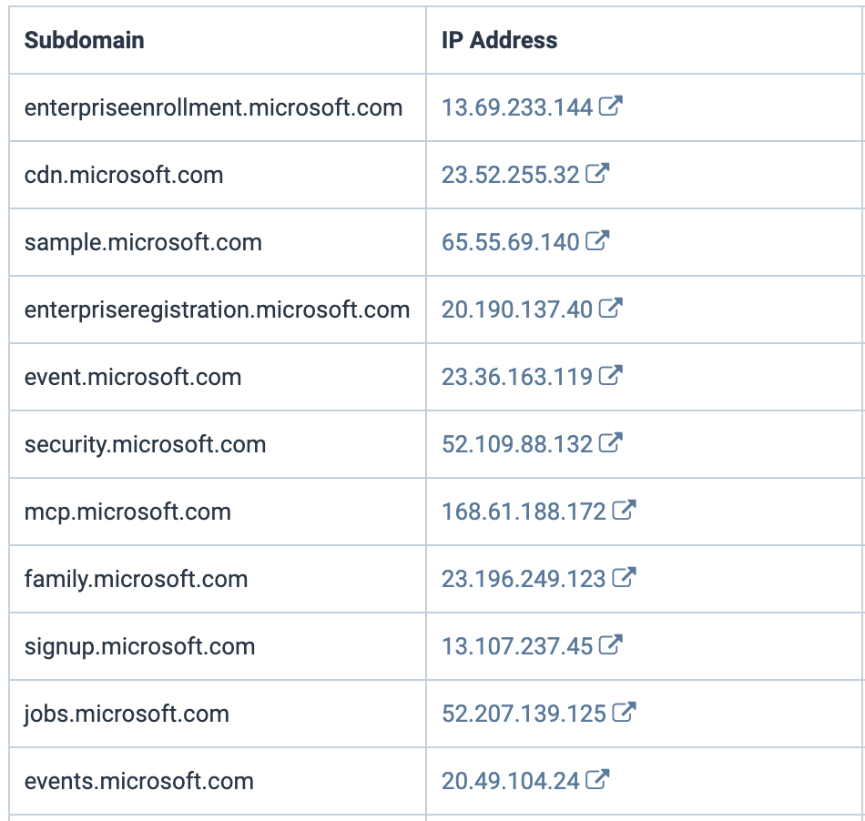

Motivation
An efficient detection system is absent for quickly digging out vulnerable domains in the wild
Large companies have thousands of subdomains, with DNS chains changing frequently
How to timely detect vulnerable domains among them?
  Previous work: active DNS resolution
  [Daiping 2016, Eihal 2020 , Marco 2021]
Notes:
Second, an efficient detection system is absent for quickly and timely digging out vulnerable domains.
Since there are thousands of subdomains whose DNS chains change frequently, and the active resolution has limited efficiency.
Any node in the DNS chain could induce takeover.

Slide 17
Can we discover more hosting services and
detect vulnerable domains timely?
The domain characteristics of hosting services and the DNS chains of domains are logged in DNS traffic.
17
Notes:
So, can we solve these two challenges?
The answer is yes. Because the domain features of hosting services and DNS chains are all logged in DNS traffic.

Slide 18
Empirical Observations
O1. Similar endpoint naming conventions
Service Endpoint Patterns
Service Endpoint Name
<prefix>.<service>.<region>.<vendor-domain>
www.alice.com.s3.us-east-1.vendor-domain.com
User-defined Prefix
Endpoint Pattern
18
Notes:
Here are our observations.
First, we find that the hosting service has similar endpoint naming conventions.
We can use these common service endpoint patterns to identify hosting services.

Slide 19
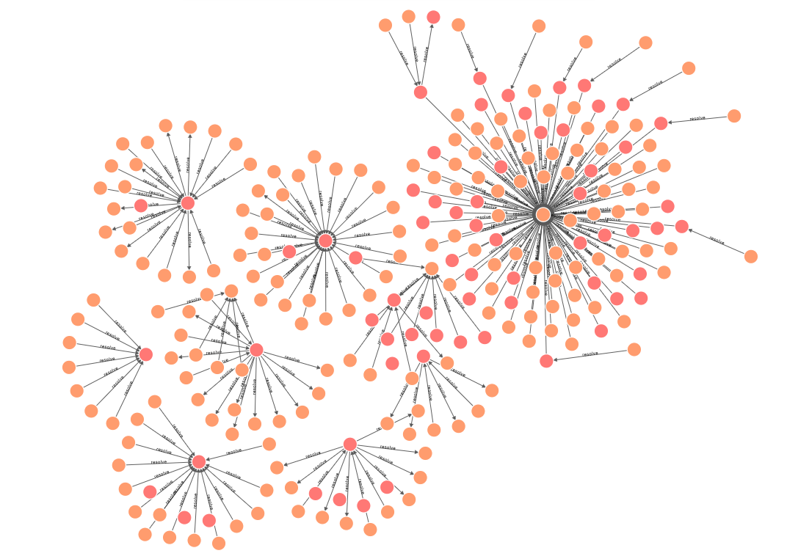

Empirical Observations
O2. High domain dependency number
One service apex domain may serve thousands of customers’ domains
custom1.com CNAME prefix1.service.com
custom2.com CNAME prefix2.service.com
...
customN.com CNAME prefixN.service.com
yelp-com.map.fastly.net
triprd1wcuse3workspaceportal.atp.azure.com
obs.dfvcg0.cn-east-2.myhwclouds.com
d1vlioozhblixi.cloudfront.net
hz-nbu-backup.obs.cn-east-2.myhwclouds.com
$$DN\left(“service.com”\right)=N$$
domains.gannett.map.fastly.net
19
Notes:
Second, to reduce false positives, we can use the high domain dependency number to filter out small services that have less pointed customers’ domains.

Slide 20
Our solution
Automate the approach to discovering services and vulnerable domains using passive DNS traffic.
20
Notes:
Lastly, our solution is to use the passive DNS traffic to automate the approach to discovering services and vulnerable domains.

Slide 21
Our Tool: DareShark
A novel framework that can assist in:
  Discovering vulnerable hosting services
  Detecting hosting-based vulnerable domains efficiently
Expand the detection scope
Prevent potential security threats
21
Notes:
We design a novel framework DareShark that can help us in two ways:
Discovering vulnerable hosting services and Detecting hosting-based vulnerable domains efficiently.

Slide 22






DareShark Workflow
Part 1. Vulnerable service discovery (offline procedure)
a) Find potential
service endpoints
b) Extract
endpoint patterns
c) Identify
vulnerable services
d) Maintain a vulnerable service database
$$service$$
$$endpoints$$
$$endpoint$$
$$patterns$$
Passive DNS
22
Notes:
DareShark has two parts.
Part 1 is the offline vulnerable service discovery.
First, we use passive DNS to find potential service endpoints.
Second, common endpoint patterns are extracted.
Third, by manual analysis, we identify vulnerable services.
Lastly, a vulnerable service db is created.

Slide 23










DareShark Workflow
Part 1. Vulnerable service discovery (offline procedure)
a) Find potential
service endpoints
b) Extract
endpoint patterns
c) Identify
vulnerable services
d) Maintain a vulnerable service database
$$service$$
$$endpoints$$
$$endpoint$$
$$patterns$$
Passive DNS
patterns
fingerprints
$$apexes$$
$$subdomains$$
$$DNS chains$$
$$D_{vulhost}$$
Target
Domains
a) Collect subdomains
b) Construct
DNS chains
c) Discover domains
hosted on vulnerable services
d) Recognize
dangling domains
Reports
Part 2. Vulnerable domain detection workflow (periodic procedure)
23
Notes:
Part 2 is the vulnerable domain detection.
For each target domain, we first collect all its subdomains and construct DNS chains using passive DNS.
Then for each record in the DNS chain, we apply the service db to discover domains hosted on vulnerable services.
Besides, through active HTTP and DNS requests, we identify dangling domain with pre-collected fingerprints.
In the end, reports are output.

Slide 24
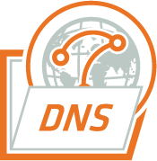

Part I: Discovering Vul. Services
Step 1: Finding service endpoint candidates
  Filtering endpoint domains by DNS resolution popularity and domain dependency.
CNAME
$$Daily Query$$
$$Volume$$
DNS Records
NS
Format
filter
Compute domain dependency number
Candidates
Passive DNS Database
MX
24
Notes:
In detail, for part 1, we use the DNS resolution popularity and domain dependency to find service endpoint candidates that might use hosting services.

Slide 25
Part I: Discovering Vul. Services
Step 2: Extracting endpoint patterns via a Domain Suffix Tree
“.”
Level 1
Level 2
Domain Tree Construction:
The root is “.”, and children nodes are eTLDs, apex domains, apex+1, apex+2, and so on
Level 3
www-alice-com.us-east-1.service.com
...
Domain Tree
25
Notes:
Then, for each endpoint candidate, we construct a domain suffix tree following the structure of domain name space.

Slide 26
Part I: Discovering Vul. Services
Step 2: Extracting endpoint patterns via a Domain Suffix Tree
“.”
Level 1
...
org
Level 2
Domain Tree Construction:
The root is “.”, and children nodes are eTLDs, apex domains, apex+1, apex+2, and so on
...
Level 3
www-alice-com.us-east-1.service.com
1
2
...
...
Domain Tree
26
Notes:
For each node, we calculate their tree node attributes, such as the number of sub nodes.
For example, node 1 at level 3 has more than 1 sub nodes.

Slide 27
Part I: Discovering Vul. Services
Step 2: Extracting endpoint patterns via a Domain Suffix Tree
“.”
Level 1
...
org
Level 2
Tree node attributes (Example of Node 1)
{
“name” : “us-east-1.service.com”,
“suffixLevel”: 3,
“DN” : Dependency Number,
“subCount” : 3,
“subList” : [‘a’, ‘b’, ‘c’],
“subEntropy” : Shannon entropy of subList
}
...
Level 3
www-alice-com.us-east-1.service.com
1
2
...
...
Domain Tree
27
Notes:
For each node, we calculate their tree node attributes, such as the number of sub nodes.
For example, node 1 at level 3 has more than 1 sub nodes.

Slide 28
Part I: Discovering Vul. Services
Step 2: Extracting endpoint patterns via a Domain Suffix Tree
“.”
Level 1
...
org
Longest endpoint suffix
Level 2
...
Domain Tree Pruning
Prune the tree from the bottom up, by limiting number of hosted FQDNs, subCount, and subEntropy of each node
Level 3
www-alice-com.us-east-1.service.com
1
2
...
...
...
Domain Suffix Tree (DST)
28
Notes:
Then we prune the tree from the bottom up, by limiting the number of hosted attributes of each node, until only the leaf is left.
The left nodes and their domain names are considered as the longest endpoint suffix.

Slide 29
Part I: Discovering Vul. Services
Step 2: Extracting endpoint patterns via a Domain Suffix Tree
Service Endpoint Examples
Services | Endpoint Names (endpoint patterns)
Aliyun OSS | alice.storage.com.oss-cn-hongkong.aliyuncs.com
Amazon S3 | a.b.c.d.s3.us-east-1.amazonaws.com ab-cd.s3.dualstack.us-gov-west-1.amazonaws.com
GitHub | abcd.github.io
29
Notes:
Step2, for each service, we extract their endpoint pattern via the domain suffix tree.
Each service may have multiple patterns.

Slide 30
Part I: Discovering Vul. Services
Step 3: Identifying services and checking service vulnerabilities
  Narrow down the candidate list of endpoint patterns
  Map endpoint patterns to services
  Check vulnerabilities in domain connection and domain ownership validation
  e.g., remove highly randomized endpoint domains
  e.g., access homepages, dig through search engines
30
Notes:
Step 3 is to identify services and check vulnerabilities.
Through extracting endpoint patterns, manual effort is largely reduced.
We remove highly randomized patterns, check their DOV and connection methods, and access their websites.

Slide 31
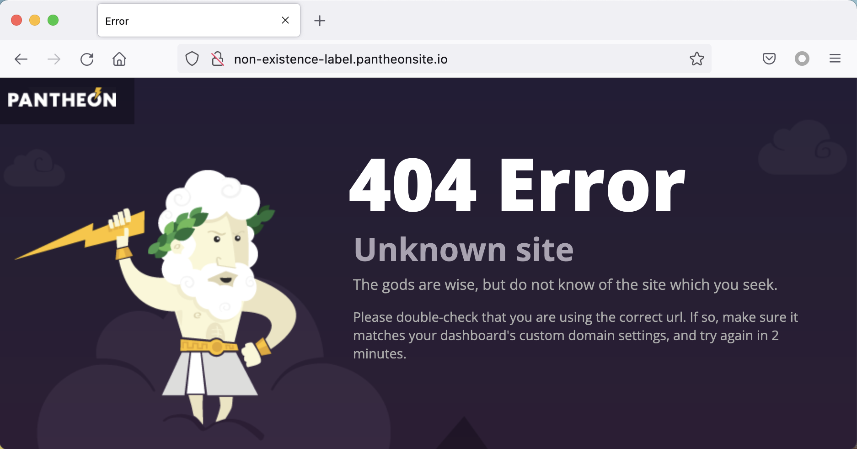
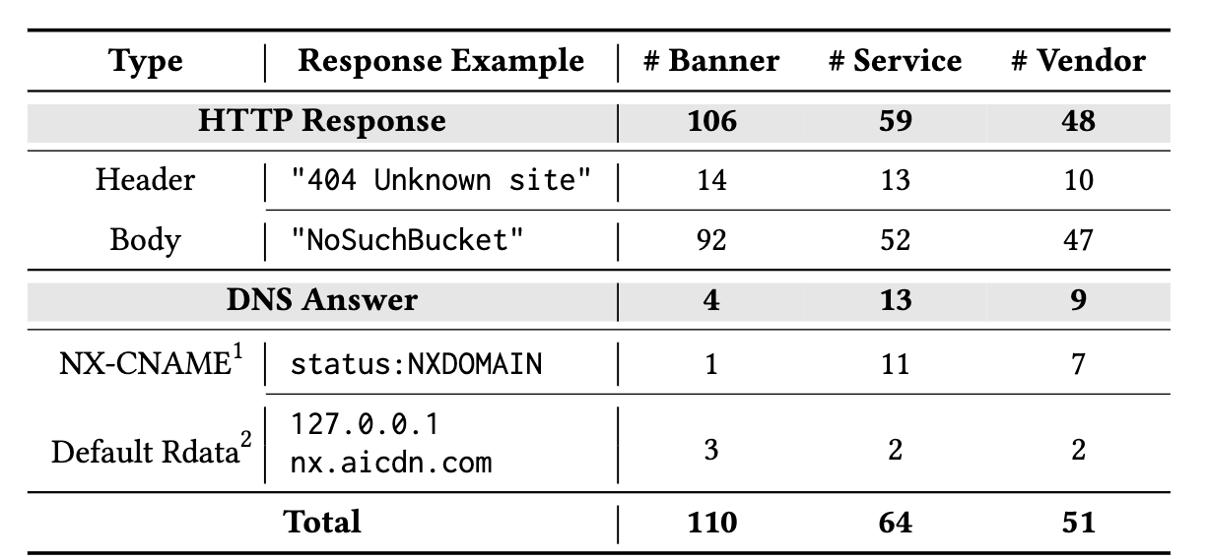
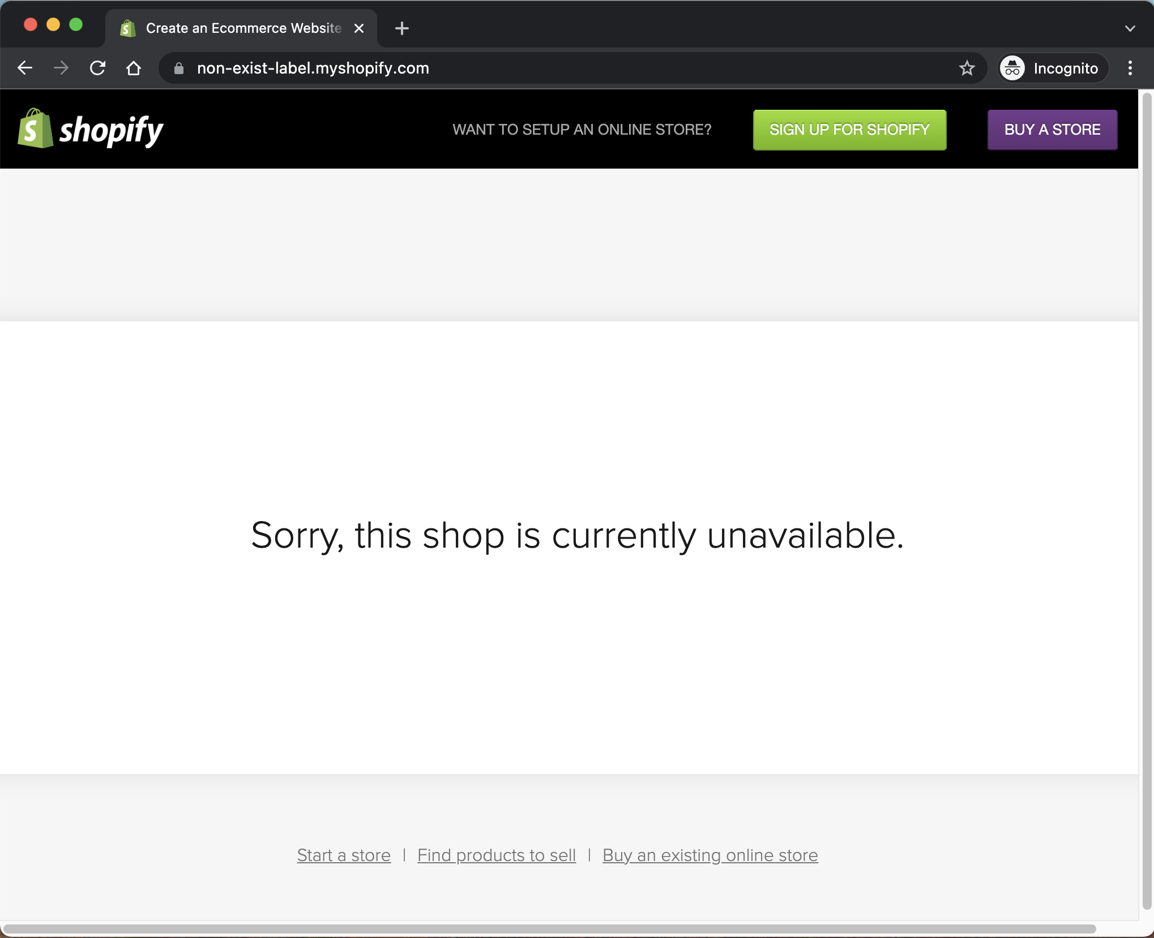
Part I: Discovering Vul. Services
Step 4: Maintaining a database for vulnerable services
Vulnerable Service Fingerprints
31
Notes:
Step 4, after checking all services, we maintain a db for vulnerable ones, collecting their HTTP and DNS fingerprints.

Slide 32


Part II: Detecting Hosting-based Dares
Collecting subdomain names from passive DNS logs
  Legal format
  Filter disposable domains created on demand
[RFC 1034] Domain Names - Concepts And Facilities
e.g., scanning, convey “one-time signals”
$$Total Query Volume>100$$
Reconstructing domain dependencies (DNS chains)
Recursively query canonical names
CNAME
$$Daily Query$$
$$Volume$$
A
FQDN
DNS Records
Format filter
NS
Passive DNS Database
DNS chains
MX
32
Notes:
Part 2 is detecting hosting-based dares.
With passive DNS, we can collect massive of subdomains for each target domain and reconstruct the DNS chain recursively and efficiently.

Slide 33




Part II: Detecting Hosting-based Dares
Probing hosted domains to inspect service status
Vulnerable Service DB
endpoint patterns
fingerprints
DNS Fingerprint
DNS Chains
Hosted FQDNs
Discontinued Services
Vulnerable
domains
HTTP Fingerprint
Fingerprint
Prober
33
Notes:
Then, for each record in the DNS chain, we use the endpoint pattern to identify hosting service domains, and use the service fingerprints to discover vulnerable domains by active accessing them.

Slide 34
Part II: Detecting Hosting-based Dares
Probing hosted domains to inspect service status
(1) Webflow
(2) Fastly
rmi.xxxx.edu
mrcd.xxxxxxxxx.vip
34
Notes:
In the end, with double-check, we can detect all vulnerable hosting-based dares in our db.
Here are some examples from the service of Webflow, Fastly.

Slide 35
Part II: Detecting Hosting-based Dares
Probing hosted domains to inspect service status
(3) Cloudflare
(4) Alibaba Cloud
web.xxxx.net
rrzxxx.xxxxxxxxxxxxxx.cn
35
Notes:
Cloudflare and Ali Cloud.

Slide 36
DareShark Deployment
Passive DNS dataset
  DNS response data from public DNS resolvers for 114DNS, the largest DNS provider in China
  600B DNS queries per day, covering 99.9% of Tranco Top 1M domains
  DNS queries originate from telecom companies (e.g., China Telecom), research institutions (e.g., MIT and NUS), and large providers (e.g., Alibaba and Google)
36
Notes:
We implement and deploy DareShark with a large passive DNS dataset that contains 600B DNS queries per day, covering 99.9% of Tranco Top 1M domains.

Slide 37
What did we find for hosting services?
The current practice of hosting services is in a mass, resulting in various types of service vulnerable to domain takeover.
37
Notes:
We find that the current practice of hosting services is in a mass, resulting in various types of service vulnerable to domain takeover.

Slide 38
Vulnerable Hosting Services
65 services vulnerable to domain takeover threats.
Vulnerable services comprise a variety of service types.
Categories | # Vendor |  | # Endpoint Patterns |  | # Services
 | All | Vulnerable | All | Vulnerable | All | Vulnerable
Cloud Storage | 7 | 7 | 130 | 118 | 12 | 9
CDN | 25 | 7 | 247 | 31 | 44 | 8
Website Builder | 51 | 40 | 156 | 105 | 60 | 44
Others | 27 | 4 | 462 | 4 | 49 | 4
Newly Discovered | 55 | 19 | 920 | 183 | 125 | 34
All | 88 | 52 | 995 | 258 | 165 | 65
38
Notes:
In total, we identify 65 services vulnerable to domain takeover threats, which comprise a variety of types, such as Cloud storage and CDN.

Slide 39
Vulnerable Hosting Services
7/9 domain connecting methods are exploitable
Method | Type | Connect a custom domain to... | # Services | Exploitable
CNAME | M1 | Fixed canonical domains | 12 | ●
Website Builder | M2 | Any canonical domains customized by any users | 70 | ●
Others | M3 | New canonical domains customized by new users | 12 | ○
Newly Discovered | M4 | The canonical domains allocated from a candidate pool | 5 | ◐
All | M5 | Canonical domains containing newly generated random labels | 47 | ○
NS | M6 | Fixed nameservers | 1 | ●
 | M7 | The nameservers allocated from a candidate pool | 5 | ◐
IP | M8 | Fixed IPs | 8 | ●
 | M9 | The IPs allocated from a candidate pool | 4 | ◐
39
Notes:
We summarize 9 domain connecting methods, 7 of which are exploitable.

Slide 40
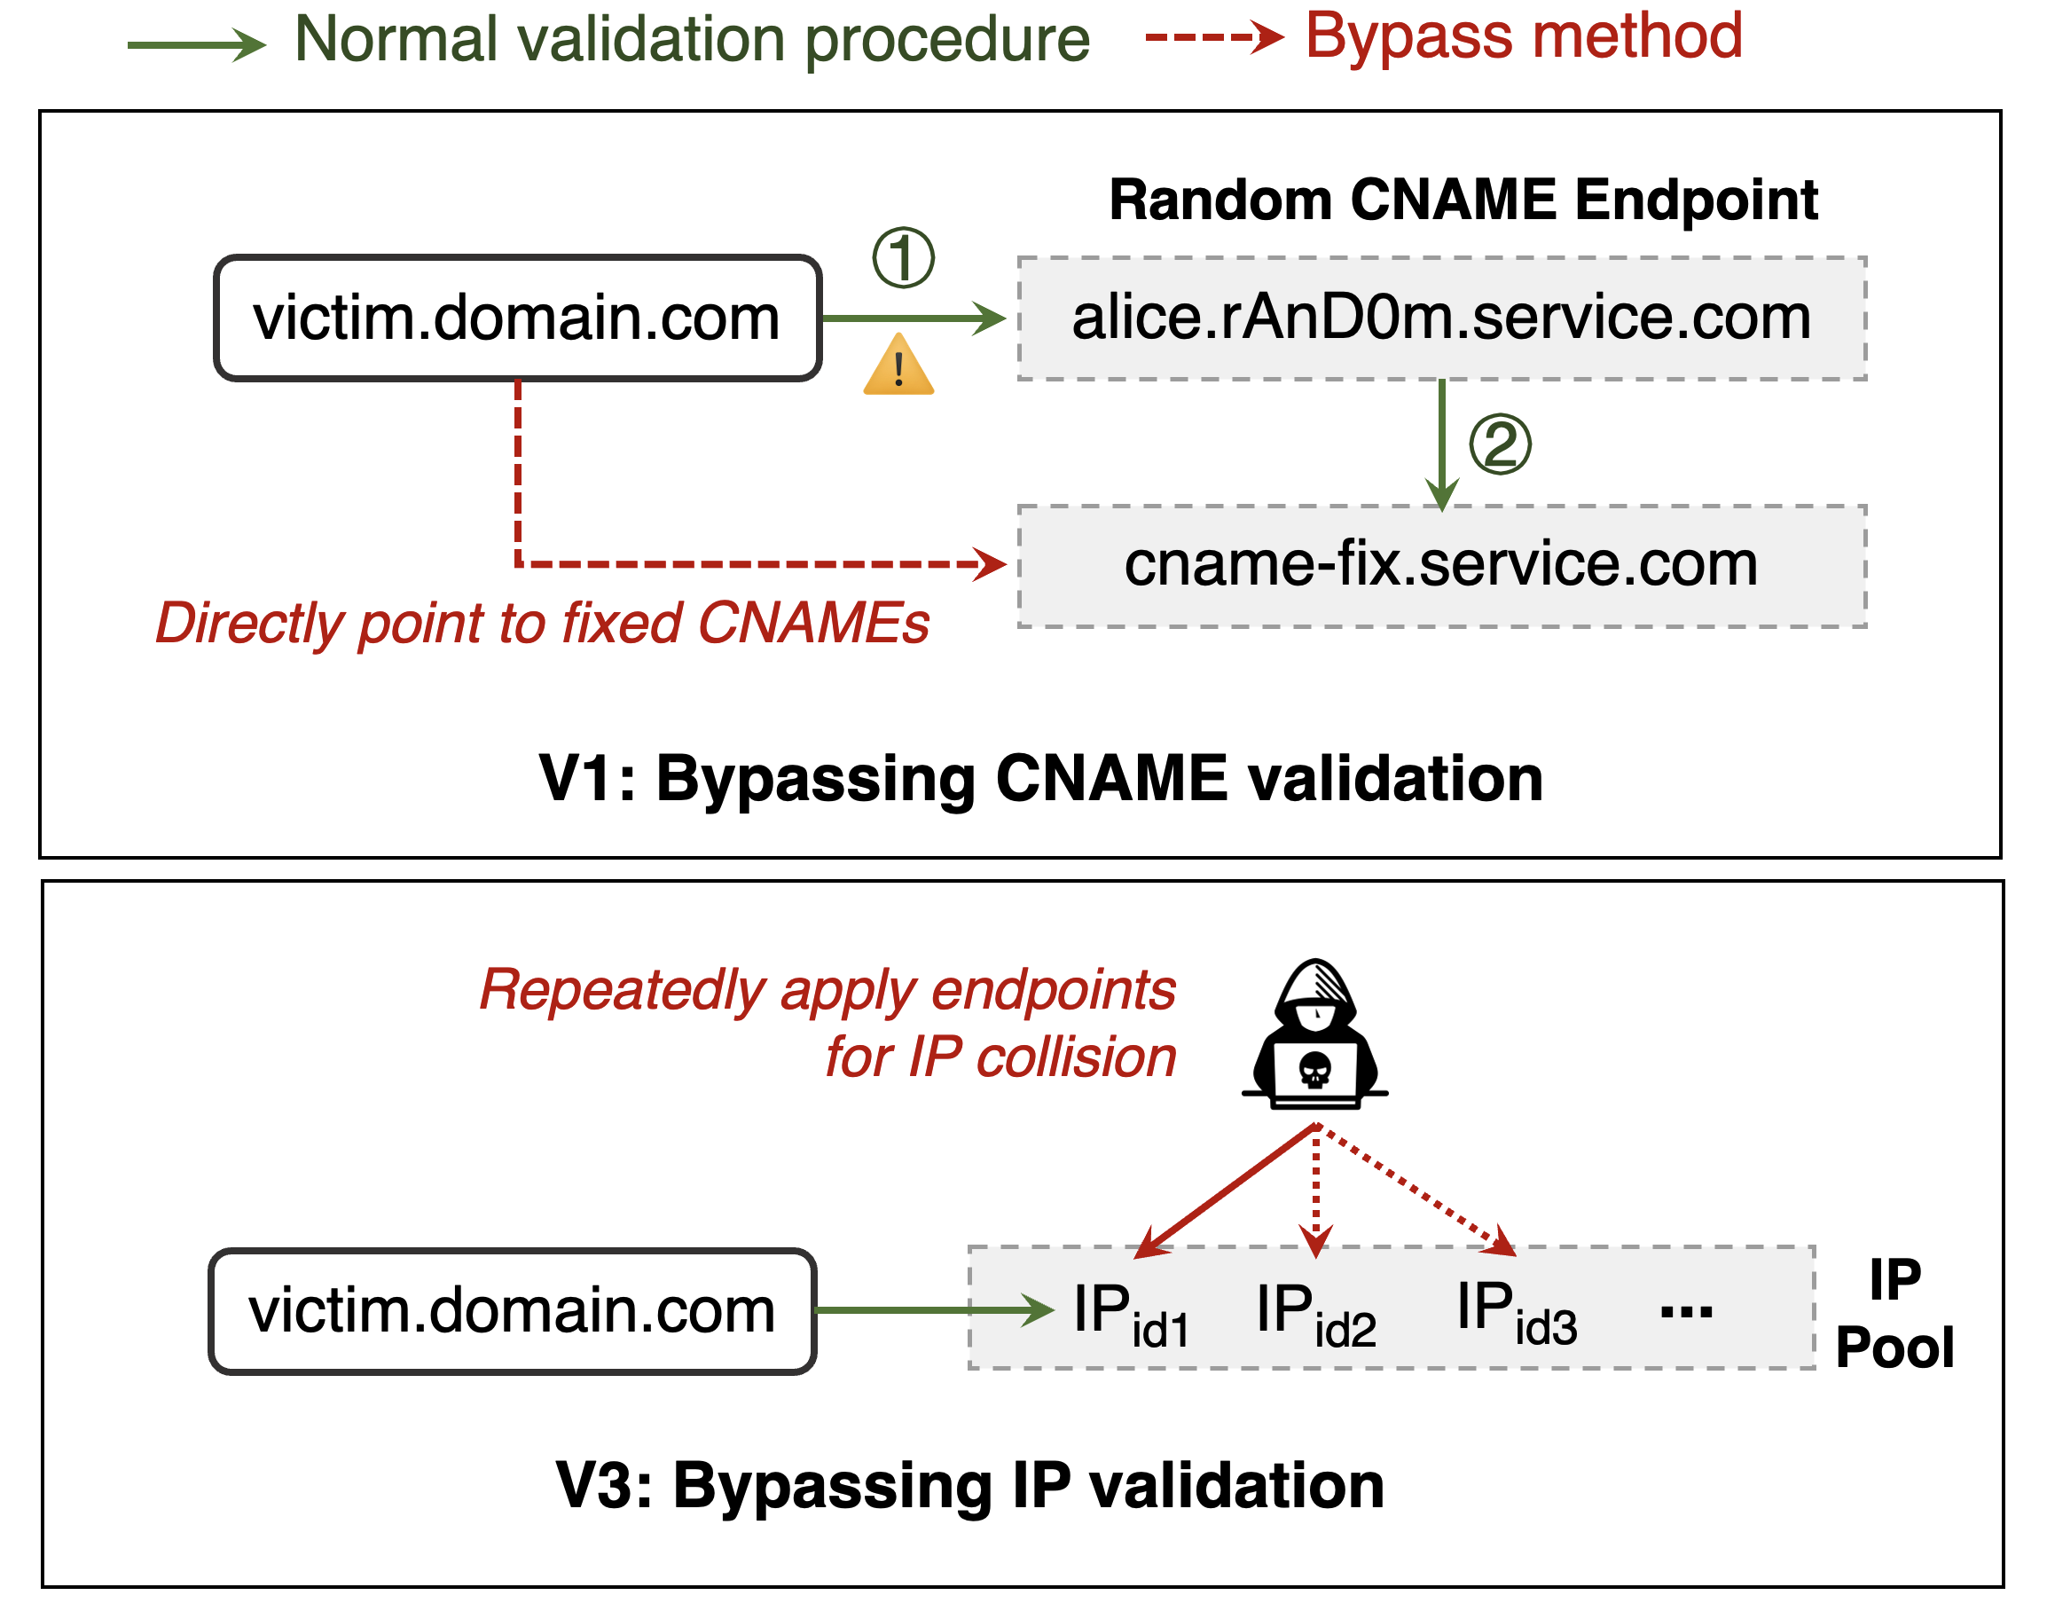
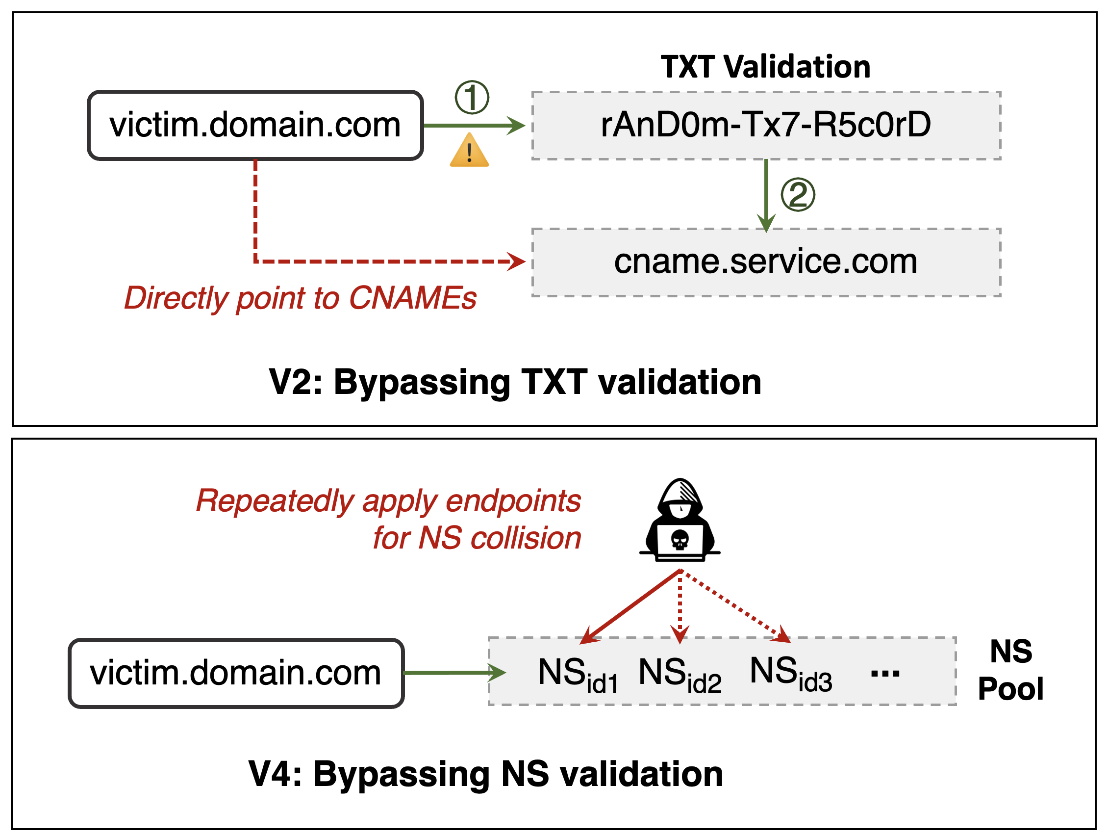
Vulnerable Hosting Services
4 new threat models that can bypass flawed DOV
40
Notes:
We also identify 4 new threat models that can bypass domain ownership validation.

Slide 41
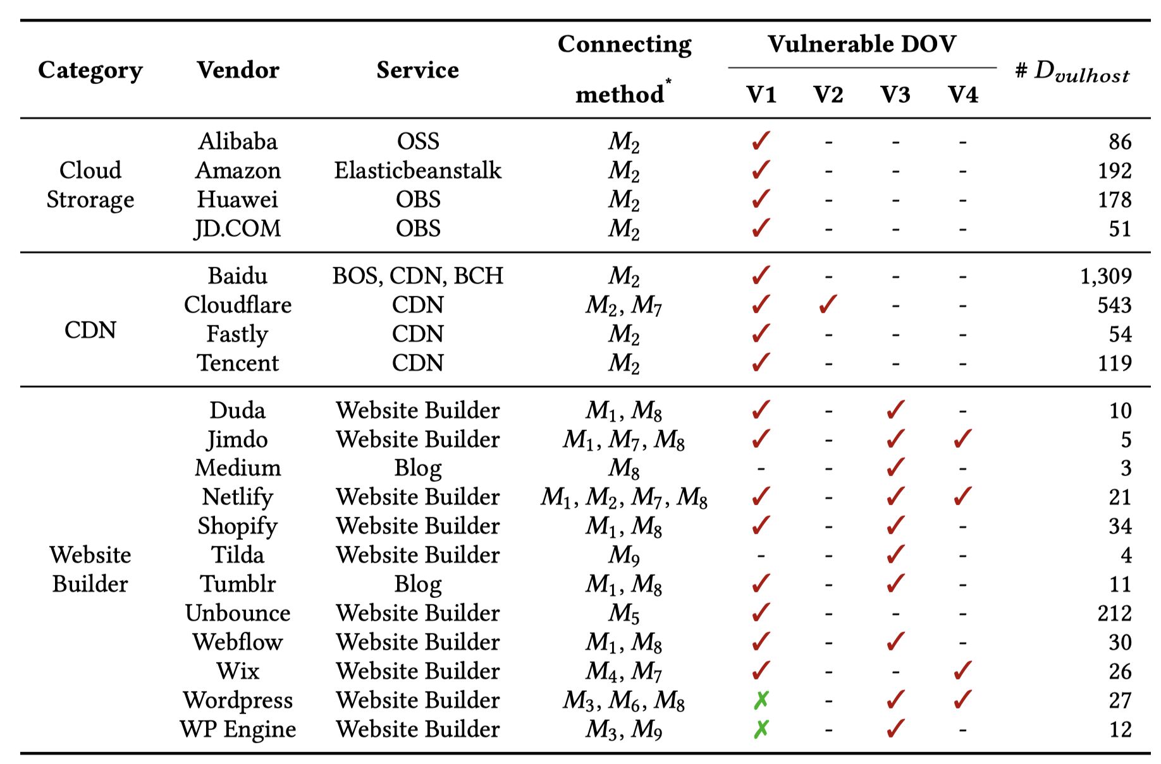
Vulnerable Hosting Services
Top 20 vendors with 70% market share are vulnerable
41
Notes:
For hosting services, we find 20 vendors with 70% market share are vulnerable.
At least one of their services are flawed.

Slide 42
What did we find for domain takeover?
Hosting-based domain takeover threats are still prevalent.
42
Notes:
Besides, we find hosting-based domain takeover threats are still prevalent.

Slide 43
Measurement and Findings
Detection target domains
  Tranco Top 1M apex domains +9,808 .edu and 7,198 .gov apexes
  We collect 11,446,359 subdomains from PDNS for all apexes.
Longitudinal and periodic measurement
  101 rounds (Dec. 16, 2021 – Jul. 28, 2022)
  ~1 day/round
43
Notes:
We conduct a large and periodic measurement for Tranco Top 1M domains and domains under edu and gov from Dec. 2021 to July 2022.

Slide 44
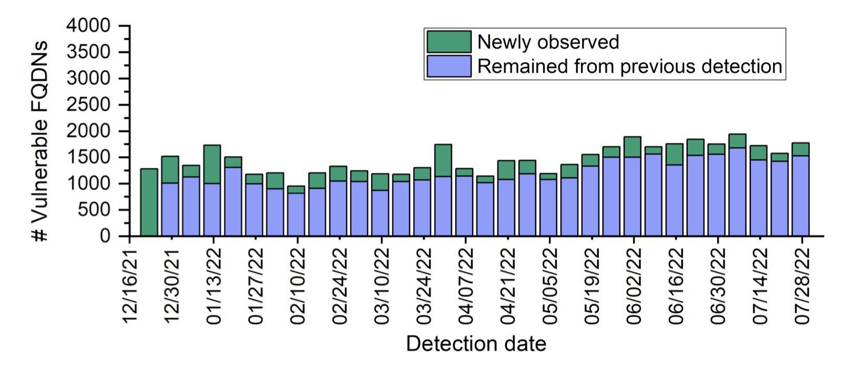
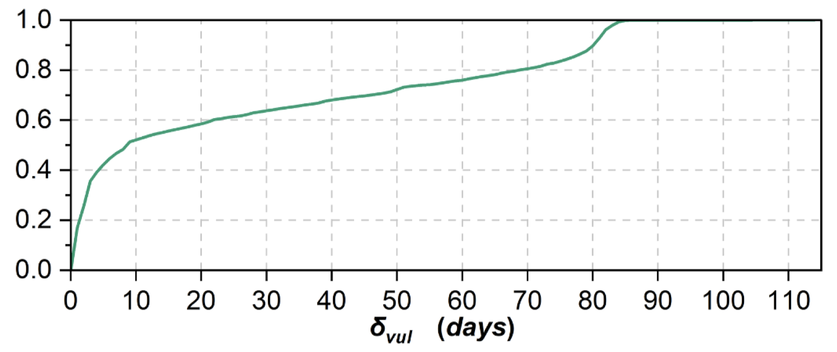
Measurement and Findings
114,063 (1.0%) FQDNs have been hosted on vulnerable services
10,351 FQDNs are vulnerable, covering 2,096 apex domains
Reputable universities (e.g., Stanford and Rice)
Famous companies (e.g., Baidu, Huawei, and Marriott).
Hosting-based domain takeover appears frequently and long-lasting
Weekly cumulative detection results.
Distribution of vulnerable days
270 new vulnerable domains emerge per week.
Over 50% remain vulnerable for over 10 days.
44
Notes:
Results show that 114k fqdns have been hosted on vulnerable services.
10k fqdns are vulnerable, including reputable universities and companies.
Specifically, hosting-based domain takeover appears frequently and long-lasting.
We observed newly vulnerable domains every week.

Slide 45






Conclusion
DareShark: A novel and effective detection framework
  High efficiency and coverage
Comprehensive measurements
  7-month longitudinal measurement on Tranco 1M apexes’ subdomains
  Detect 10,351 vulnerable domains (8x more than previous study)
Systematic service inspection and threat analysis
  Discover 65 vulnerable services and new security flaws
  Receive vulnerability confirmation from 10 vendors, and provide solutions
Notes:
As a conclusion, we propose a new hosting-based dangling domain detection framework, DareShark, with high efficiency and coverage.
We use DareShark conducting longitudinal measurements on Tranco domains and detect 10k vulnerable domains.
Through systematic analysis with automated methods, we discover 65 vulnerable services and receive confirmation from 10 vendors and provide them with detailed solutions.
We hope our study could help resolve the dangling domain takeover issue.

Slide 46
Thanks for listening!
Any question?
Xiang Li, Tsinghua University
x-l19@mails.tsinghua.edu.cn
Notes:
This is my share today, thank you all for your attention.
And now I’m happy to take question, thank you.

