Slide 1
How Ready is the global DNS for IPv6?
Ralf Weber
16.2.2023

Slide 2
Introduction and methodolgy
Inspired by Momoka Yamamotos OARC39 talk
Gather large FQDN data sets
From our anonymized customer logs
From domain categorisation
Run resolution to find zone cuts
Gets a smaller number of delegated domains
The reachability of the name server is the same for all its FQDNs
Check if delegated domains are reachable
Over dual stack
Over v4 only
Over v6 only

Slide 3
Global Query Data
Worldwide
service
providers
Real-time
anonymized
query streams
200-300B/day
Akamai
infrastructure
Data science
Security research

Slide 4
Data analysed
From customer query logs
300 billion queries (302,956,617,039)
1 week of data
~500kqps average
2 billion uniqe FQDNs (2,241,672,371)
From domain categorisation
100 million categorised domains (106,401,193)

Slide 5
DNS delegation
; <<>> DiG 9.16.1-Ubuntu <<>> +trace +nodnssec www.google.com
;; global options: +cmd
. 452735 IN NS a.root-servers.net.
. 452735 IN NS b.root-servers.net.
. 452735 IN NS c.root-servers.net.
. 452735 IN NS d.root-servers.net.
. 452735 IN NS e.root-servers.net.
. 452735 IN NS f.root-servers.net.
. 452735 IN NS g.root-servers.net.
. 452735 IN NS h.root-servers.net.
. 452735 IN NS i.root-servers.net.
. 452735 IN NS j.root-servers.net.
. 452735 IN NS k.root-servers.net.
. 452735 IN NS l.root-servers.net.
. 452735 IN NS m.root-servers.net.
;; Received 239 bytes from 127.0.0.53#53(127.0.0.53) in 4 ms
com. 172800 IN NS a.gtld-servers.net.
com. 172800 IN NS b.gtld-servers.net.
com. 172800 IN NS c.gtld-servers.net.
com. 172800 IN NS d.gtld-servers.net.
com. 172800 IN NS e.gtld-servers.net.
com. 172800 IN NS f.gtld-servers.net.
com. 172800 IN NS g.gtld-servers.net.
com. 172800 IN NS h.gtld-servers.net.
com. 172800 IN NS i.gtld-servers.net.
com. 172800 IN NS j.gtld-servers.net.
com. 172800 IN NS k.gtld-servers.net.
com. 172800 IN NS l.gtld-servers.net.
com. 172800 IN NS m.gtld-servers.net.
;; Received 839 bytes from 199.7.83.42#53(l.root-servers.net) in 8 ms
google.com. 172800 IN NS ns2.google.com.
google.com. 172800 IN NS ns1.google.com.
google.com. 172800 IN NS ns3.google.com.
google.com. 172800 IN NS ns4.google.com.
;; Received 291 bytes from 2001:503:d2d::30#53(k.gtld-servers.net) in 148 ms
www.google.com. 300 IN A 142.250.184.228
;; Received 59 bytes from 216.239.38.10#53(ns4.google.com) in 8 ms
Root (.)
com
net
de
google.com
www.google.com

Slide 6
Delegated domains
From customer query logs
57 million (57,371,853)
45 million caused by singular hits (44,933,295)
2 billion out of 300 billion requests (1,916,121,064)
From domain categorisation
49 million (48,949,650)
Overall
86 million (85,989,871)
Notes:
Running >2billion domains through resolution thankfully is easy to parallelise to get to this

Slide 7
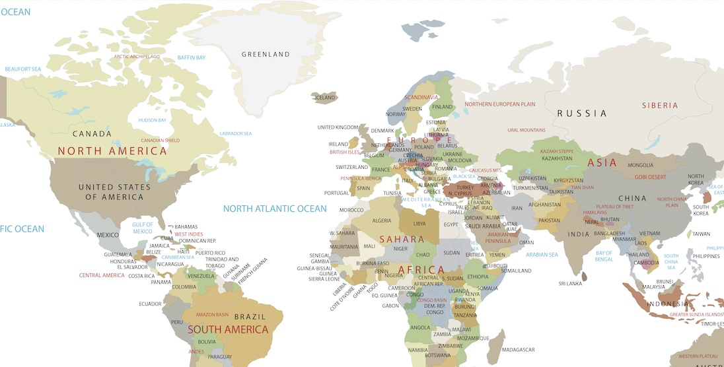
CANADA
LITHUANIA
300 Billion queries
2 Billion unique FQDNs
57 Million delegated domains
COMOROS
MAP SOURCE: gisgeography.com

Slide 8
A word on one hit wonders
googlesyndication.com.
by far the most “popular” one FQDN hit machine (1% of single hit traffic)
gstatic.com, google.com are also towards the top of the list
s3.amazonaws.com.
Sort of expected as some S3 buckets are not popular
guizhou.gov.cn.
The Chines province of Guizho (no idea why)
Lots of CDNs and ”Measurement”
Amazon, Netflix, Dailymotion, Microsoft, Nielsen, Cedexis

Slide 9
One hit wonder patterns
”Random” prefixes or encodings?
ybar-bojdu3dss2report.wc.yahoodns.net
aa4e403b69cfce762947190e3a48cf0e.safeframe.googlesyndication.com
ad24a7b45dc44618a3cf2982c783da65.fp.measure.office.com
avian-jaguar-wo5crsw3ll45xhg6q393txol.www.oiegmycentre.com.herokudns.com
aifbva6ppo33cirsbhgyb2od7jbhq1670081759.nuid.imrworldwide.com
i2-aveyyuahbfwvmnlyobpcpuuzhcbeki.init.cedexis-radar.net
Word riddles?
w1boardsdev2b0bciphoneapi5-gallery-content-2018.peck.gat.guizhou.gov.cn
mta-sts.audibene-info.mail.eo.cadburygifting.in
gluta-panacea-online.ipaidthat.io

Slide 10
Looking through the data
Using 100 instances to crawl through data
Discovering zone cuts from 2 billion FQDNs took two weeks
No DNSSEC, 0x20 or qname minisation
Discovering resolution results for 86 million domains took 11 days
Three resolution attempts (dual stack, v4, v6)
Failed queries take much longer then successful
DNS is dynamic
4.7 million delegated domains SERVFAIL (4,781,809)
2 million no longer exist – NXDomain (1,942,818)
80 millions to consider (79,265,244)

Slide 11
The results are in
337 domains
413654 queries

Slide 12
Looking at TLDs
to.
sl.
mp.
cd.
uz.
dj.
ck.
et.
mm.
kp.
hm.
sr.
gf.
pf.
fk.
mq.
mh.
xn--ygbi2ammx.
xn--wgbh1c.
xn--mgba3a4f16a.
xn--mgbai9azgqp6j.
xn--l1acc.
xn--lgbbat1ad8j.
Most TLDs support IPv6
1477 observed
23 are IPv4 only
Common TLDs are most popular
Most common
Com
Net
Org
Io
Hk
Failed TLDs ->

Slide 13
What causes IPv6 only failures
Name Servers need to be reachable over IPv6
So this should be ok ?
; <<>> DiG 9.16.1-Ubuntu <<>> hwcdn.net. NS @2001:4de0:ac11::1:0:1
;; global options: +cmd
;; Got answer:
;; ->>HEADER<<- opcode: QUERY, status: NOERROR, id: 32694
;; flags: qr aa rd; QUERY: 1, ANSWER: 2, AUTHORITY: 0, ADDITIONAL: 4
;; WARNING: recursion requested but not available
;; QUESTION SECTION:
;hwcdn.net. IN NS
;; ANSWER SECTION:
hwcdn.net. 86400 IN NS ns1.hwcdn.net.
hwcdn.net. 86400 IN NS ns2.hwcdn.net.
;; ADDITIONAL SECTION:
ns1.hwcdn.net. 86400 IN A 69.16.174.10
ns1.hwcdn.net. 3600 IN AAAA 2001:4de0:ac11::1:0:1
ns2.hwcdn.net. 86400 IN A 209.197.2.10
ns2.hwcdn.net. 3600 IN AAAA 2001:4de0:ac12::1:0:2
;; Query time: 0 msec
;; SERVER: 2001:4de0:ac11::1:0:1#53(2001:4de0:ac11::1:0:1)
;; WHEN: Mon Feb 13 03:46:58 UTC 2023
;; MSG SIZE rcvd: 151

Slide 14
What causes IPv6 only failures
Name Servers need to be reachable over IPv6
So this should be ok ?
No because delegation happens at the parent
You need to add your IPv6 name server to the parent through your registrar
; <<>> DiG 9.16.1-Ubuntu <<>> hwcdn.net. NS @c.gtld-servers.net
;; global options: +cmd
;; Got answer:
;; ->>HEADER<<- opcode: QUERY, status: NOERROR, id: 16289
;; flags: qr rd; QUERY: 1, ANSWER: 0, AUTHORITY: 2, ADDITIONAL: 3
;; WARNING: recursion requested but not available
;; OPT PSEUDOSECTION:
; EDNS: version: 0, flags:; udp: 4096
;; QUESTION SECTION:
;hwcdn.net. IN NS
;; AUTHORITY SECTION:
hwcdn.net. 172800 IN NS ns2.hwcdn.net.
hwcdn.net. 172800 IN NS ns1.hwcdn.net.
;; ADDITIONAL SECTION:
ns2.hwcdn.net. 172800 IN A 209.197.2.10
ns1.hwcdn.net. 172800 IN A 69.16.174.10
;; Query time: 0 msec
;; SERVER: 2001:503:83eb::30#53(2001:503:83eb::30)
;; WHEN: Mon Feb 13 03:50:51 UTC 2023
;; MSG SIZE rcvd: 106

Slide 15
Top 10 IPv4 only domains
Ooops
akadns.net.
trafficmanager.net.
g.aaplimg.com.
fastly.net.
bytefcdn-oversea.com.
ovscdns.net.
wsdvs.com.
v.aaplimg.com.
ms-acdc.office.com.
ha.office365.com.

Slide 16
Top 10 IPv4 only domains
Ooops (it can happen)
; <<>> DiG 9.16.1-Ubuntu <<>> akadns.net @d.gtld-servers.net
;; global options: +cmd
;; Got answer:
;; ->>HEADER<<- opcode: QUERY, status: NOERROR, id: 4033
;; flags: qr rd; QUERY: 1, ANSWER: 0, AUTHORITY: 10, ADDITIONAL: 6
;; WARNING: recursion requested but not available
;; OPT PSEUDOSECTION:
; EDNS: version: 0, flags:; udp: 4096
;; QUESTION SECTION:
;akadns.net. IN A
;; AUTHORITY SECTION:
akadns.net. 172800 IN NS a3-129.akadns.net.
akadns.net. 172800 IN NS a7-131.akadns.net.
akadns.net. 172800 IN NS a11-129.akadns.net.
akadns.net. 172800 IN NS a1-128.akadns.net.
akadns.net. 172800 IN NS a9-128.akadns.net.
akadns.net. 172800 IN NS a5-130.akagtm.org.
akadns.net. 172800 IN NS a28-129.akagtm.org.
akadns.net. 172800 IN NS a13-130.akagtm.org.
akadns.net. 172800 IN NS a18-128.akagtm.org.
akadns.net. 172800 IN NS a12-131.akagtm.org.
;; ADDITIONAL SECTION:
a3-129.akadns.net. 172800 IN A 96.7.49.129
a7-131.akadns.net. 172800 IN A 23.61.199.131
a11-129.akadns.net. 172800 IN A 84.53.139.129
a1-128.akadns.net. 172800 IN A 193.108.88.128
a9-128.akadns.net. 172800 IN A 184.85.248.128
;; Query time: 0 msec
;; SERVER: 2001:500:856e::30#53(2001:500:856e::30)
;; WHEN: Mon Feb 13 04:11:51 UTC 2023
;; MSG SIZE rcvd: 344
akadns.net.
trafficmanager.net.
g.aaplimg.com.
fastly.net.
bytefcdn-oversea.com.
ovscdns.net.
wsdvs.com.
v.aaplimg.com.
ms-acdc.office.com.
ha.office365.com.

Slide 17
Top 10 IPv6 only domains
jiangxi.gov.cn.
hitlist.sdstrowes.co.uk.
cns.mtnet.gov.tw.
dnsbl.beetjevreemd.nl.
cablevideodigital.com.
rpkitest6.nlnetlabs.nl.
bionik.tv.
costumemaker.com.
v6-any1.67ysto.c.100e6.net.
v6-any2.67ysto.c.100e6.net.
What ?

Slide 18
Top 10 IPv6 only domains
;; AUTHORITY SECTION:
cablevideodigital.com. 172800 IN NS ns1.cablevideodigital.com.
cablevideodigital.com. 172800 IN NS ns2.cablevideodigital.com.
;; ADDITIONAL SECTION:
ns1.cablevideodigital.com. 172800 IN A 131.255.63.232
ns1.cablevideodigital.com. 172800 IN AAAA 2803:5b80::232
ns2.cablevideodigital.com. 172800 IN A 131.255.63.232
ns2.cablevideodigital.com. 172800 IN AAAA 2803:5b80::232
Domains have IPv4 addresses
But don’t respond if IP is not a known nameserver
These “protections” are not active on IPv6
jiangxi.gov.cn.
hitlist.sdstrowes.co.uk.
cns.mtnet.gov.tw.
dnsbl.beetjevreemd.nl.
cablevideodigital.com.
rpkitest6.nlnetlabs.nl.
bionik.tv.
costumemaker.com.
v6-any1.67ysto.c.100e6.net.
v6-any2.67ysto.c.100e6.net.
What ?

Slide 19
Takeaways
DNS is not IPv6 ready
Especially the long tails and CDNs need work
Popular stuff looks better
Actions needed
Add IPv6 addresses to your name servers
Register them in the parent

Slide 20
Questions

