Slide 1
Research Agenda for a Post-Quantum DNSSEC
Andrew Fregly
OARC 40 –February 16-17, 2023

Slide 2
Drivers for DNSSEC-Related Ecosystem Research
Collaborative multi-stakeholder involvement in research and modeling is needed to inform the DNSSEC PQC standardization and transition agenda
NIST’s chosen Post Quantum Cryptographic (PQC) signature algorithms may have significant size impact on DNSSEC, transport, memory and processing
There are multiple approaches for addressing the issues PQC algorithms present to DNSSEC with significant pros and cons for these approaches
DNSSEC needs long-term cryptographic resiliency that addresses the long lead time to roll out new algorithms
2

Slide 3
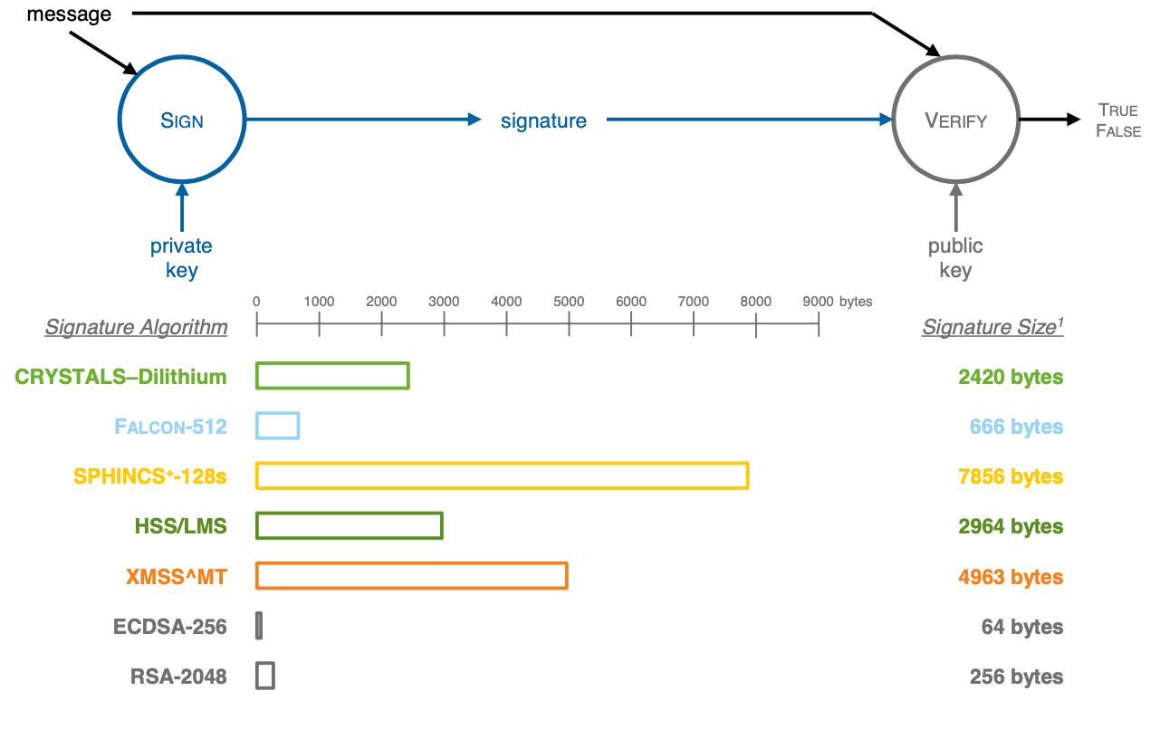
NIST PQC Signature Algorithms Relative to UDP MTUs 666- to 7856-Byte Minimum Signature Sizes with Example Parameters¹
DNS Over UDP Limitations

Slide 4
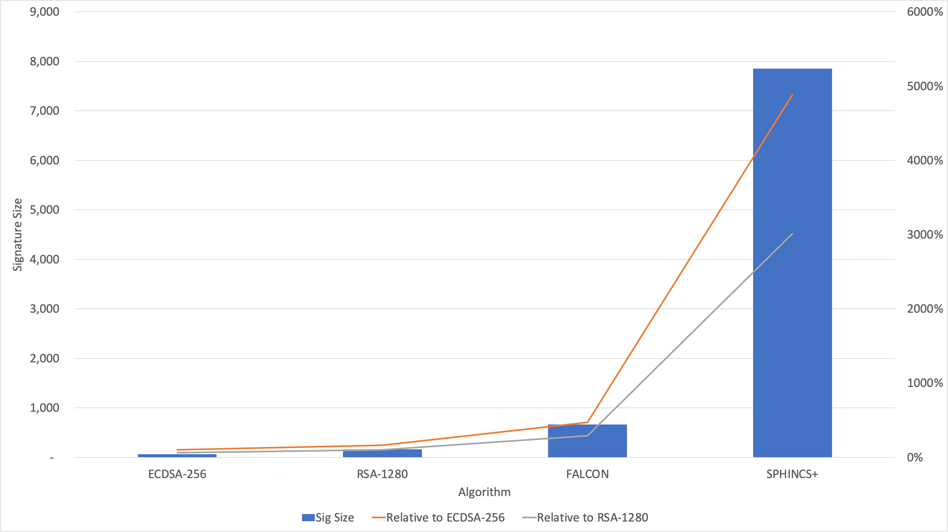
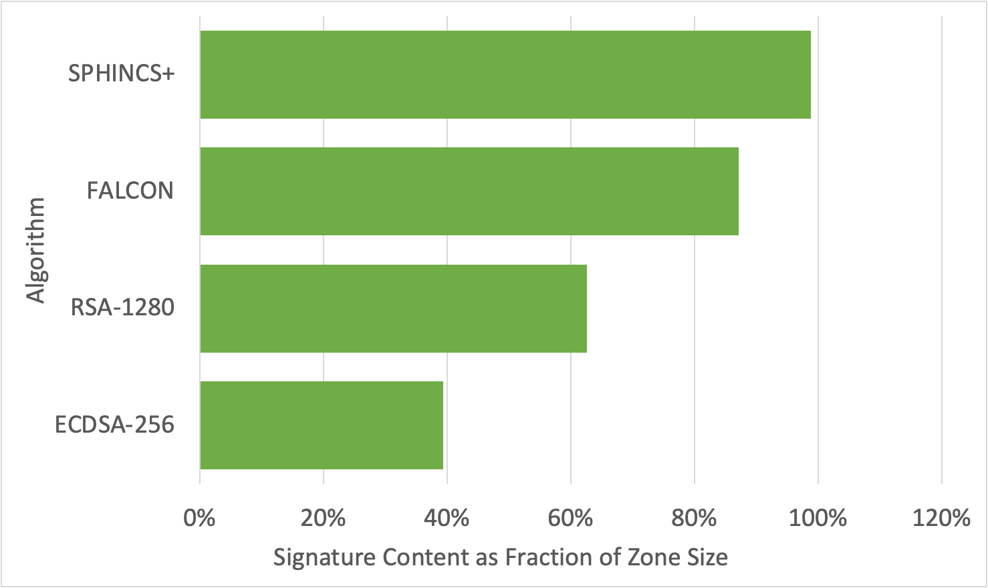
Signature Size Impact on Example Fully Signed TLD Zone
Signature Size
Zone Size Increase

Slide 5
Approaches to Minimize Size Impact on UDP Transport
Selective - Algorithm Negotiation*
Skip - Proactive Caching
Shift - Out-of-Band Retrieval of Keys and/or Signatures
Smaller - Merkle Tree Ladder Mode of Operation for Small Signature Size Impact³
Split - Split Large Keys/Signatures Across RRs**
* Based on expired draft “Algorithm Negotiation in DNSSEC”²
**One proposed approach is “Post-Quantum Signatures in DNSSEC via Request-Based Fragmentation”³

Slide 6
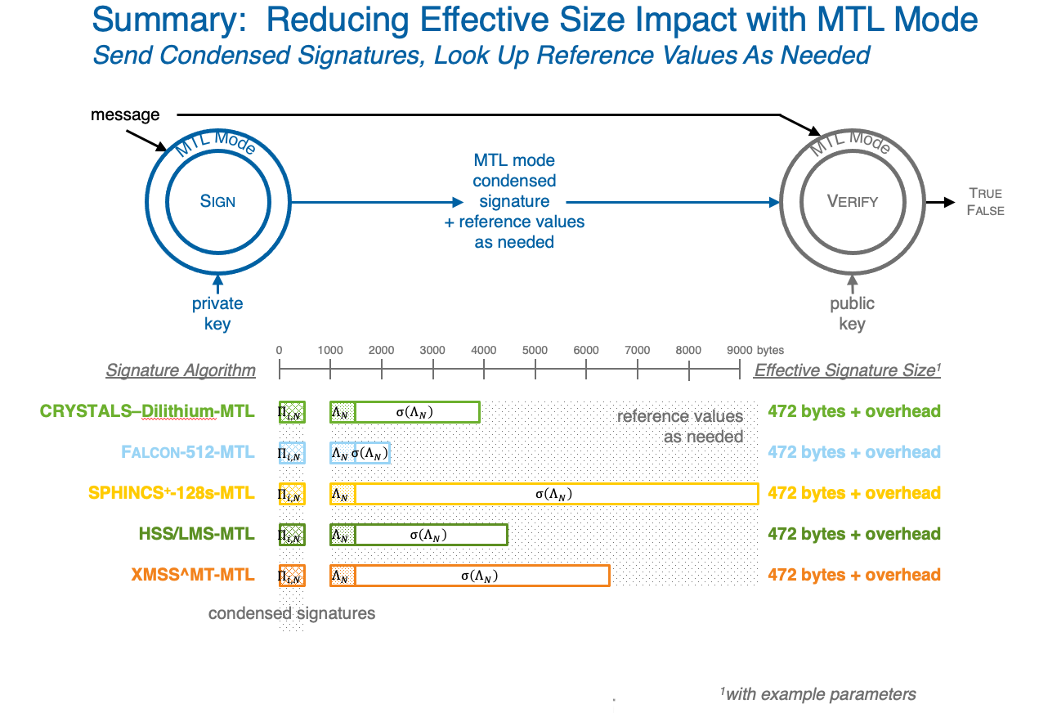
Signature Size Impact Reduction using Merkle Tree Ladder Mode of Operation
See Burt Kaliski’s Talk for the NIST Fourth PQC Standardization Conference⁴
6

Slide 7
Research Agenda: DNS Ecosystem Metrics
Deployment Analytics: device types and characteristics; roles (stub, resolver, authoritative nameserver); algorithms; environmental constraints such as network limitations; software used for resolution and nameserver operations; resolver in-memory cache sizes; authoritative nameserver in-memory database sizes; supportable transports
UDP Networking Path MTU Analytics: stub to resolver; resolver to resolver; resolver to authoritative
Analyze DNS/DNSSEC Query and Response Traffic: stub to resolver; resolver to resolver; resolver to authoritative interactions
Composition, size, and response times of DNS queries and responses: including details for overall traffic and DNSSEC-related traffic
DNS response time impact on use cases (browsing, web services, mobile, IoT,...)
Truncation and Fragmentation Analysis: overall traffic; DNSSEC related traffic; failures; retries
Session Based Protocols: percentage of traffic; response times; session setup and teardown metrics; failures
Analyze Zones Based on Domain Level (root, TLD, lower levels)
DNSSEC related RRs; signature algorithms; frequency of updates; zone signing metrics

Slide 8
Research Agenda: Modeling for Projected Impact of PQC Algorithms and DNS Protocol Changes
Base on DNS Ecosystem Metrics Research
Project Impacts: to processing, network requirements, costs, and dependencies
Model impact of PQC algorithms
Model impact of proposed protocol changes
Modeling to Create Snapshot Projections:
Base on transition timelines for DNS ecosystem components

Slide 9
References
1 – NIST CSRC, “PQC Standardization Process: Announcing Four Candidates to be Standardized, Plus Fourth Round Candidates”, NIST, July , https://csrc.nist.gov/news/2022/pqc-candidates-to-be-standardized-and-round-4.
2 – S. Huque, H. Shulman, S. Kerr, "Algorithm Negotiation in DNSSEC", July 2018, https://datatracker.ietf.org/doc/draft-huque-dnssec-alg-nego/03/.
3 – J. Goertzen, D. Stebila, “Post-Quantum Signatures in DNSSEC via Request-Based Fragmentation”, University of Waterloo, November 2022, https://s3.amazonaws.com/files.douglas.stebila.ca/files/research/papers/EPRINT-GoeSte22.pdf
4 – B. Kaliski, “Merkle Tree Ladder Mode: Reducing the Size Impact of NIST PQC Signature Algorithms in Practice”, NIST Fourth PQC Standardization Conference, December 2022, https://csrc.nist.gov/Presentations/2022/merkle-tree-ladder-mode

