Slide 1
DNSCrypt Protocol: Current State and Planned Extensions
Brian Somers, Dejan Donin
Presented at OARC 40

Slide 2
Agenda
DNSCrypt background and use cases
RFC for DNSCrypt
Comparison with related protocols
Version 2 of the protocol
DNSCrypt performance
Version 3 protocol extensions

Slide 3
DNSCrypt Background
In existence since 2013
Considerable attention from the DNS community with several major DNS services providing support
This protocol also has several established client and server side open-source implementations in different programming languages
While not providing end-to-end DNS security, this protocol is designed to protect the ‘last mile’ traffic between a client and recursive name server (resolver) against eavesdropping, spoofing or man-in-the-middle attacks
Establishes cryptographic security for communication between client and its first level resolver
Efficient and adding minimal overhead to the plain text queries

Slide 4
DNSCrypt Use Case
DNS
Resolver
Authoritative DNS Server
Authoritative DNS Server
Client
’last mile’
Authoritative DNS Server

Slide 5
Comparison with related protocols (1)
DNS Security Extensions (DNSSEC) [RFC4035]
Adds digital signatures to DNS responses
Used for data origin authentication and data integrity protection for responses from authoritative servers
DNS over TLS (DOT) [RFC7858]
Secures ‘last mile’ communication using Transport Layer Security (TLS)
Adds significant overhead due to TCP and TLS handshake
Grouping queries in a single session can recoup some of the TLS overhead and result in network overhead gain
Suffers from ‘head-of-line’ blocking associated with TCP transport layer
DNS over HTTPS (DOH) [RFC8484]
DNS requests and responses are sent over HTTPS protocol
DNS traffic is obfuscated by other HTTPS traffic and difficult to monitor
Suffers from ‘head-of-line’ blocking associated with TCP transport layer
Easier to implement on the client side than DOT, but harder on the server side as it needs to process HTTPS headers

Slide 6
Comparison with related protocols (2)
DNS over QUIC (DOQ) [RFC9250]
DNS traffic is mapped onto the separate stream of QUIC protocol transport layer
Mapping is ‘lean’ without using HTTPS as in DNS over HTTP/3
QUIC protocol layer has inherent UDP-based transport security protection
QUIC designed to not suffer from ‘head-of-line’ blocking
Employs source address verification in the QUIC handshake to defend against amplification attacks
DNS over HTTP/3 (DOH3)
DNS requests and responses are sent over HTTP/3 protocol which uses QUIC transport layer
DNS traffic is combined with other HTTPS traffic and difficult to monitor
Like DOH, easier to implement on the client side than DOQ, but harder on the server side as it needs to process HTTPS headers

Slide 7
DNSCrypt Protocol Interactions: Version 2
DNS Client
DNS Resolver
Generate Short Term Key Pair
Generate Short Term Key Pair
Certificate Request
Protocol version
Provider name
Publish certificate with signed short-term public key
Response for Certificate Request
Signed Certificate
Verify signature, select a certificate, generate shared key, encrypt query
DNSCrypt Encapsulated Query
Client public key
Chosen certificate client magic
Client nonce, MAC
Generate shared key, decrypt query, verify MAC, resolve query, encrypt response
DNSCrypt Encapsulated Response
Resolver magic
nonce
Decrypt response, verify MAC

Slide 8
DNSCrypt: Crypto Algorithms (Version 2)
Protocol Version | Encryption System Name | Public Key Length | Signature | nonce | MAC
0x01 | X25519-Ed25519-Salsa20-Poly1305 | 32 | 64 | 24 | 16
0x02 | X25519-Ed25519-Chacha20-Poly1305 | 32 | 64 | 24 | 16

Slide 9
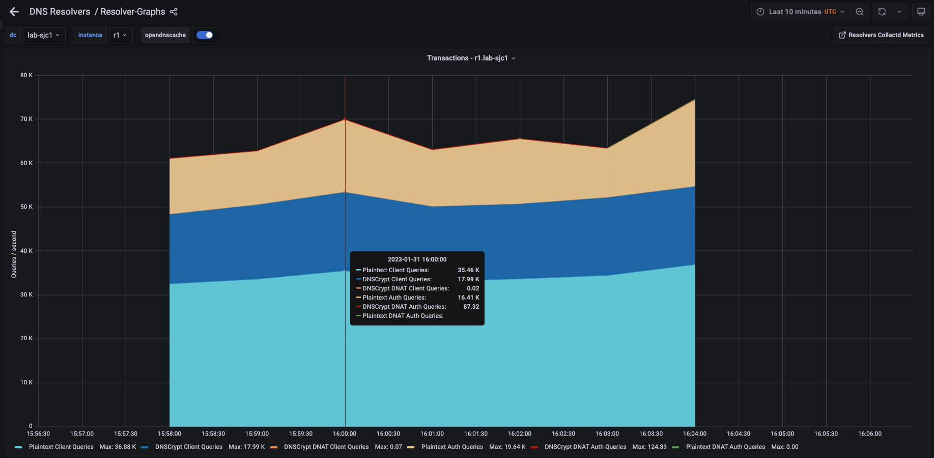
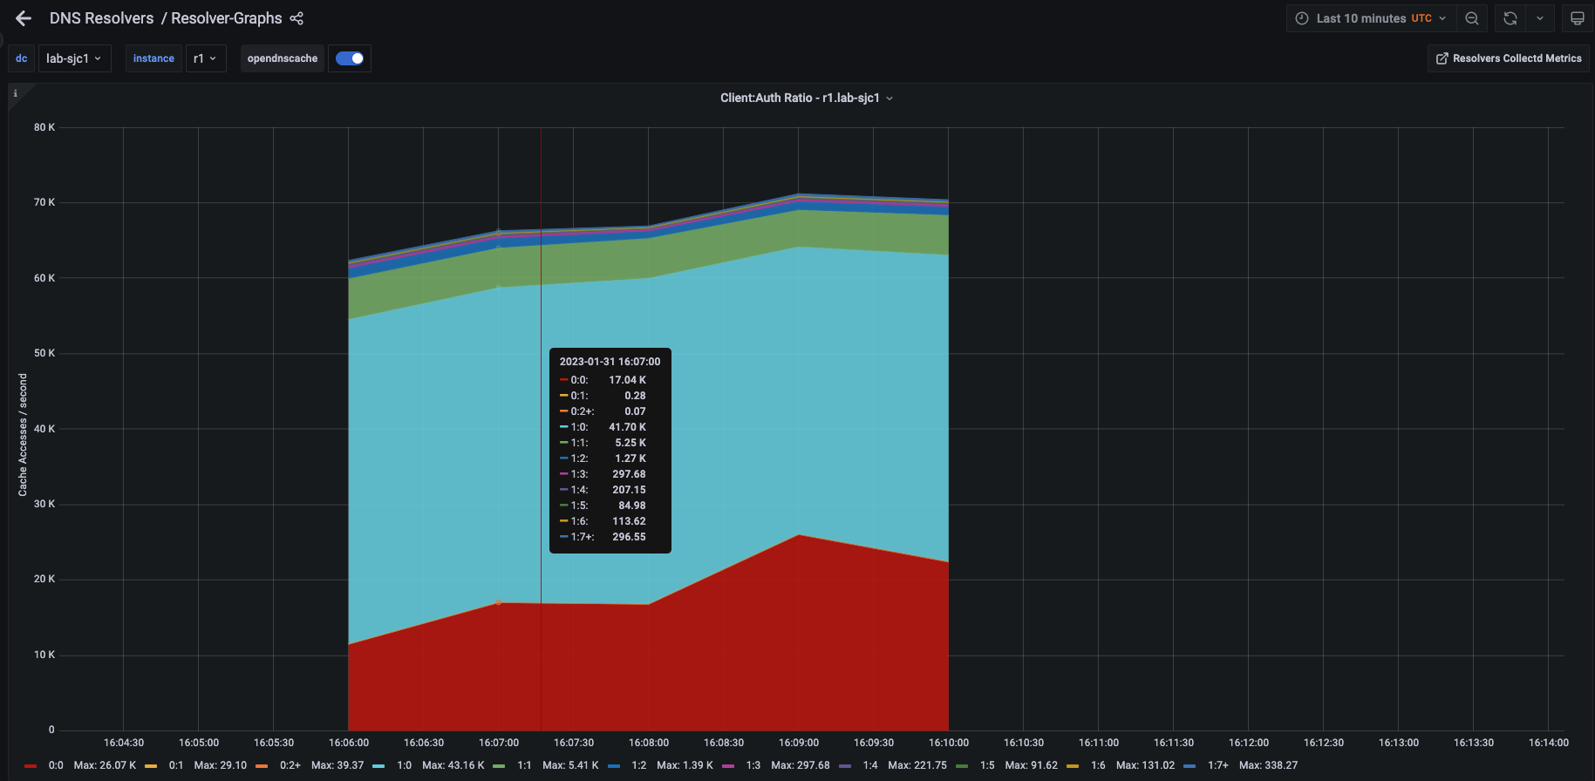
DNSCrypt Performance
Our measurements show that DNSCrypt is approximately 4 times slower than plain text queries
Can be further improved by caching the derived keys
DNSCrypt: Dark Blue
Plain Text: Light Blue
From Cache: Light Blue
1 auth query: Green

Slide 10
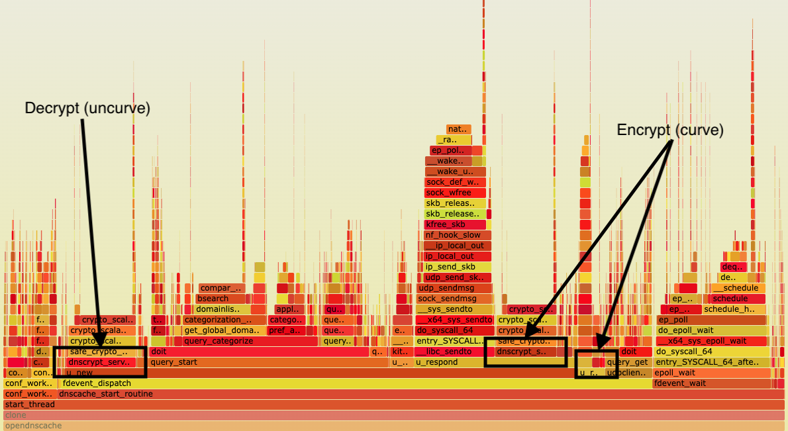
Flame Graphs

Slide 11
Decrypt (uncurve)
Most of the time is spent in crypto_box_beforenm (derive shared key)
Encrypt (curve)
Most of the time is spent in crypto_box_beforenm (derive shared key)

Slide 12
DNSCrypt Version 3 Extensions (1)
Protocol Version | Encryption System Name | Public Key Length | Signature | nonce | MAC
0x03 | ECDHE-ECDSA-AES128-GCM-SHA256 (P-256) | 33 | 64 | 24 | 16
Encryption system ECDHE-ECDSA-AES128-GCM-SHA256 (P-256)
P-256 Elliptic Curve Diffie-Hellman Ephemeral (ECDHE) for key exchange
P-256 Elliptic Curve Digital Signature Algorithm (ECDSA)
AEAD Advanced Encryption Standard with 128bit key
Secure Hash Algorithm 256 (SHA256) [RFC5289]
FIPS support
Above encryption system is FIPS 140-2 compliant

Slide 13
DNSCrypt Version 3 Extensions (2)
UDP Query Padding
Version 2 of the protocol had padding mechanism to avoid DNS amplification attacks
Response length was always kept equal or shorter than initial client query length
In Version 3 of the protocol this padding has been removed as it is deemed counterproductive
Tests show that, due to incremental query length increase, query length quickly gets to 1314 (IPv6) or 1294 (IPv4) bytes
Certificate Renewal
Version 2 is unclear on when to perform certificate renewal
It will be stipulated in Version 3 that clients SHOULD renew certificates based on TTL expiry

Slide 14
References
[DNSCRYPT-WEBSITE] https://www.dnscrypt.org/
[RFC5289] Rescorla, E., "TLS Elliptic Curve Cipher Suites with SHA-256/384 and AES Galois Counter Mode", RFC 5289, August 2008.
[RFC4035] Arends, R., Austein, R., Larson, M., Massey, D., and S. Rose, "Protocol Modifications for the DNS Security , Extensions", RFC 4035, March 2005.
[RFC8484] Hoffman, P. and P. McManus, "DNS Queries over HTTPS (DoH)", RFC 8484, DOI 10.17487/RFC8484, October 2018.
[RFC7858] Hu, Z., Zhu, L., Heidemann, J., Mankin, A., Wessels, D., and P. Hoffman, "Specification for DNS over Transport Layer Security (TLS)", RFC 7858, DOI 10.17487/RFC7858, May 2016.
[RFC9250] C. Huitema, S. Dickinson, A. Mankin ” DNS over Dedicated QUIC Connections”, RFC 79250, 10.17487/RFC9250, May 2022.

Slide 15
Thank you

