Slide 2
EduDig
Making DNS Education a little bit easier.

Slide 3
Had an Idea
🤯
Found 5 versions of it online

Slide 4
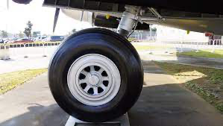
Kind of, not really
We are not reinventing any wheels

Slide 5
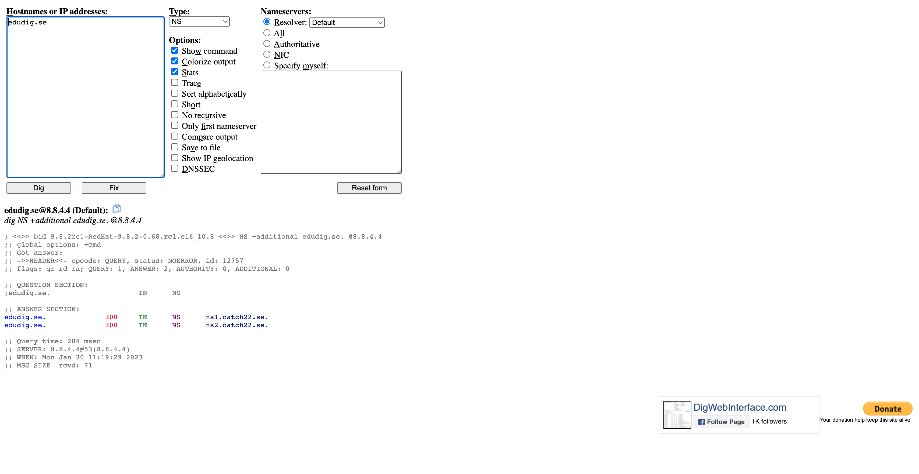
https://www.digwebinterface.com/

Slide 6
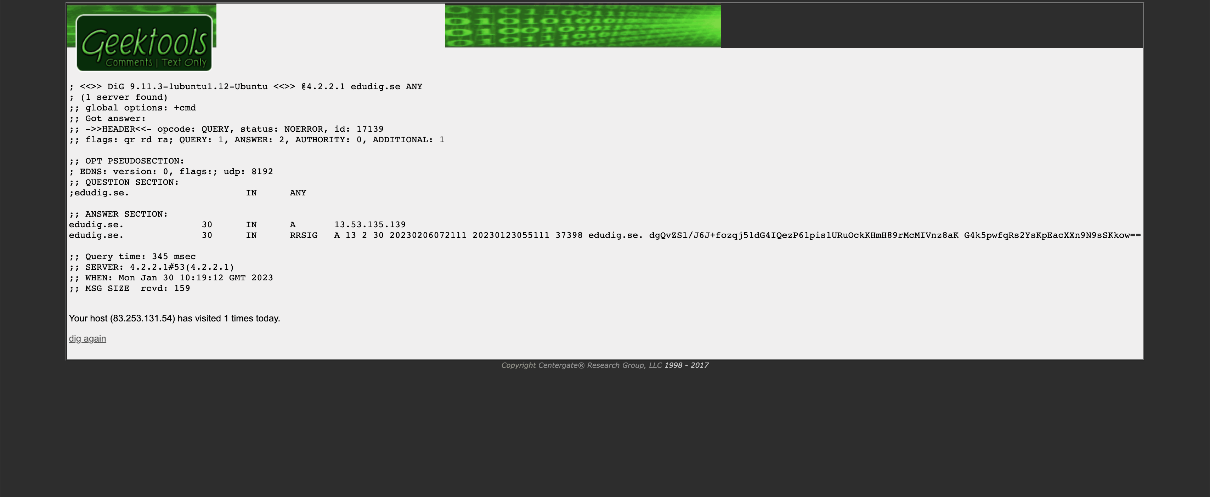
http://www.geektools.com/

Slide 7
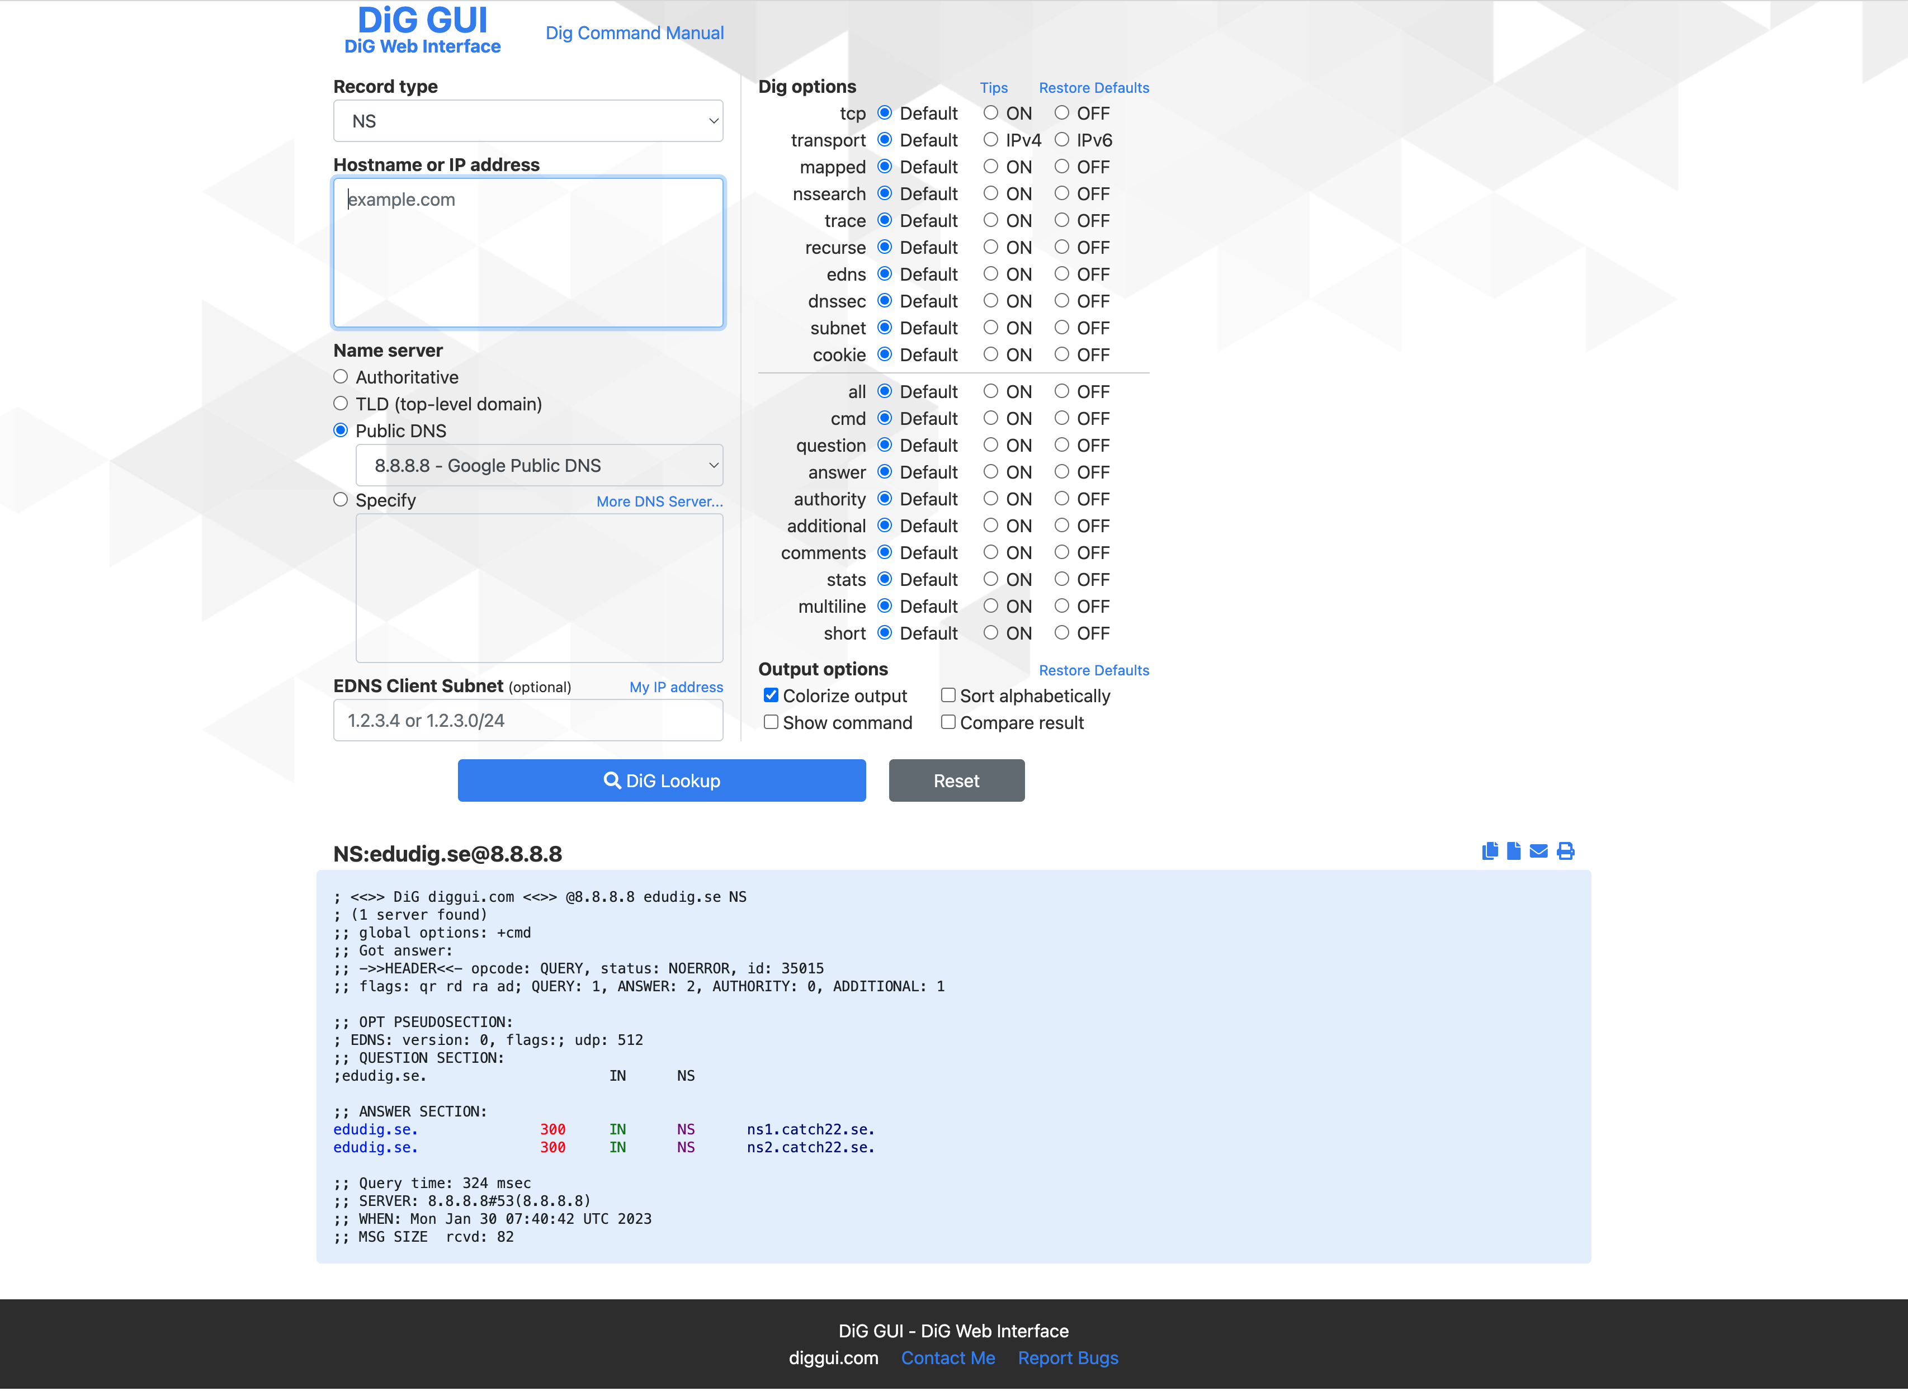
https://www.diggui.com/

Slide 8
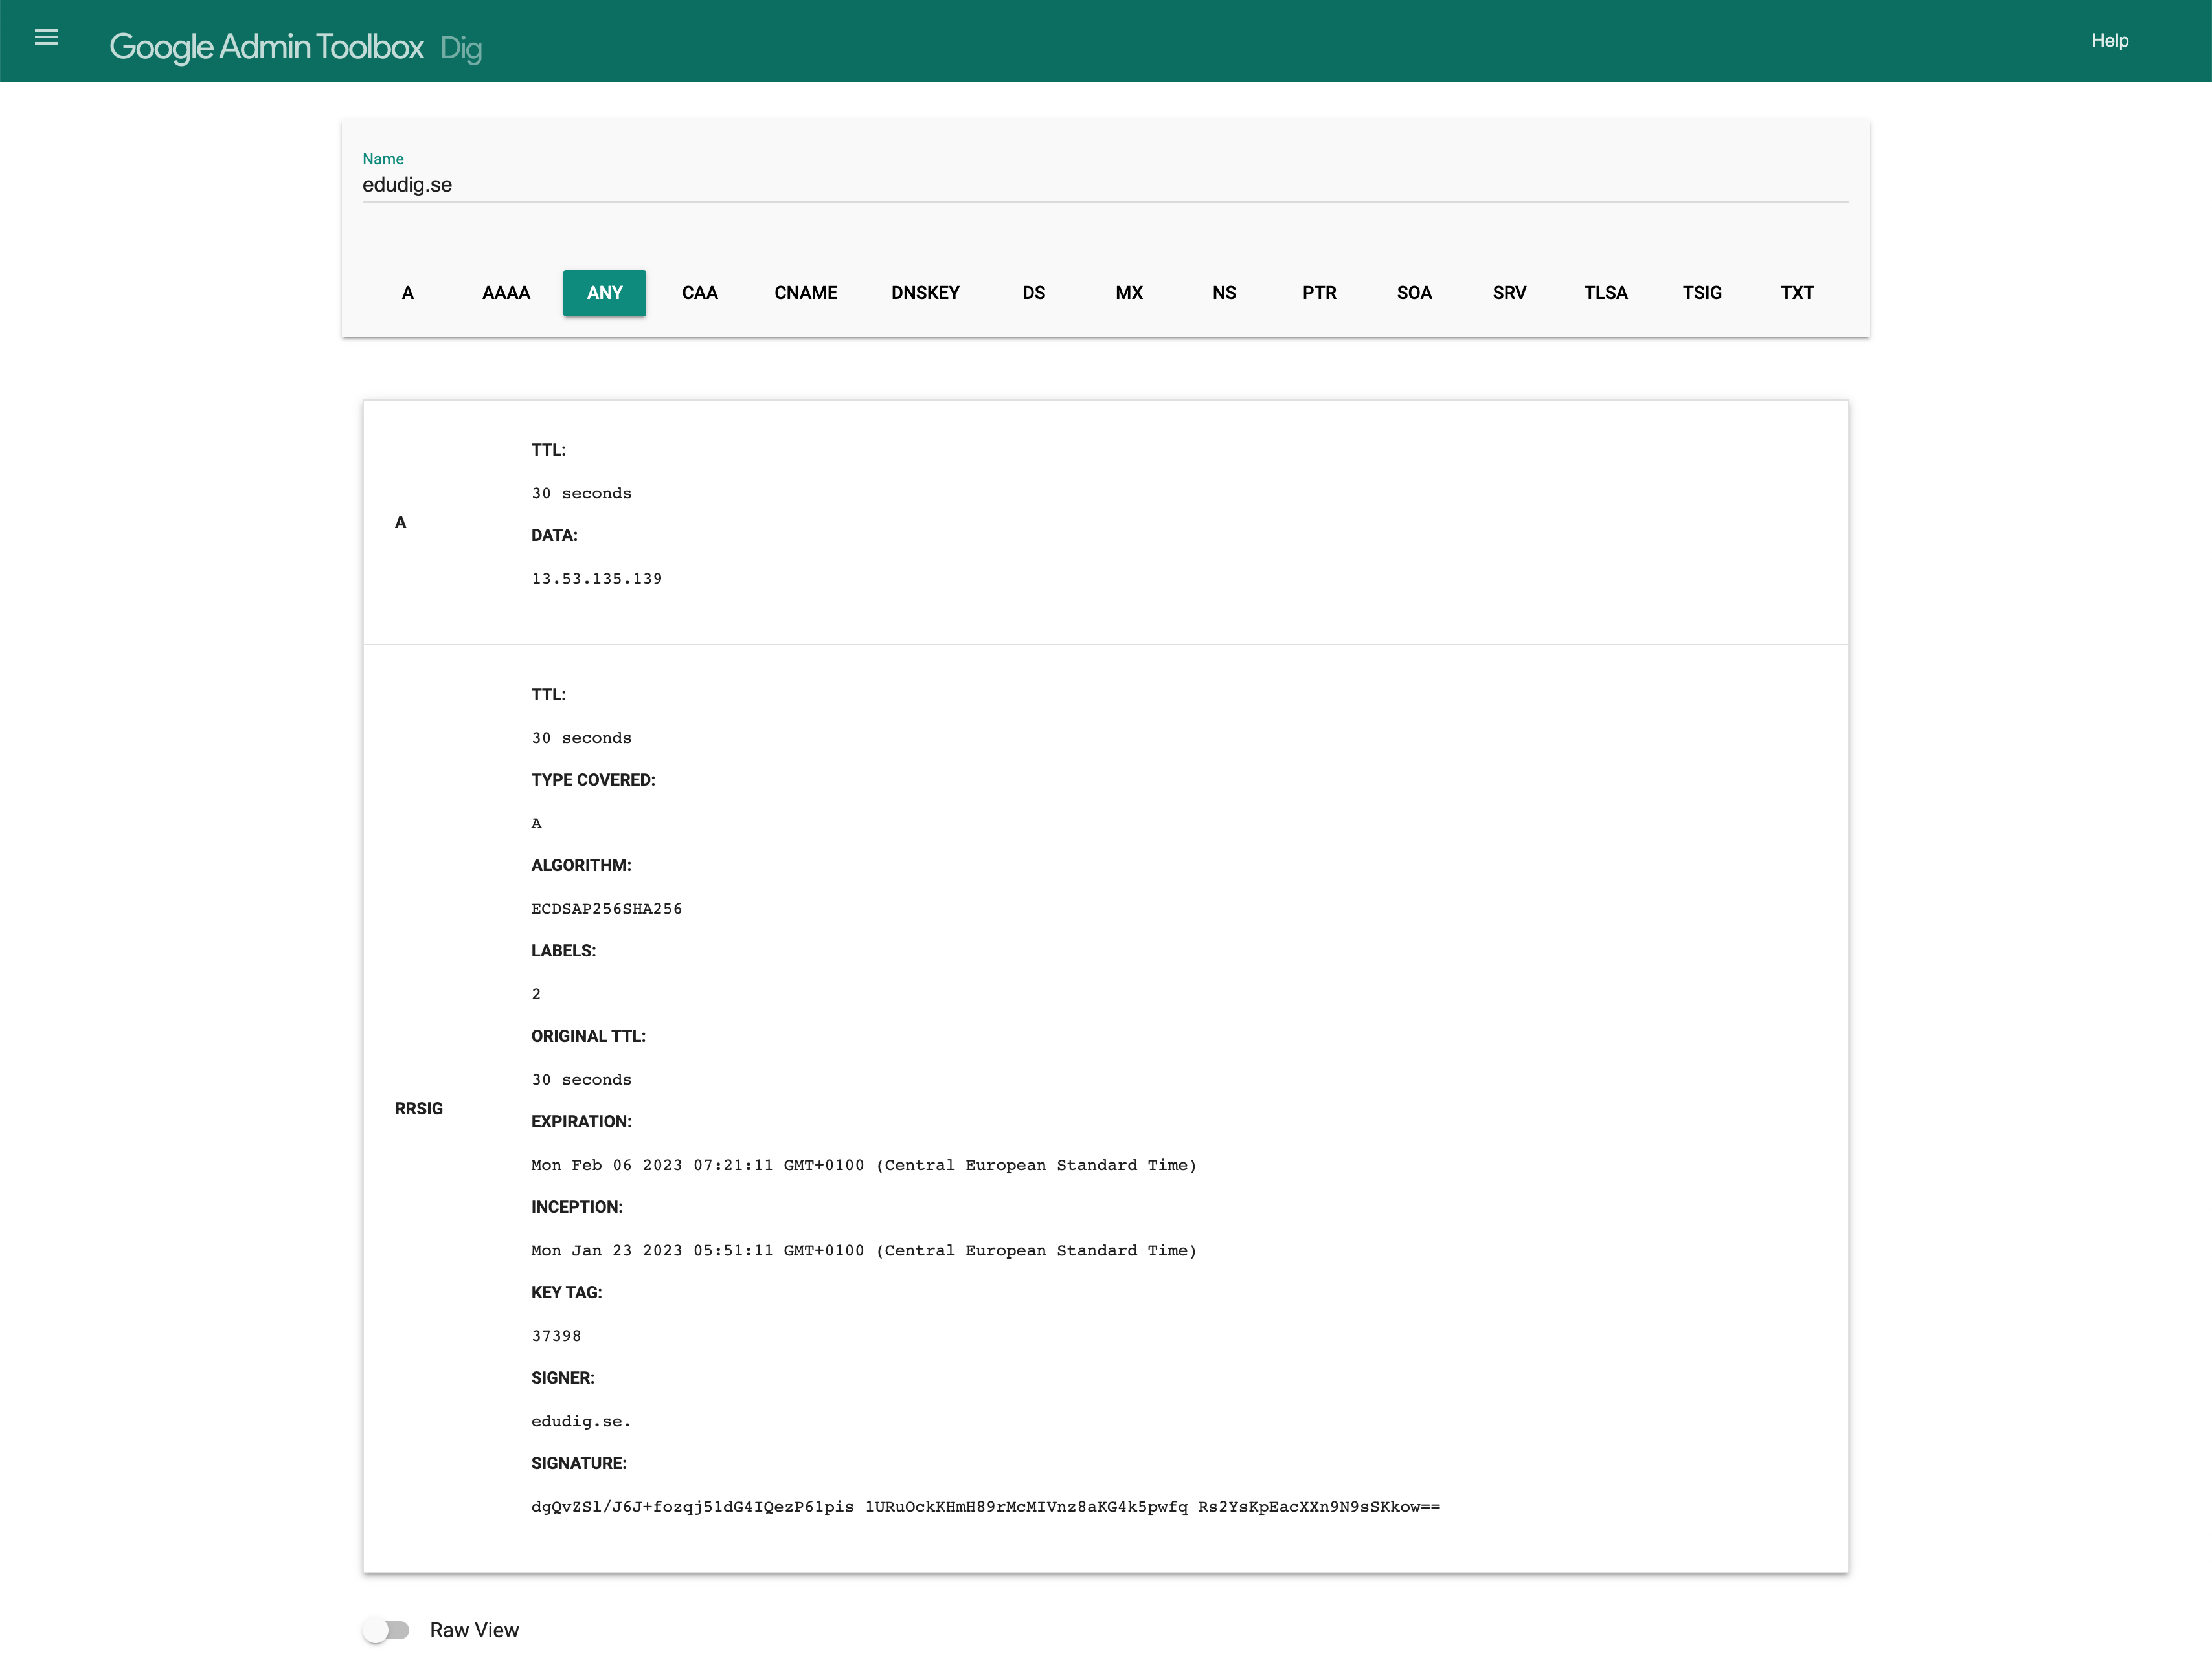
https://toolbox.googleapps.com/apps/dig/

Slide 10
Just a rounder wheel?
not new
not super original
not revolutionary

Slide 11
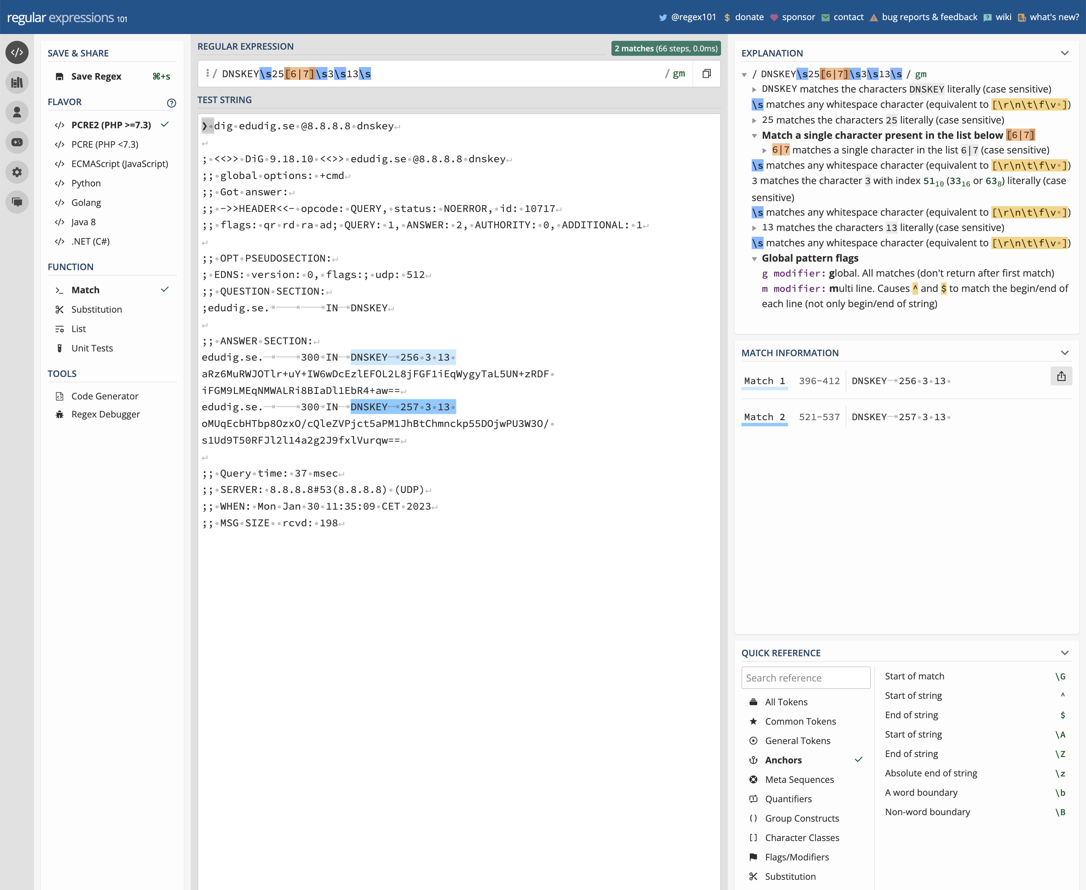
https://regex101.com/

Slide 12
EduDig
A web based dig”ish” tool designed from the ground up as an educational
tool to teach dig and dns.

Slide 13
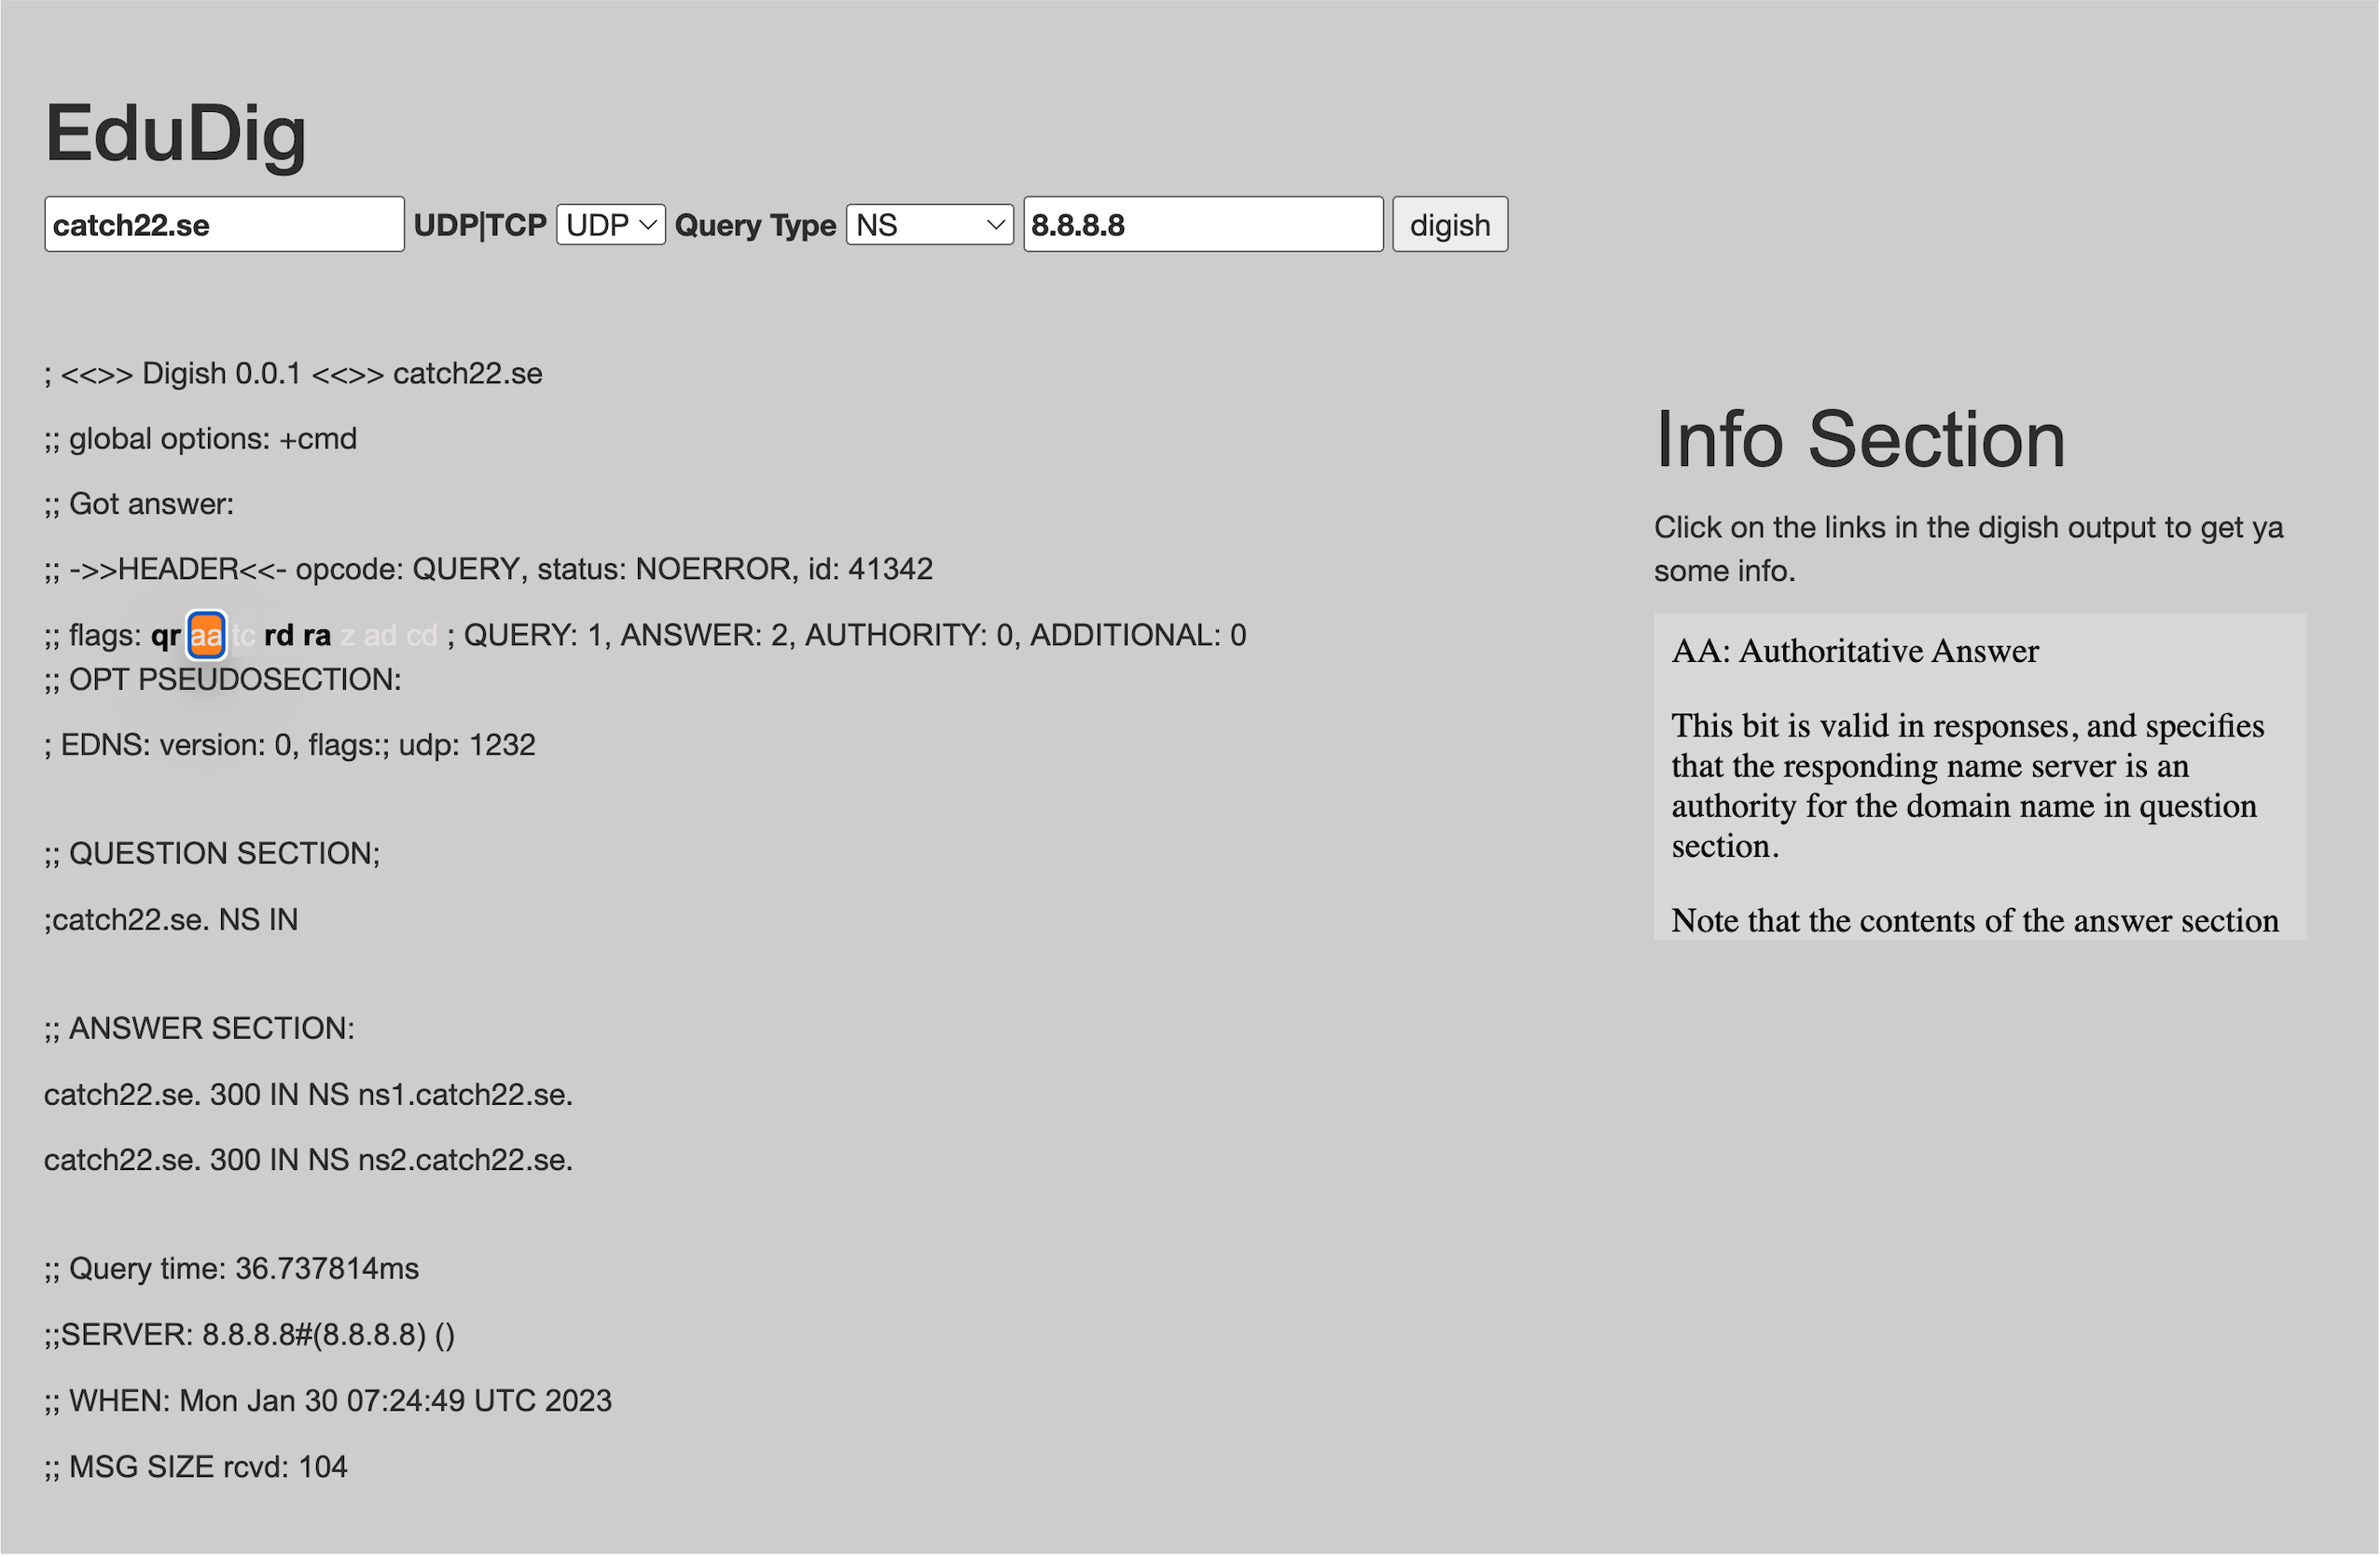

Slide 14
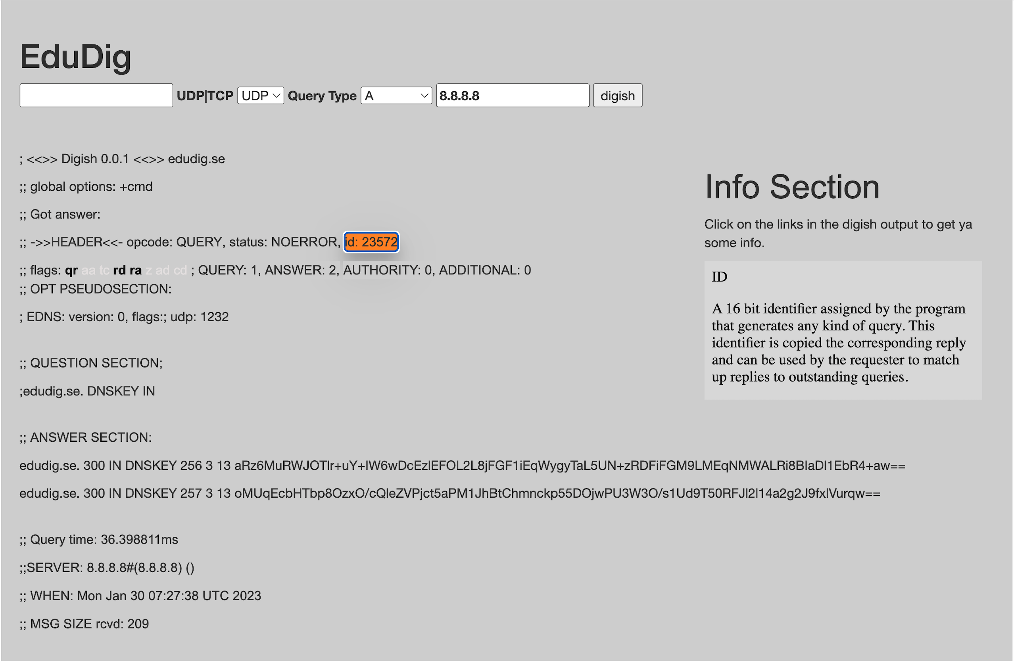

Slide 15
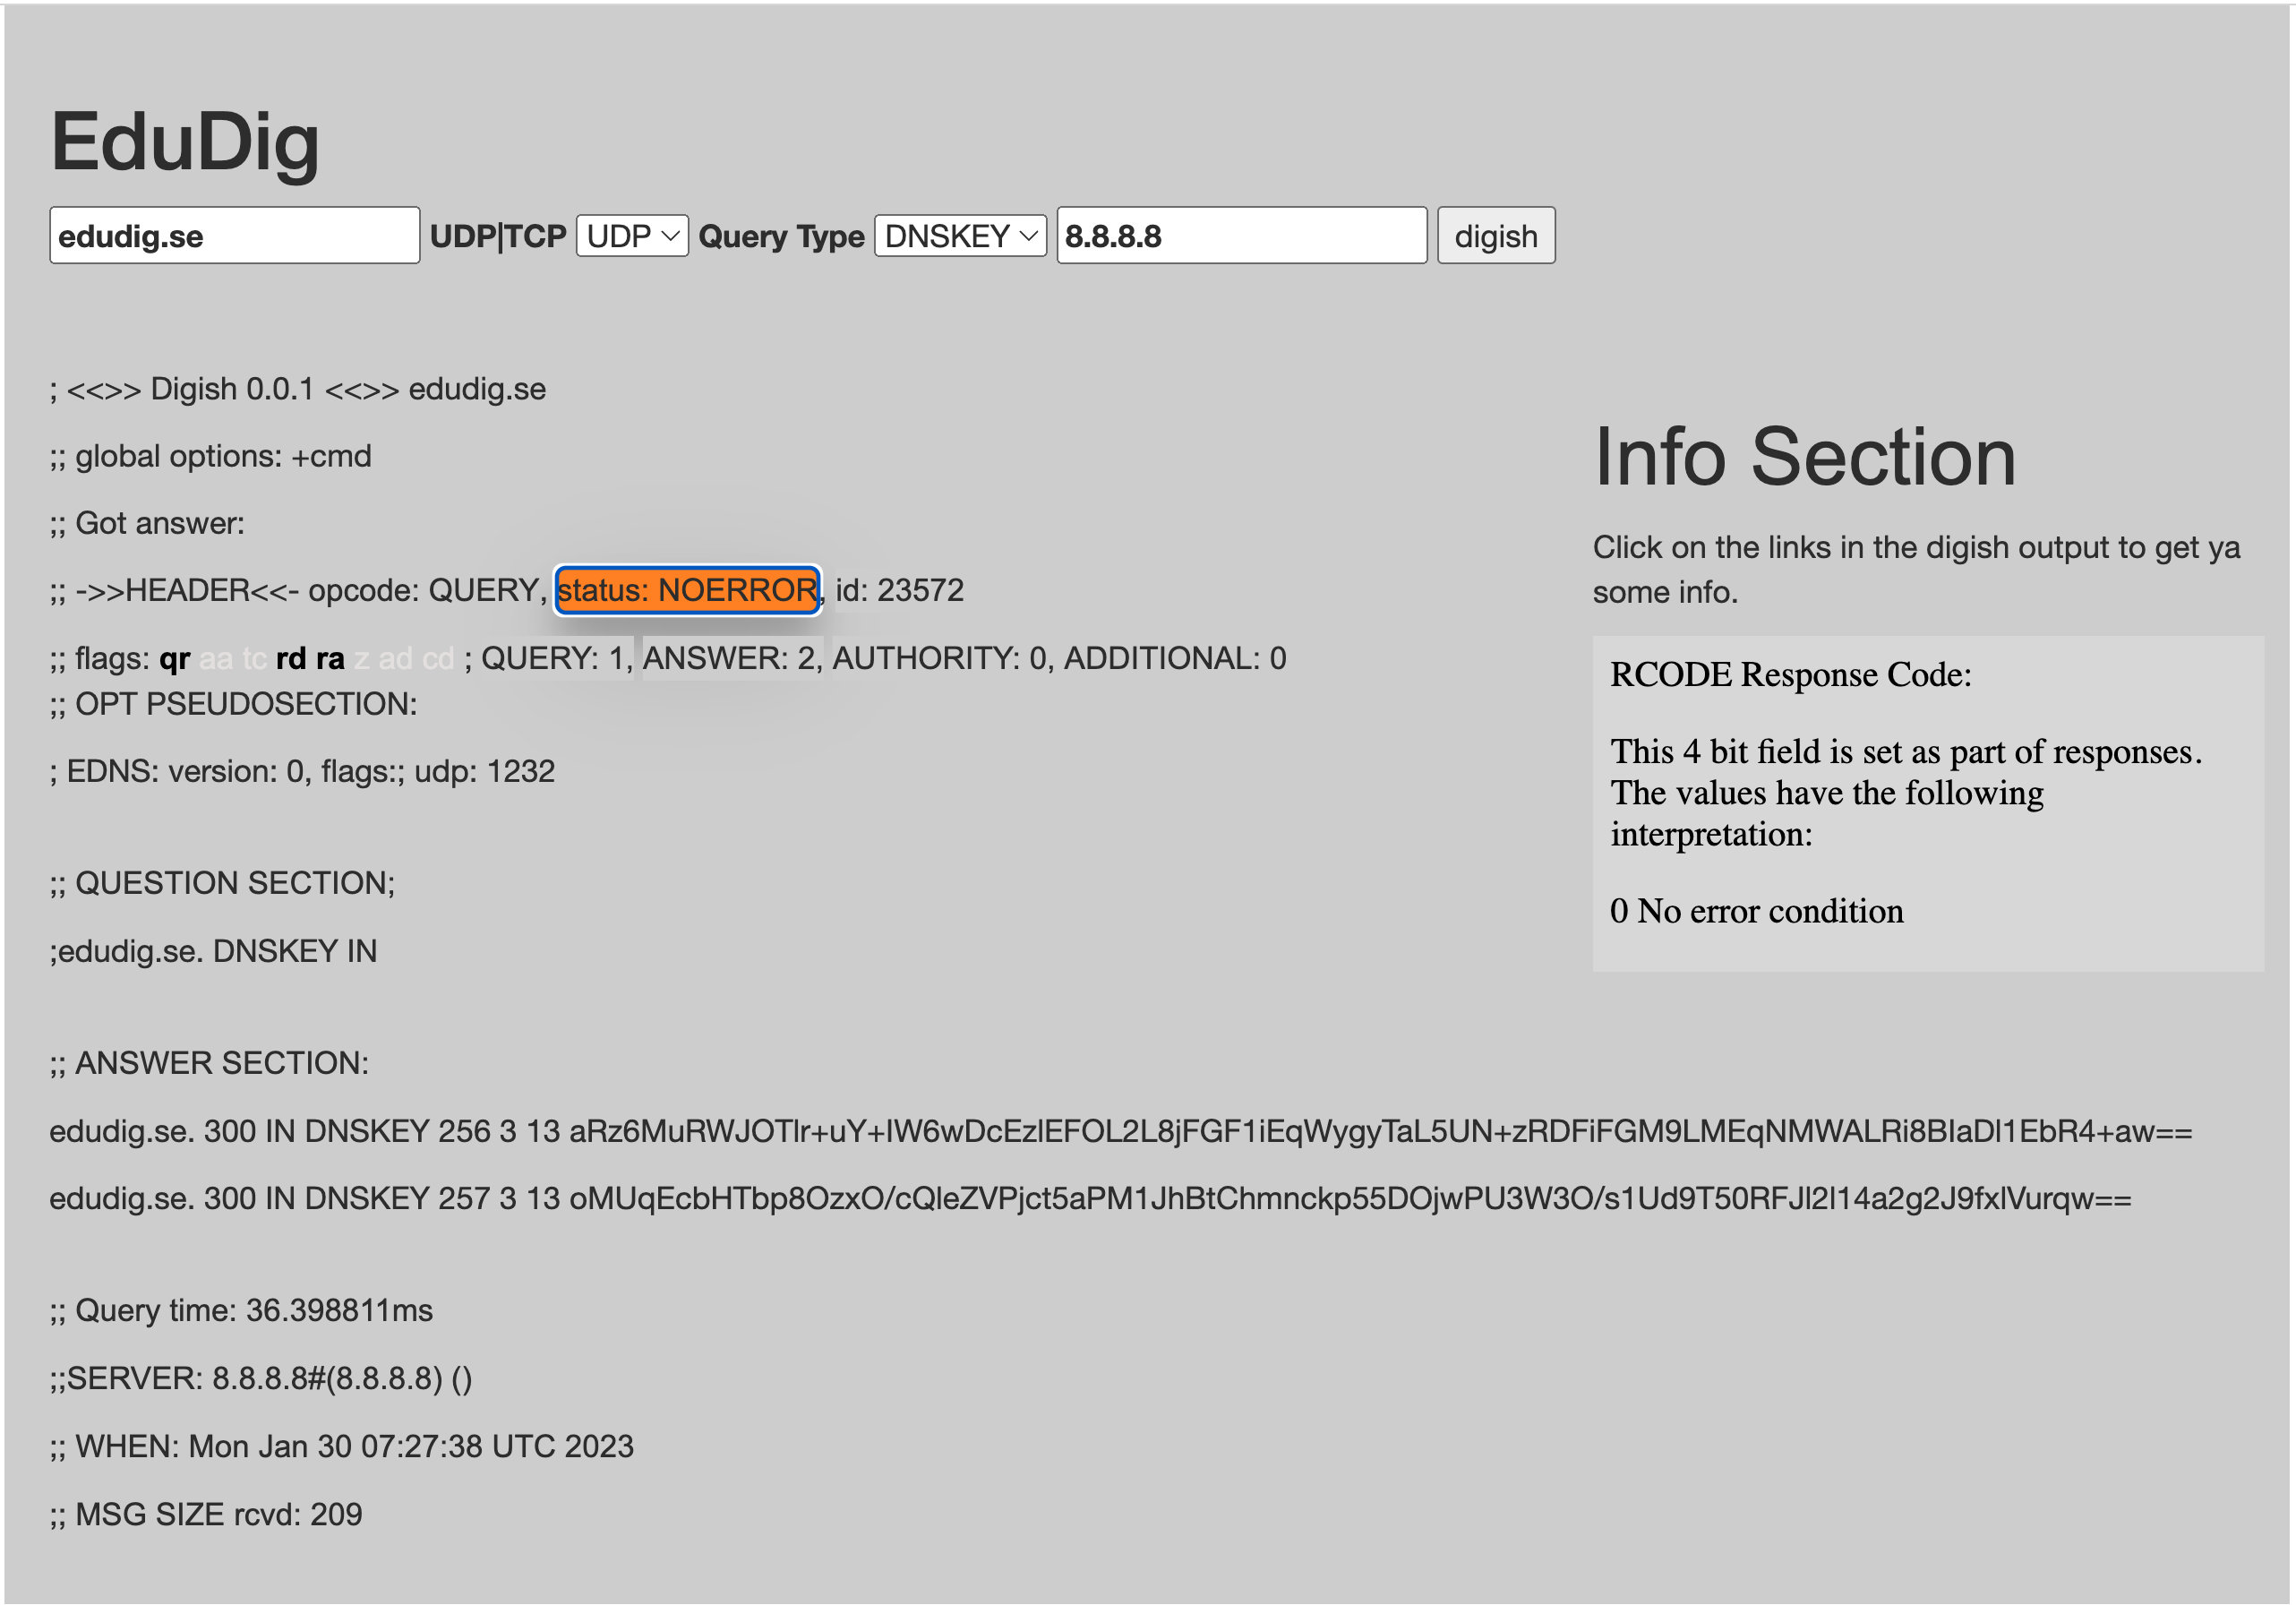

Slide 16
http://edudig.se/
https://github.com/dotse/edudig

Slide 17
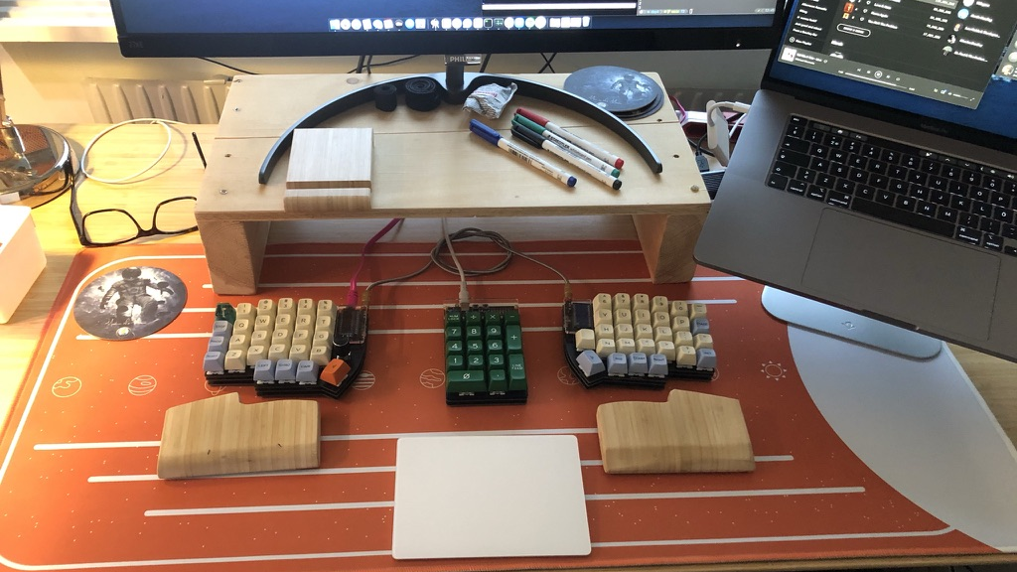
🙏 Thank you for your time. 🙏

